Slide 1
Towards using EarthCARE and GPM to improve radiance models, retrievals and microphysical understanding
Robin J. Hogan, Emma Turner, Shannon Mason, Mark Fielding & Kamil Mroz (ECMWF)
Thanks to Shunsuke Aoki (JAXA) & Leonhard Scheck (LMU)

Slide 2
Overview
What can we learn from coincident observations by EarthCARE and GPM?
  Wavelengths span 5 orders of magnitude: passive from 0.6 μm to 3 cm, active from 0.3 μm to 2.2 cm
In this talk we forward-model GPM observations, using as input both EarthCARE synergy retrievals (ACM-CAP) and ECMWF weather forecasts (IFS)
  Crucial test of RTTOV radiance model used in assimilation, recently updated to calculate radar profiles
  Are our ice microphysical and scattering assumptions capable of spanning this wavelength range?
  How good are EarthCARE’s rain retrievals? Can we increase the upper limit on retrieved rain rate?
  How can we use this information to improve processes in weather and climate models?
This is work in progress!

Slide 3
Data flow in this talk…
Observations
Atmospheric properties
Radiative transfer schemes
Simulated obs.
Test BE baseline of ACM-CAP, radiative closure using BBR
Test weather forecasts using same models
RTTOV used for assimilating radiances, recently able to simulate radar profiles as well
ZmVar used for assimilating CPR and soon ATLID at ECMWF
EarthCARE
EarthCARE
BBR fluxes
ATLID lidar
ecRad radiation scheme
BBR radiances
ACM-CAP retrieval
MSI imager
MSI imager
RTTOV satellite simulator
CPR radar
CPR radar
ZmVar radar simulator
Multiple satellite radiances, including GPM’s GMI
ECMWF IFS model
GPM
GMI imager
DPR
radar
ACM-CAP forward models

Slide 4
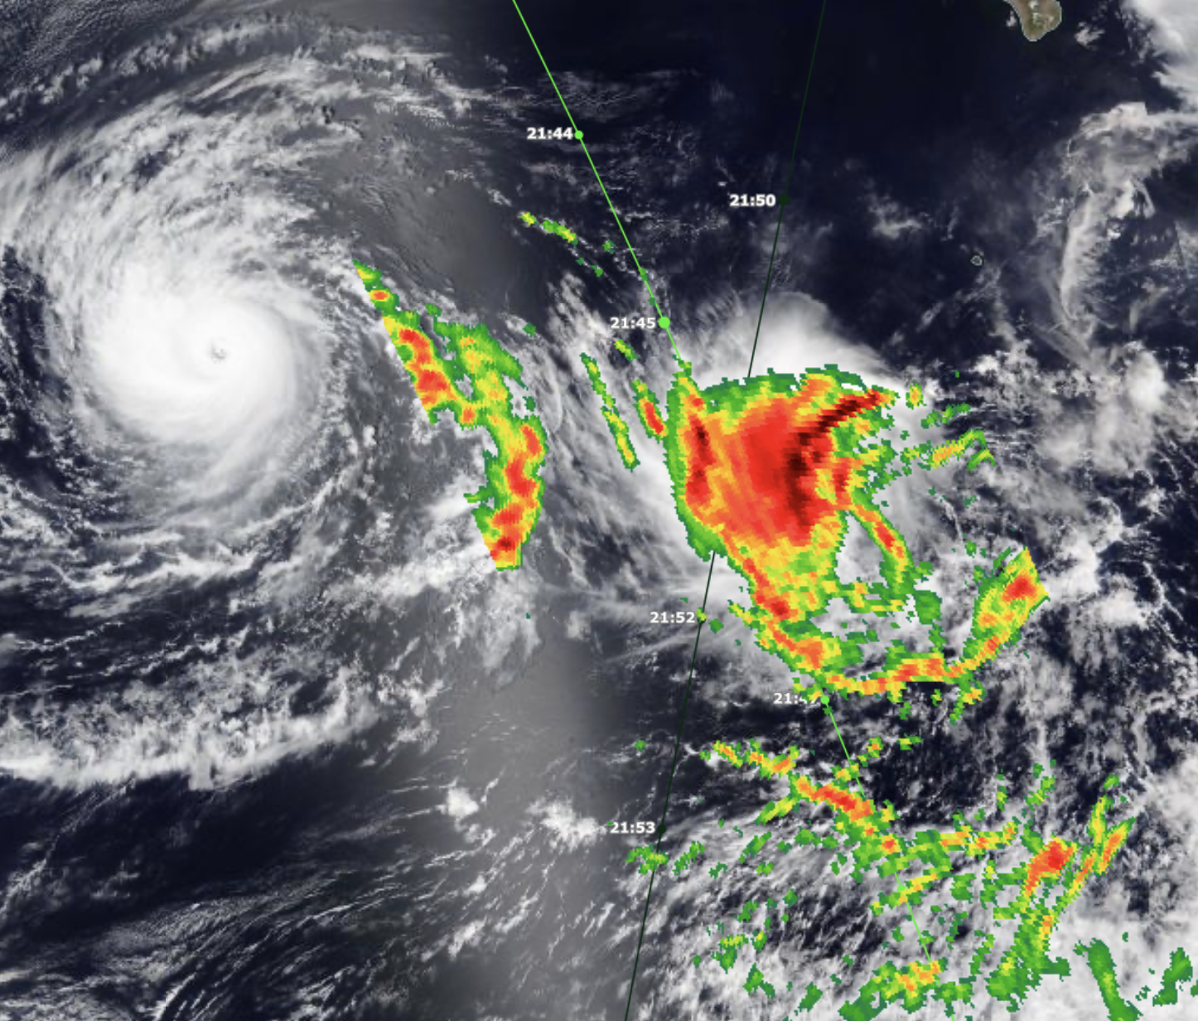
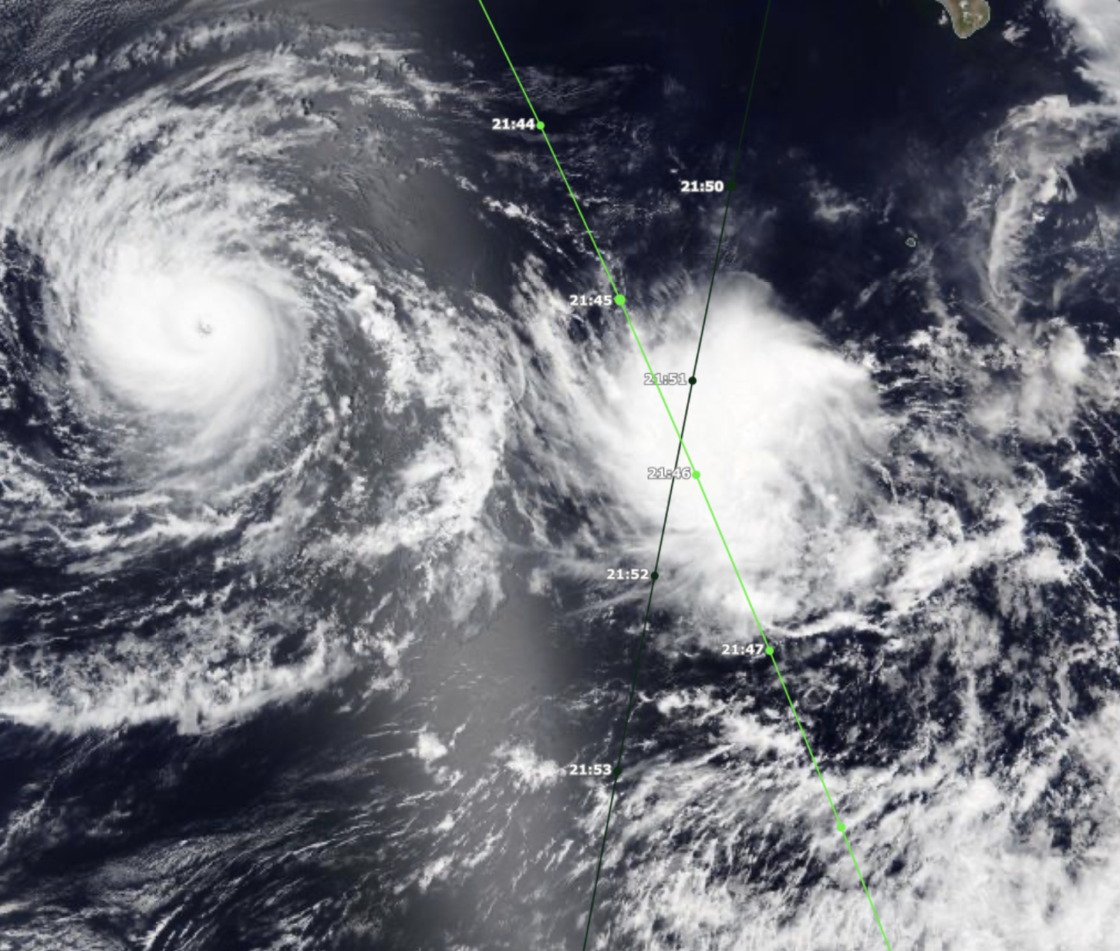
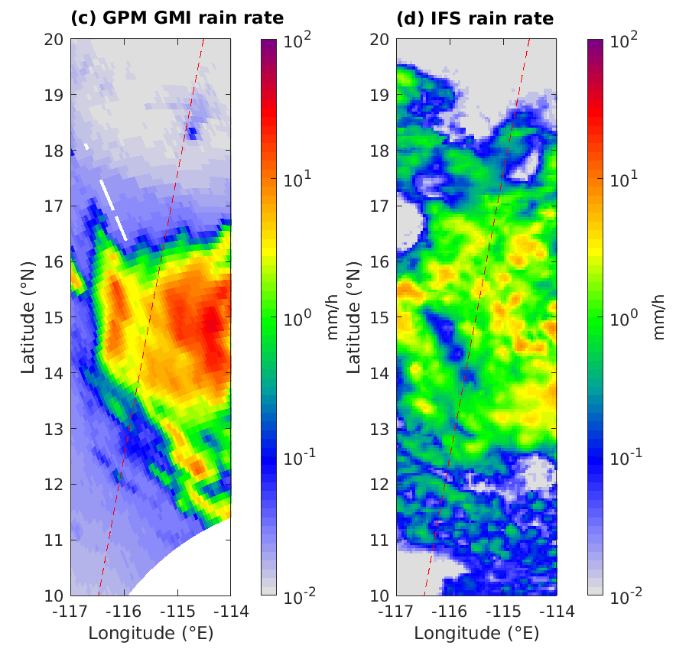

Pre-Tropical Storm Hector (NE Pacific)
22 August 2024
Gilma
VIIRS NOAA-20: 21:10
GPM rain rate: 21:46
EarthCARE overpass: 21:51
Pre-Hector
GMI
IFS
GPM
EarthCARE
02698E

Slide 5
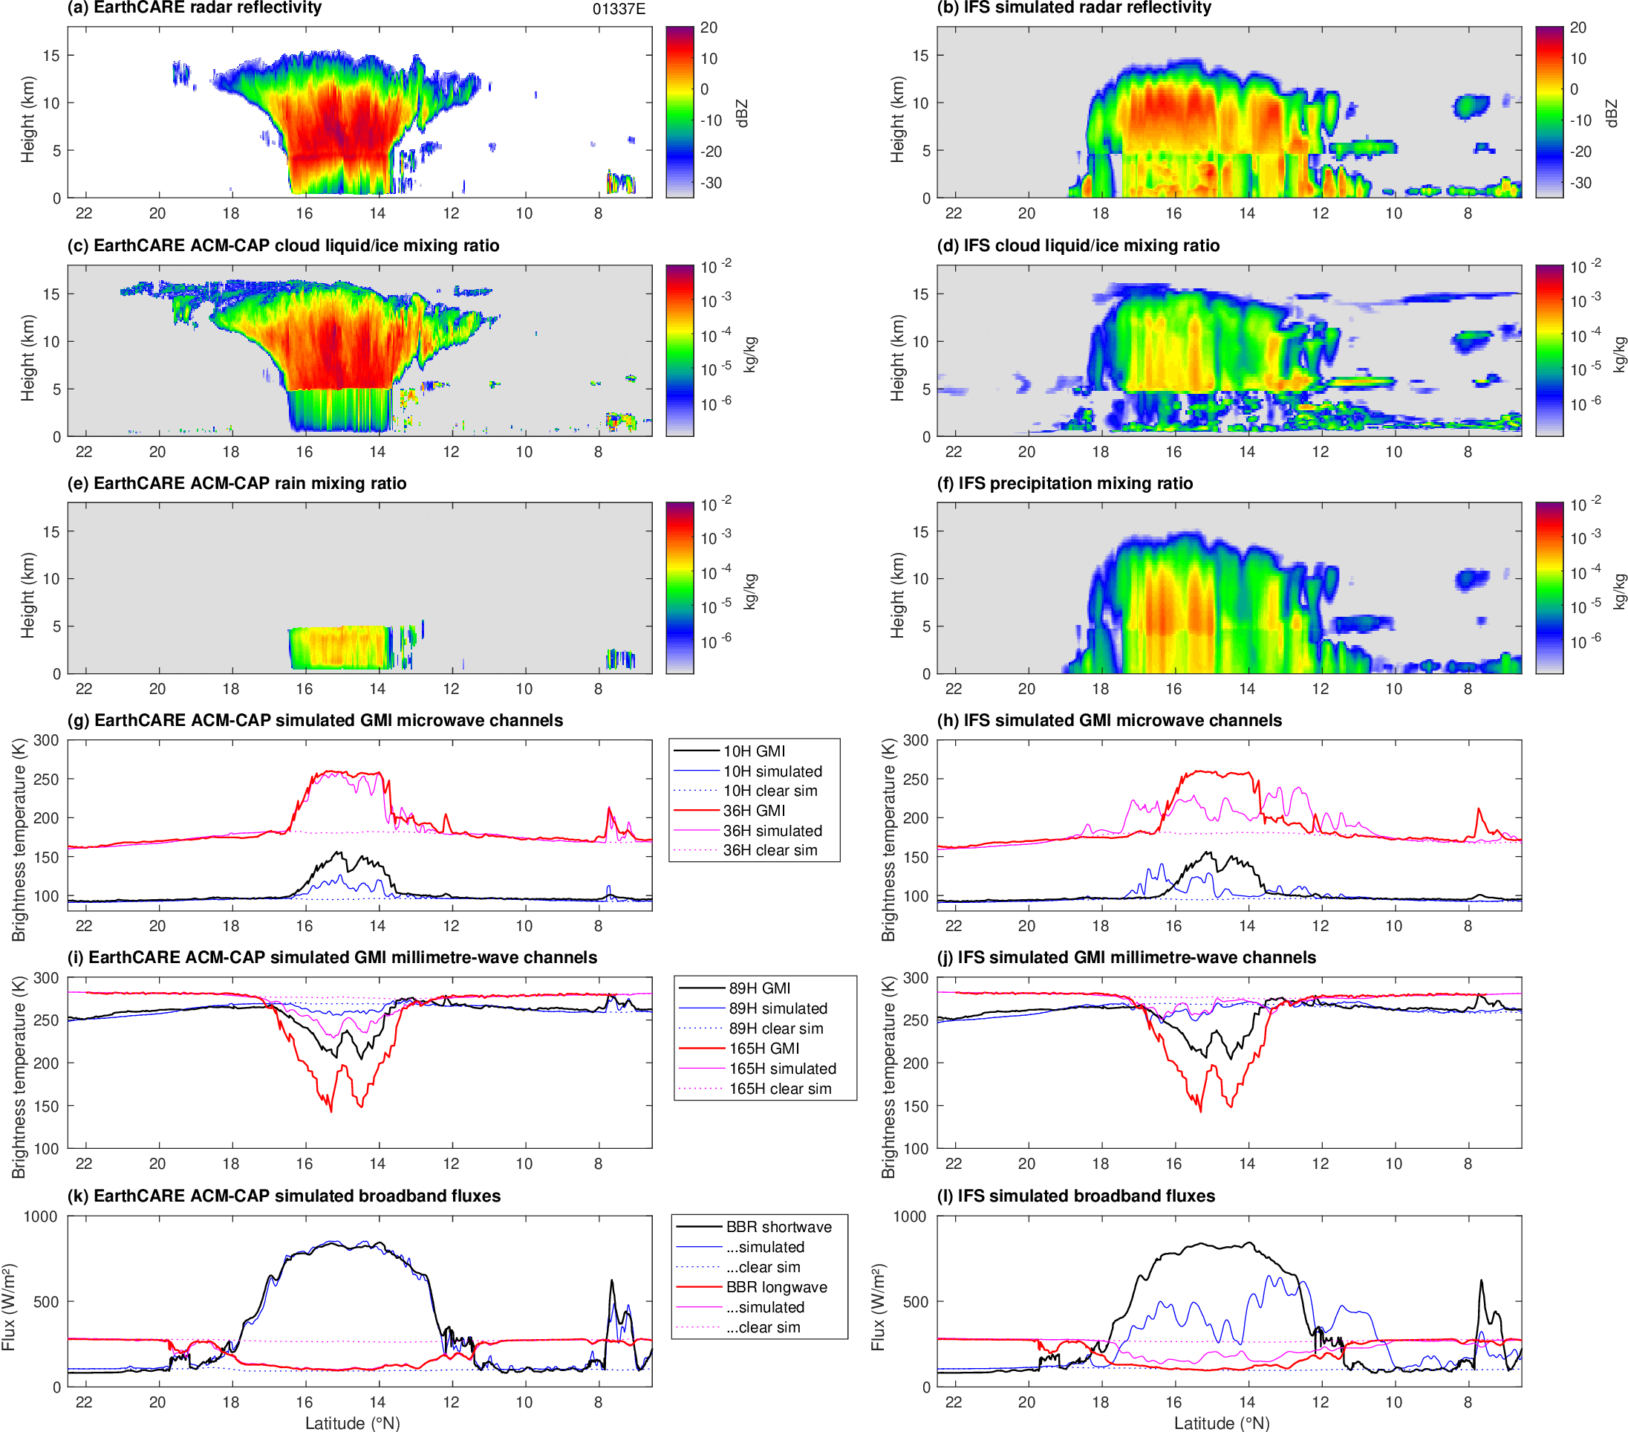
Forward-modelled radiances
Treat ACM-CAP ice as cloud ice in RTTOV
Rain-sensitive radiances are too low
Ice-sensitive radiances are too high
Broadband fluxes well captured
Poor ZmVar simulation using IFS microphysical assumptions
Storm system too broad and weak
EarthCARE
IFS
10 GHz
36 GHz
89 GHz
165 GHz
Shortwave
Longwave

Slide 6
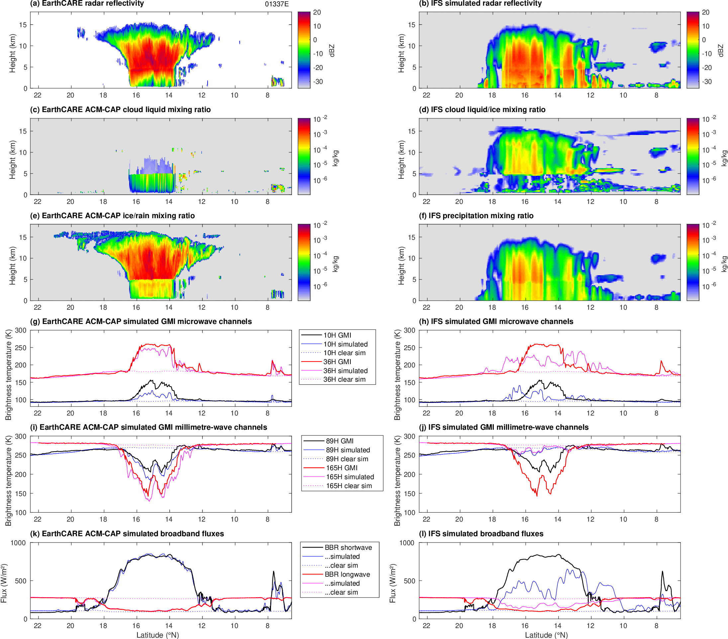
…improved ice assumptions
Treat ACM-CAP ice as snow in RTTOV
Rain-sensitive radiances are too low
Ice-sensitive radiances are much better
Broadband fluxes well captured
Better ZmVar simulation using ACM-CAP microphysical assumptions!
Storm system too broad and weak
EarthCARE
IFS
10 GHz
36 GHz
89 GHz
165 GHz
Shortwave
Longwave

Slide 7
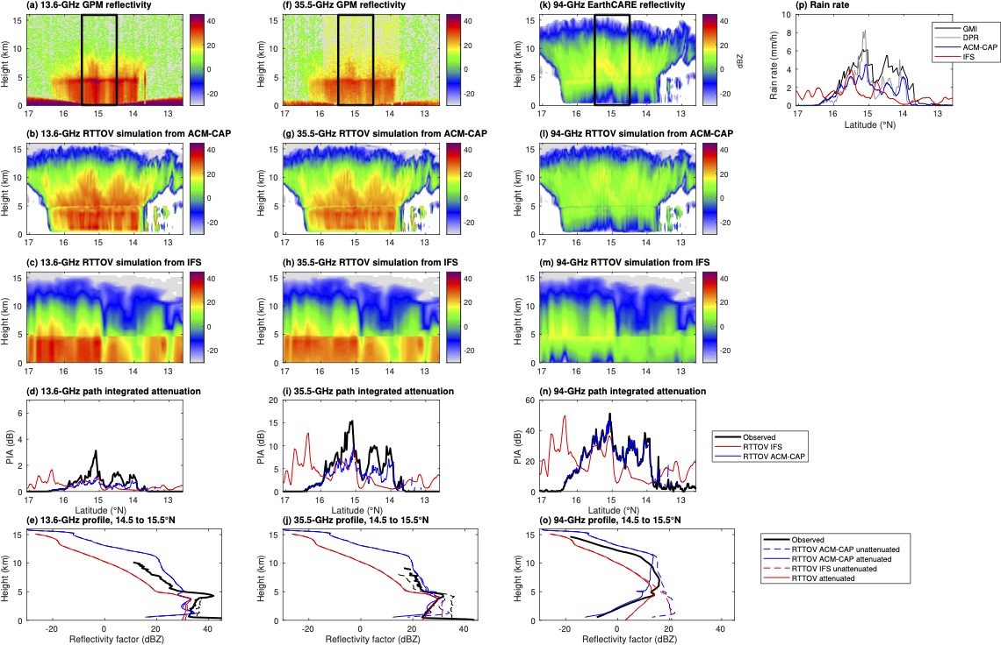
13.6 GHz
35.5 GHz
94 GHz
Measured
ACM-CAP
RTTOV
ACM-CAP rain rate agrees well with GPM’s 2A DPR product, but but both less than its 2A GMI “GPROF” product!
Forward modelled 35.5 GHz: reflectivity profile excellent, PIA underestimated
a
IFS
RTTOV
?
PIA
✓
Profiles

Slide 8
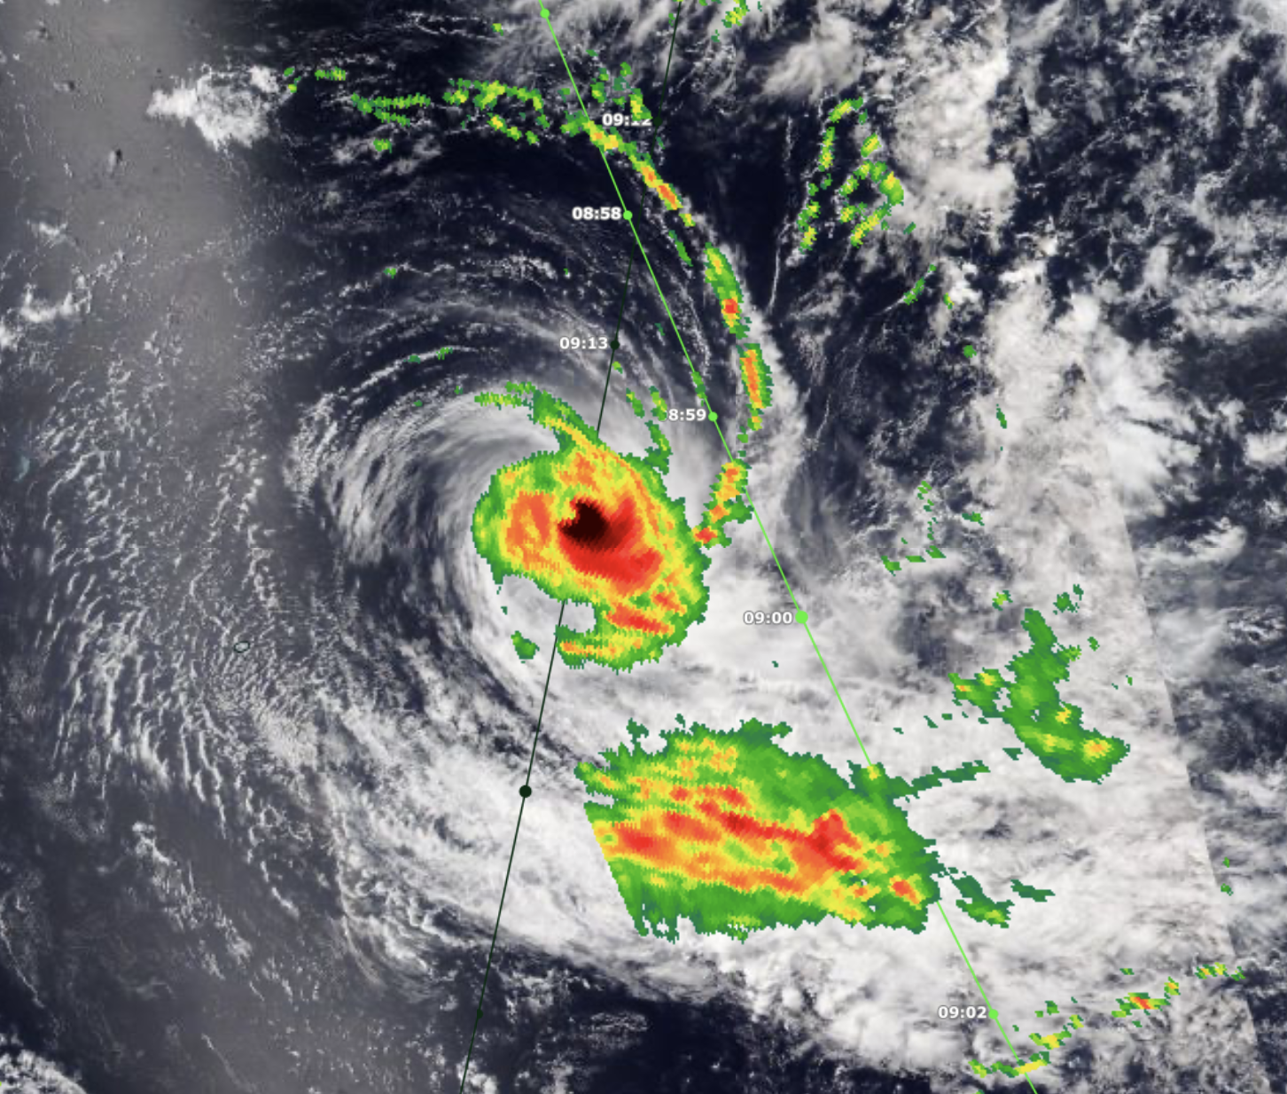
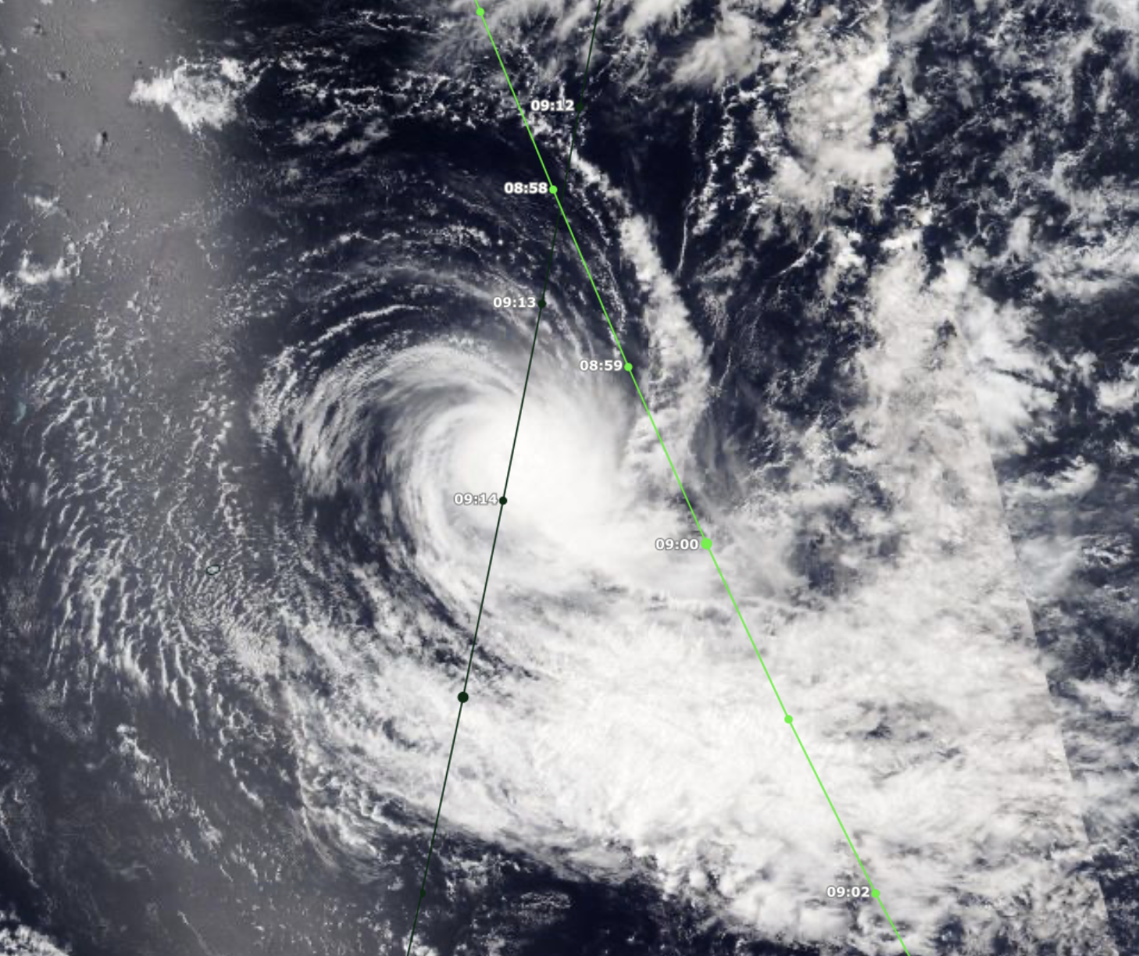
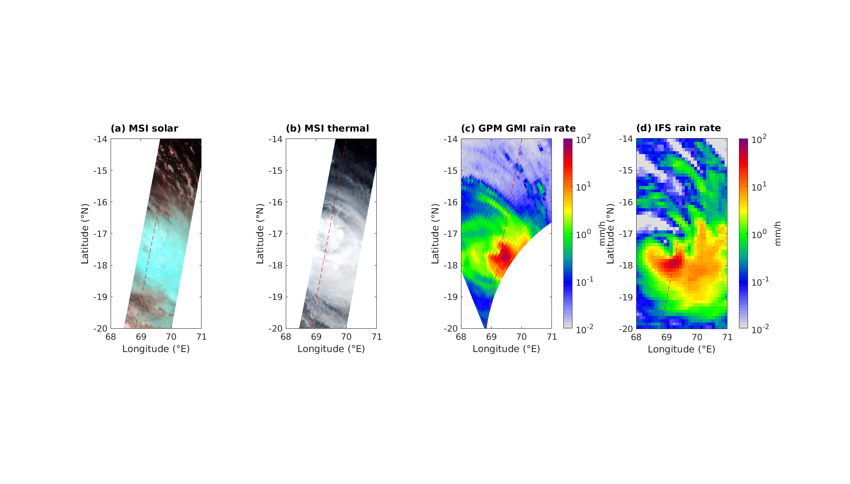
Tropical Cyclone Bheki (Indian Ocean)
18 Nov 2024 (Cat 4)
VIIRS NOAA-21: 09:13
GPM rain rate (used in IMERG): 09:00
EarthCARE overpass: 09:14
GPM
50 mm/h
EarthCARE
01337E
GMI
IFS

Slide 9
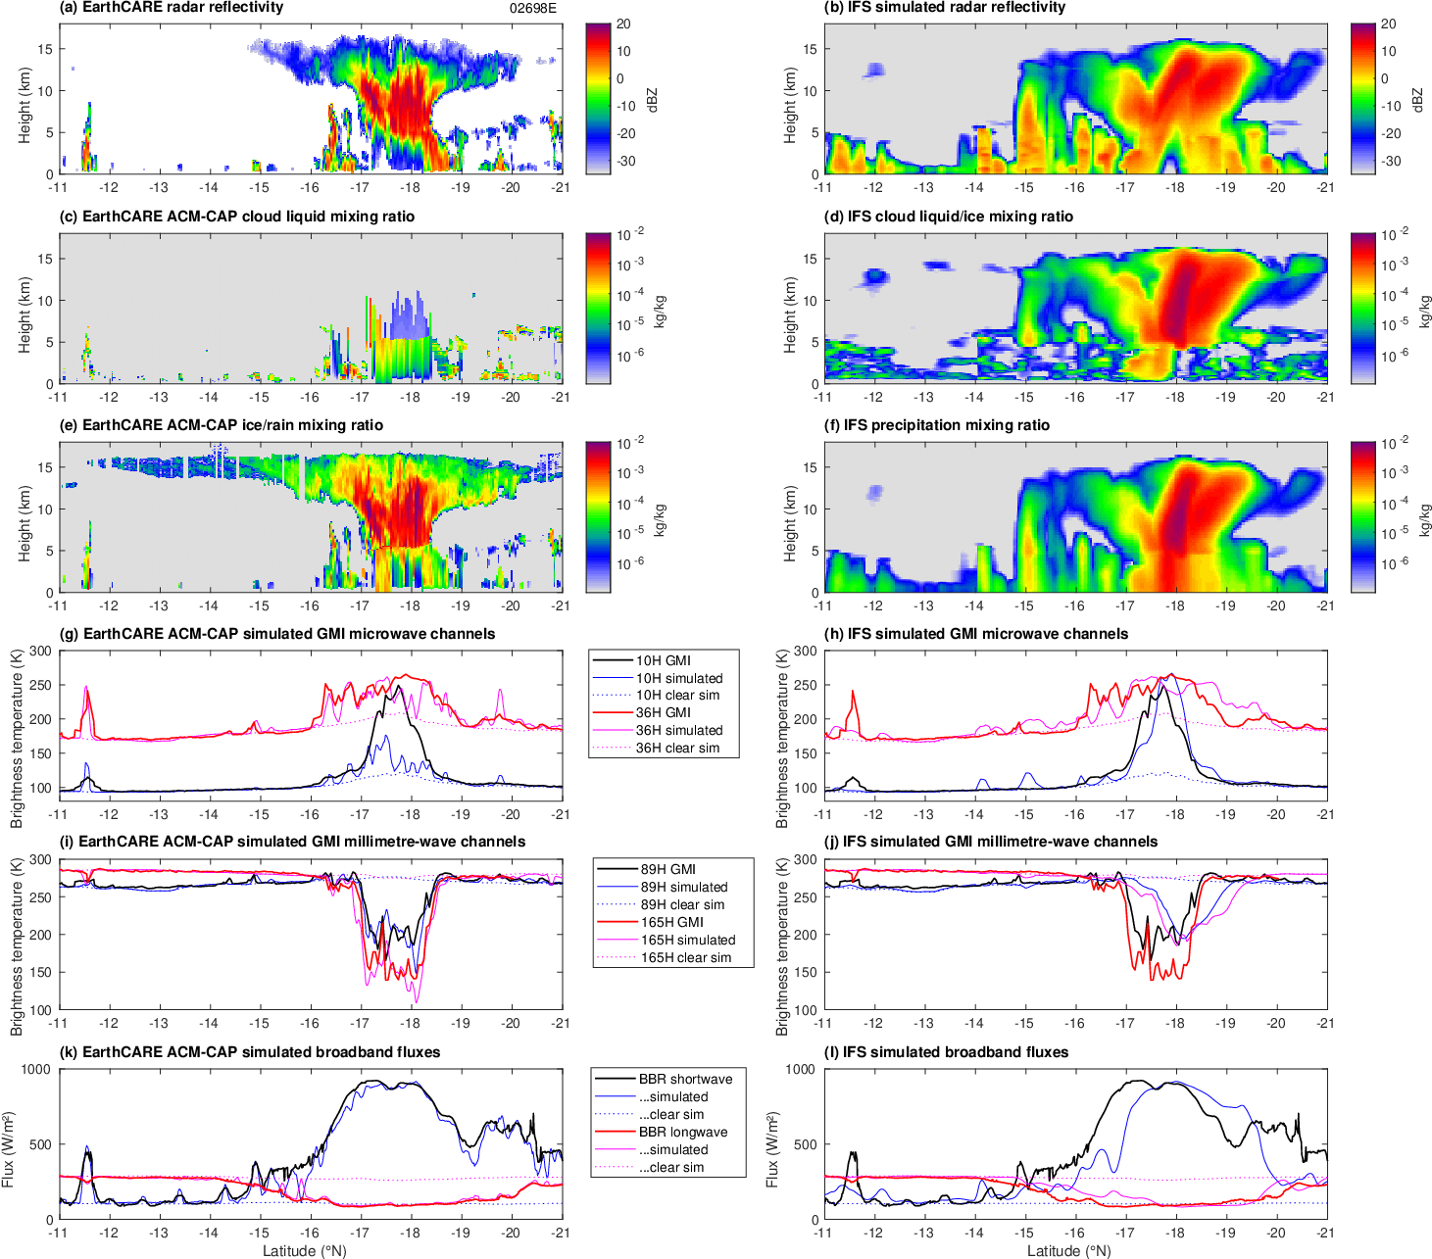
Bheki: forward-modelled radiances
EarthCARE
IFS
Rain-sensitive radiances much too low with ACM-CAP, about right with IFS
Ice-sensitive radiances are well captured
Broadband fluxes well captured
10 GHz
36 GHz
✗
✓
✓
89 GHz
165 GHz
Shortwave
Longwave

Slide 10
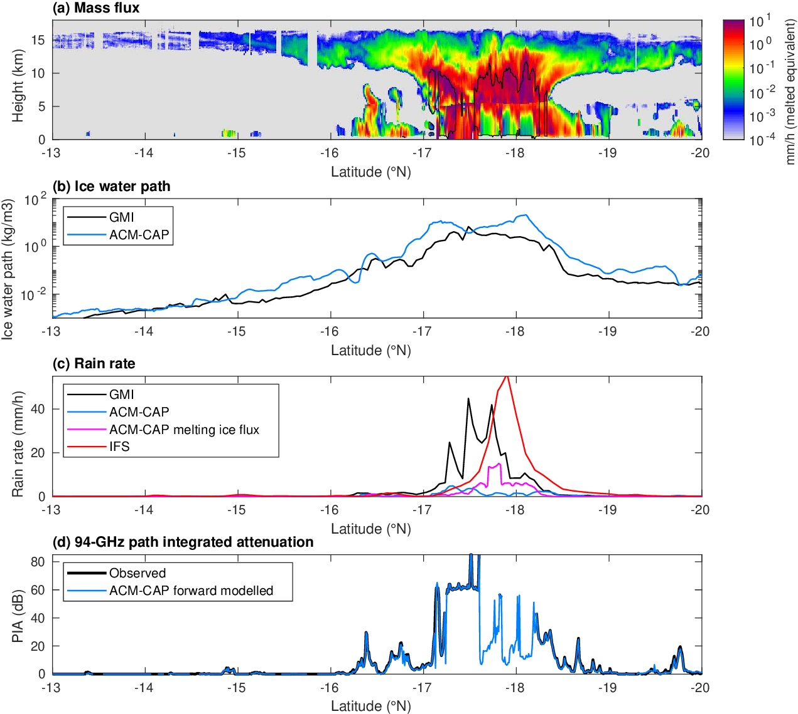
Potential to improve EarthCARE retrievals of heavy rain?
IFS simulates the rain intensity well!
ACM-CAP ice water path too high: 20 kg m⁻³
PIA saturates at 65-85 dB, corresponding to a rain rate of around 5 mm/h: ACM-CAP needs to be able to distinguish “saturated PIA” from “missing PIA” and use in retrievals
ACM-CAP snow flux just above melting layer is a bit better: can we extend it down into the rain?
Possible improvement: assume denser ice when multiple scattering diagnosed, leading to less IWP but potentially higher ice mass flux, and feed this into rain retrieval below?

Slide 11
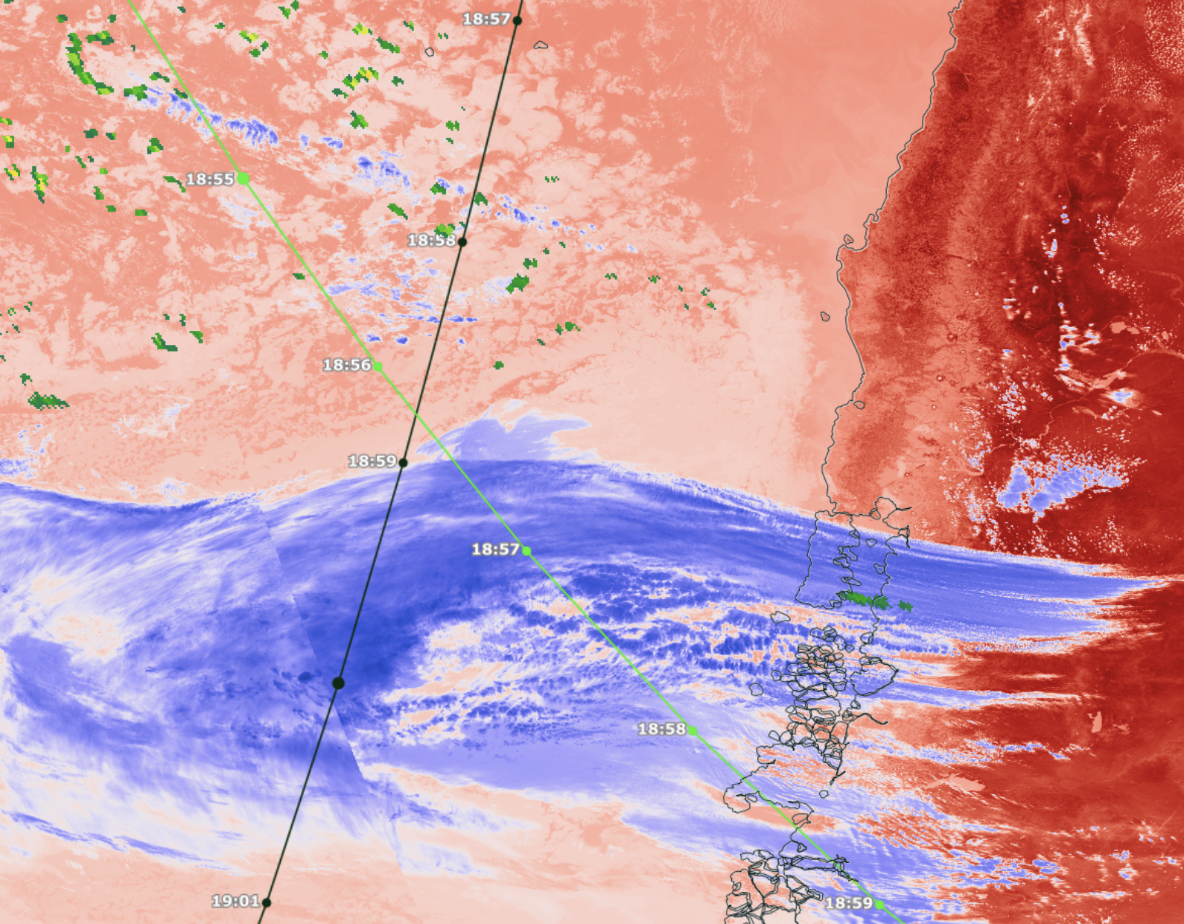
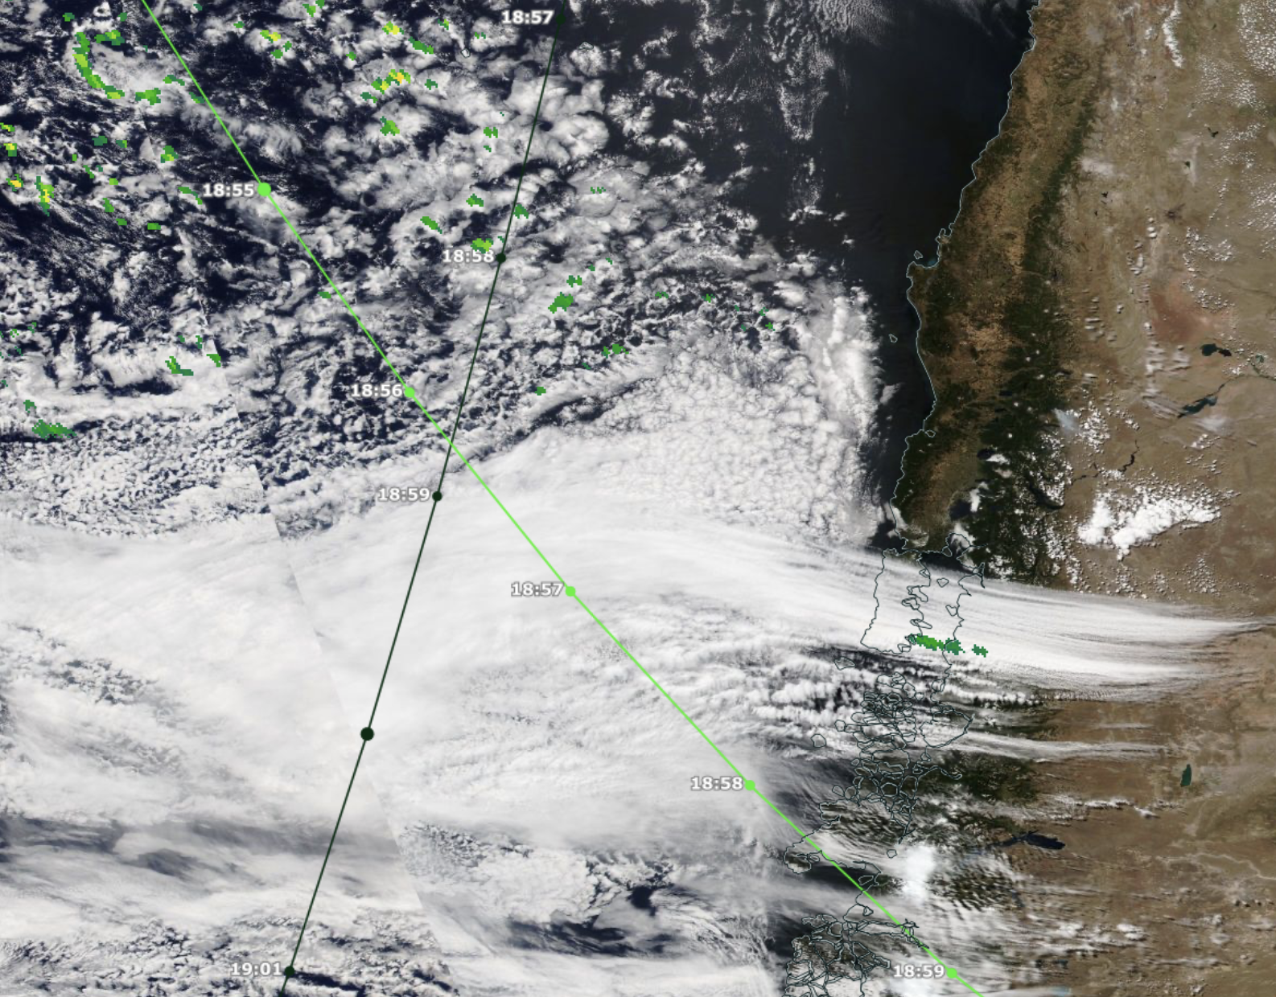

Cirrus and boundary-layer cloud (SE Pacific)
13 Feburary 2026
VIIRS NOAA-21: 18:41
GPM rain rate: 18:56
EarthCARE overpass: 18:59
GPM
EarthCARE
04058F
Infrared brightness temperature
210 K
330 K

Slide 12
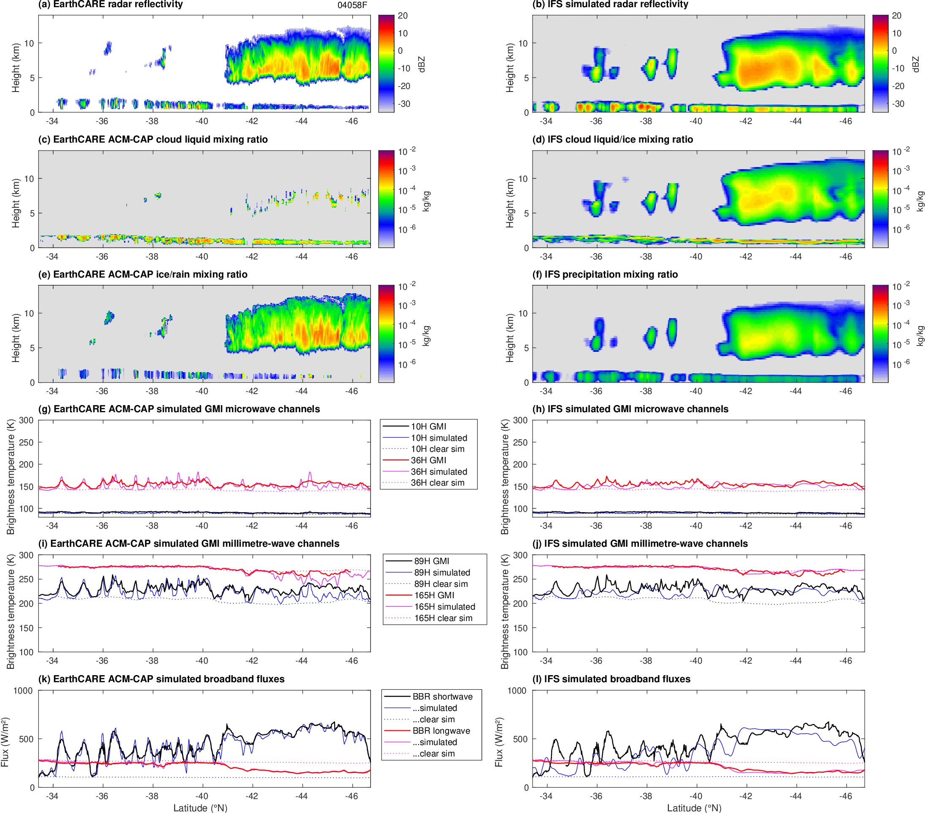
Low cloud & cirrus: radiances
EarthCARE
IFS
10 GHz
36 GHz
35/89 GHz radiances in low clouds agree well
ACM-CAP predicts a larger scattering signal in 89/165 GHz channels than observed by GMI
89 GHz
165 GHz
Shortwave
Longwave

Slide 13
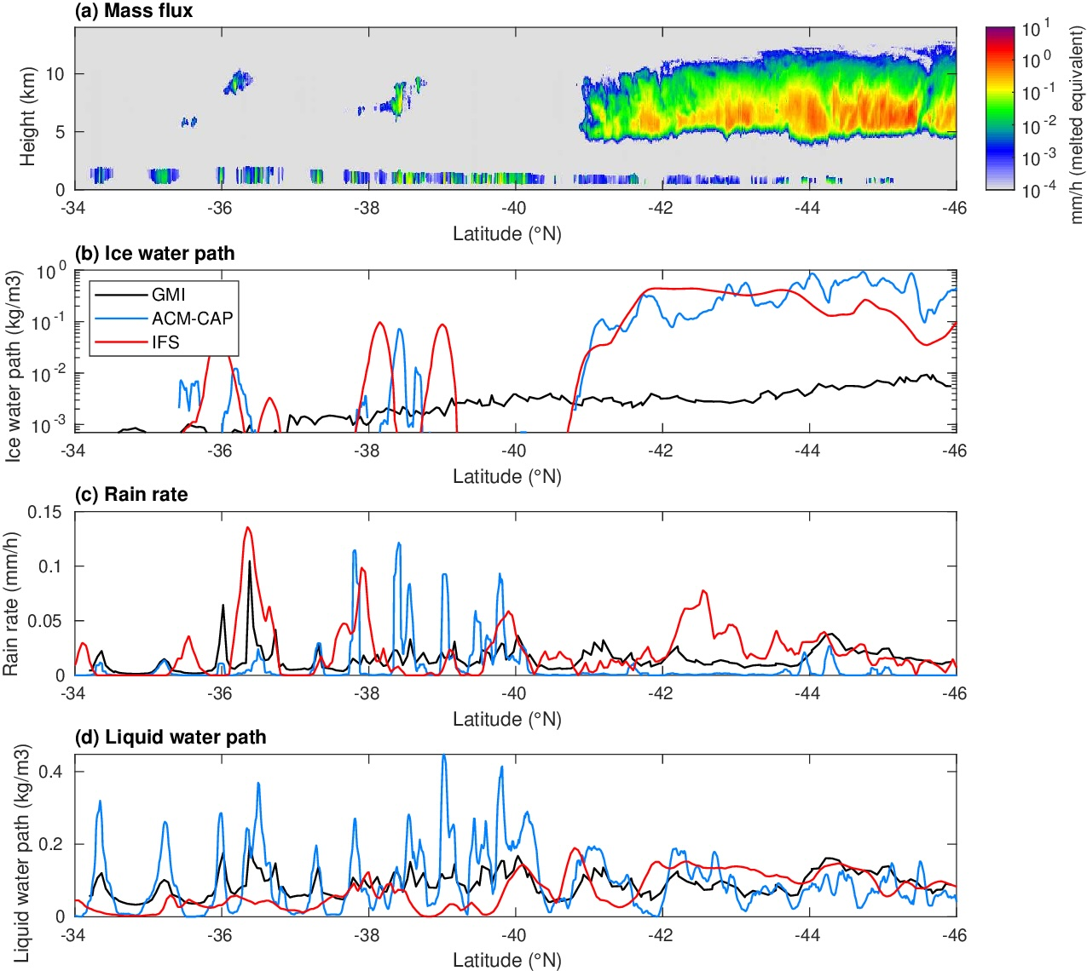
Comparison of retrievals
IWP -46°N to -42°N:
  GMI: 4.9 g m⁻³
  ACM-CAP: 395 g m⁻³
  IFS: 254 g m⁻³
GMI barely detects cirrus?
GMI and ACM-CAP agree well in low cloud but much finer scale from EarthCARE
IFS: too much rain from too little cloud
÷100!
Rain rate -40°N to -34°N:
  GMI: 0.012 mm/h
  ACM-CAP: 0.013 mm/h
  IFS: 0.020 mm/h
Liquid water path
  GMI: 84 g m⁻³
  ACM-CAP: 105 g m⁻³
  IFS: 36 g m⁻³

Slide 14
Outlook
Huge potential to use EarthCARE/GPM coincidences to improve ice & rain size distribution and scattering assumptions, and to improve retrievals
Next steps:
  Ensure microwave forward models in RTTOV use consistent ice scattering model as retrieval, and provide constraints on ice size distributions and density
  Understand differences in size distributions between warm and cold rain, reconciling raindrop number/size retrievals and making use of Doppler velocity
  Can we bridge the gap between mid-infrared and microwave to obtain consistent ice optical properties in the far-infrared in preparation for FORUM?
Other ideas:
  Can we assimilate EarthCARE’s PIA? Tight constraint on rain rate
  EarthCARE II should carry a suite of microwave radiometers!

Slide 16
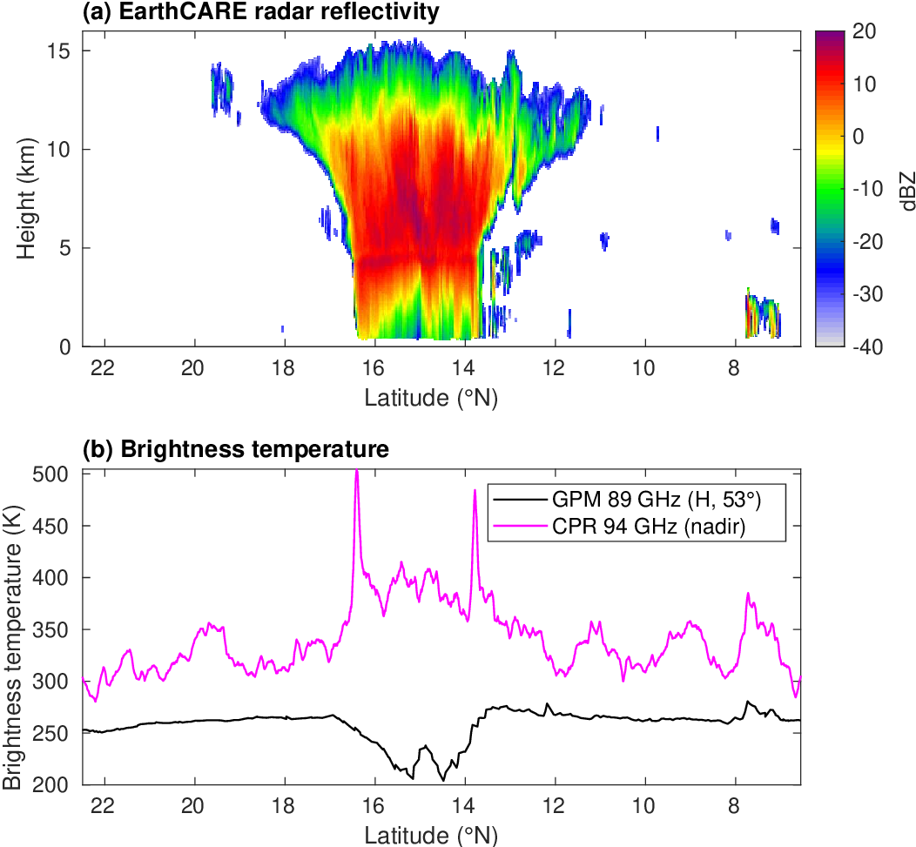
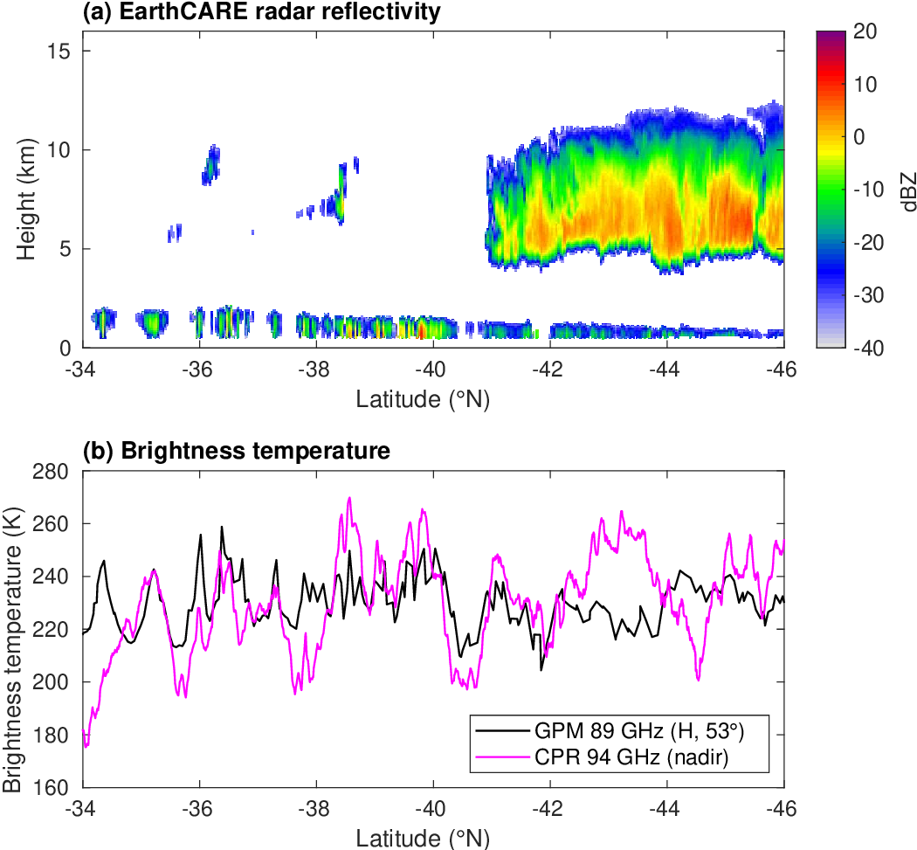
CPR brightness temperature

Slide 17
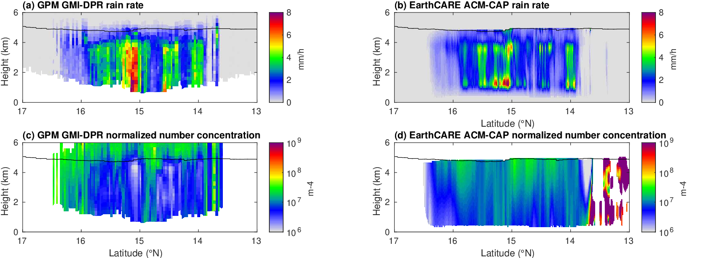
Pre-Hector: Comparing Nw
Normalized number concentration from GPM 2B synergy retrieval and from EarthCARE’s ACM-CAP

