Slide 1
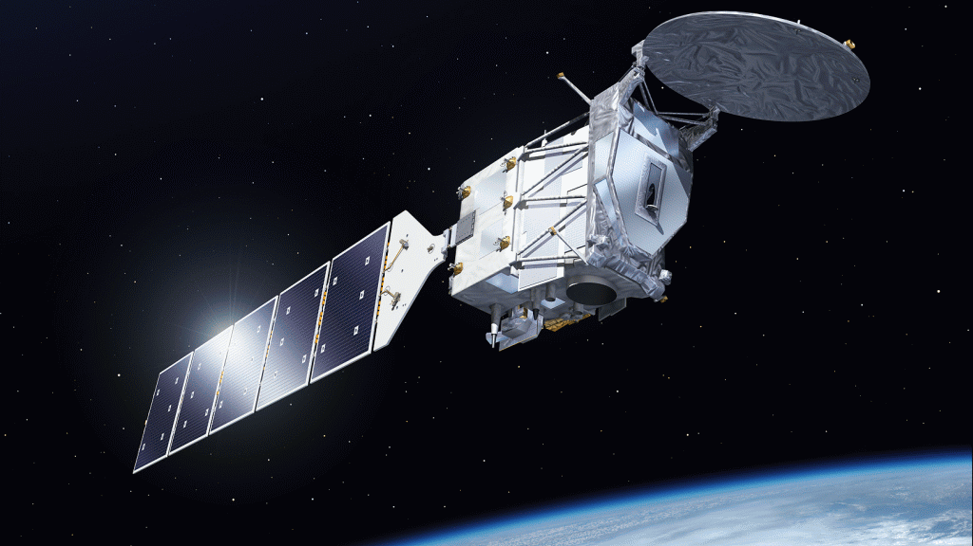
Scientific opportunities from EarthCARE
Robin Hogan
ECMWF and
University of Reading
Thanks to
Shannon Mason, Mark Fielding, Marta Janisková,
Rebecca Murray-Watson, Richard Forbes, Peter Hill (ECMWF)
Jason Cole, Zhipeng Qu, Howard Barker (ECCC)
Pavlos Kollias, Bernat Puigdomenech-Tresseras (McGill)
David Donovan, Gerd-Jan van Zadelhoff (KNMI)
Almudena Velazquez, Nicolas Clerbaux (RMIB)
robin.hogan@ecmwf.int

Slide 2

Overview
Motivation
How CloudSat and CALIPSO have been beneficial to ECMWF
Introduction to ”CAPTIVATE” which produces ACM-CAP
The Synergy Case: how much can we learn from 12 minutes of data?
Evaluating aerosol forecasts including the California fires
Assimilation of EarthCARE into the ECMWF forecast model
Learning about ice cloud microphysical properties
Addressing climate questions

Slide 3
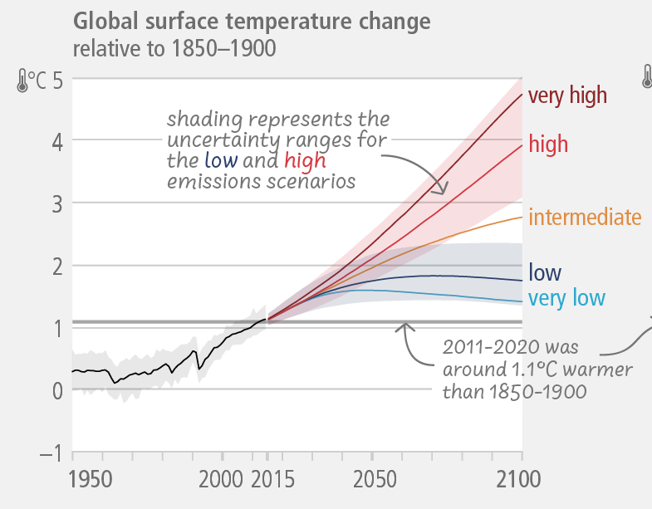
How much will the climate change this century?
Emission scenario:
+5ºC if clouds amplify the warming, a positive cloud feedback
a
+3ºC if clouds stay about the same
NOW!
How can EarthCARE improve clouds, aerosols, precipitation and radiation in climate and weather models?
IPCC report 2023

Slide 4
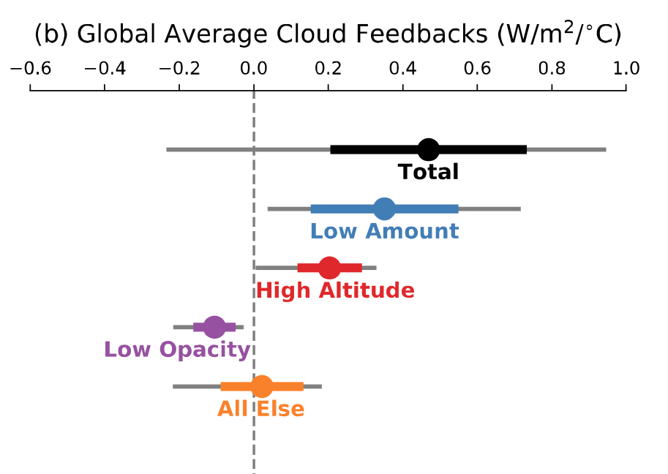
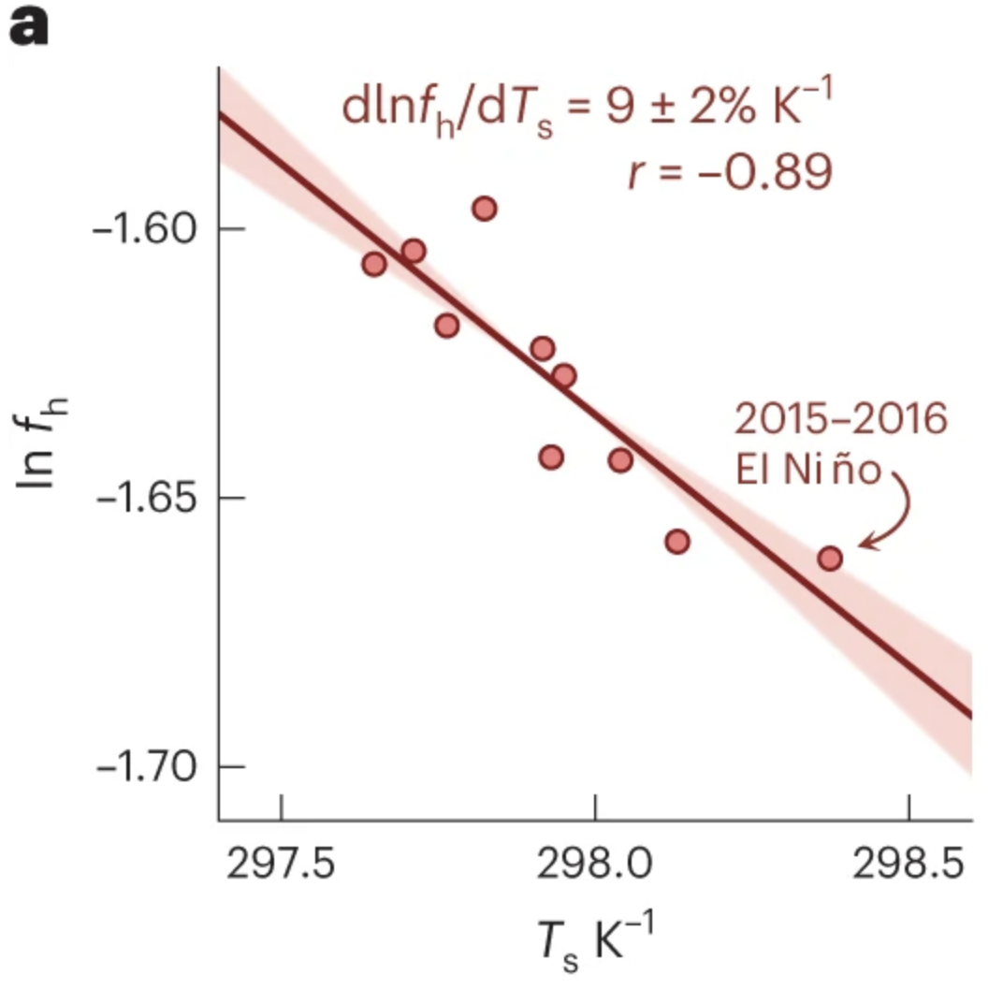
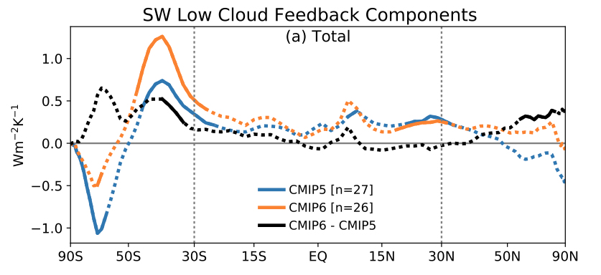
Decomposing cloud feedbacks
Whether marine low clouds are stratocumulus or cumulus, and their cover, depends on things like inversion strength, the changing patterns of which are uncertain. Sensitive also to higher SST and downwelling longwave from GHGs above. Aerosol impacts hugely uncertain.
Land cloud cover expected to decrease
Zelinka et al. (Nature 2017)
High cloud tops rise and cool, now detectable in MODIS and CloudSat (Richardson et al) – see later
e.g. CALIPSO anvil cloud area weakly dependent on temperature (McKim et al. 2024)
CALIPSO cloud phase observations improved models, reducing negative feedback & uncertainty (Zelinka et al. 2020)

Slide 5
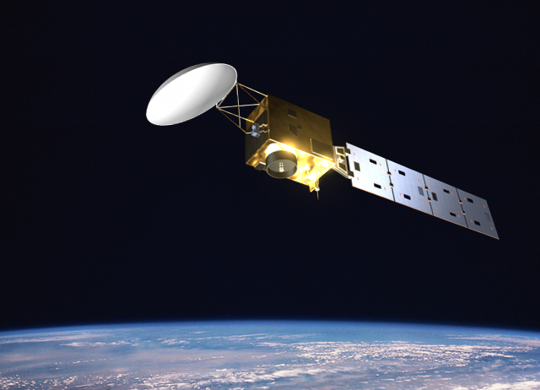
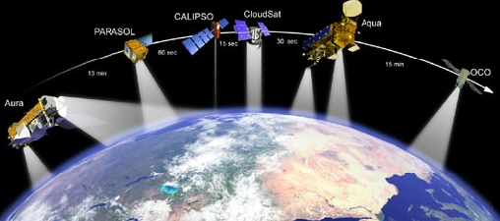
The A-Train versus EarthCARE
The A-Train (fully launched 2006)
  NASA
  Multiple platforms
  700-km orbit
  CloudSat 94-GHz radar
  CALIPSO 532/1064-nm lidar
  MODIS multi-wavelength radiometer
  CERES broad-band radiometer
EarthCARE (launched May 2024)
  ESA and JAXA
  Single platform
  393-km: higher radar sensitivity
  94-GHz Doppler cloud profiling radar (CPR)
  355-nm high spectral resolution lidar (ATLID)
  Multi-spectral imager (MSI)
  3-view broad-band radiometer (BBR)

Slide 6
Impact of CloudSat & CALIPSO on ECMWF model developments (1)
CloudSat vs ECMWF ice water path clearly showed need to include snow in radiation scheme: ~10 W m⁻² in convective regions (Li et al. 2014)
Dreary paper: rain occurs twice as often as it should with on average half the intensity it should (Stephens et al. JGR 2010)
Prognostic ice water content agrees much better with radar-lidar retrievals than diagnostic (Delanoe et al. QJRMS 2011)
Understand cloud/precip occurrence biases from forward modelling reflectivity (DiMichele et al. QJRMS 2012)
Evaluation of CAMS dust profiles using CALIPSO (Georgoulias et al. 2018, Ryder et al. 2023)
Delanoe et al. (QJRMS 2011)

Slide 7
Impact of CloudSat & CALIPSO on ECMWF model developments (2)
New mixed-phase cloud treatment informed by CALIPSO cloud top phase (Forbes & Ahlgrimm 2014)
Convective detrainment of supercooled water in cold air outbreaks greatly improves shortwave radiation in Southern Ocean (Forbes et al. 2016)
Radar & lidar assimilation demonstration (Janisková & Fielding 2020)

Slide 8
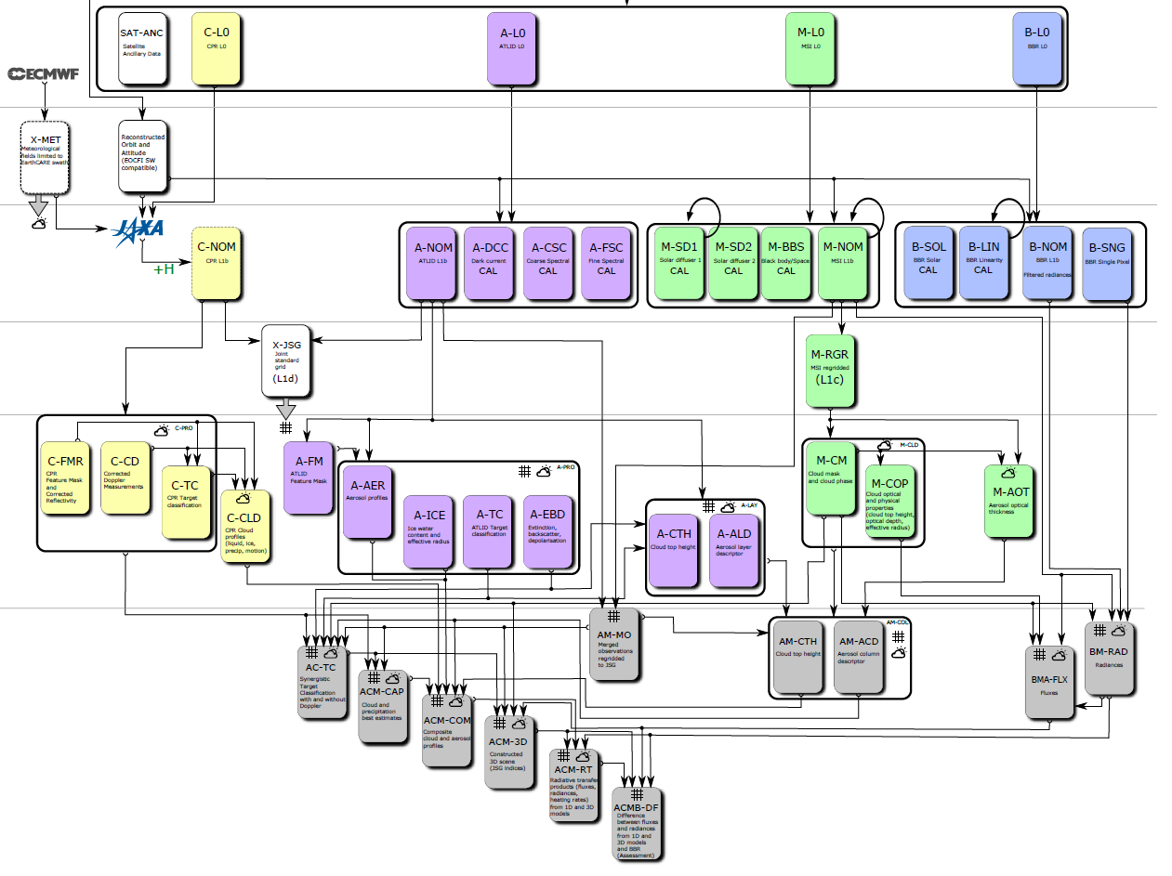
EarthCARE Products
Radar (CPR)
Lidar (ATLID)
Imager (MSI)
Broadband radiometer (BBR)
Level 0: Raw measurements
Level 1: Processed measurements
Level 2a: Single-instrument products
Level 2b: Synergy products
A-EBD: aerosol & cloud extinction profiles from high spectral resolution lidar
ACM-CAP: synergistic cloud, aerosol & precipitation from variational “CAPTIVATE” algorithm
ACM-RT: radiative transfer on retrieved atmospheric properties

Slide 9
The “CAPTIVATE” algorithm – which produces the ACM-CAP product
1. New ray of data: define state vector
Use classification to specify variables describing each species at each gate
Ice: extinction coefficient, N₀’, lidar backscatter-to-extinction ratio, riming factor
Liquid: water content and number concentration
Rain: rain rate, N₀*
Aerosol: number concentration
Variational approach: adjust the retrieved variables to minimize a cost function that penalizes differences to the observations and to prior estimates (Mason et al. 2023)
2. Convert state vector to radar-lidar resolution
Often the state vector will contain a low-resolution description of the profile
3. Forward model
6. Iteration method
Derive new state vector using quasi-Newton scheme
3a. Radar model
Including surface return and multiple scattering
3b. Lidar model
Including HSRL channels and multiple scattering
3c. Radiance model
Solar and IR channels
4. Compare to observations
Check for convergence
Not converged
Converged
7. Calculate retrieval error
Error covariances and averaging kernel
Proceed to next ray of data

Slide 10
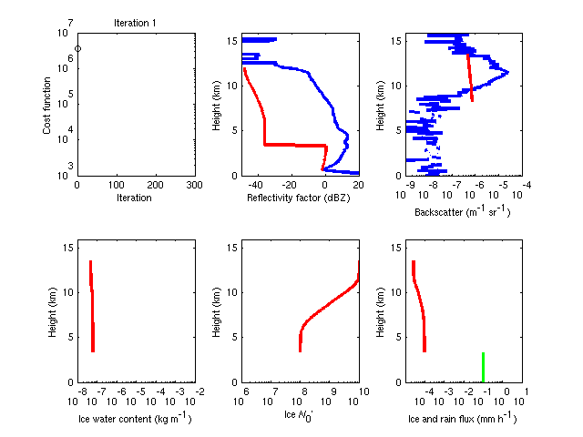
Ice cloud retrieval best at cloud top where both radar and lidar are sensitive
Deeper in the cloud we are more dependent on prior constraints, particularly at night: can we improve these using real data?
Extra physical constraints: rain/snow flux should be constant across the melting layer

Slide 11
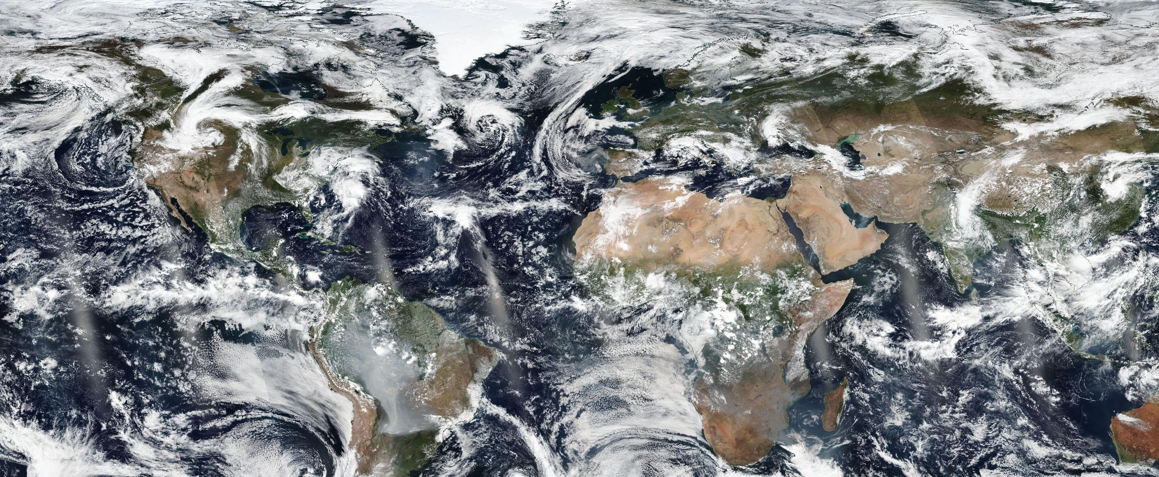
18 Sept 2024, 14 UTC “Synergy case” Frames 01752D/E

Slide 12
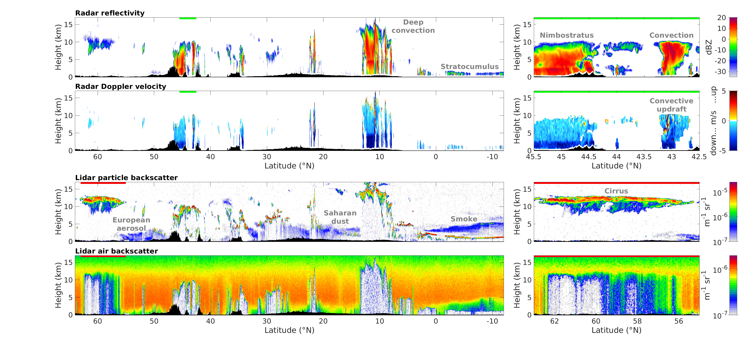

Slide 13
New measurements from radar and lidar
Radar reflectivity
Lidar particle backscatter
Radar Doppler velocity
Lidar air backscatter
Radar Doppler velocity provides rain and snow fall speed from which we can infer drop size and rimed fraction
We can also measure the strength and width of convective updrafts
High spectral resolution lidar separately measures backscatter of particles (clouds & aerosols) and air (Rayleigh scattering)
Can unambiguously calculate the important profile of extinction coefficient from how much the air backscatter is attenuated

Slide 14
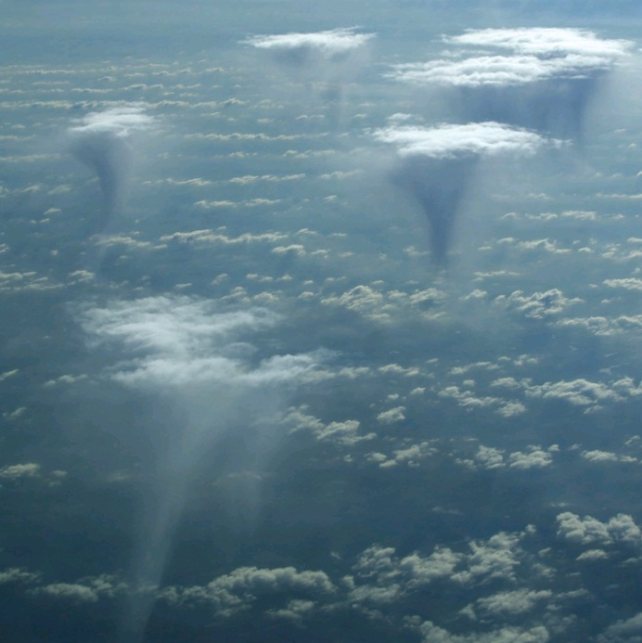
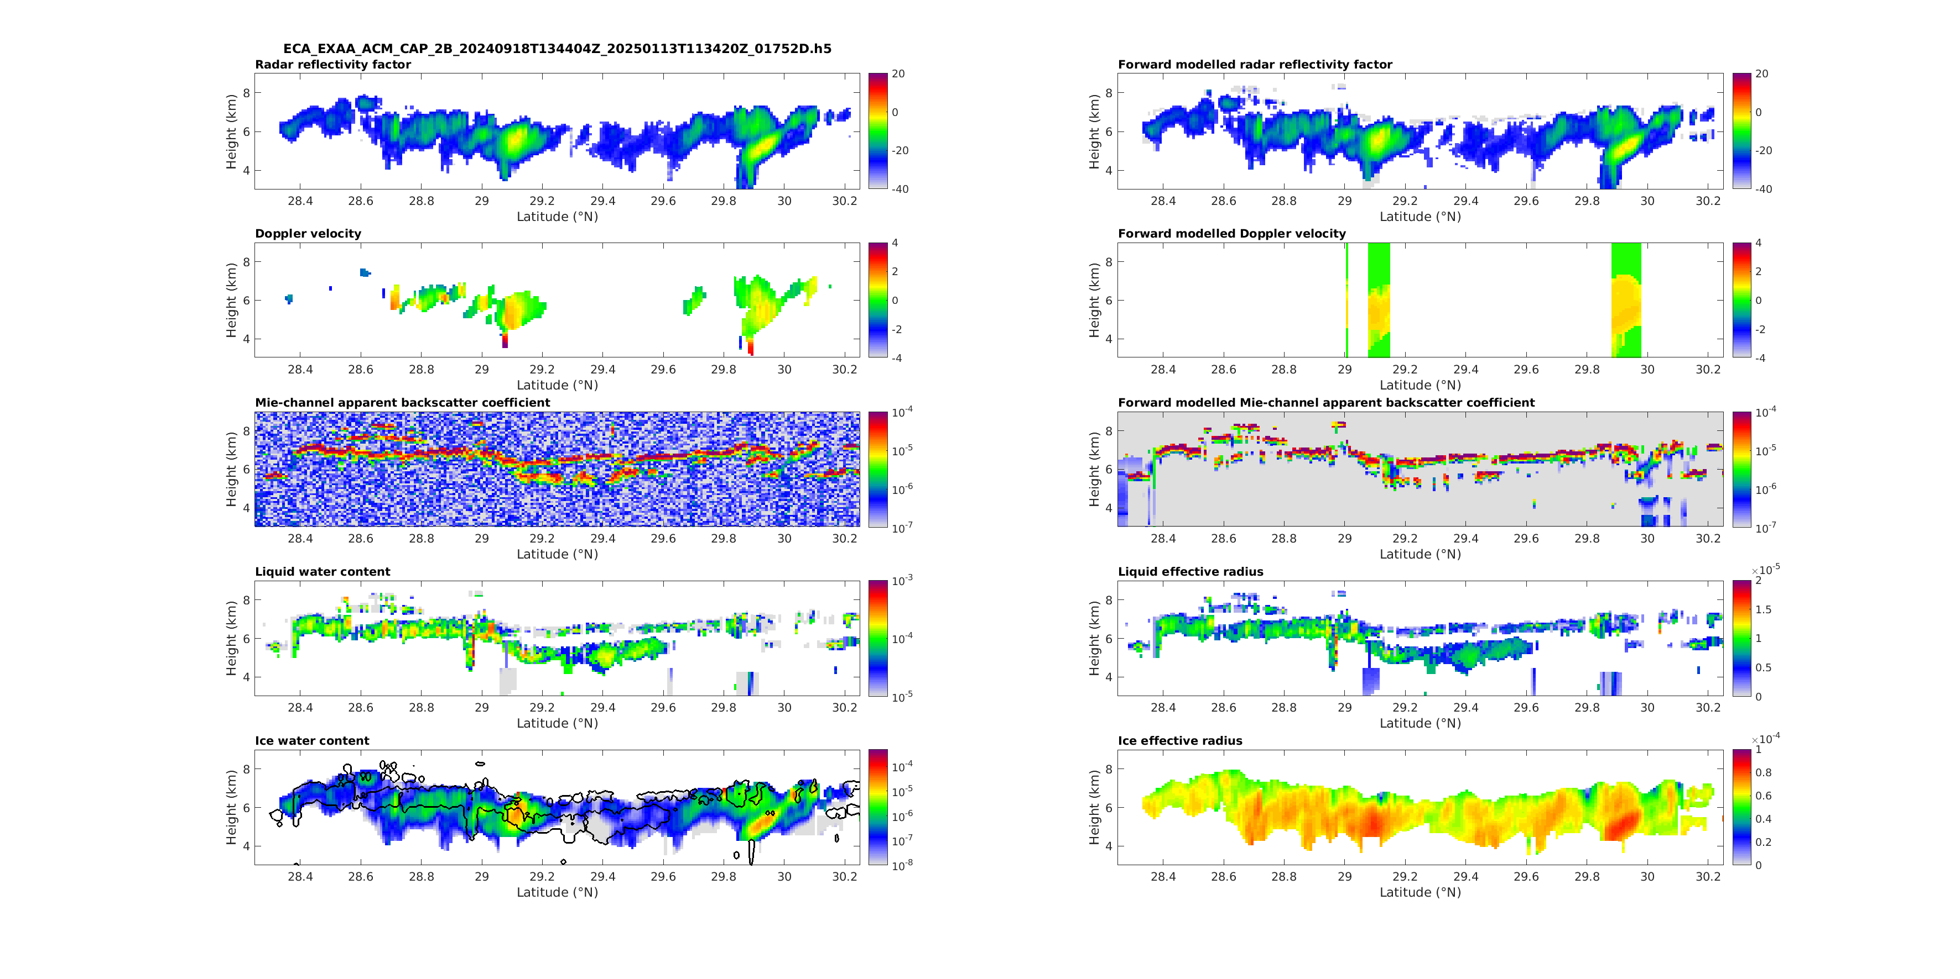
Altocumulus example
Altocumulus consist of small liquid water droplets detected by the lidar beneath which larger ice particles are often falling detected mainly by the radar

Slide 15
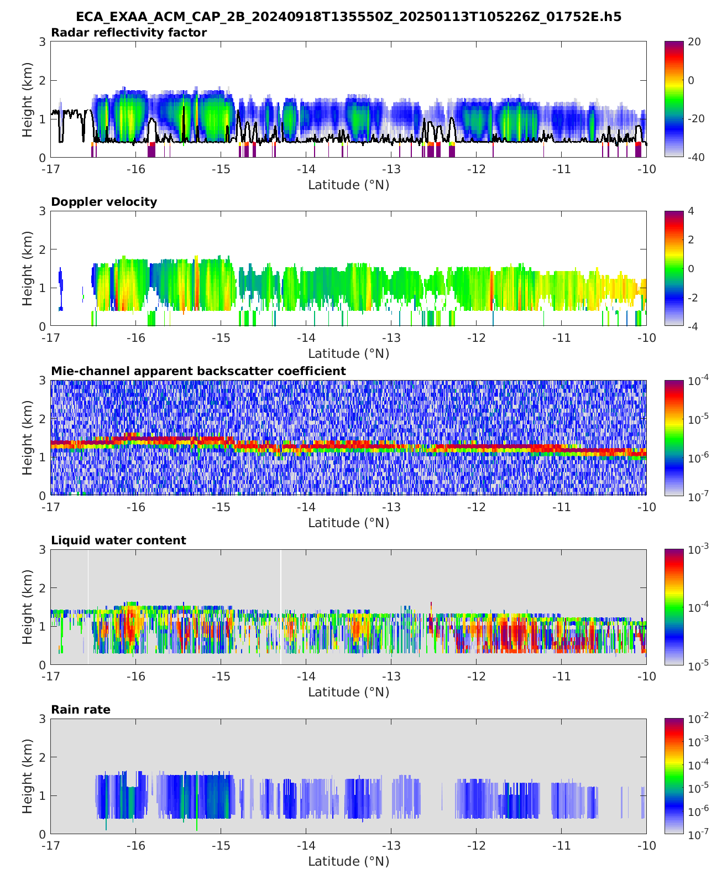
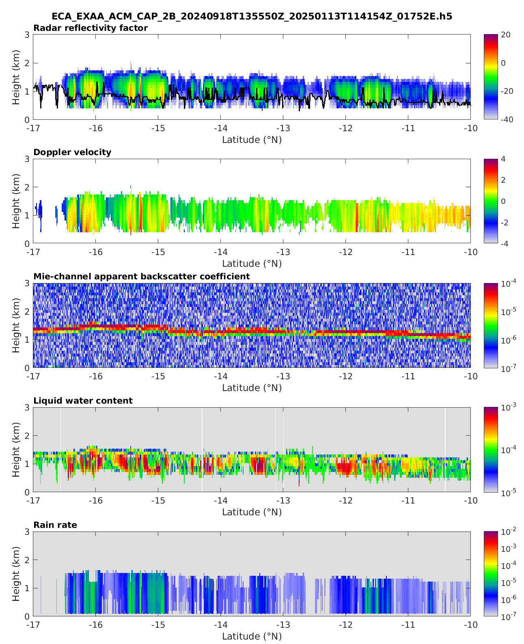
Estimating cloud base from the radar: C-TC update
Robin Hogan (ECMWF),
Bernat P-T (McGill)
Shannon Mason (ECMWF)
Radar sees mostly drizzle in stratocumulus: when reflectivity decreases towards the ground it means drizzle is evaporating below cloud base
C-TC better diagnoses cloud base
Improved liquid water profile in ACM-CAP

Slide 16
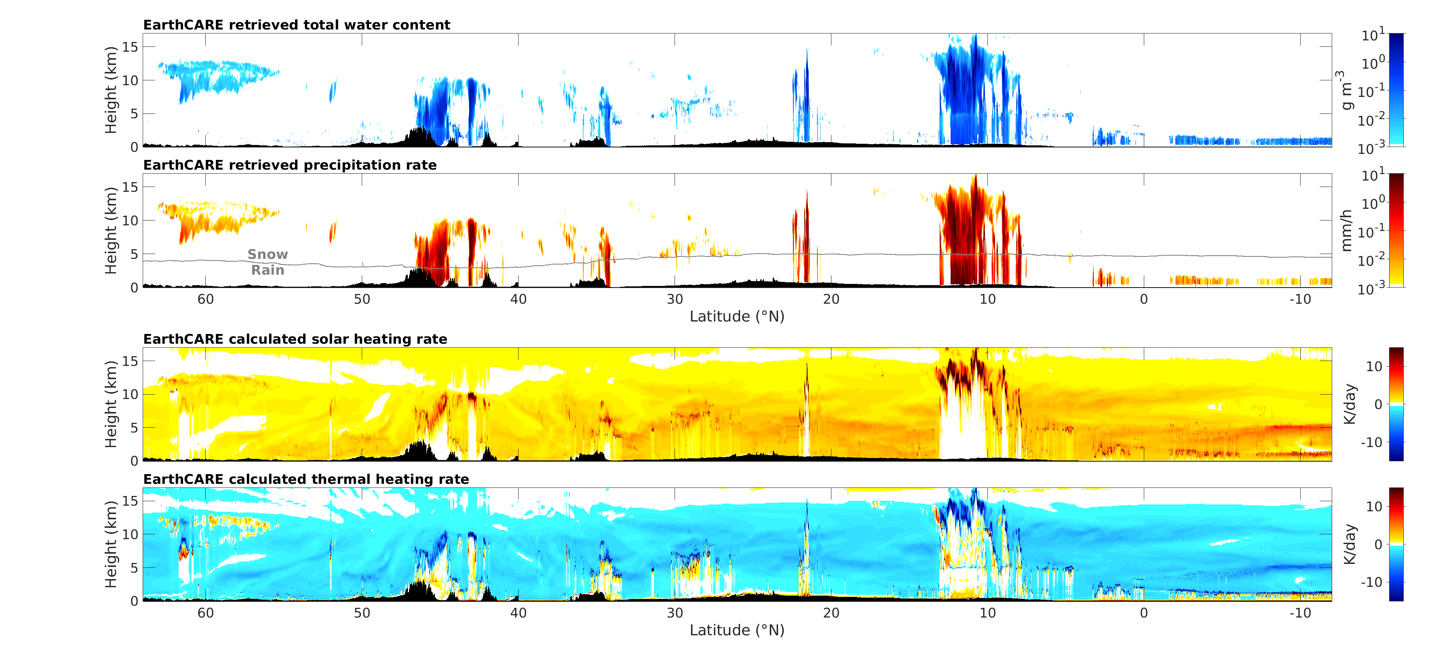
Cloud/precipitation retrievals (ACM-CAP) and heating rates (ACM-RT)
a
”ACM-CAP” uses synergy of radar, lidar & imager to retrieve mass and particle sizes of clouds, aerosols & precipitation (Robin Hogan & Shannon Mason, ECMWF)
”ACM-RT” computes fluxes & heating rates from retrievals using 3D radiative transfer (Jason Cole, Howard Barker & Zhipeng Qu, ECCC)

Slide 17
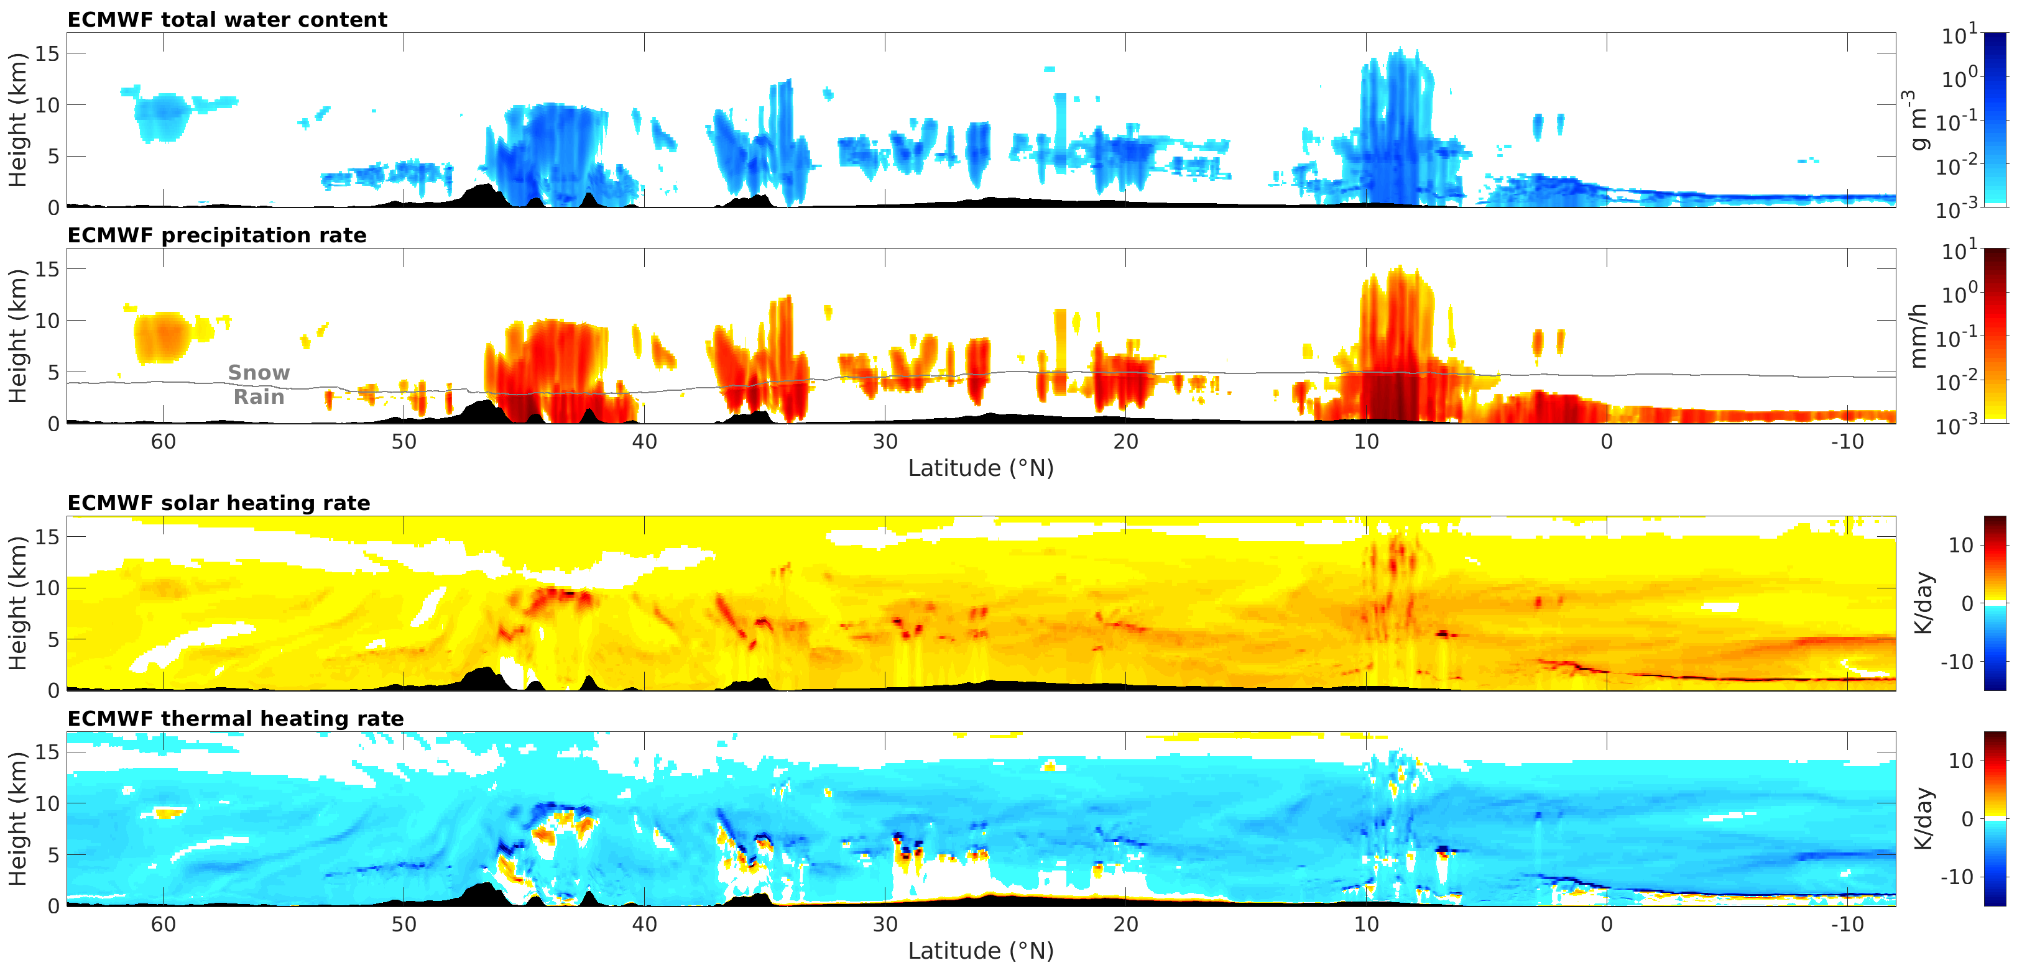
Evaluate the ECMWF 9-km forecast model
Robin Hogan (ECMWF)
Good forecast of European rainfall, but tropical clouds less well predicted

Slide 18
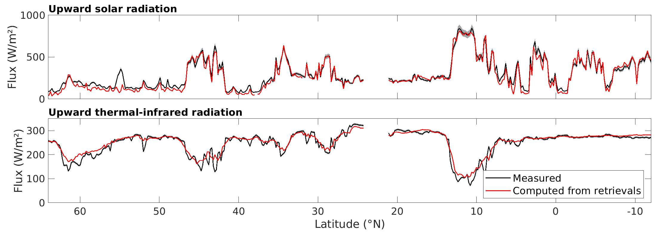
Self-evaluation using radiative closure
Cirrus not reflective enough?
A-TC misses a very low cloud (fog?)
Spread indicates 10% uncertainty (BBR 10% higher than CERES)
Surface albedo error?
EarthCARE continually compares computed fluxes from ACM-RT to measurements by the broadband radiometer (processed by BMA-FLX, Almudena Velazquez & Nicolas Clerbaux, RMIB)
If they agree, it gives us confidence in the retrieved cloud properties, if they disagree then we have something to improve in our algorithms or something to learn about the atmosphere!

Slide 19
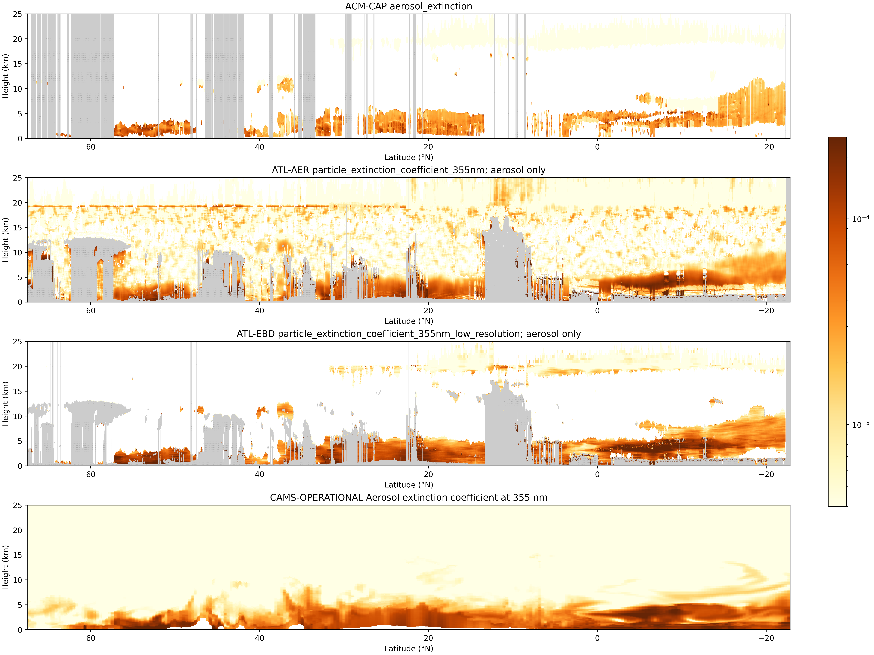
Comparison of extinction profiles between EarthCARE and CAMS forecasts
CAMS: Copernicus Atmosphere Monitoring Service, ECMWF’s air quality forecast
EarthCARE lidar saw widespread stratospheric aerosol from Mt Ruang eruption, Indonesia, 16 April 2024
EarthCARE
“A-EBD”, David Donovan (KNMI)
Volcanic aerosol
CAMS
European continental aerosol
Desert dust
Elevated smoke
Peter Hill (ECMWF), David Donovan & Gerd-Jan van Zadelhoff (KNMI)

Slide 20
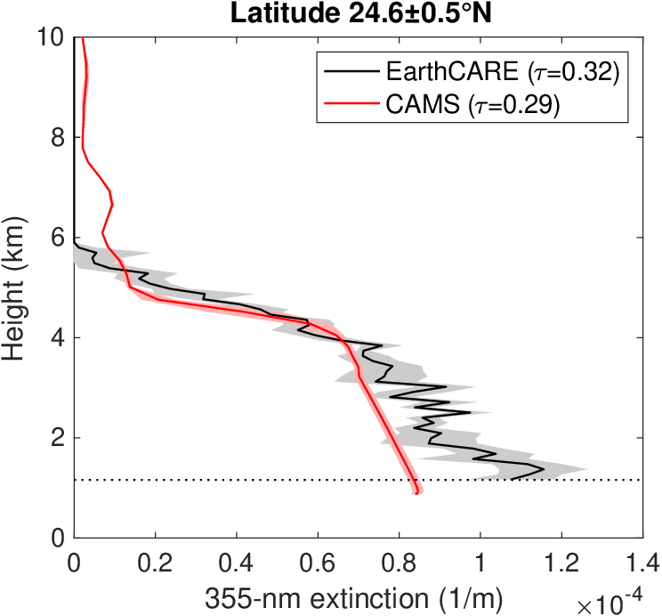
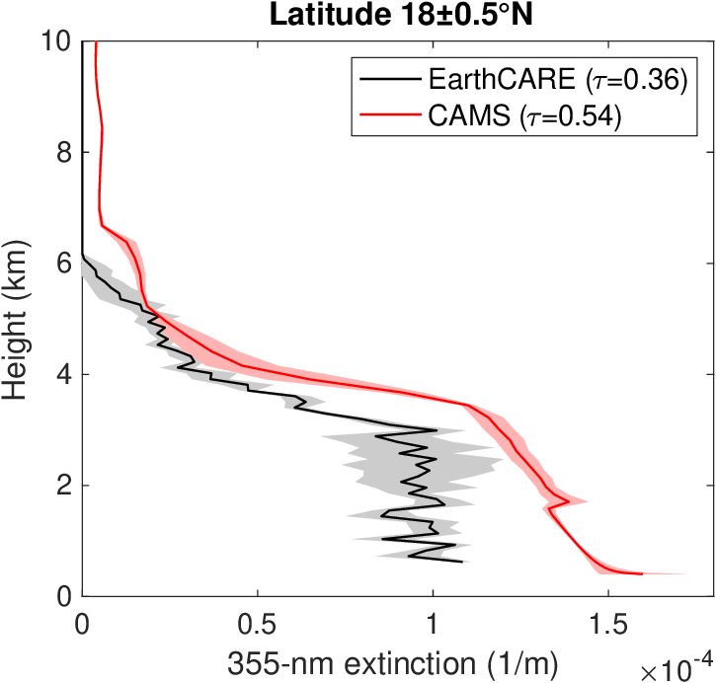
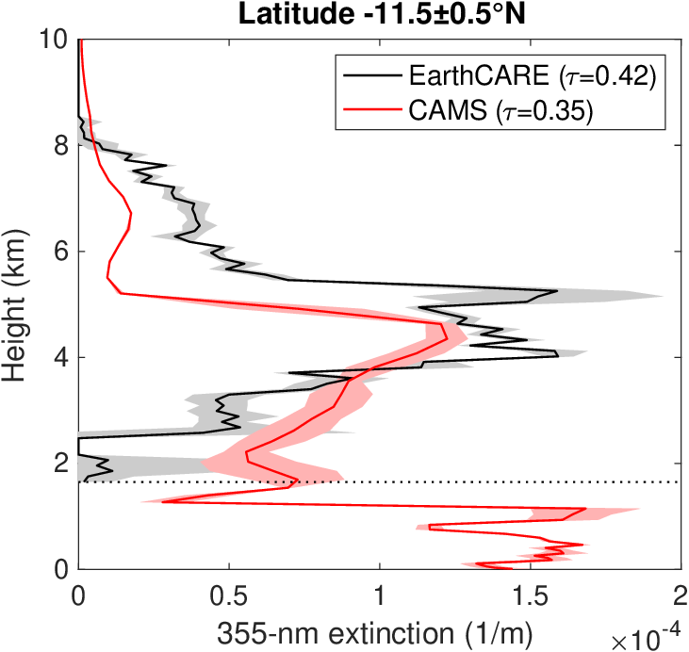
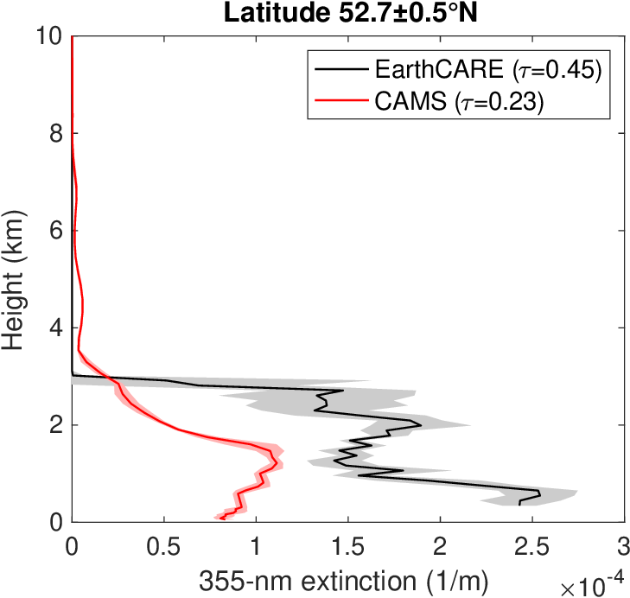
Desert dust
Desert dust
Elevated smoke
above cloud
EarthCARE
“A-EBD”
European continental aerosol
CAMS profiles are mostly good - have never been able to evaluate aerosol profiles globally with such resolution & accuracy, nor above clouds!
ECMWf is working on assimilating EarthCARE into CAMS…
Robin Hogan, Peter Hill (ECMWF)

Slide 21
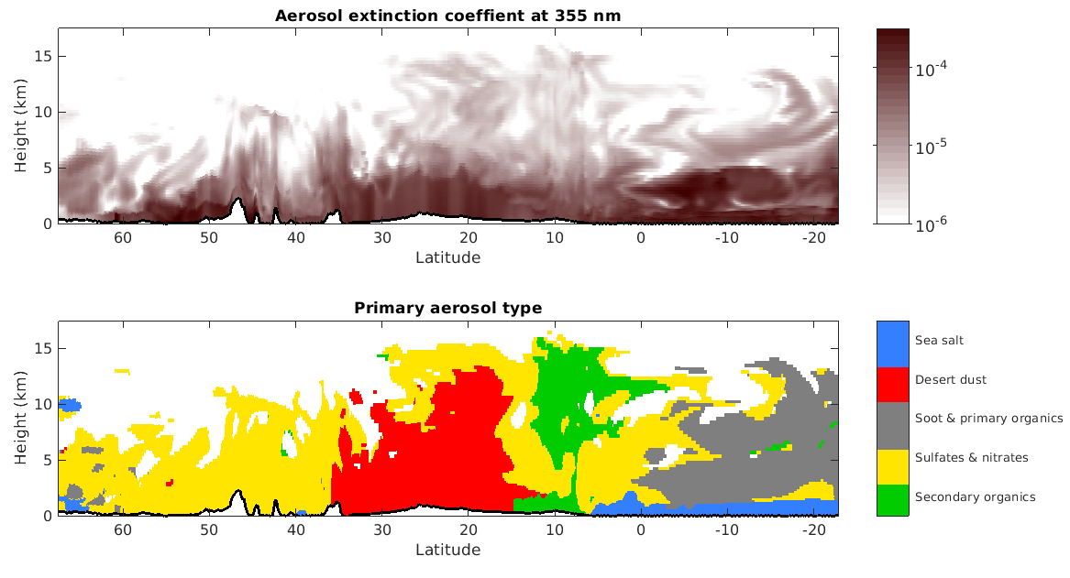
Next step: aerosol type
Robin Hogan (ECMWF)
CAMS has seven aerosol types some with two or three size bins: potential to evaluate with EarthCARE aerosol classification

Slide 22
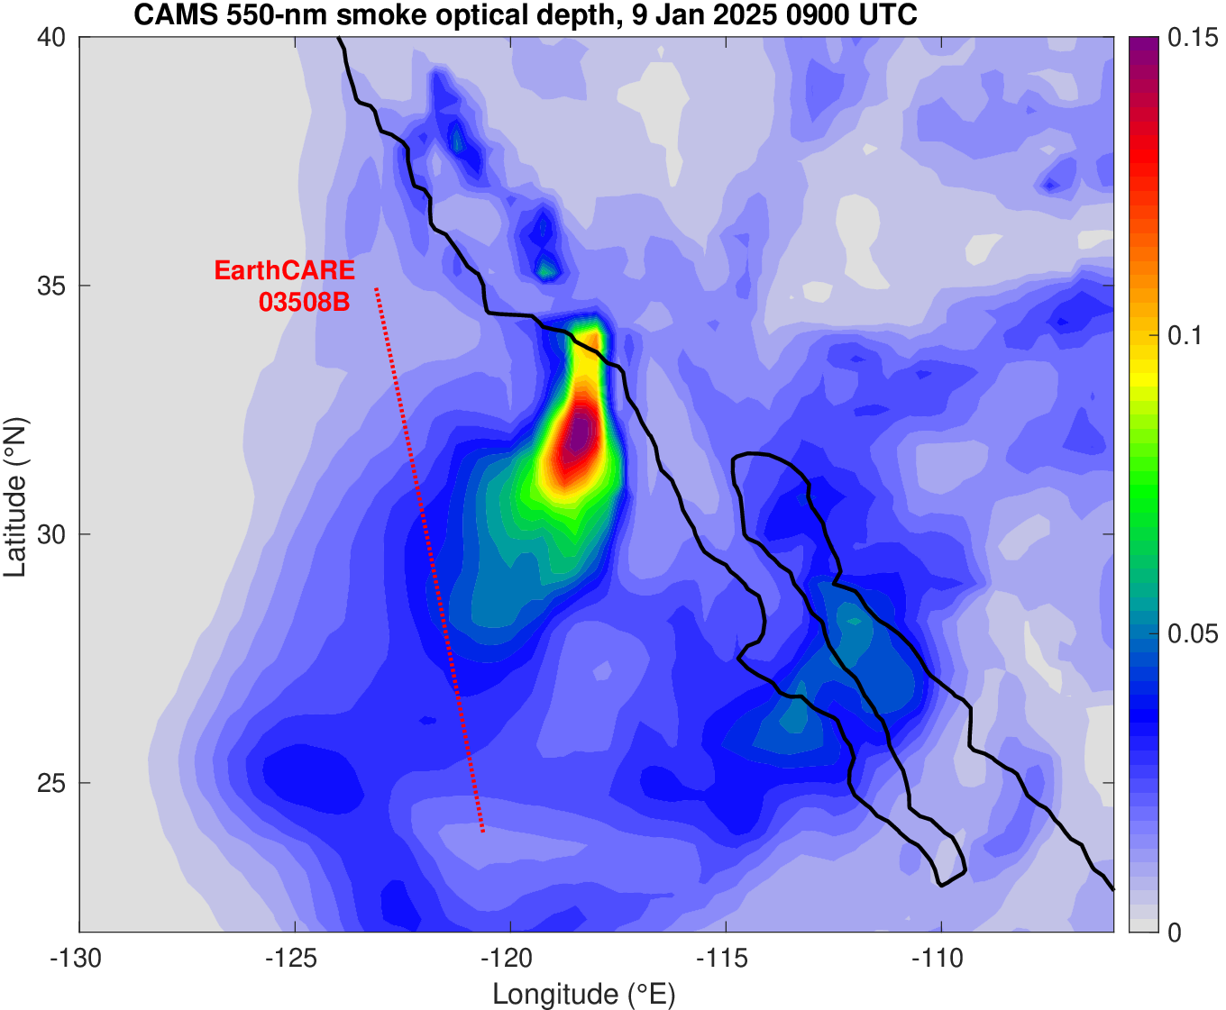
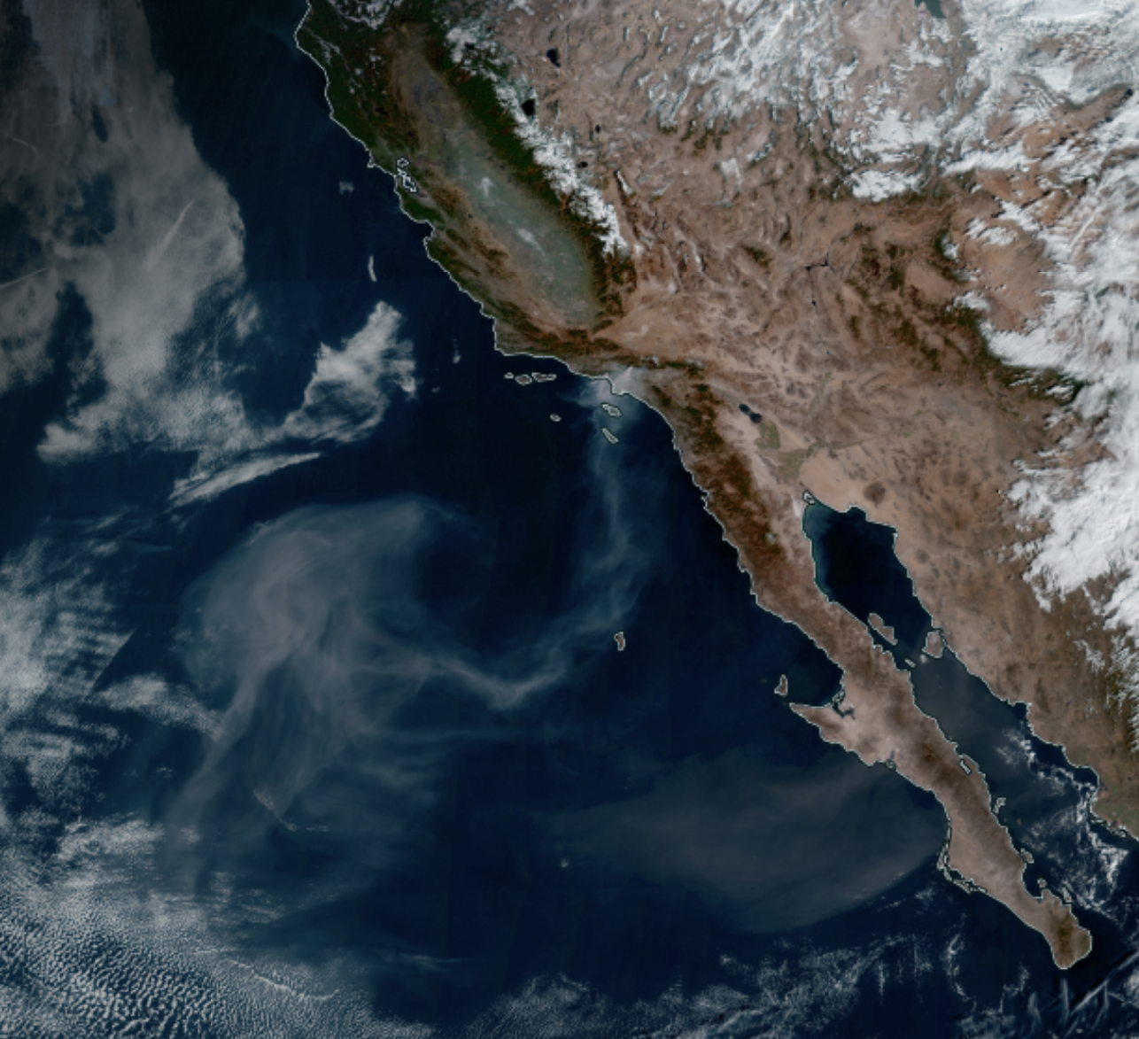
California fires: 9 January 2025
Robin Hogan (ECMWF)
NASA geostationary composite (17 UTC)
ECMWF operational “CAMS” aerosol optical depth but only showing smoke aerosol species: organic matter + black carbon
Notes:
This is the best day for EarthCARE: note that EarthCARE passed at night and this is the closest CAMS simulation, but we need a satellite image from later in the day to see the plume in the visible.

Slide 23
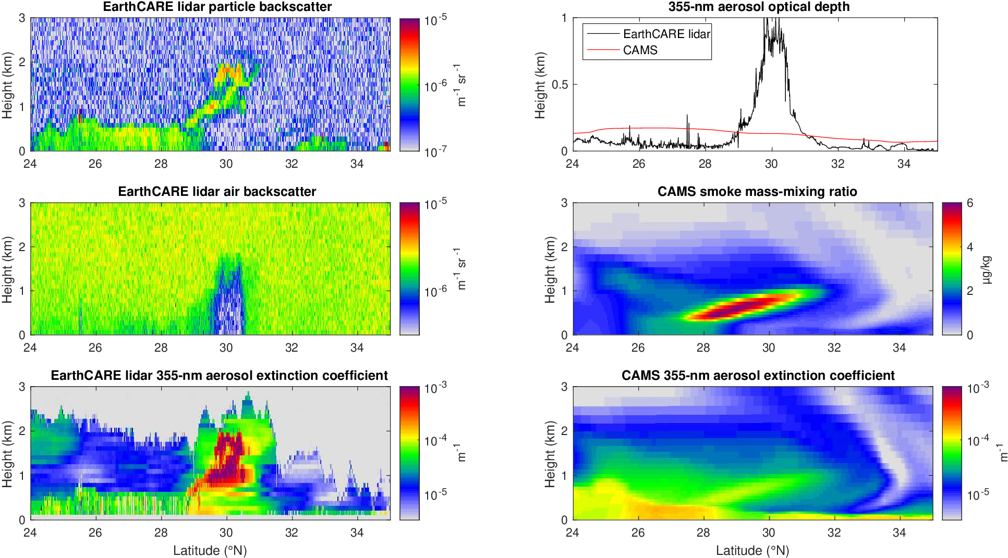
Comparison of EarthCARE’s “A-EBD” extinction product to CAMS
Robin Hogan (ECMWF), David Donovan (KNMI)
A-EBD uses HSRL capability to infer extinction very accurately
A-EBD infers smoke optical depth up to 1
CAMS optical depth dominated by background species like sea salt
CAMS simulates the smoke plume but it is much too weak
…and is only a small contribution to the total aerosol optical depth, unlike in the EarthCARE observations

Slide 24
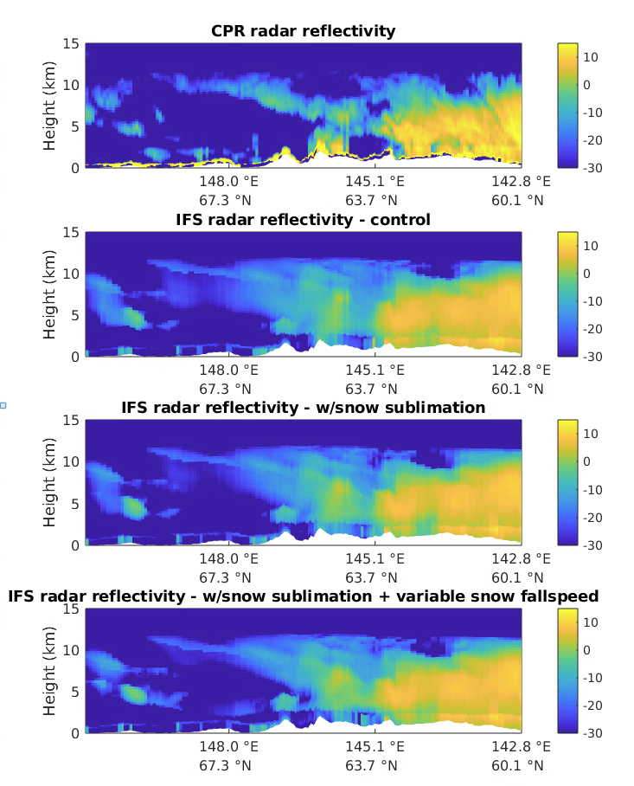
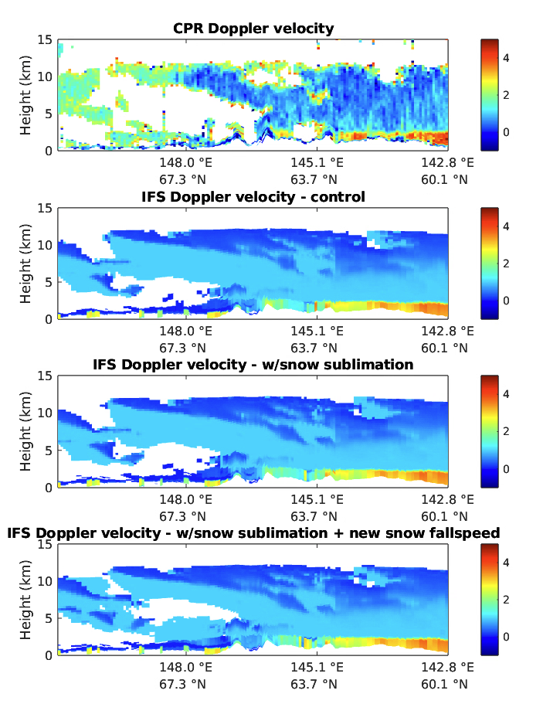
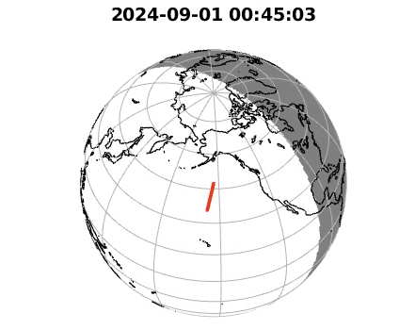
Using EarthCARE to improve microphysical processes in the ECMWF model
Better fit to reflectivity using new ice sublimation scheme
Potential to improve snow fallspeed representation using Doppler observations
Rebecca Murray-Watson, Richard Forbes, Mark Fielding (ECMWF)

Slide 25
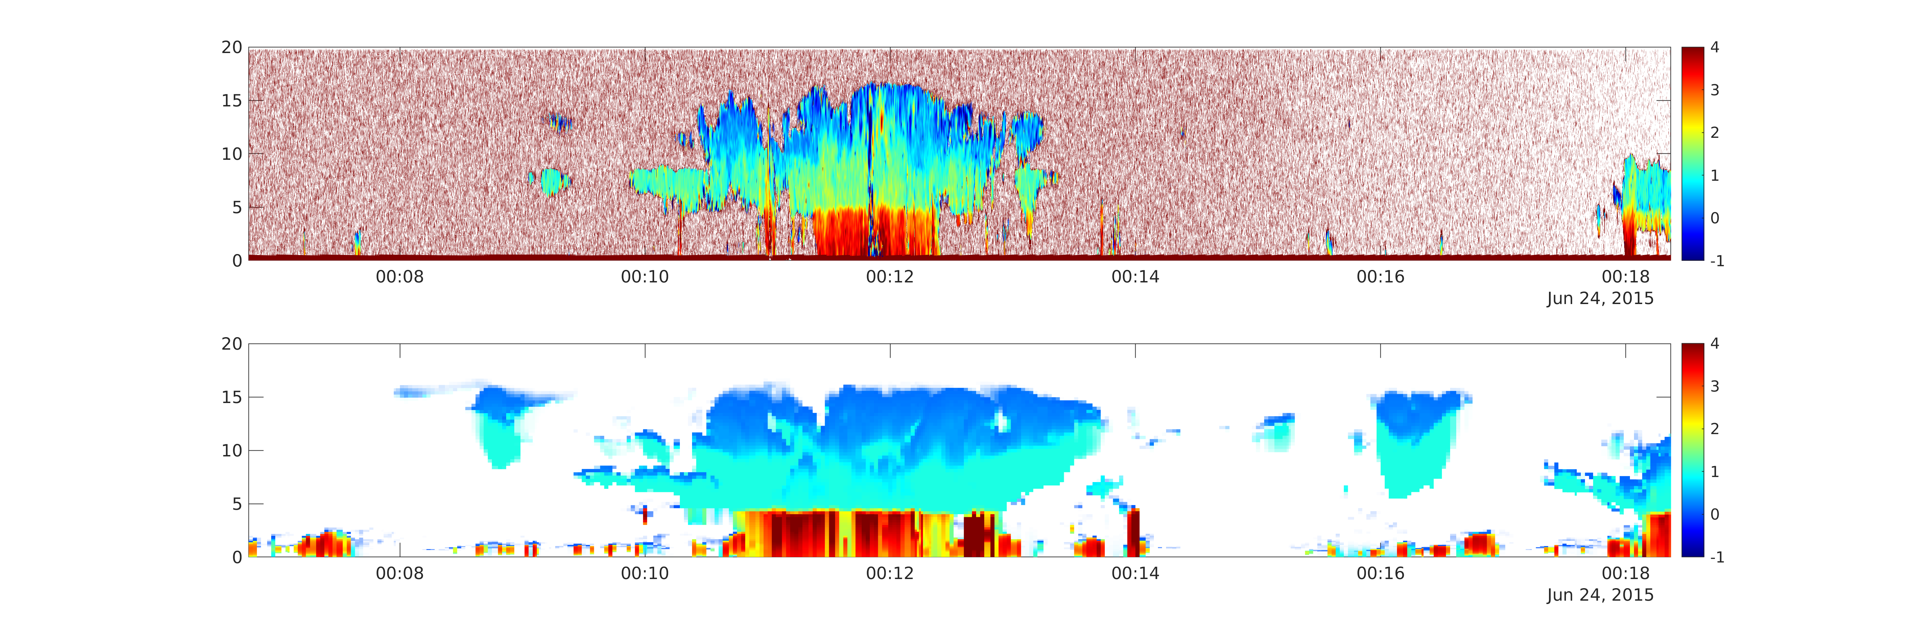
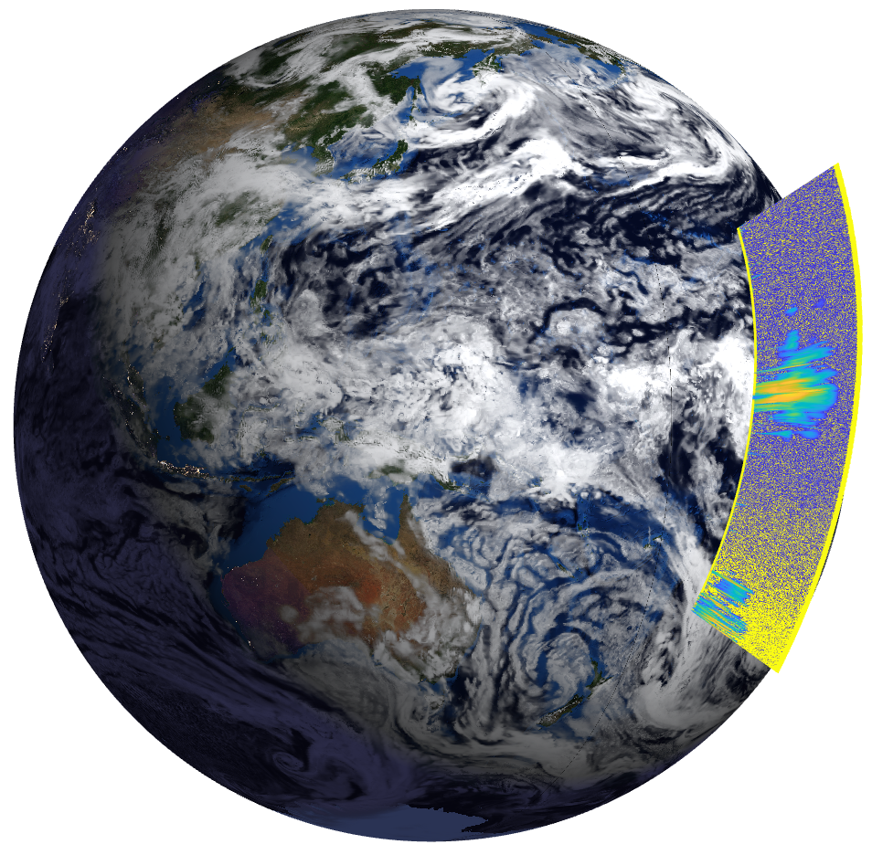
Simulated Doppler fall speeds in a tropical storm
Air rising in storm core at 5-10 m/s
GEM and ECMWF models
GEM (250-m resolution)
m/s
Radar reflectivity
Snow falls at 1 or 2 m/s?
Rain falls at 3 or 4 m/s?
ECMWF (9-km resolution)
10 km
1000 km
This is why we need EarthCARE!

Slide 26
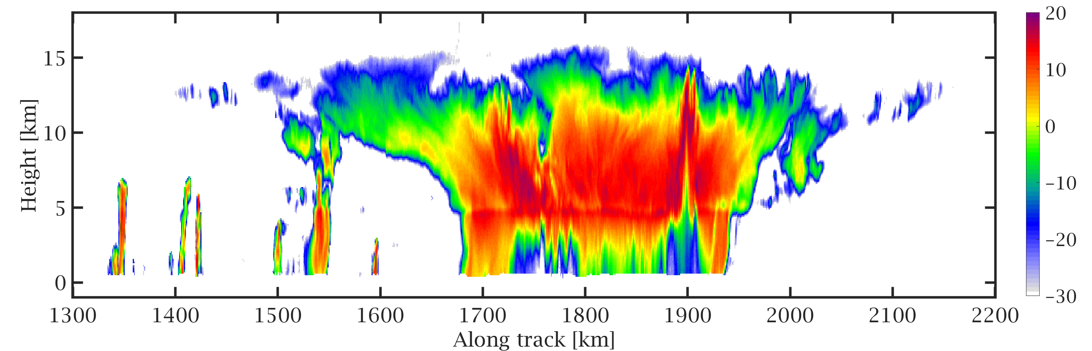
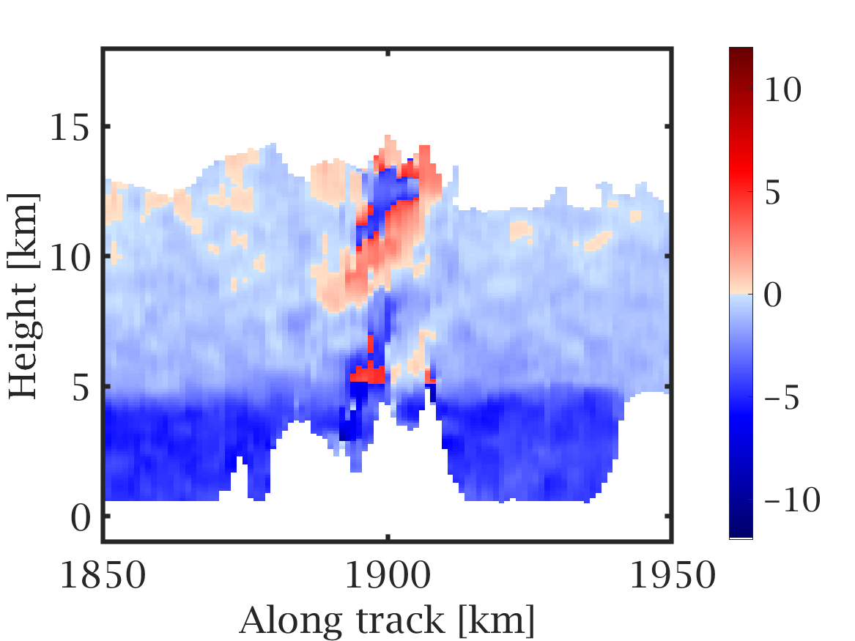
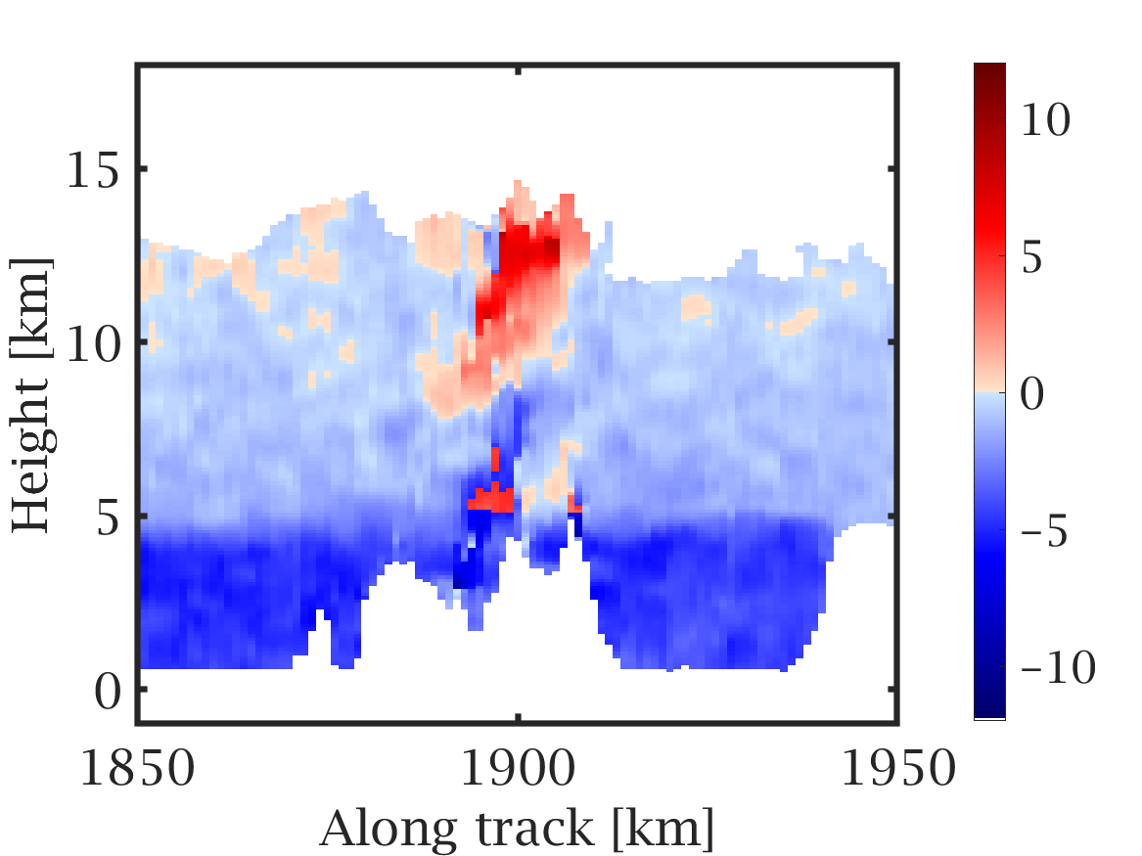
Convective updraft strength & width
Pavlos Kollias, Bernat Puigdomenech-Tresseras (McGill)
Unambiguous Doppler range is only +/- 5 m/s, but convective updrafts can be up to 50 m/s!
Very tricky to “unfold” due to noise and strong updrafts tend to be associated with strong multiple-scattering
Need a strategy to evaluate the strength and width of updrafts in models that can deal with these difficulties
Masaki Satoh & Robin Hogan are initiating “ECOMIP”, the EarthCARE-ORCESTRA Model Intercomparison Project
Folded Doppler velocity
Unfolded Doppler velocity

Slide 27
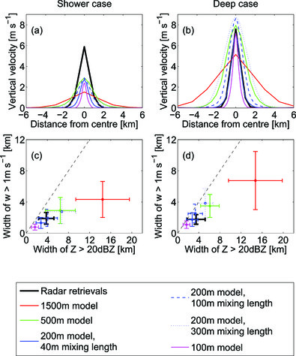
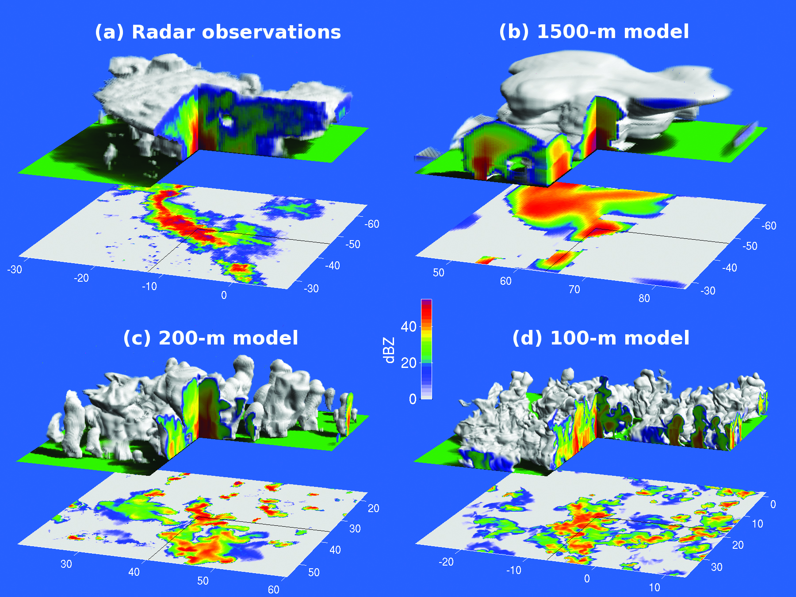
DYMECS experiment (Stein et al. BAMS 2015)
Evaluating Met Office model with scanning radar

Slide 28
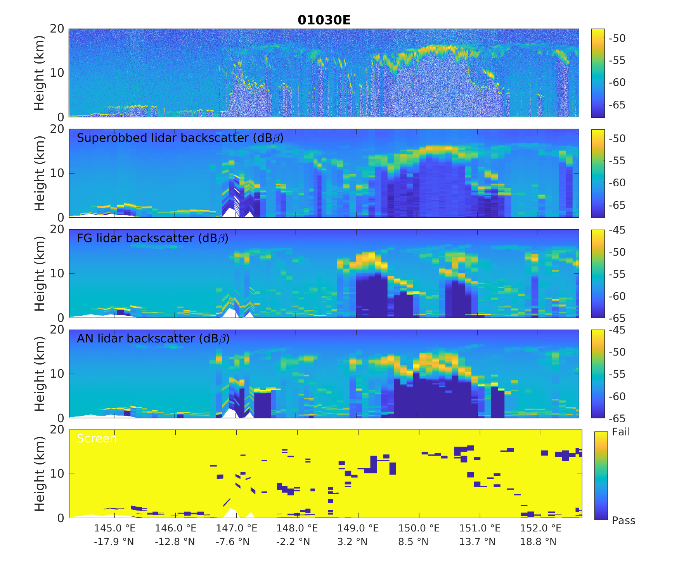
First experimental assimilation of EarthCARE lidar backscatter at ECMWF!
Higher backscatter
EarthCARE lidar backscatter observations
Lower backscatter
EarthCARE averaged to model scale
Model lidar backscatter before assimilation
Model lidar backscatter after assimilation
Marta Janiskova & Mark Fielding (ECMWF)

Slide 29
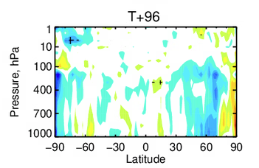
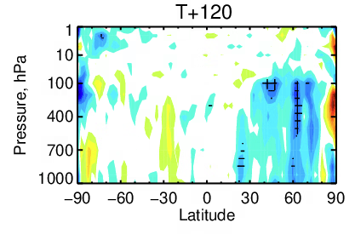
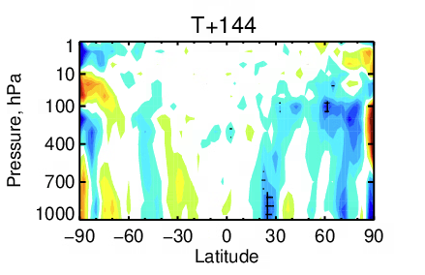
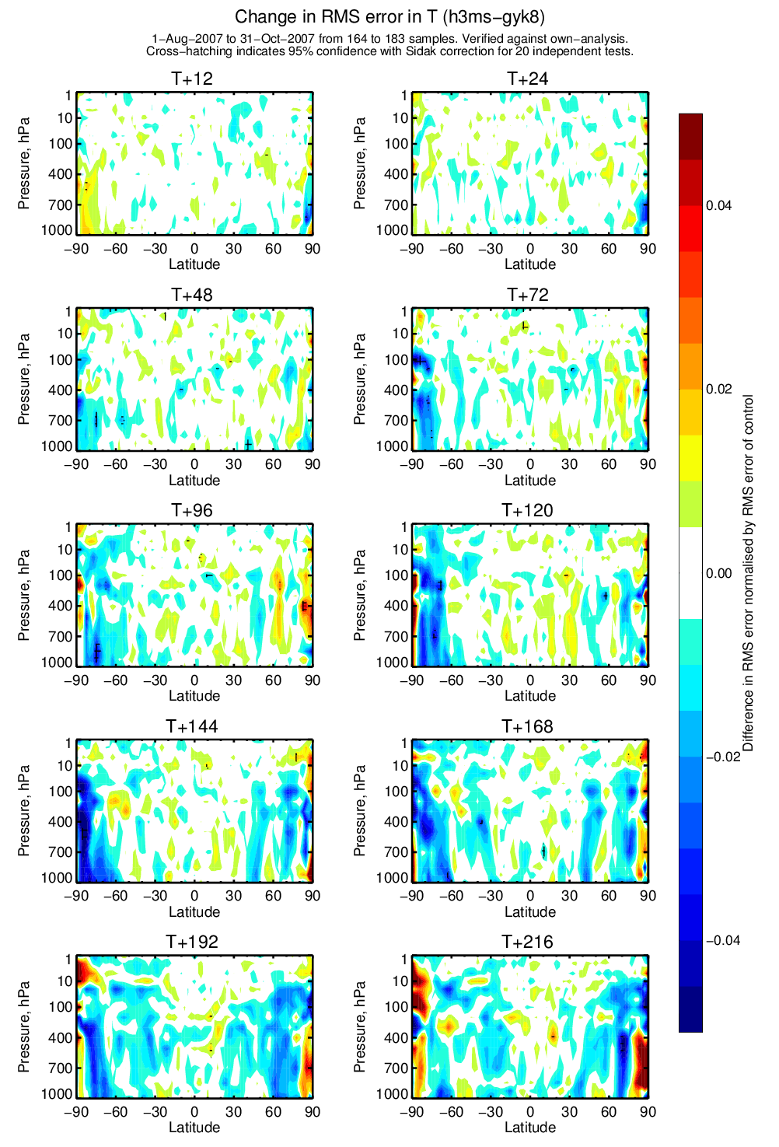
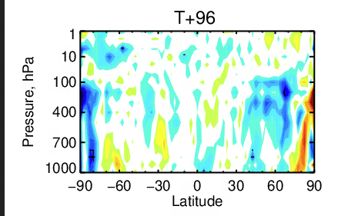
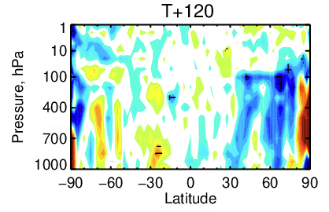
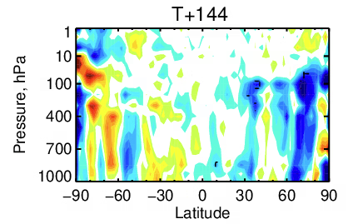
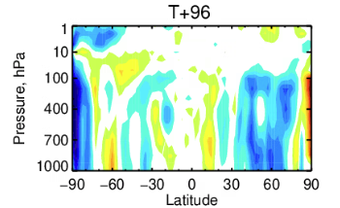
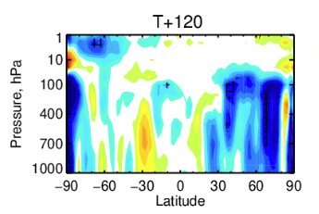
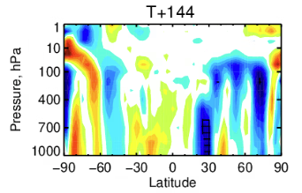
EarthCARE 2024-08-08 -> 2024-10-31
Mark Fielding & Marta Janiskova (ECMWF)
Day 4
Day 5
Day 6
0.04
RED
worse
Wind
0.02
Difference in RMS error normalised by RMS error of control
Temperature
0.00
– 0.02
Geopotential
BLUE
better
– 0.04
Verification of forecast against own analysis: potential to improve further…

Slide 30
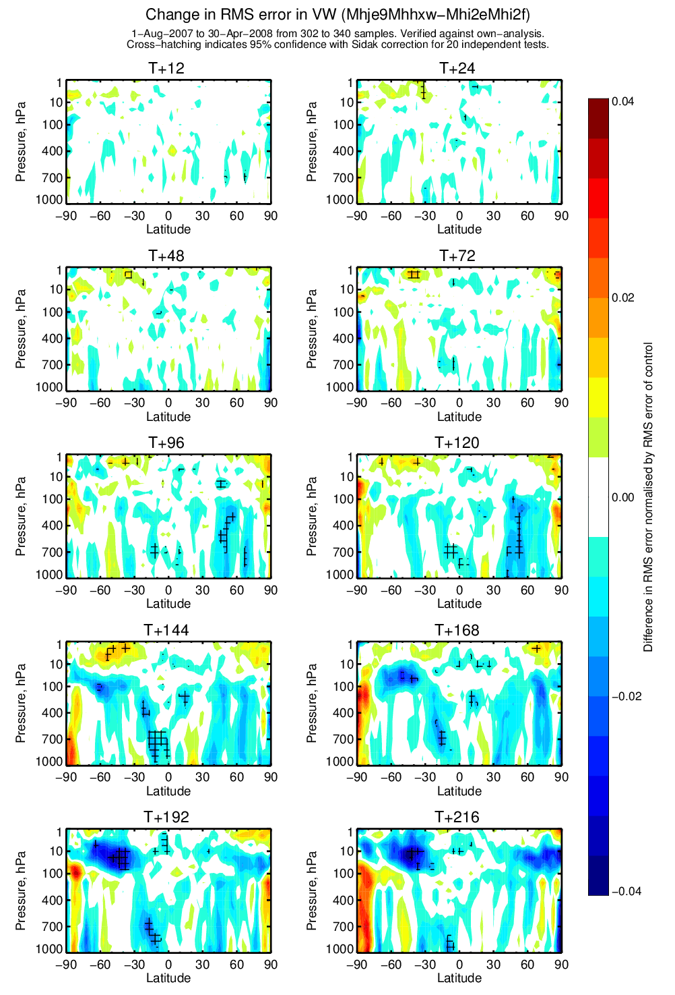
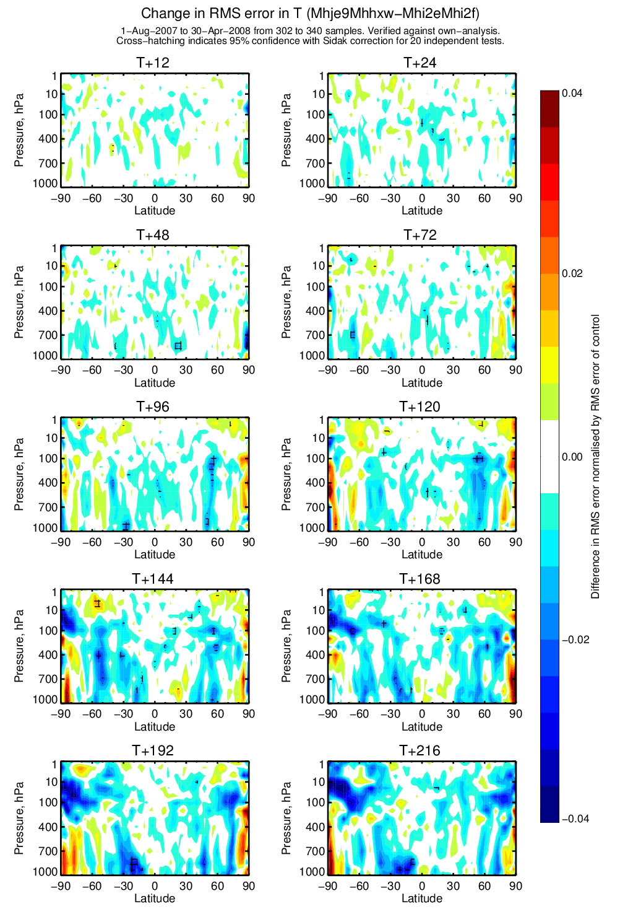

…with similarities to CloudSat 2007-07-01 -> 2007-12-31
Mark Fielding & Marta Janiskova (ECMWF)
Day 4
Day 5
Day 6
0.04
RED
worse
Wind
0.02
Difference in RMS error normalised by RMS error of control
Temperature
0.00
– 0.02
Geopotential
BLUE
better
– 0.04
Verification of forecast against own analysis

Slide 31

Improving ice retrievals using EarthCARE
Radar & lidar measure two moments of the ice size distribution, from which we retrieve two independent pieces of information, e.g. number and mean size
But when only one is available (e.g. radar deep in a cloud) we need to assume the other, accounting for cold clouds tending to be composed of smaller, more numerous particles
Colder clouds
Warmer clouds
Increasing radar reflectivity
N₀’
Colder clouds
N₀’
Number concentration N₀*
Warmer clouds
Delanoe & Hogan (2008) used large database of ice particle size distributions to show that “N₀ prime” is best with strong temperature dependence: retrieved by ACM-CAP with strong prior assumption
But Delanoe & Hogan ignored particles smaller than 100 microns due to unreliable aircraft observations!
Mean particle size D₀
Robin Hogan & Shannon Mason (ECMWF)

Slide 32

Where do real EarthCARE observations pull the retrieval?
Robin Hogan & Shannon Mason (ECMWF)
Observations
Forward model
Retrievals
“N₀ prime” retrievals
Radar & lidar observations at cloud top imply much larger N₀’ than prior!
Also, solar radiances pull the entire column to higher N₀’ (not available at night)

Slide 33

Extinction (from A-EBD) versus radar reflectivity and temperature from 50 frames
Idea: use coincident radar and lidar observations to characterize temperature dependence of N₀’
Use as new prior assumption to spread this information into clouds detected only by one instrument
Only possible with EarthCARE via its HSRL-retrieved extinction!
Black line shows the “SD line” whose slope is the ratio of the standard deviation of the two dimensions
Robin Hogan & Shannon Mason (ECMWF)

Slide 34






Parametric fit
Best fit: $α={10}^{0.071Z\left[dBZ\right]−0.038T\left[℃\right]−3.65}$
Limit T-dependence to $−57℃<T<−17℃$
This is useful for radar-only retrievals, but also as the prior constraint for ACM-CAP
Can also derive effective radius relationship for use in weather & climate models
Existing ACM-CAP prior relationship from Delanoe & Hogan (2008) underpredicts extinction from Z & T by a factor of three!
Empirical fit from aircraft data by Hogan, Mittermaier & Illingworth (2006) is OK for $T>−60$℃ provided we use 35 GHz fit (because their radar scattering by large ice was too low)
Robin Hogan & Shannon Mason (ECMWF)

Slide 35

Distribution of N₀’ retrievals from one orbit (01752)
Robin Hogan & Shannon Mason (ECMWF)
Original retrieval: pulls to higher N₀’ than the Delanoe & Hogan prior (dashed line) except when only one instrument available
New retrieval: new N₀’ prior from EarthCARE’s extinction(Z,T) sits close to middle of retrievals
Can we use a similar approach with other a priori constraints for other cloud types?

Slide 36

Impact of new N₀’ prior on nighttime retrievals: 01752B
Robin Hogan & Shannon Mason (ECMWF)
Old retrieval New retrieval Ratio
Extinction near cloud top unchanged: well sampled by radar and lidar
Larger extinction deeper in the cloud where we have only radar, because N₀’ reverts to new prior implying smaller more numerous particles
Higher optical depth!
We urgently need in-situ verification of this result with the latest cloud probes sampling < 100 microns! Use FAAM?
Cloud-top info from lidar may not be representative of whole cloud!

Slide 37




New N₀’ parameterization: does EarthCARE imply many more small ice particles?
Recall that Delanoe & Hogan (2008) fitted to ice size distributions with no particles smaller 100 microns
EarthCARE extinction/reflectivity/temperature relationship can be reconciled with aircraft data only if we use Hogan & Illingworth’s (2003) fit of small particles by extrapolation, then multiply by eight!
Need underflights with FAAM aircraft!
Robin Hogan & Shannon Mason (ECMWF)

Slide 38


Detection of cloud-top-height trends (cloud feedbacks)
NH
CALIPSO
Using a cloud-mask threshold
ERA5
Lacks prognostic ozone so shortwave heating rate “resists” the rising tropopause? (fixed in later versions of the ECMWF model)
Tropics
Change in CTH from 2008 (km)
SH
Mark Fielding
El Nino index
What about combining A-Train and EarthCARE retrievals to detect trends in microphysical properties?
We need to raise EarthCARE’s orbit to extend lifetime!
Richardson et al. (2022)

Slide 39
Summary
The scientific opportunities from EarthCARE are HUGE!
Low-hanging fruit: aerosol extinction distribution worldwide: HSRL is a gamechanger
I have only scratched the surface of what we can learn about cloud microphysics: intriguing information is possible from ACM-CAP on raindrop size, snowfall rates, how much riming occurs on snow, the physics of low clouds so important for climate…
Need to learn everything we can from radiative closure
Many opportunities for evaluating and improving weather & climate models (initiated in “ECOMIP”) and assimilating both cloud and aerosol information into forecasts
High-hanging fruit: what is the role of clouds and aerosols in climate change? How do we pin down cloud-aerosol interactions and quantify the various cloud feedbacks?
We can measure long-term trends in clouds and aerosols… but only if we can extend the mission lifetime by raising the orbit!

