Slide 1
Evaluating clouds, aerosols and radiation in the ECMWF model using EarthCARE
Robin Hogan, Shannon Mason, Mark Fielding, Rebecca Murray-Watson, Peter Hill & Richard Forbes (ECMWF)
David Donovan & Gerd-Jan van Zadelhoff (KNMI)
Jason Cole, Zhipeng Qu & Howard Barker (ECCC)
Almudena Velazquez & Nicolas Clerbaux (RMIB)
Bernat Puigdomenech-Treserras & Pavlos Kollias (McGill)
r.j.hogan@ecmwf.int

Slide 2
Overview
Evaluating ECMWF’s CAMS aerosol forecasts with EarthCARE’s high spectral resolution lidar
Improving ice fall speeds in the ECMWF model using EarthCARE’s Doppler radar
Verifying cloud fraction forecasts using synergy of EarthCARE’s radar and lidar
Evaluating clouds and radiation in the ECMWF model using the synergy of all EarthCARE’s instruments

Slide 3
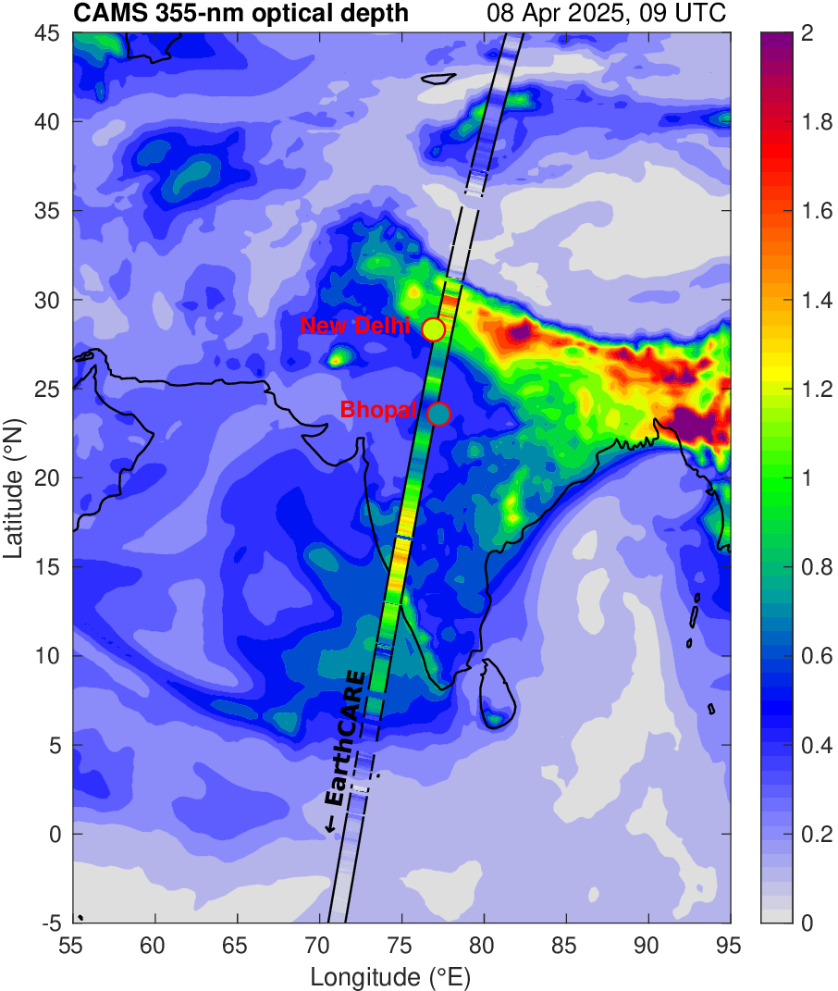
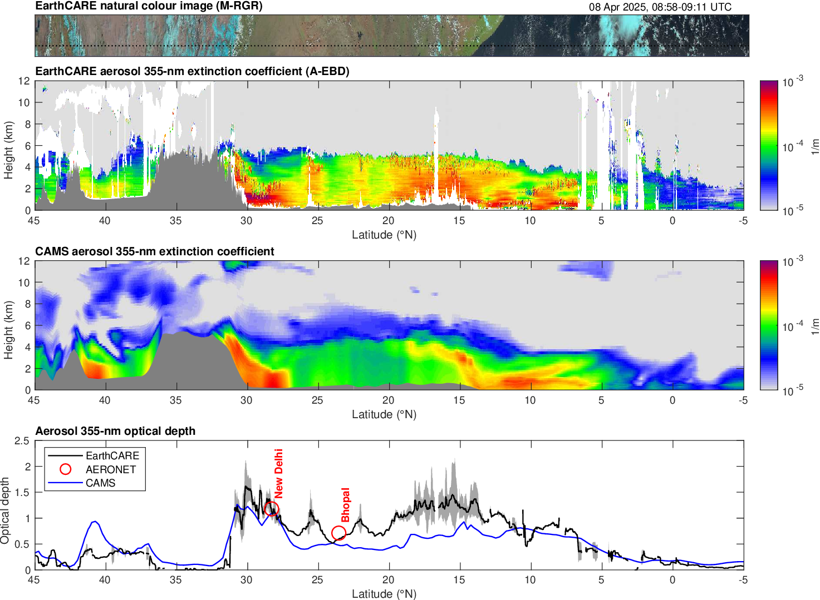
Evaluating CAMS aerosols in India, 8 April 2025
Robin Hogan, Peter Hill, David Donovan
CAMS underestimates high optical depth in south-west India
We have never before been able to evaluate aerosol profiles globally with such resolution and accuracy!
Good agreement between EarthCARE and AERONET
Notes:
Very high aerosol pollution episode in New Delhi.
We hope to use EarthCARE routinely to evaluate CAMS aerosol profiles.

Slide 4
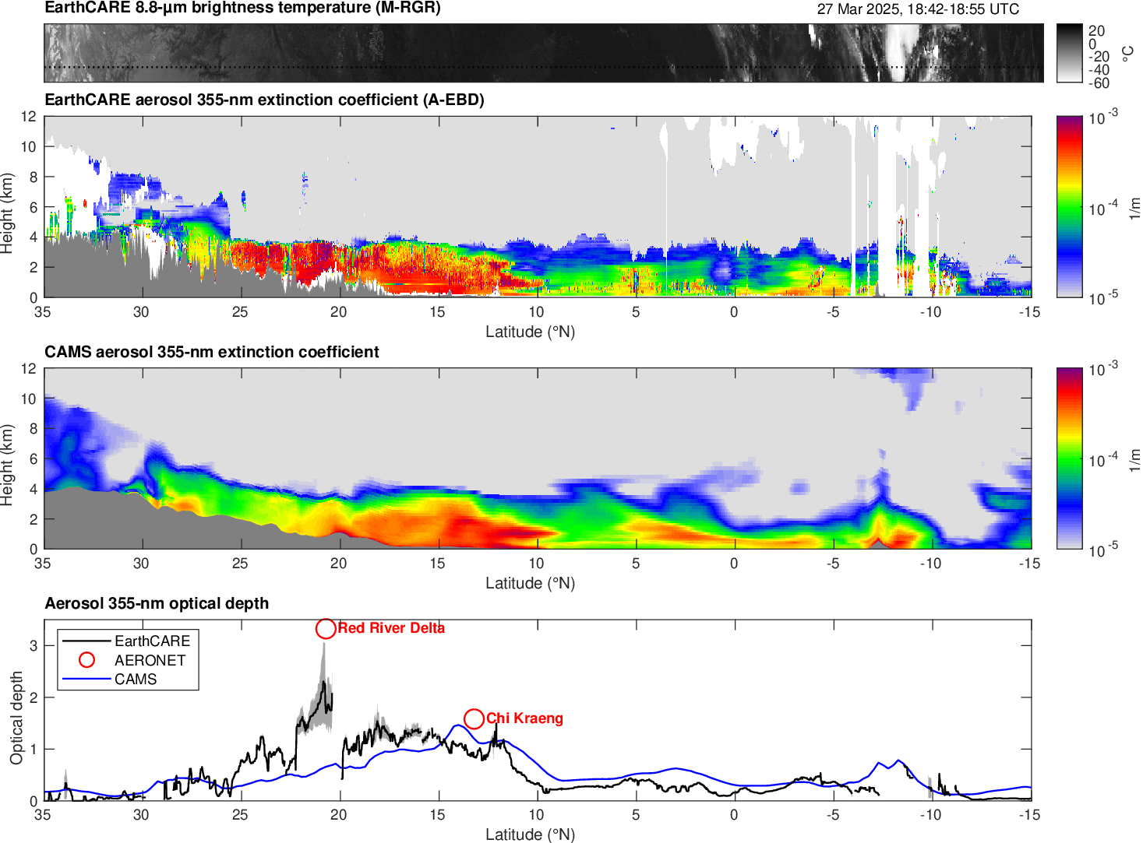
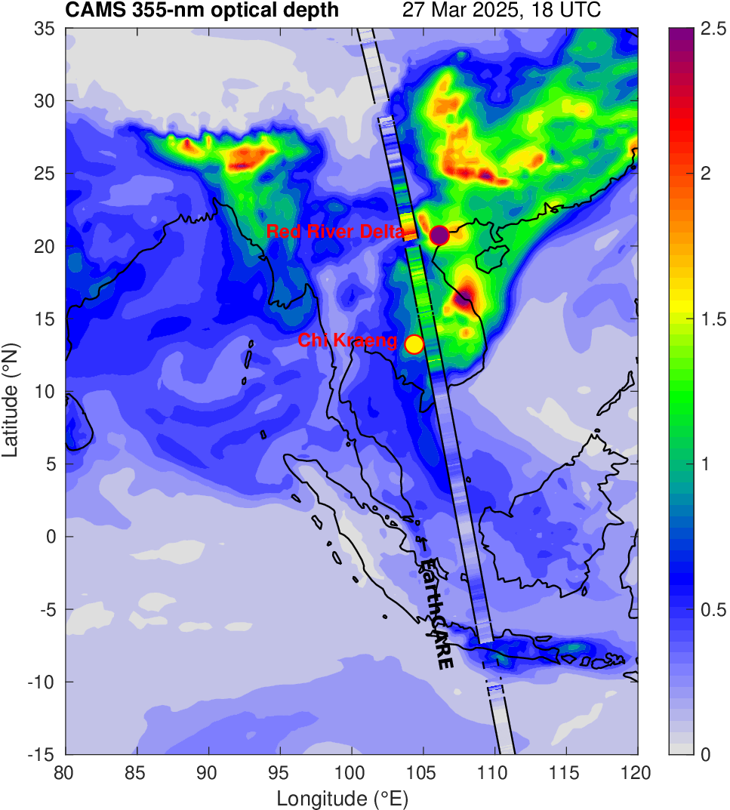
Evaluating CAMS aerosols in Vietnam, Laos & Cambodia, 27 March 2025
a

Slide 5
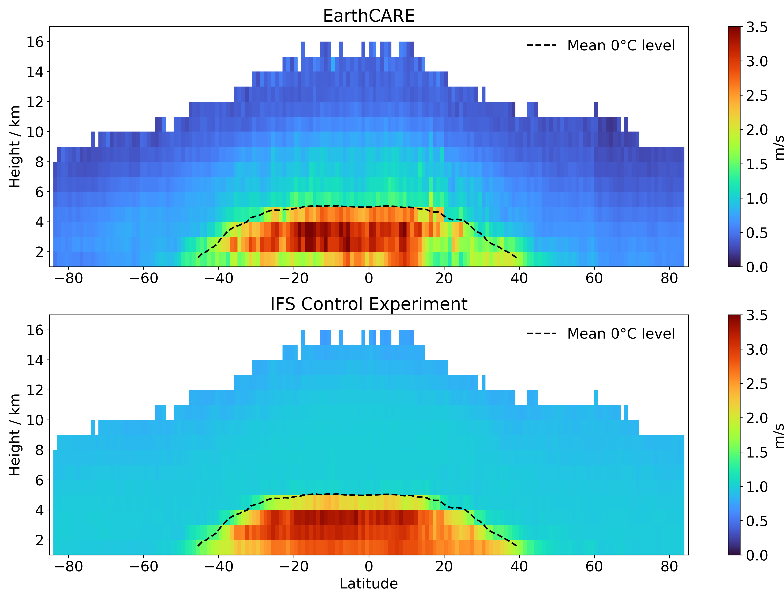
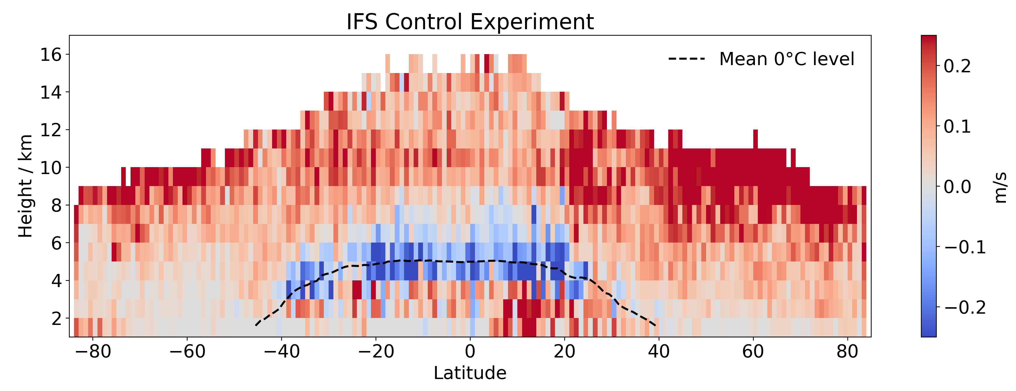
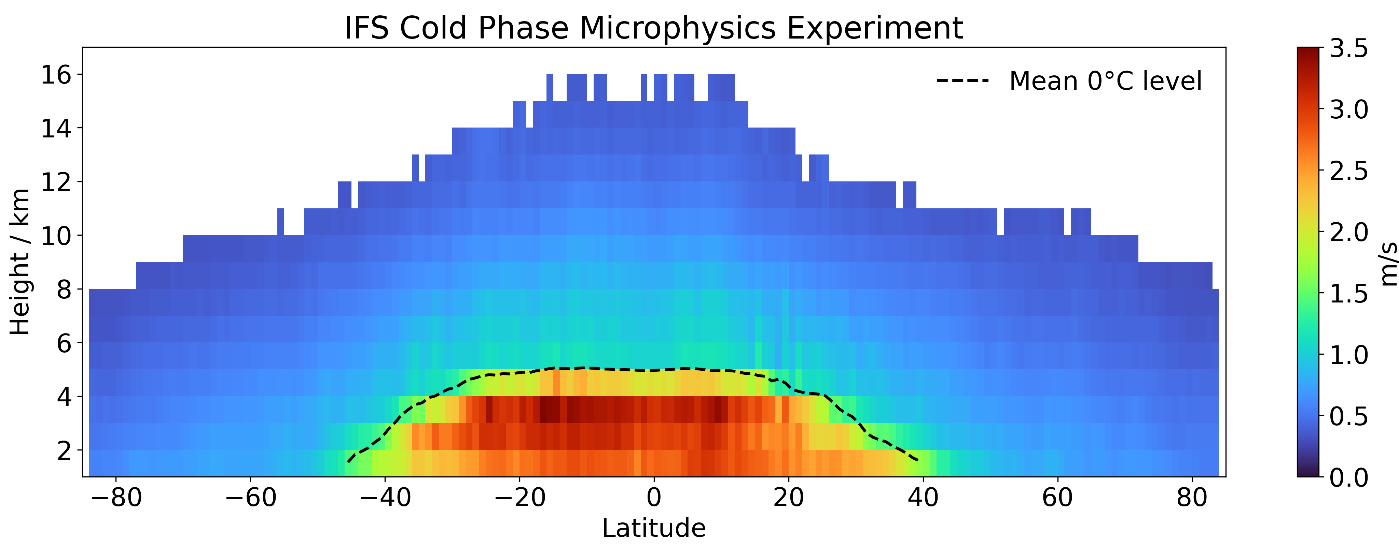
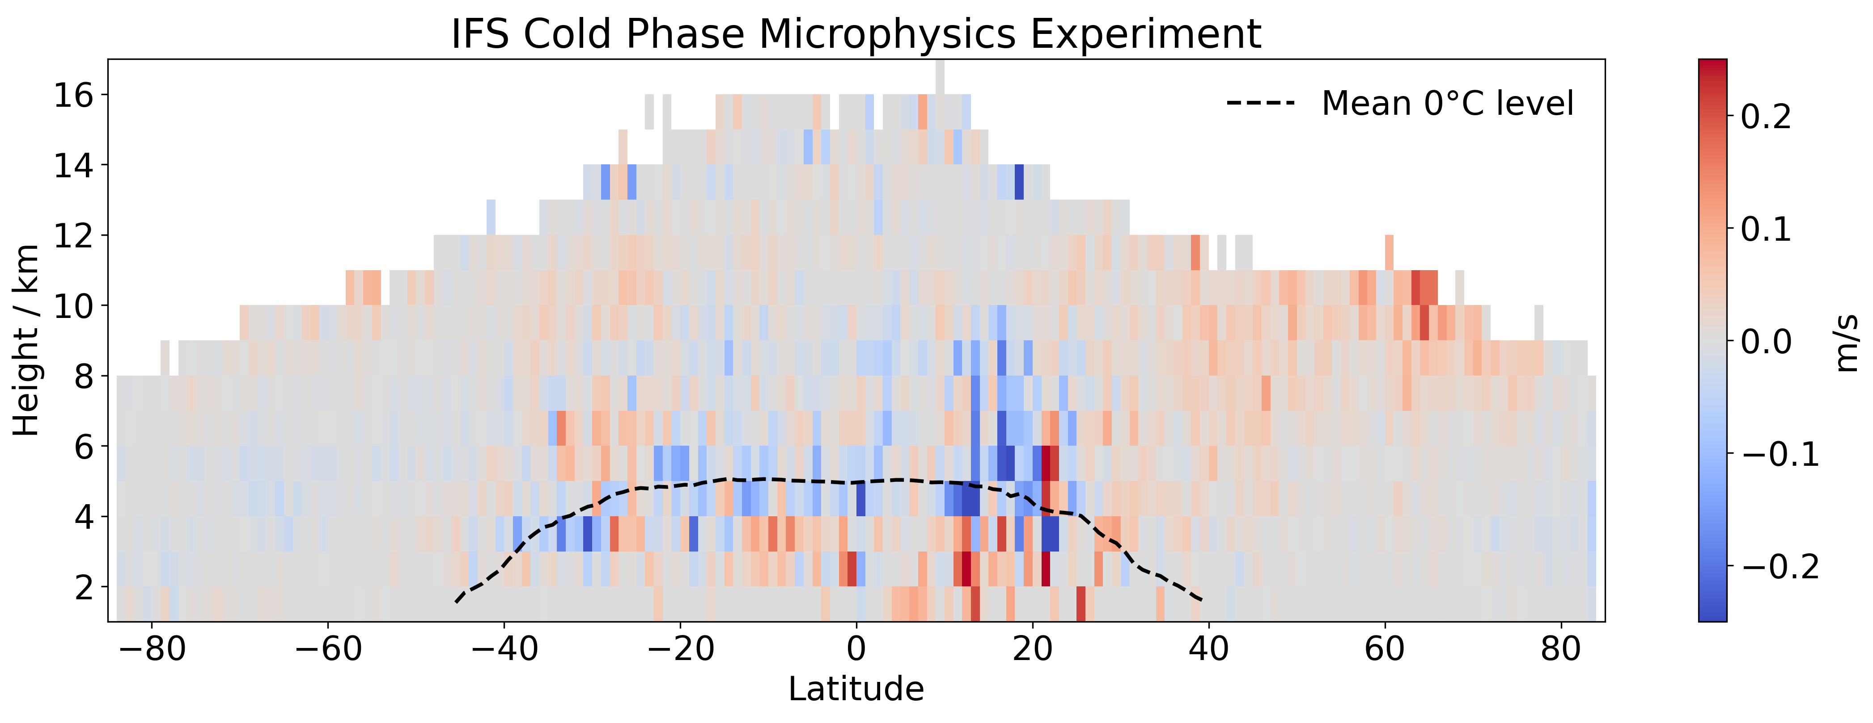
Improving ice/snow fall speed in the ECMWF model
Rebecca Murray-Watson, Mark Fielding, Richard Forbes
EarthCARE
CPR mean fall speed
ECMWF model is very simple! ice falls at 0.13 m/s, snow at 1 m/s
Modifications: use a mass-weighted fall speed; add rimed snow, temperature-dependent size & air-density effect
Ice & snow fall speeds affect model climate and forecast skill: this is first time we have been able to evaluate it globally!
ECMWF
Upper troposphere ice/snow falls 0.25+ m/s too fast
Riming snow near the melting layer should fall 0.25 m/s faster
Modified ECMWF
Biases reduced everywhere!

Slide 6
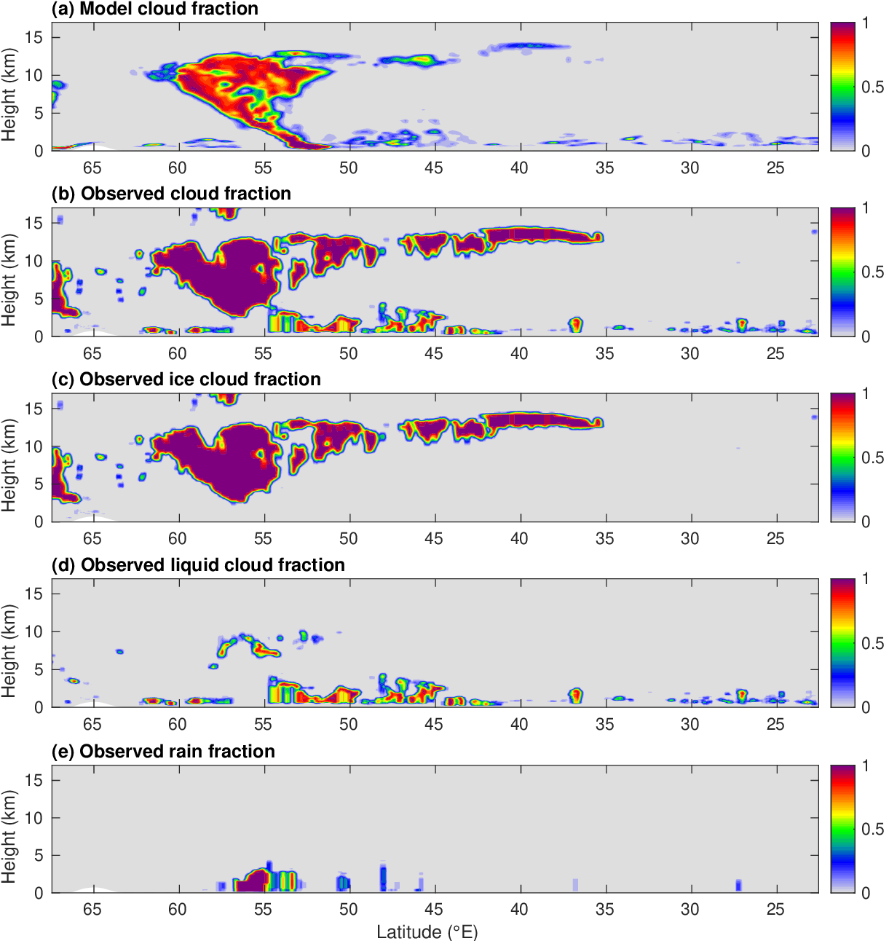
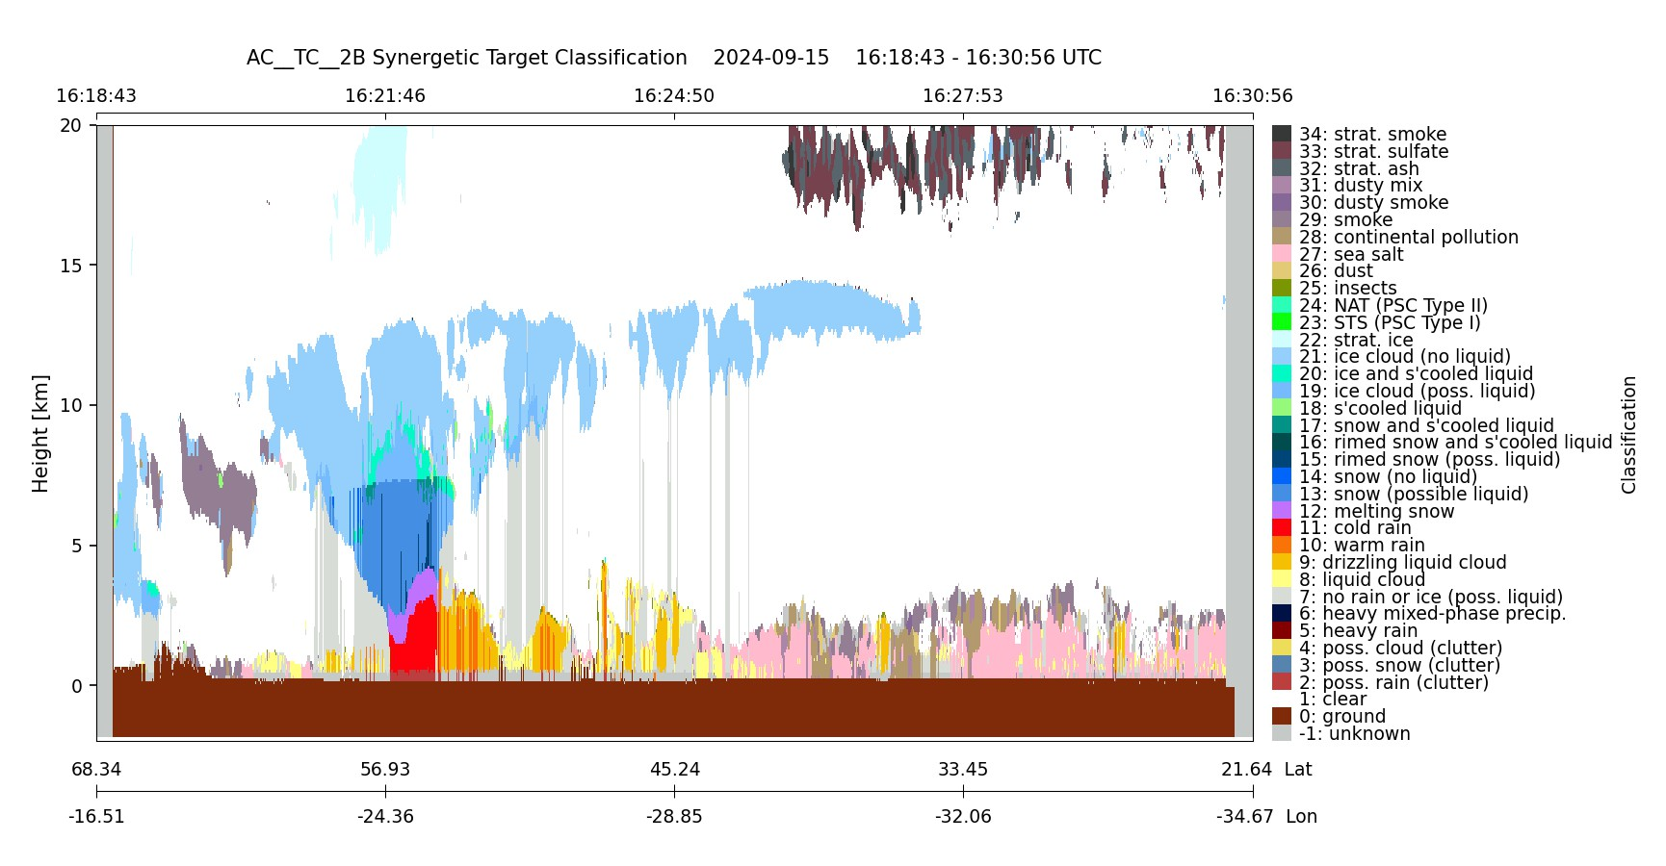
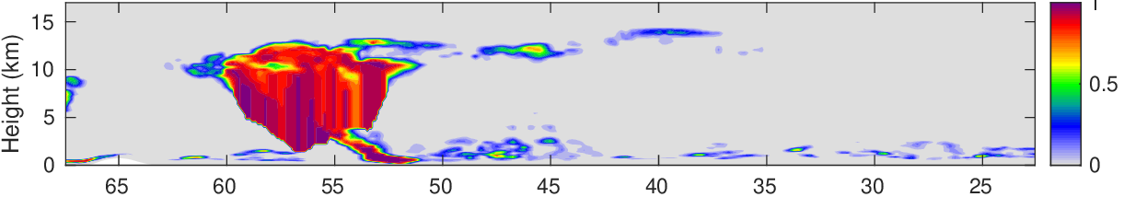
Evaluating ECMWF cloud fraction
AC-TC Radar-lidar target classification
Warm front case: 15 Sept 2024, frame 01707D
ECMWF research forecasts performed at 36-km horizontal resolution for the ORCESTRA period (Aug-Sept 2024)
Use AC-TC to calculate observed cloud fraction on ECMWF model grid
Forecast cloud fraction tends to be underestimated in this case
Model “snow” needs to be added
Radar-lidar cloud fraction on ECMWF grid (36 km)
Model cloud fraction (36-km grid)
Model cloud fraction with snow > 0.01 g/kg

Slide 7
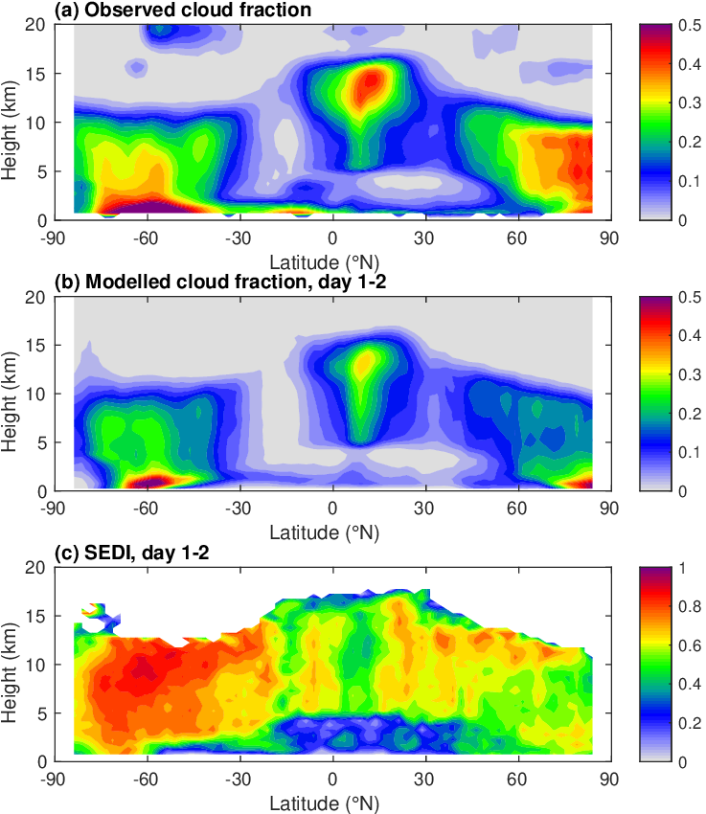
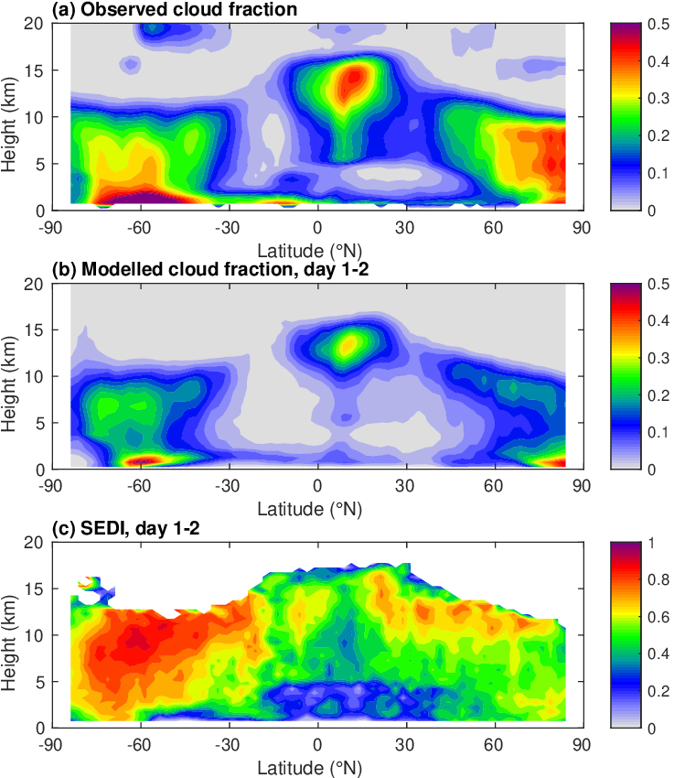
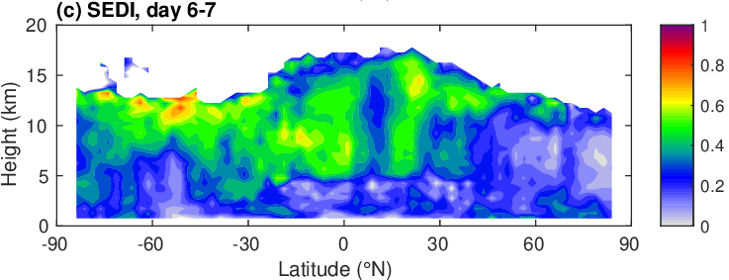
Evaluating cloud fraction August-September 2024 (ECOMIP period)
Observed cloud fraction has artifacts from radar mirror-image, will be fixed in next C-FMR reprocessing
Two-month evaluation reveals a low bias everywhere
Are clouds predicted at the right time/place? “SEDI” Skill Score (Ferro & Stephenson) calculated on occurrences of cloud fraction > 10%: 1=perfect, 0=no skill
Cloud fraction agreement somewhat improved when snow included
Significant degradation of forecast skill with lead time

Slide 8
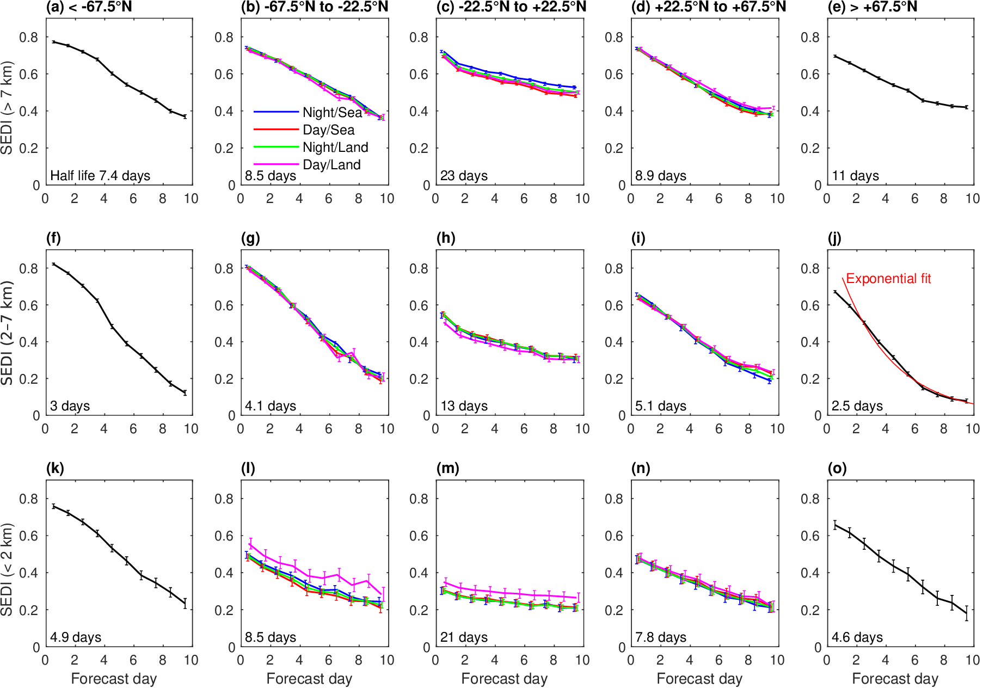
Skill versus lead-time
Very different behaviour in different cloud regimes
Day/land cloud more predictable?
Large-scale winter systems analysed best
Geographic location of tropical low cloud systems persists throughout forecast

Slide 9
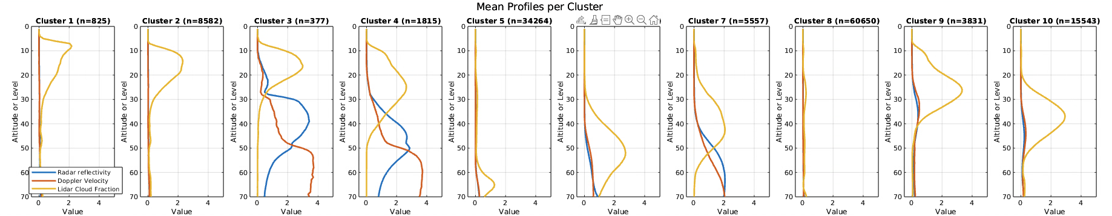
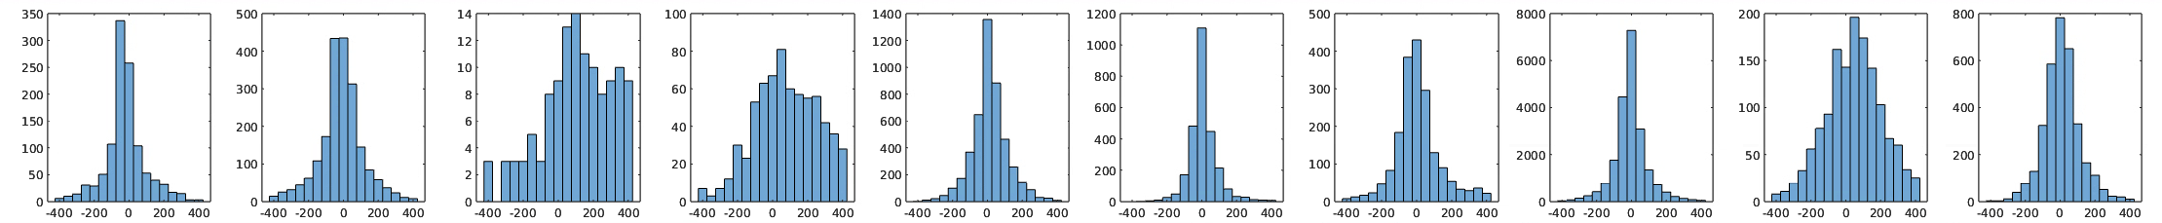
Regime-dependent net-radiation biases in the ECMWF model
Mark Fielding
K-means clustering on profiles of radar reflectivity, Doppler velocity and lidar cloud fraction
Calculate distribution of radiative errors when model regime matches observed regime
Very high cirrus
Tropical cirrus
Very deep convection
Deep convection
BL cloud
Mid-latitude frontal snow
Mid-latitude frontal rain
Thin cirrus
Precipitating cirrus
Mid-level precip.
-28
+12
+70
+50
+18
-19
0.0
-19
+58
+4.1
Shortwave
-11
-8
-29
-9
-0.2
+3.4
+0.3
+2.1
-15
-1.3
Longwave

Slide 10
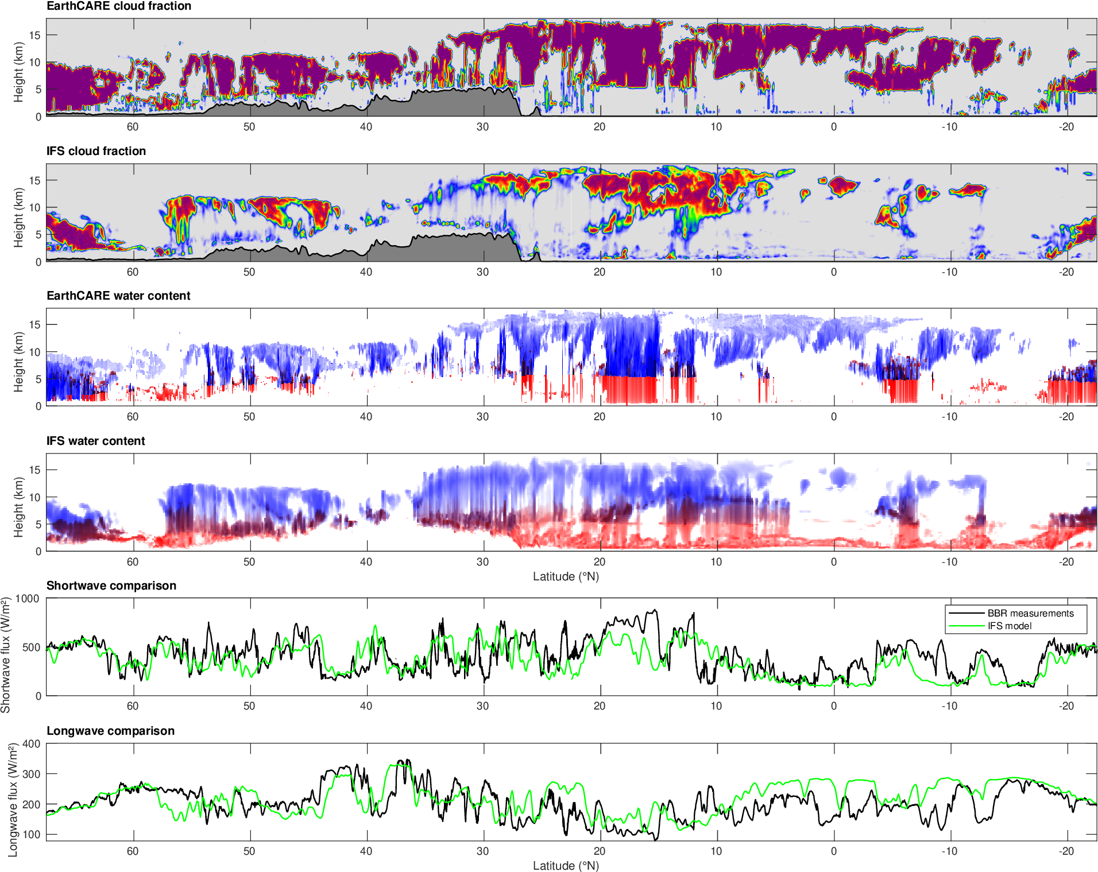
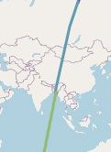
16 June 2025
Compare cloud fraction (from AC-TC), water content (from ACM-CAP) and fluxes (from BMA-FLX) with ECMWF model
Tropical convection not reflective enough
Thin cirrus not emissive enough

Slide 11
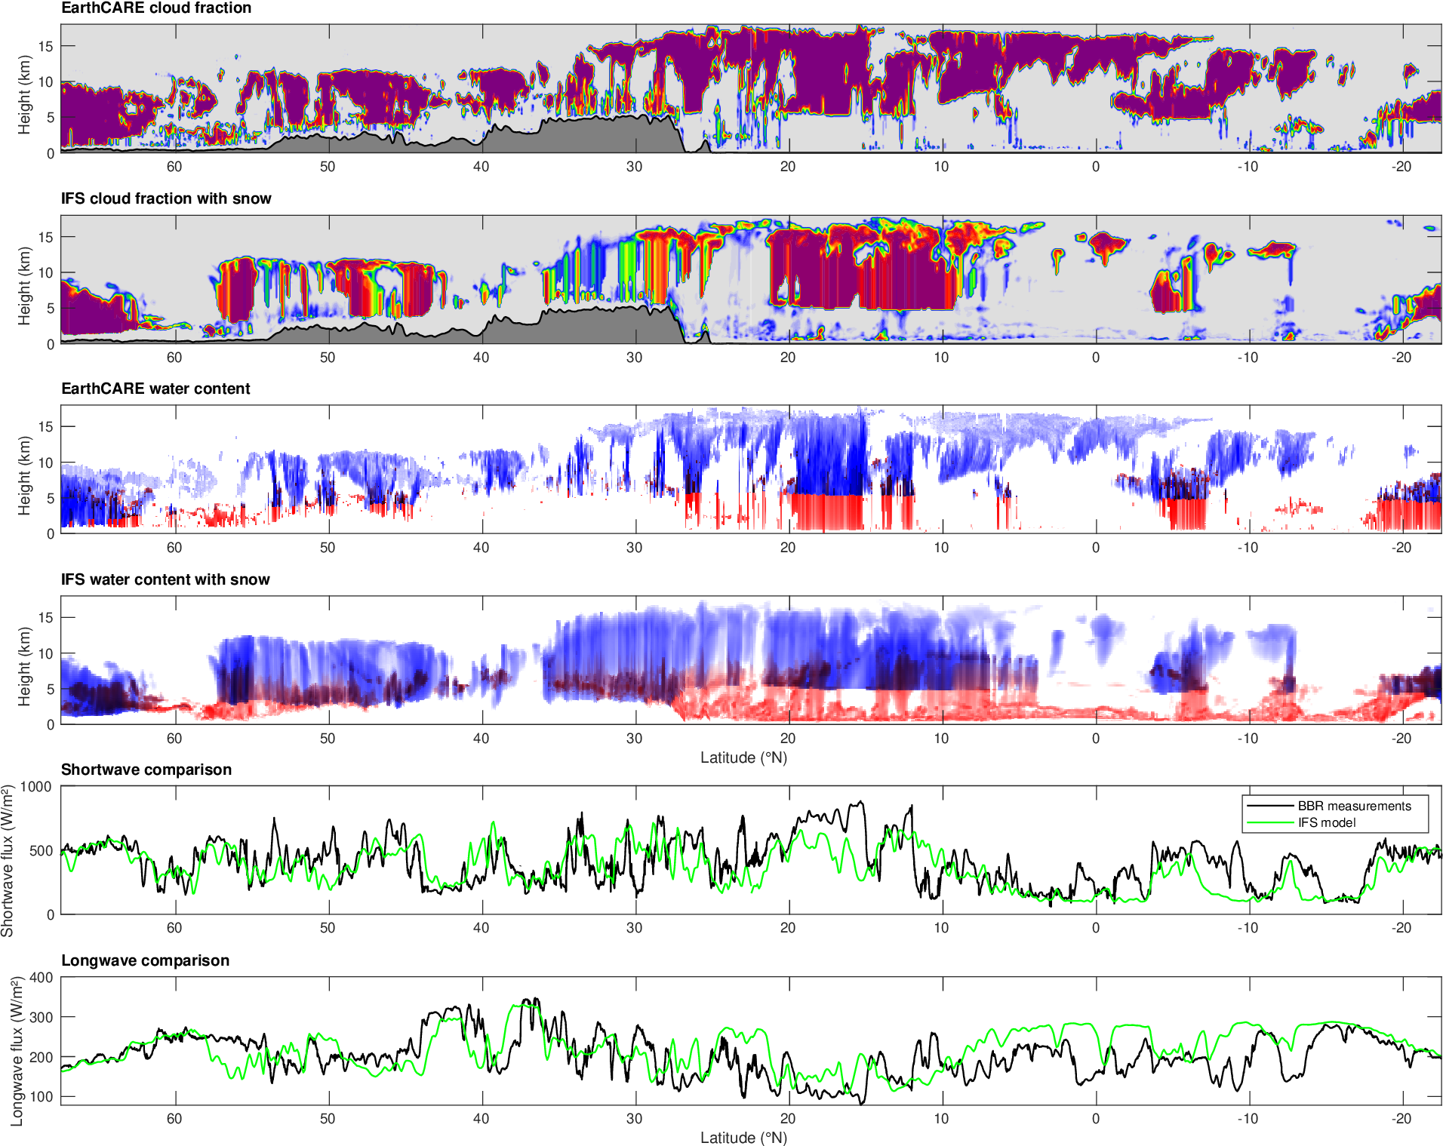
16 June 2025
Compare cloud fraction (from AC-TC), water content (from ACM-CAP) and fluxes (from BMA-FLX) with ECMWF model
Tropical convection not reflective enough
Thin cirrus not emissive enough
Snow water content is large, but radiative impact could be underestimated if cloud fraction too low

Slide 12
Outlook
We aim to use EarthCARE lidar routinely for evaluating CAMS aerosol extinction forecasts, but need robust discrimination of aerosols from clouds; crucial information for improving aerosol processes in future
We eagerly await the ESA reprocessing for long-term cloud verification, particularly for the ECOMIP period (Aug-Sept 2024), which will remove artifacts from the existing data
Huge potential for improving cloud and radiation processes simultaneously in models, e.g. proper treatment of snow in radiation scheme
Masaki Satoh will explain ECOMIP further (EarthCARE-ORCESTRA Model Intercomparison Project)

Slide 14
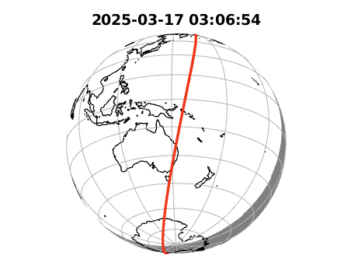
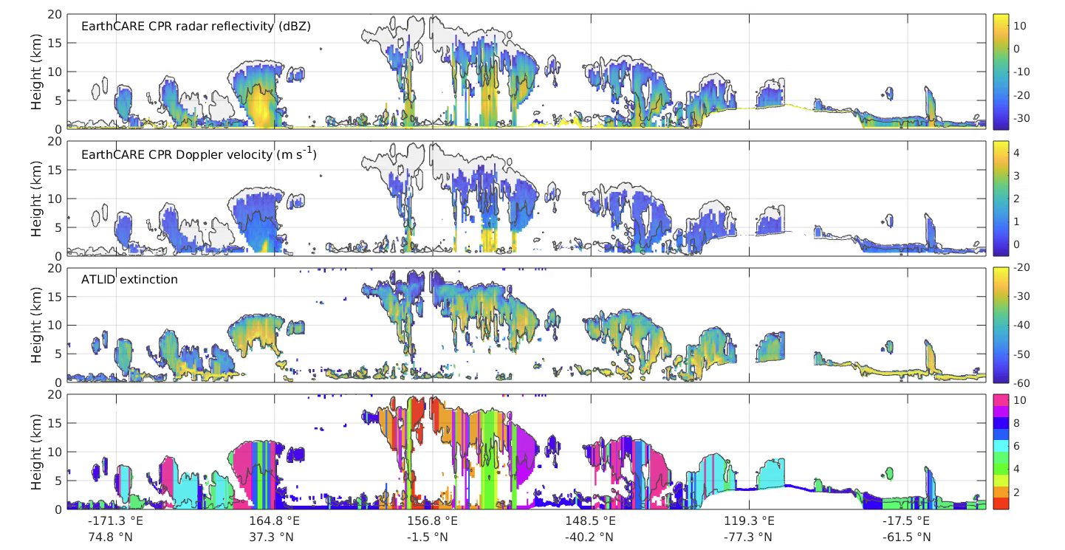
Mid-level precip
Precipitating cirrus
Thin cirrus
Mid-lat frontal rain
Mid-lat frontal snow
BL cloud
deep conv
Super deep conv
Tropic cirrus
V.high cirrus

Slide 15
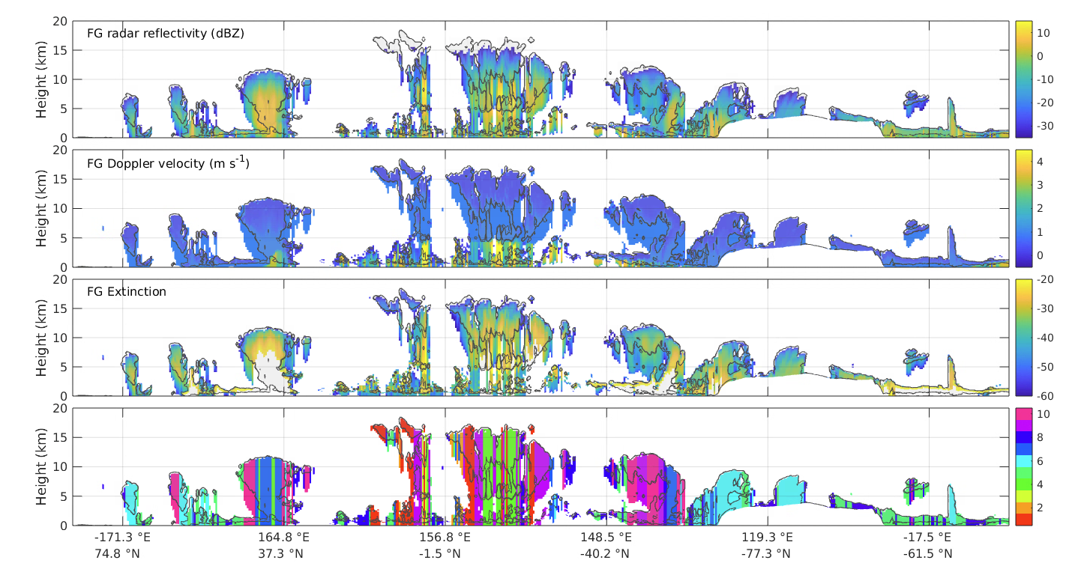
Mid-level precip
Precipitating cirrus
Thin cirrus
Mid-lat frontal rain
Mid-lat frontal snow
BL cloud
deep conv
Super deep conv
Tropic cirrus
V.high cirrus

Slide 16
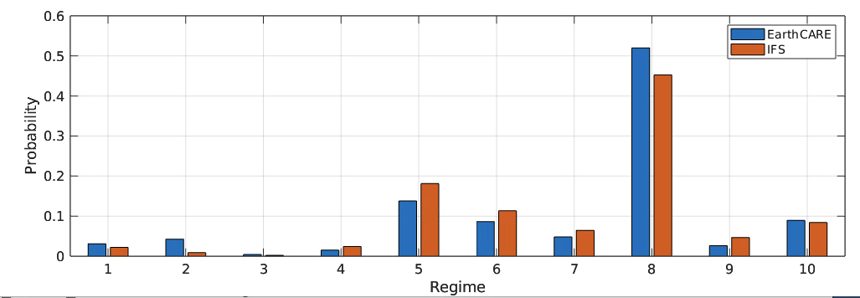
Not enough tropical tropopause cirrus
Too much deep convection
Too much BL cloud
Too much precipitating cirrus
V.high cirrus
Tropic cirrus
Super deep conv
Mid-lat frontal snow
Mid-lat frontal rain
Thin cirrus
Precipitating cirrus
Mid-level precip
deep conv
BL cloud

Slide 17
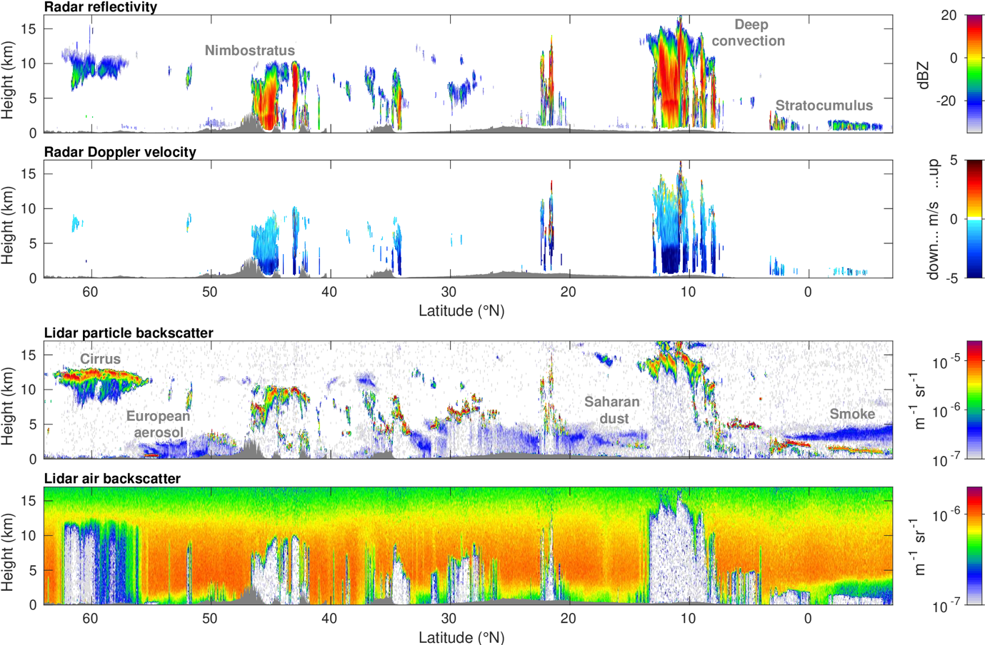

Slide 18
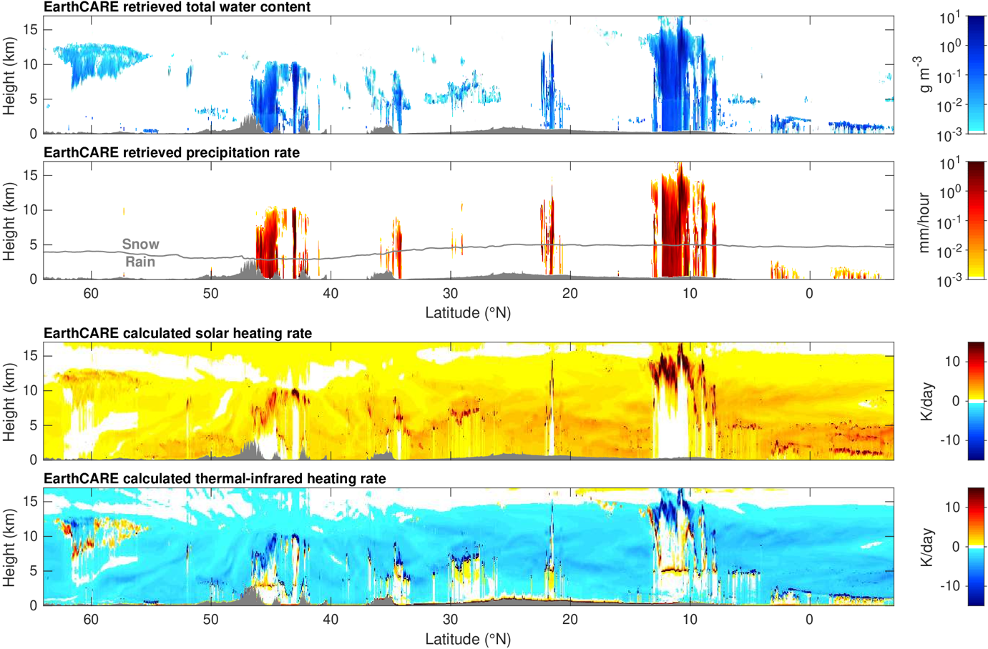
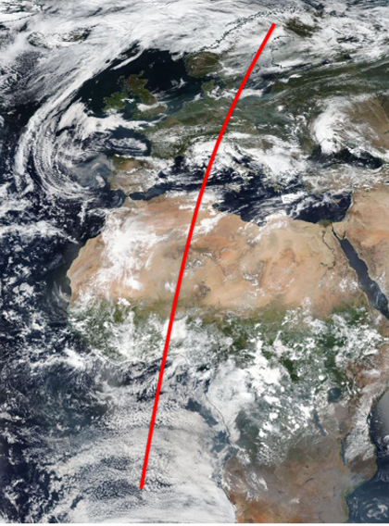
Retrieved cloud & precipitation
Deep convection
Cirrus
Nimbostratus
Mixed-phase clouds
Stratocumulus
Synergy retrievals (ACM-CAP) on 18 Sept 2024
…fed into radiative transfer calculations (ACM-RT)
Robin Hogan, Shannon Mason, Bernat Puigdomenech-Treserras, Jason Cole, Zhipeng Qu, Howard Barker

Slide 19
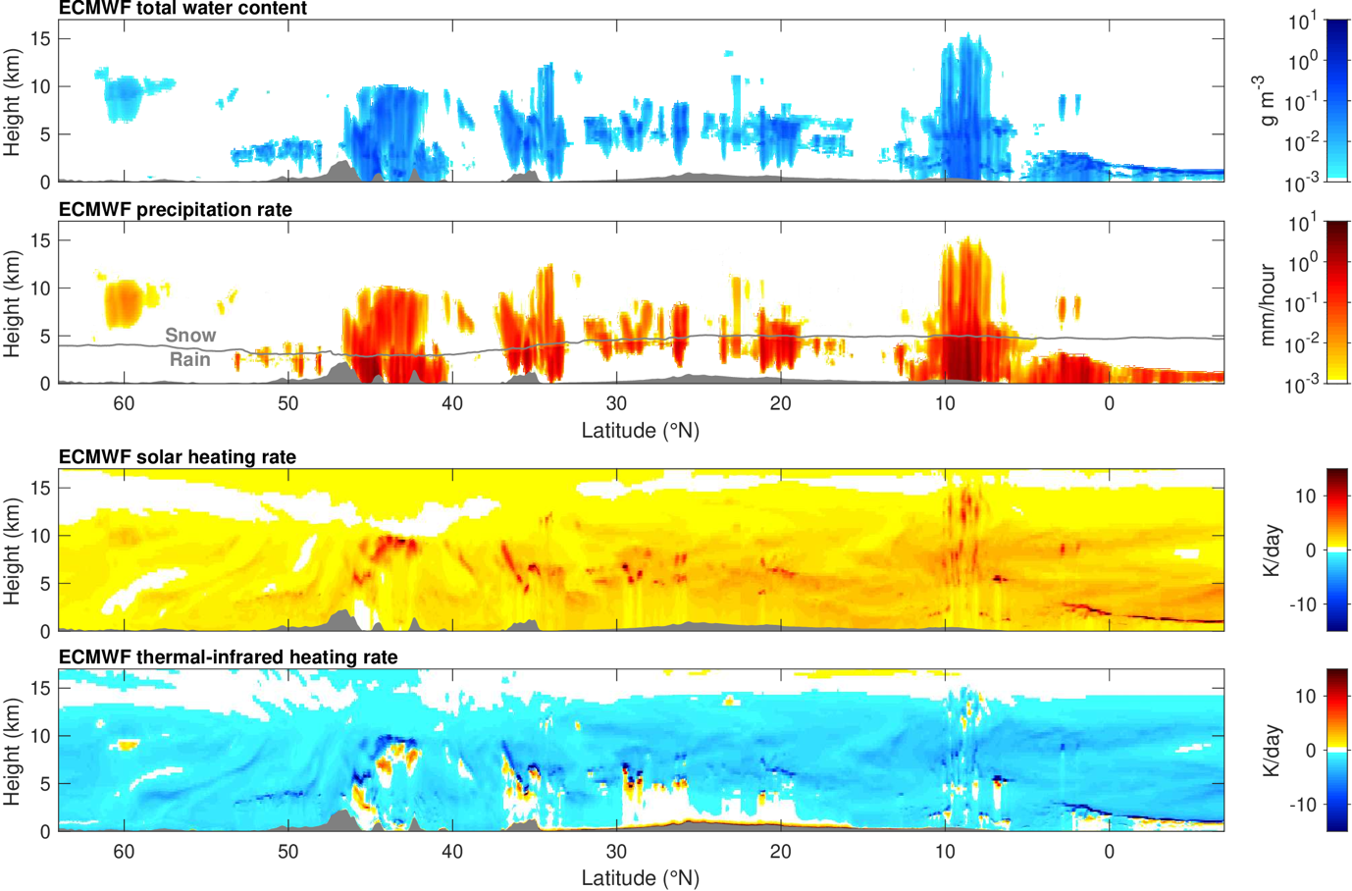
Equivalent ECMWF forecast
Deep convection
Cirrus
Nimbostratus
Mixed-phase clouds
Stratocumulus
Cloud too “diffuse”
Deep convection misplaced
Robin Hogan, Shannon Mason, Bernat Puigdomenech-Treserras, Jason Cole, Zhipeng Qu, Howard Barker

Slide 20
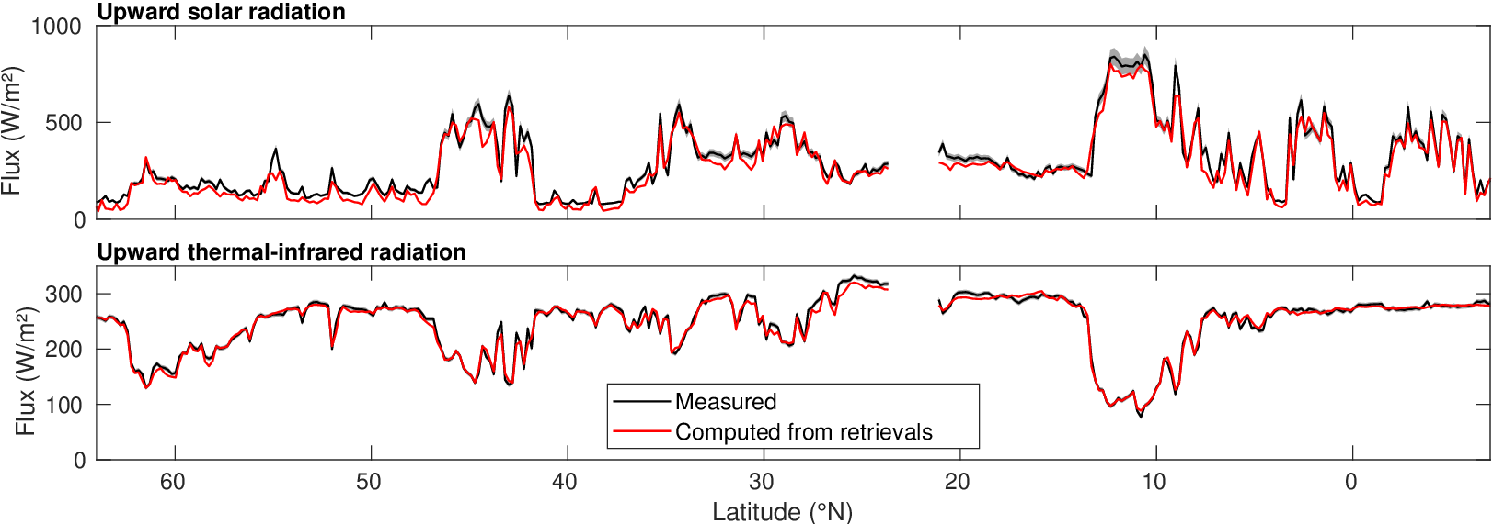
Towards radiative closure
Jason Cole, Almudena Velazquez, Zhipeng Qu, Howard Barker
Radiation calculations on retrievals agree quite well with EarthCARE’s broadband radiometer
RMS difference < 8 W/m² in longwave, ~40 W/m² in shortwave, giving confidence in retrievals

Slide 21
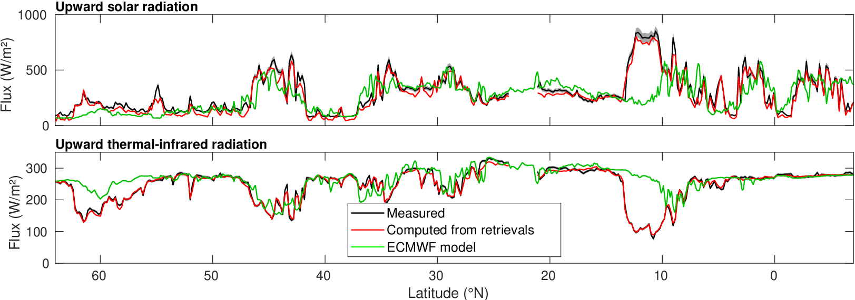
Towards radiative closure… and evaluation of ECMWF radiation
Radiation calculations on retrievals agree quite well with EarthCARE’s broadband radiometer
RMS difference < 8 W/m² in longwave, ~40 W/m² in shortwave, giving confidence in retrievals
ECMWF model fluxes show errors associated with cirrus and deep convection

