Slide 1
EarthCARE:
Unravelling the mysteries of clouds and aerosols
Robin J. Hogan and many others
ECMWF and University of Reading

Slide 2
Moving towards scientific exploitation of EarthCARE
How can we use EarthCARE to answer key questions in climate science?
Just how cool is EarthCARE?!

Slide 3
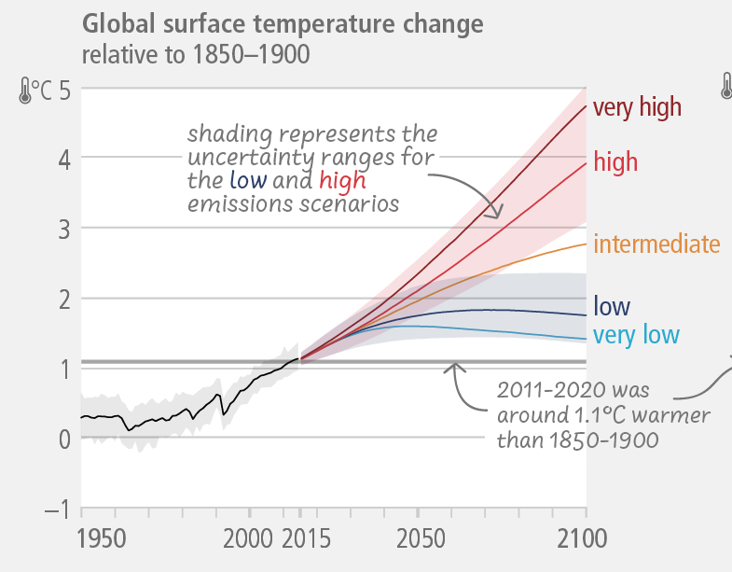
How much will the climate change this century?
Emission scenario:
a
+5ºC if clouds amplify the warming, a positive cloud feedback
+3ºC if clouds stay about the same
NOW!
How did CloudSat & CALIPSO improve our understanding, and how can EarthCARE make the next breakthrough?
IPCC report 2023

Slide 4
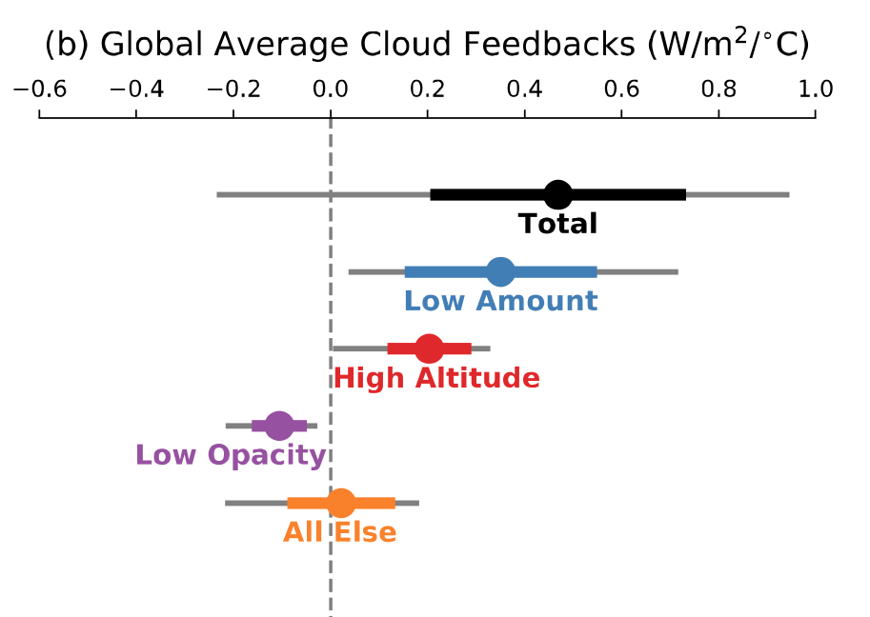
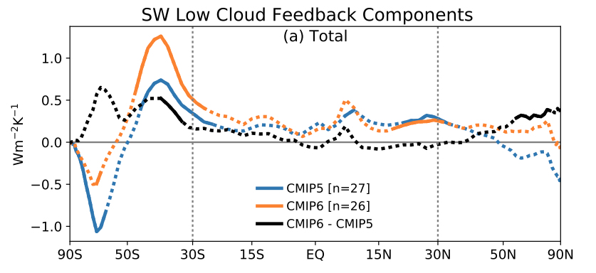
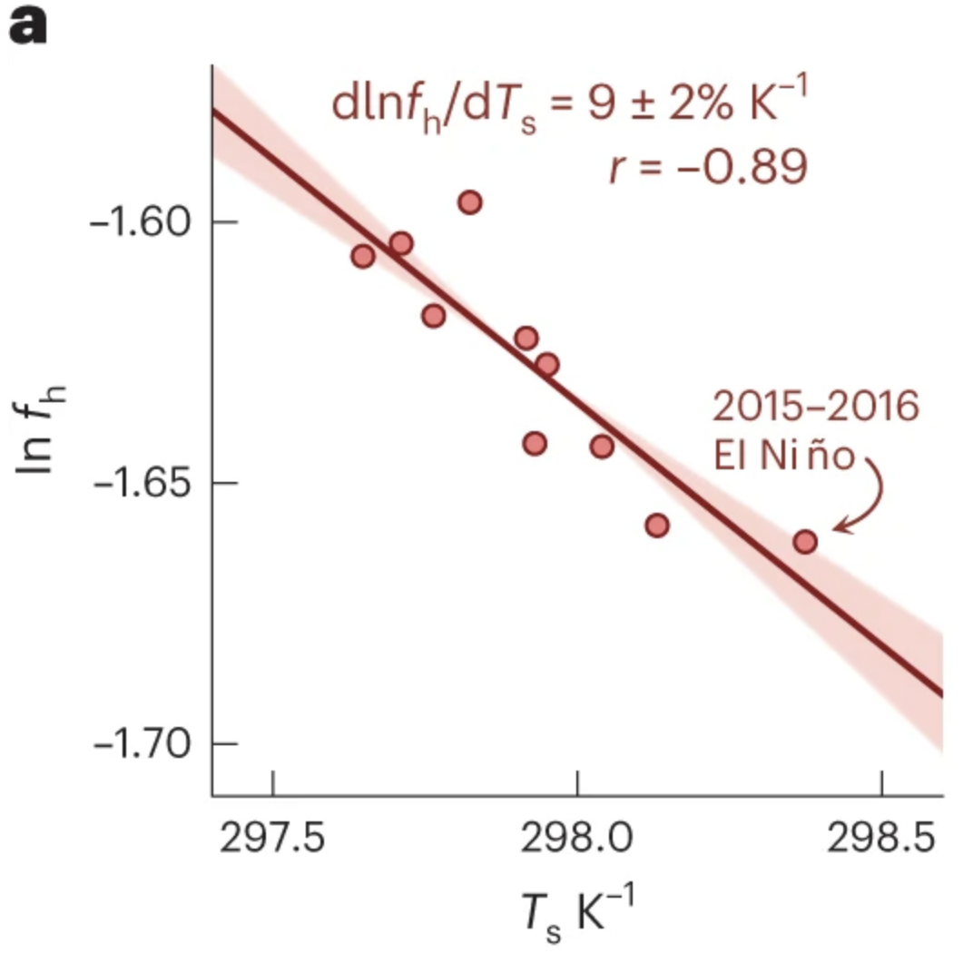
What did the A-Train tell us about cloud feedbacks?
Most models suggest low cloud cover will decrease, amplifying climate change, but amplitude is very uncertain; CloudSat provided valuable information on precipitation from low clouds
Zelinka et al. (Nature 2017)
Large uncertainty remains!
High cloud tops rise and cool, now detectable in long time series from MODIS and CloudSat (Richardson et al)
CALIPSO cloud phase observations improved models, reducing negative feedback & uncertainty (Zelinka et al. 2020)
e.g. CALIPSO anvil cloud area weakly dependent on temperature (McKim et al. 2024)

Slide 5
How CALIPSO improved our understanding of a key cloud feedback (and improved the ECMWF weather model)
Too dim!
New mixed-phase cloud treatment informed by CALIPSO cloud top phase (Forbes & Ahlgrimm 2014, Forbes et al. 2016)
One of many model improvements inspired by CloudSat & CALIPSO
Older climate models: warming up marine clouds converts ice to liquid, which is more reflective so a negative feedback, but CALIPSO showed that they already contain plenty of supercooled liquid, so effect overestimated
Improving the representation of processes in weather & climate models is one key way to reduce uncertainty in cloud feedbacks!

Slide 6
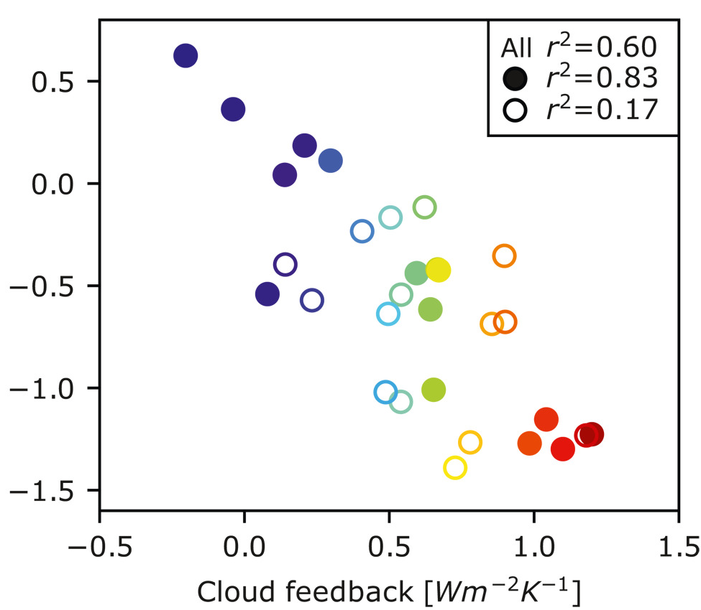
What about aerosol-cloud interactions?
There is a huge compensation between the strength of the cloud feedback and the strength of aerosol-cloud interactions in CMIP6 climate models
This allows models to fit the 20th-century temperature record for very different reasons, so their future projections diverge
It is crucial that we also try to use EarthCARE to pin down aerosol-cloud interactions!
Wang et al. (GRL 2021)
Strength of aerosol-cloud interactions (W m⁻²)
Clouds stay about the same
Clouds amplify the warming

Slide 7
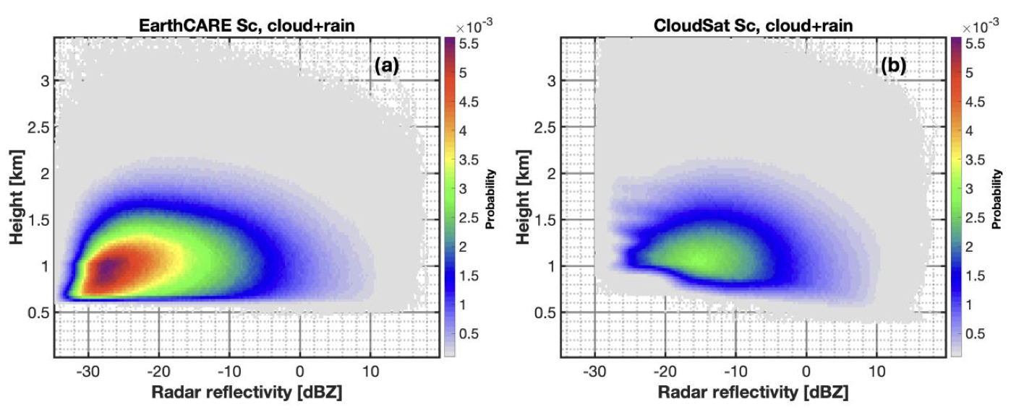
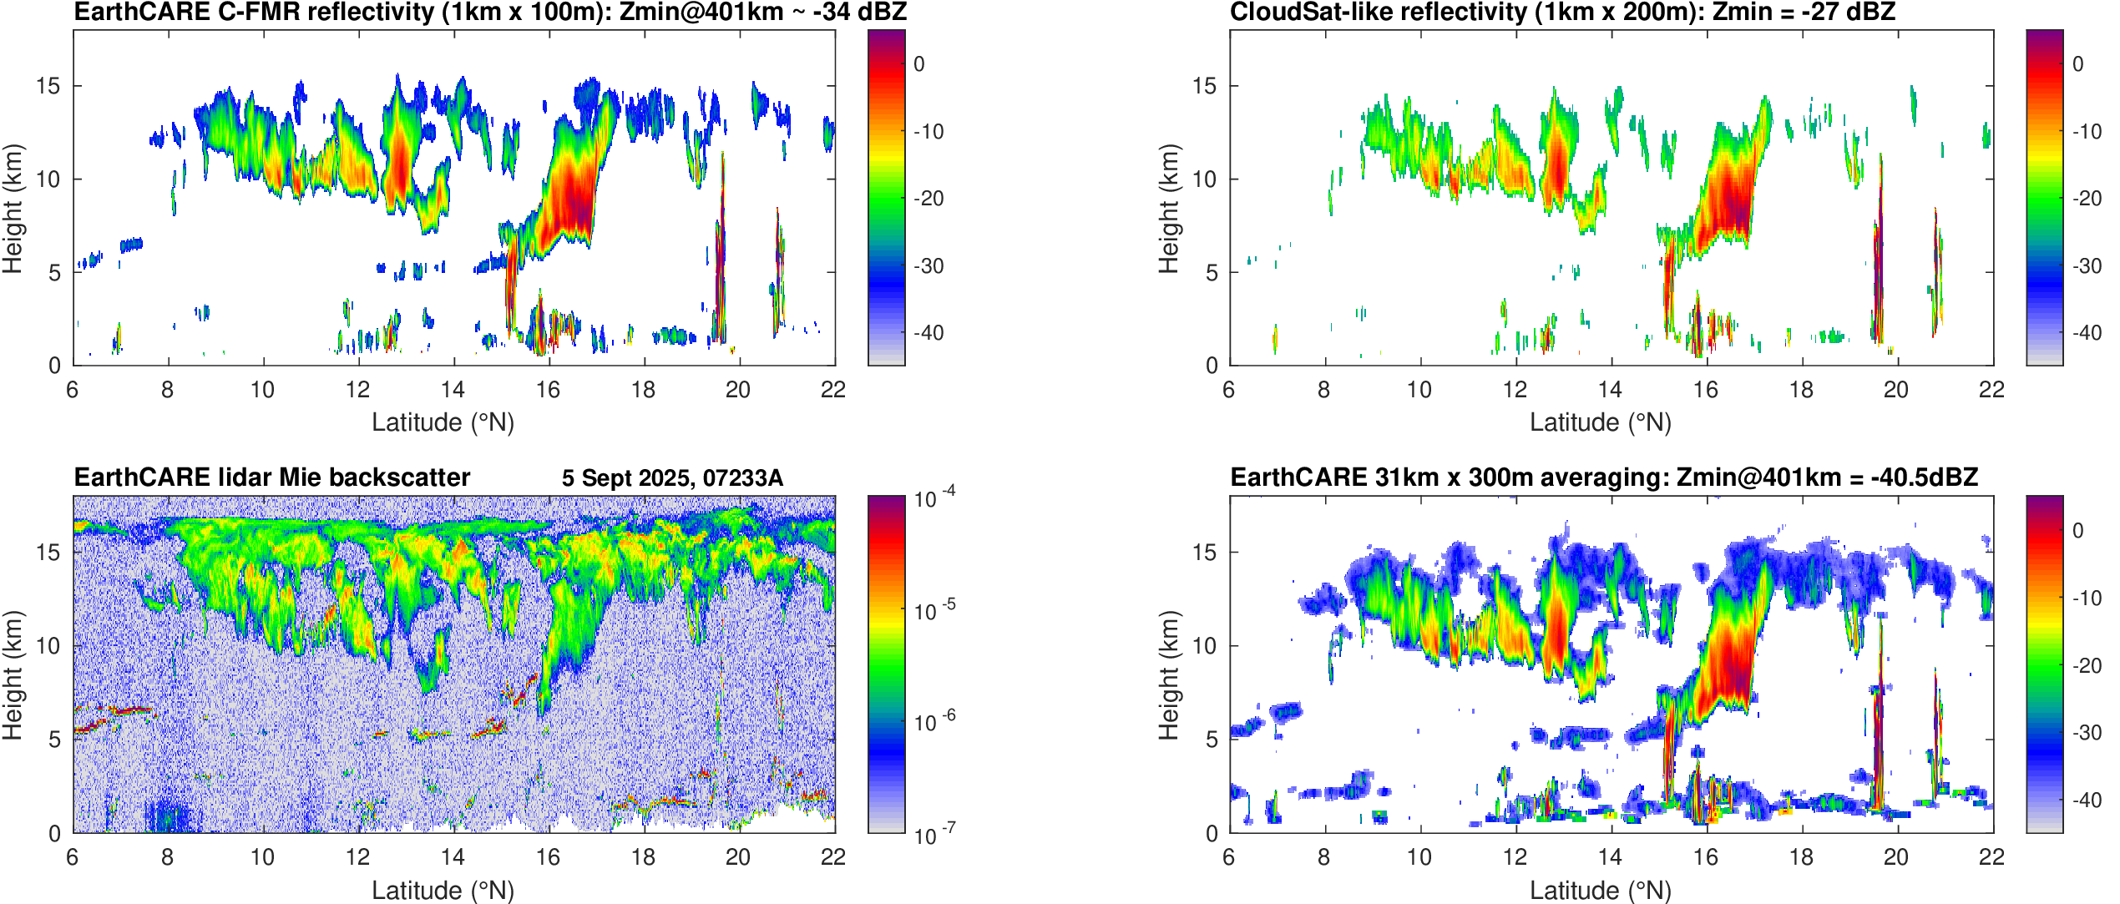
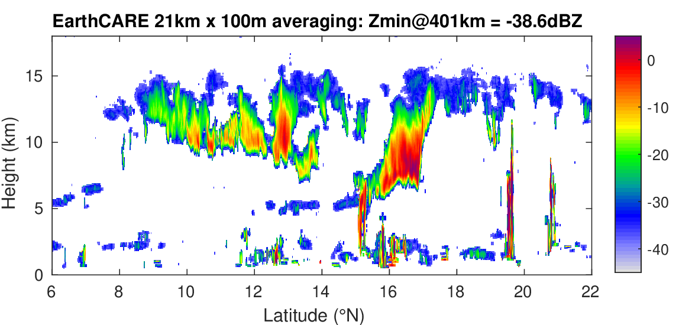
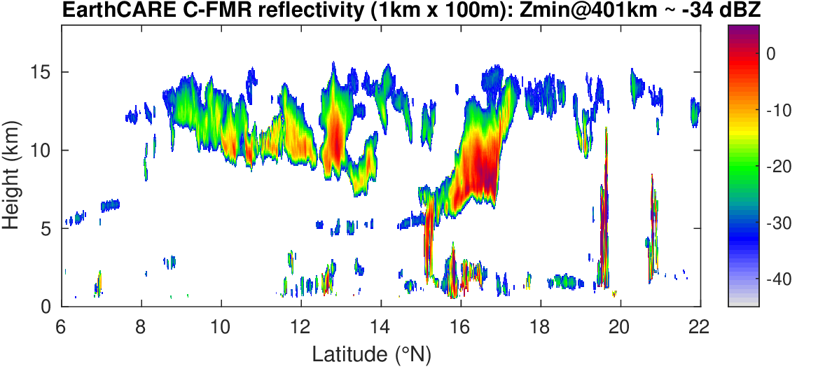
EarthCARE’s CPR is incredibly sensitive!
Can gain further sensitivity by averaging raw signal…
Zhuocan Xu et al. (2025): asymmetric pulse and 7-8 dB extra sensitivity means EarthCARE detects twice as much stratocumulus as CloudSat!
We can now compute effective radius in thin cirrus by radar-lidar synergy
Extra sensitivity could also be important for insect detection: see Shannon Mason’s talk

Slide 8
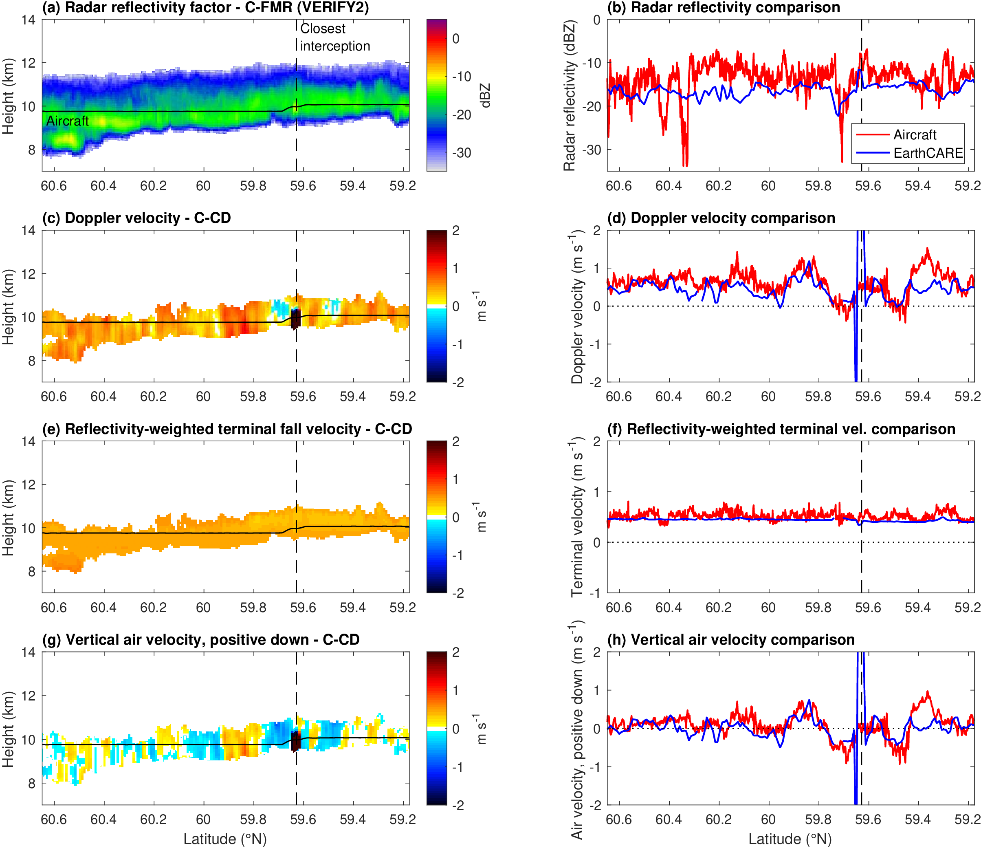
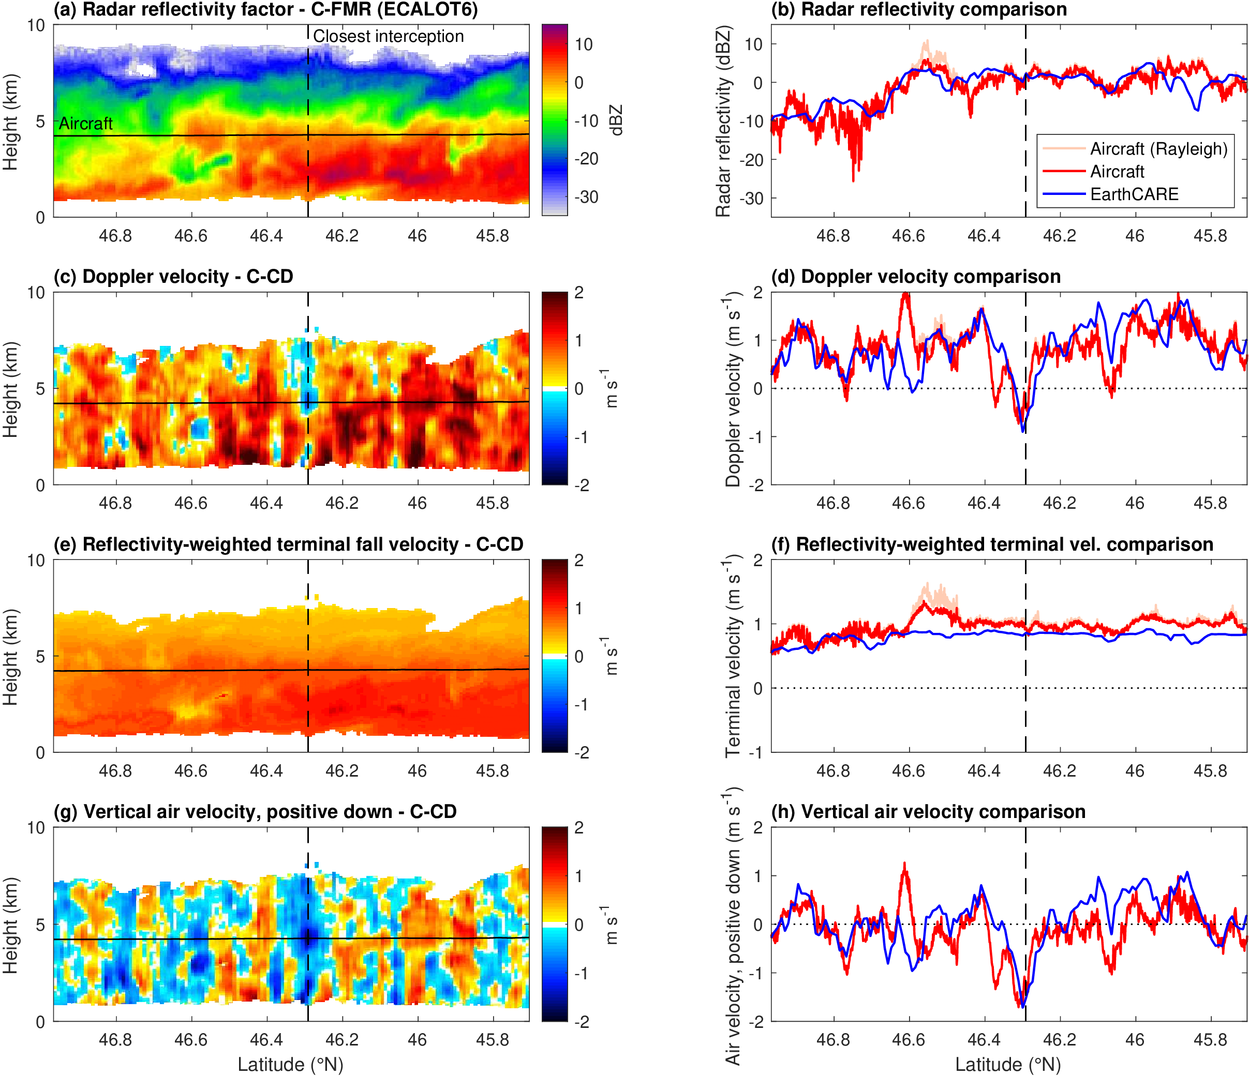
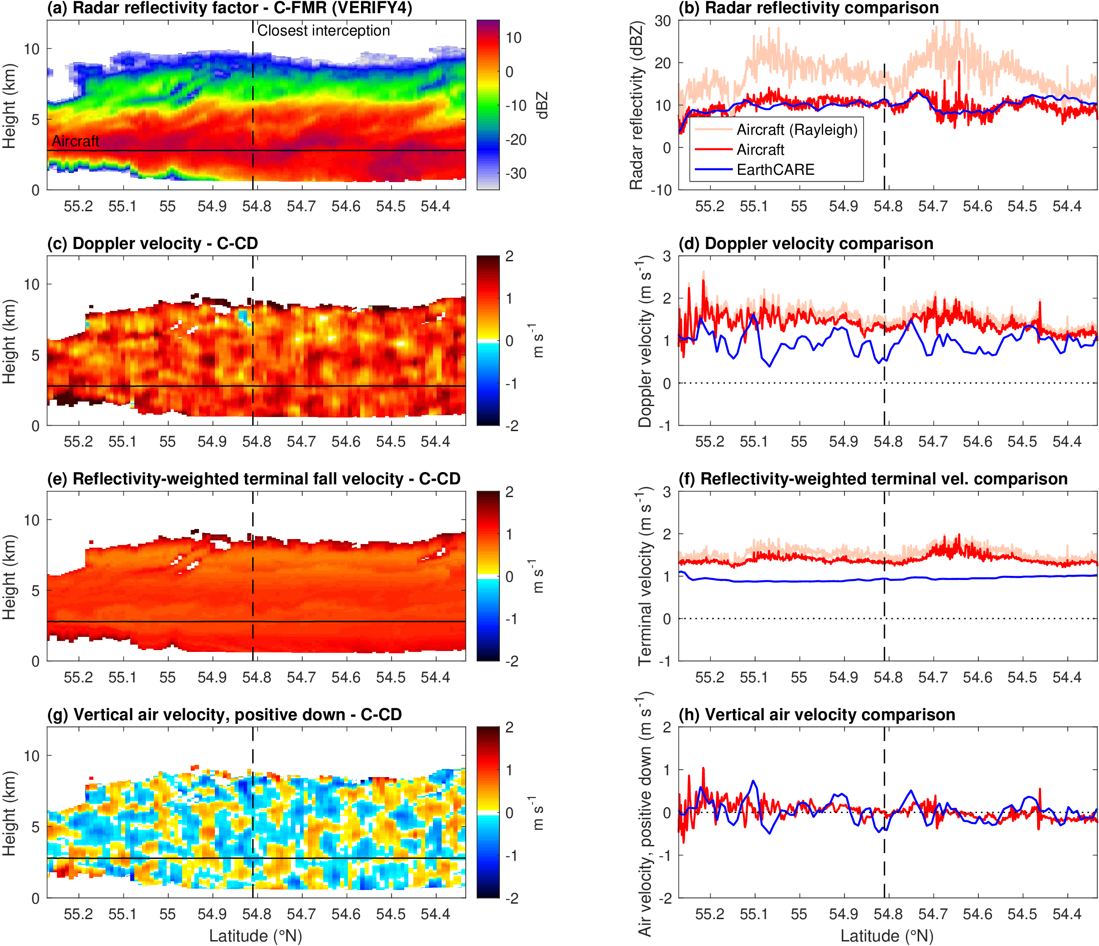
How do we separate terminal velocity & vertical wind?
VERIFY2: 7 Nov 2024 ECALOT6: 27 Jan 2025 VERIFY4: 18 Nov 2024
Radar reflectivity
Doppler velocity
Latest C-CD assumption: all the small-scale variability is air motion
With Bernat P-T, Shannon Mason, Zhipeng Qu, Kamil Mroz et al.

Slide 9
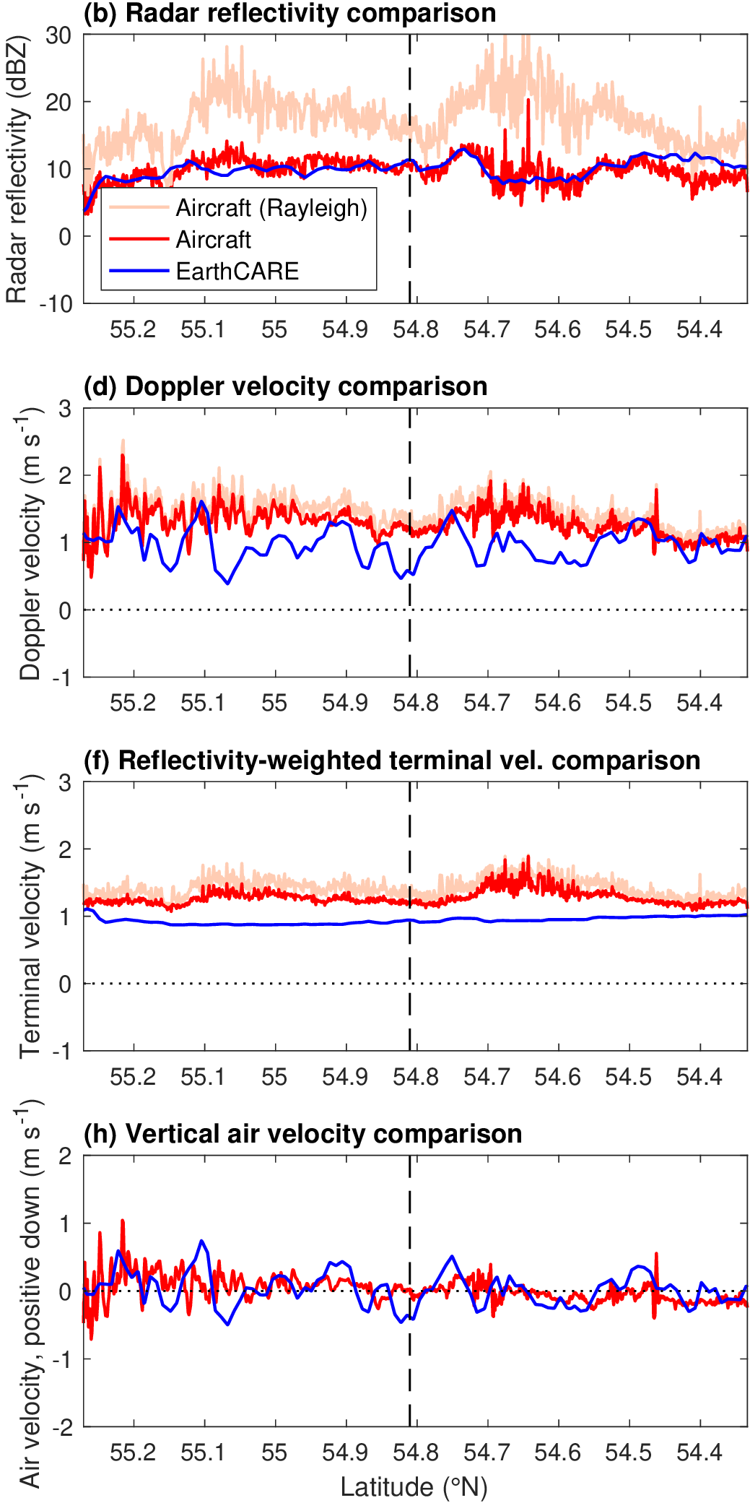

How do we separate terminal velocity & vertical wind?
VERIFY2: 7 Nov 2024 ECALOT6: 27 Jan 2025 VERIFY4: 18 Nov 2024
Radar reflectivity
Doppler velocity
Excellent agreement in phase and amplitude of gravity waves!
See my poster tomorrow (Lobby10)
Aircraft
EarthCARE (C-CD)
Doppler variations without vertical coherence are mostly noise

Slide 10
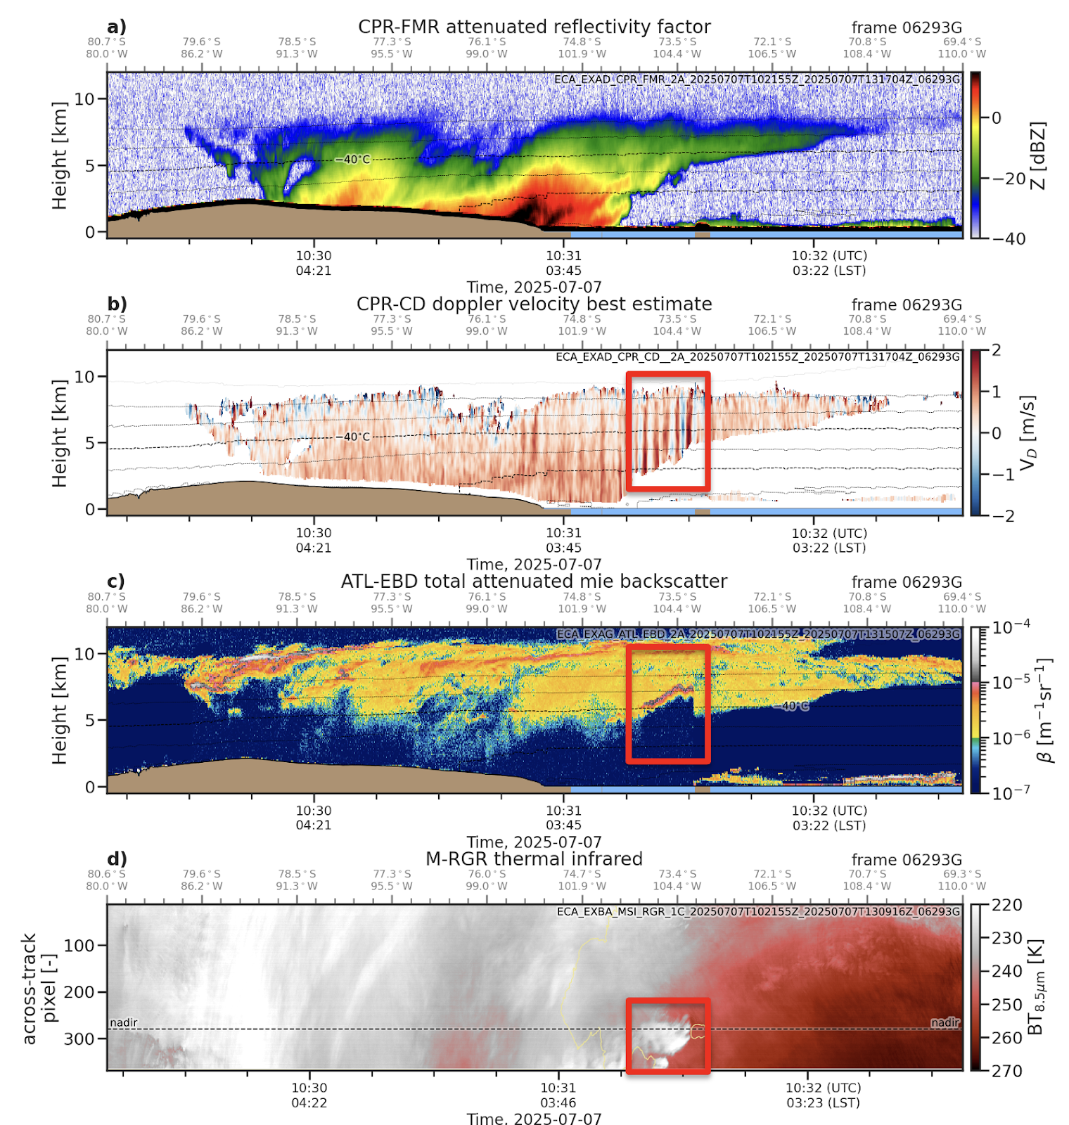
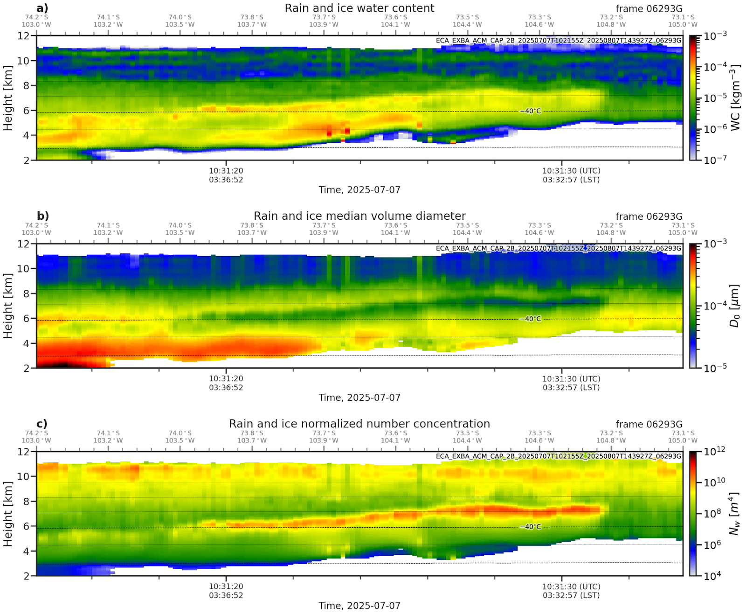
Influence of gravity waves on cloud physics
Shannon Mason (ECMWF)
Gravity waves coincide with strong lidar backscatter at -45°C (so due to ice) and sharp drop in thermal emission
ACM-CAP: mean particle diameter drops from ~200 to ~40 μm while number concentration increases by over two orders of magnitude!
How common is this globally? What’s its radiative impact? Is this process represented in models?
Ice water content
Diameter
Number concentration

Slide 11
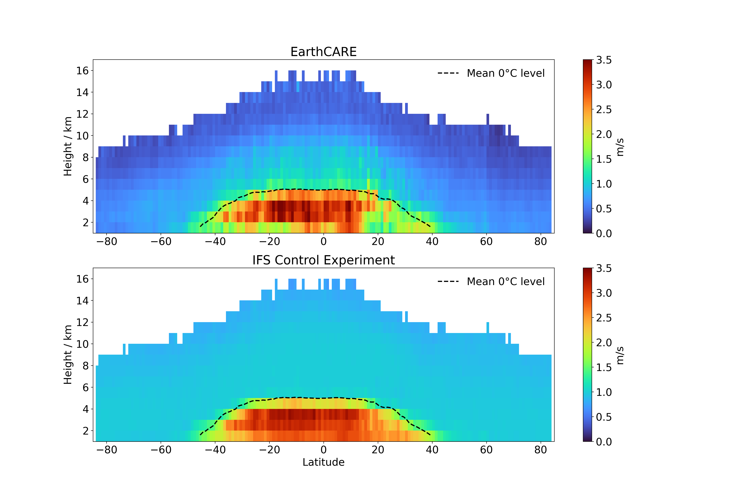
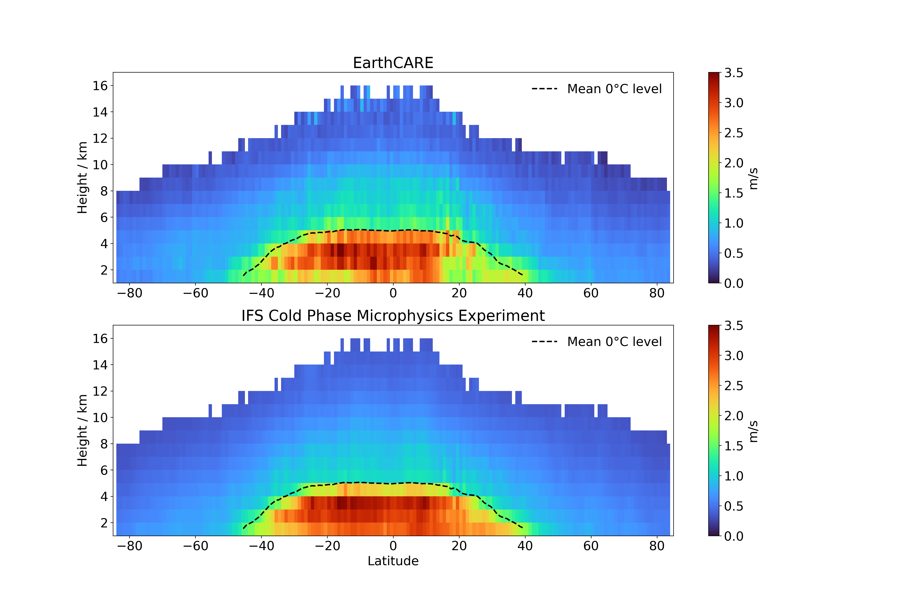
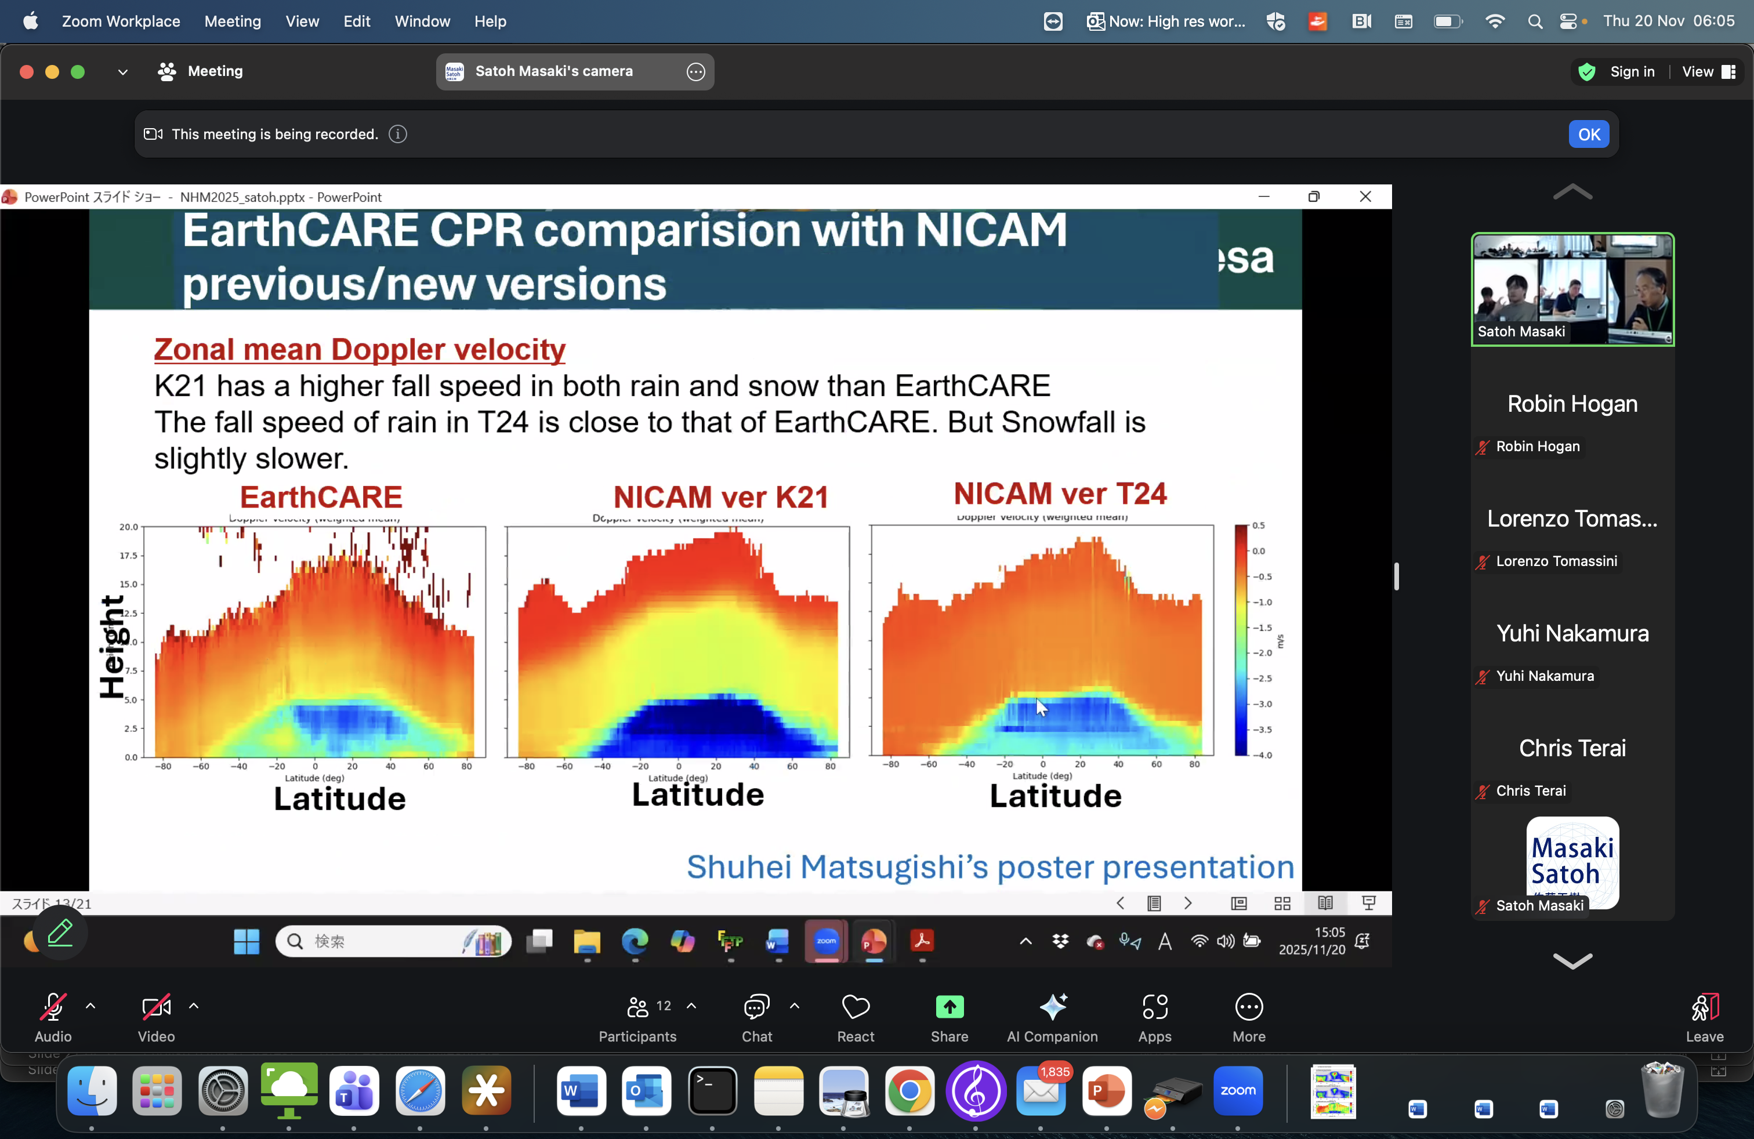
Doppler improves model fall speed
Rebecca Murray-Watson (ECMWF)
Shuhei Matsugishi (U. Tokyo)
EarthCARE
IFS control
IFS improved microphysics
Height
Ice fall speeds too constant
Ice fall speeds too variable
(Note that this is just a new model version: it was not tuned to EarthCARE!)
Rain falls too fast

Slide 12
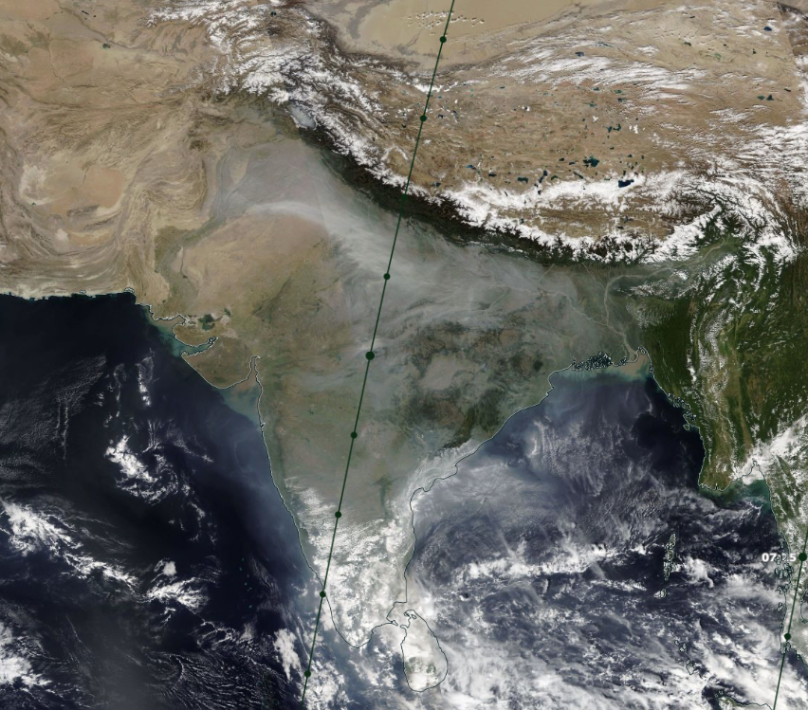
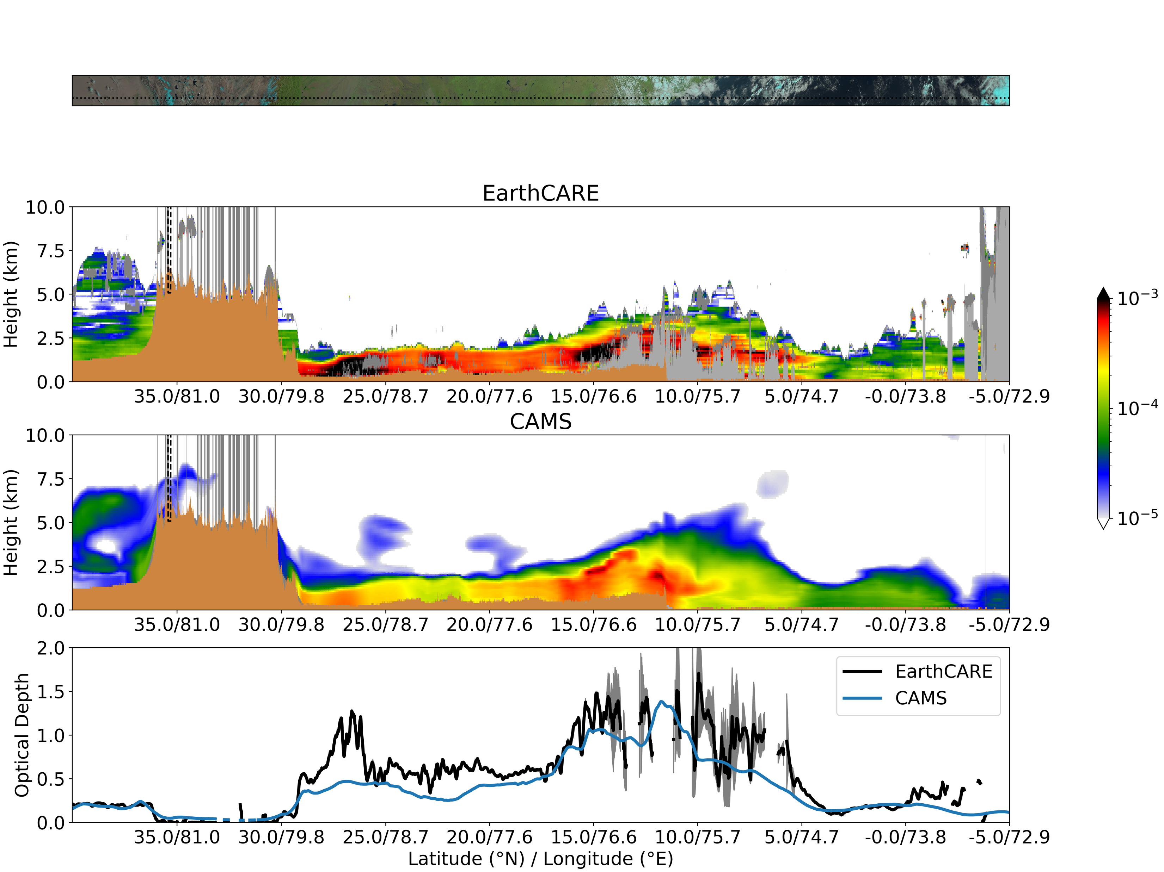
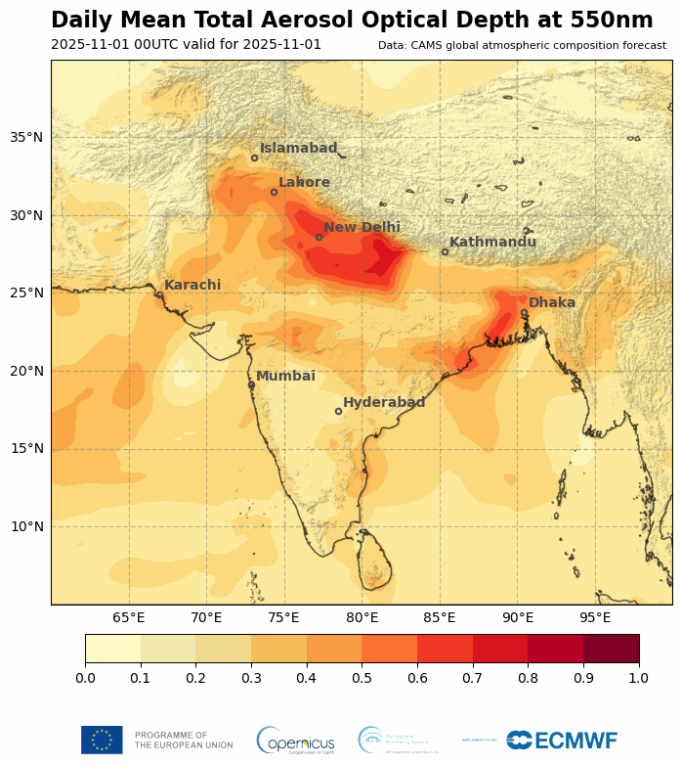
ATLID is a gamechanger for testing aerosols in models!
Peter Hill (ECMWF)
NOAA-21, 12 November 2025
Evaluation of CAMS aerosol 355-nm extinction profiles using EarthCARE
ECMWF’s CAMS AOD forecasts
CAMS AOD a factor of two too low over New Delhi
More detail in talk on Wednesday

Slide 13
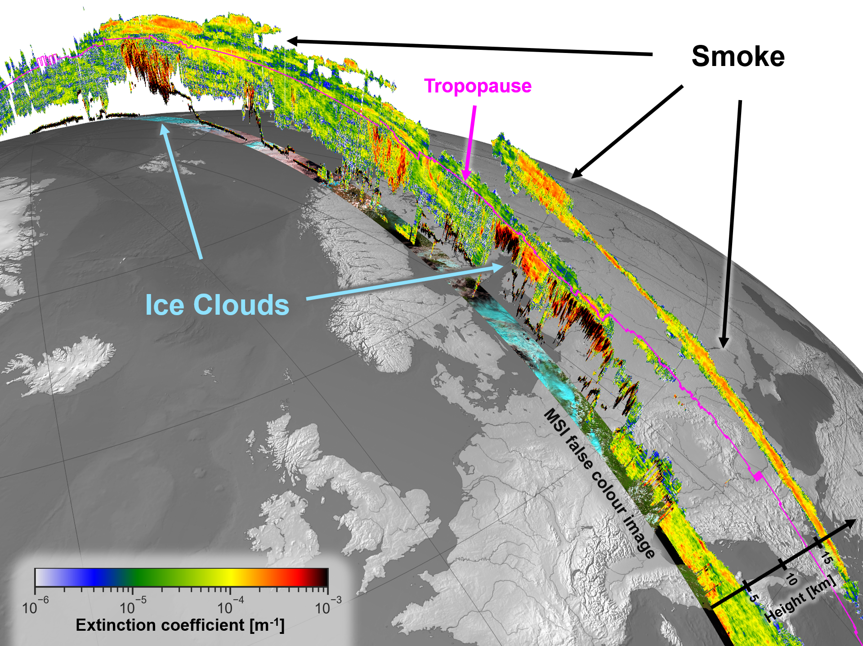
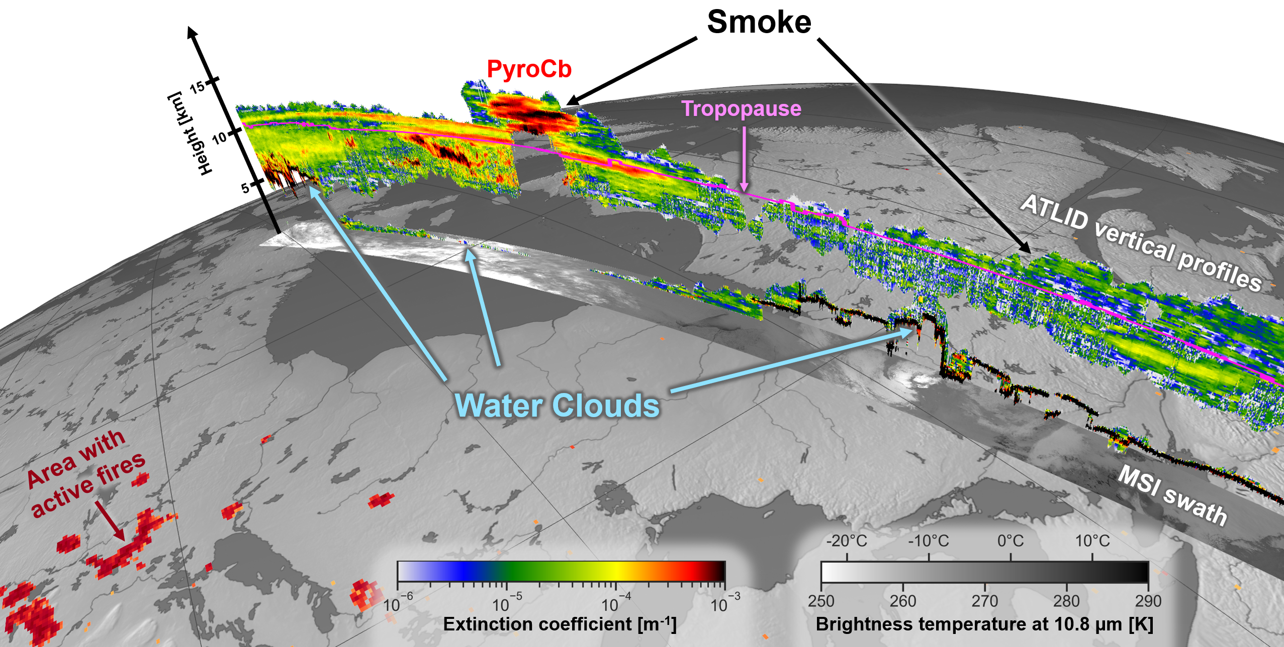
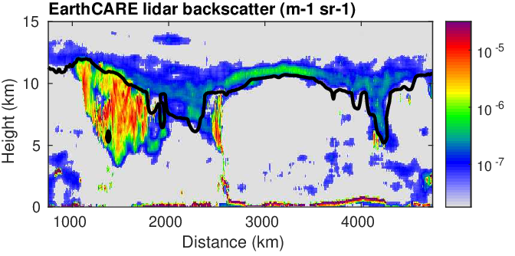
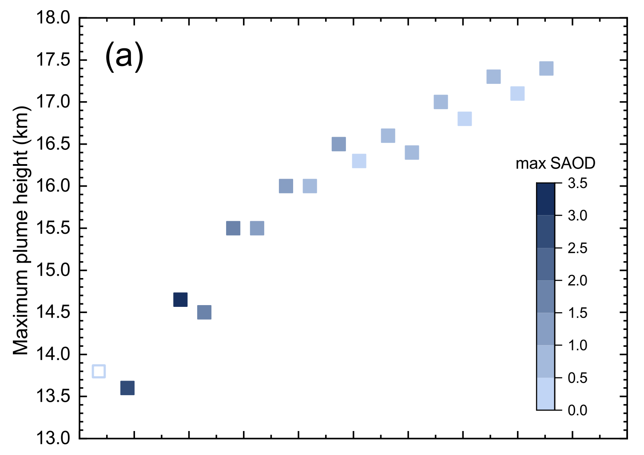
Tracking smoke from Canadian wildfires
Moritz Haarig (TROPOS)
Aerosol carried from Canada (1 June) to Europe (6 June)
ATLID revealed that the plume rose 3.6 km in 9 days: 400 m per day (Haarig et al. 2025)
Smoke lingers above tropopause and mixes back into troposphere by tropopause folds
Smoke
Tropopause
(PV=2)
Ice cloud

Slide 14
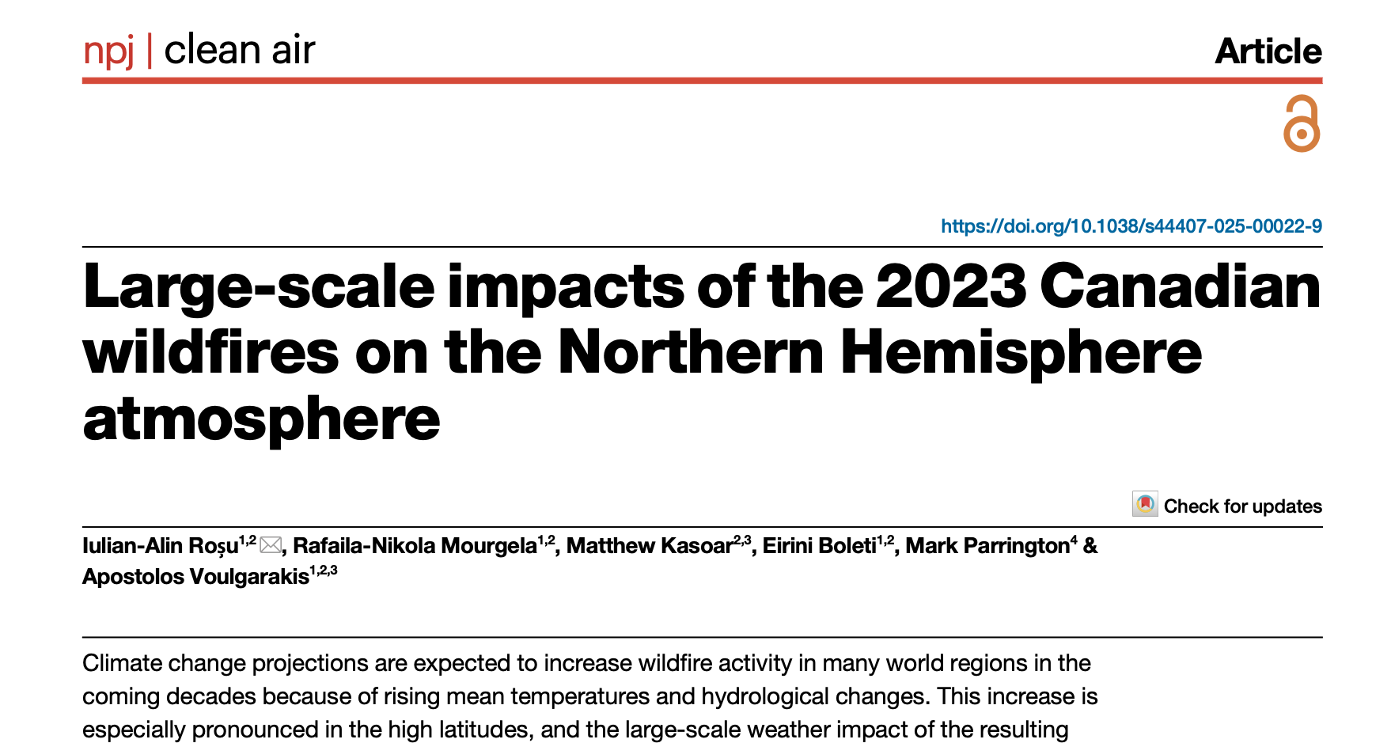
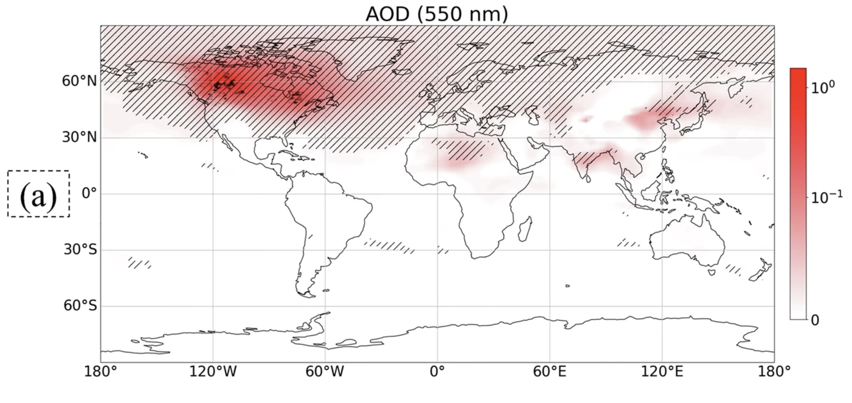
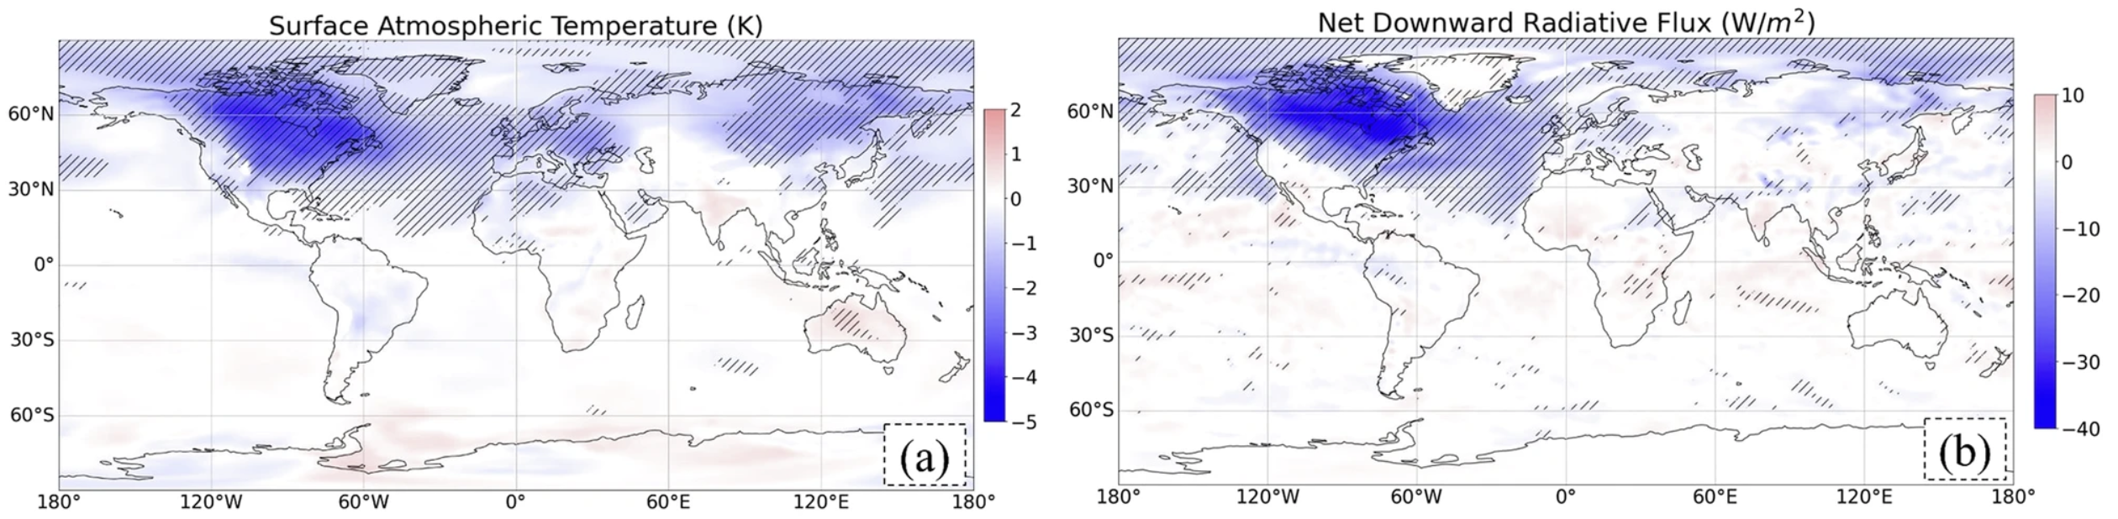
What is the climate impact of Canadian smoke?
EarthCARE measures this!
Uses MODIS fires, GFAS emissions, EC-Earth simulations
Surely we can do a better job of this!
Up to 5.4°C cooling over Canada in August,
0.9°C over entire Northern Hemisphere!
Is this really true?
EarthCARE calculates this!

Slide 15
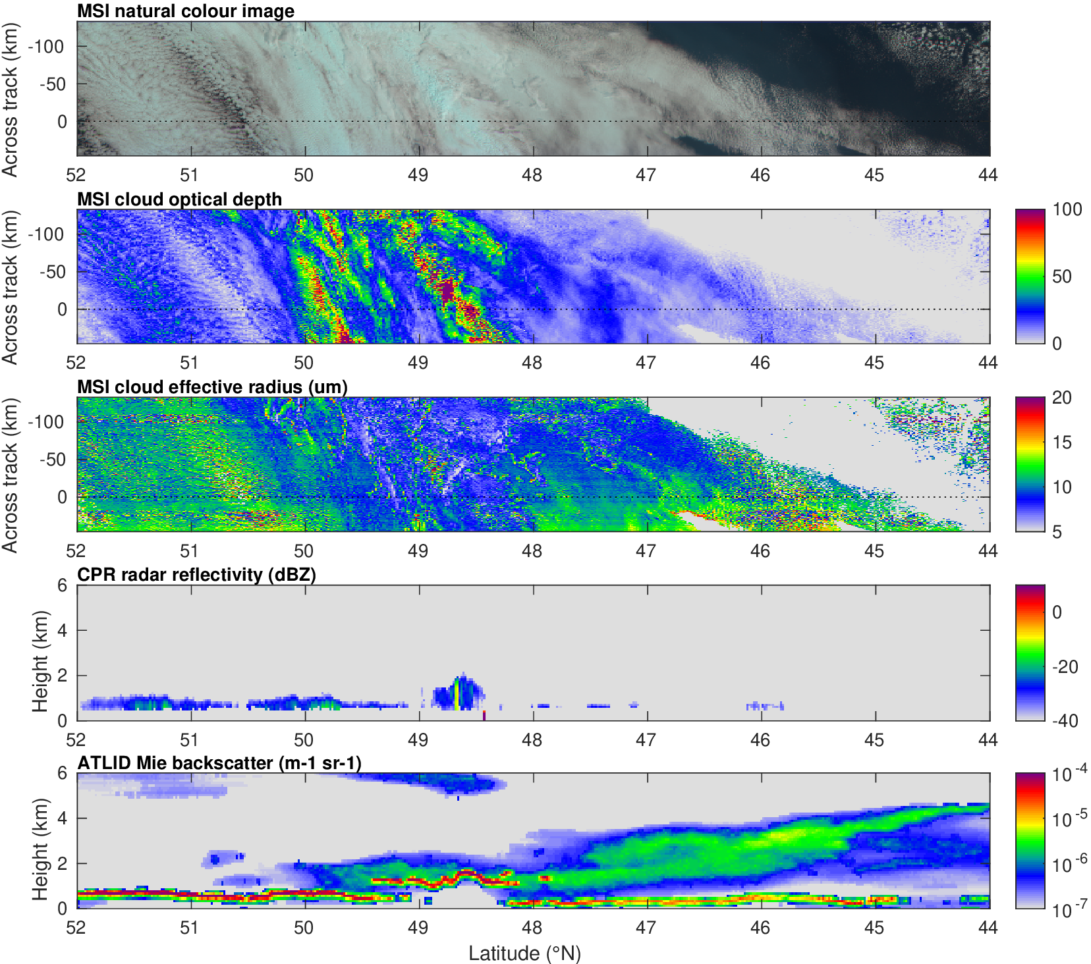
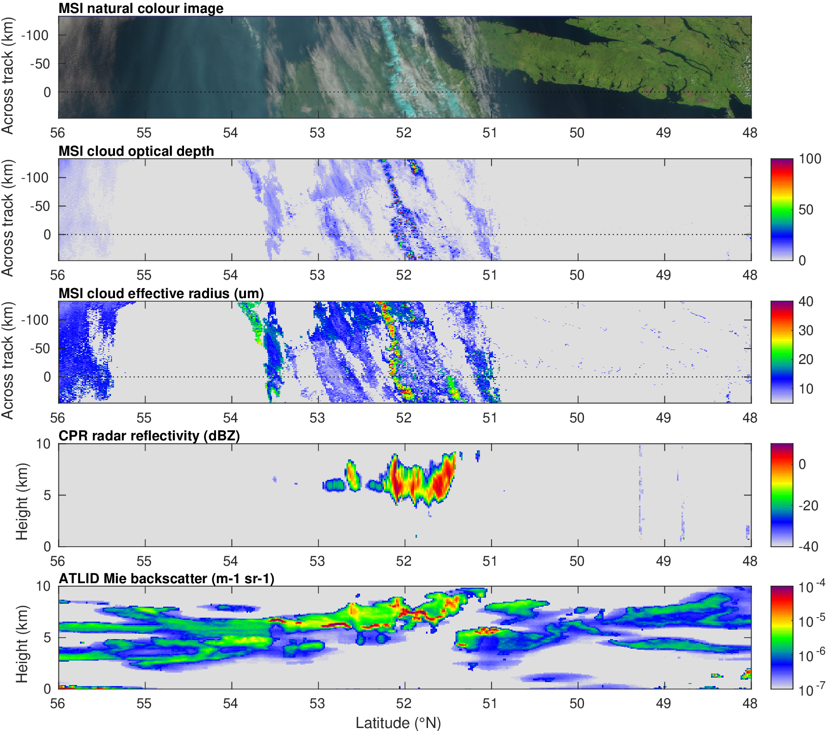
What can EarthCARE tell us about aerosol-cloud interactions, e.g. Canadian smoke August 2024?
01272D: Clear impact of smoke on liquid clouds! 01226D: Is there an impact on ice clouds?
Reduction in effective radius despite increase in optical depth!
Ice cloud
Liquid cloud
Smoke
Smoke

Slide 16
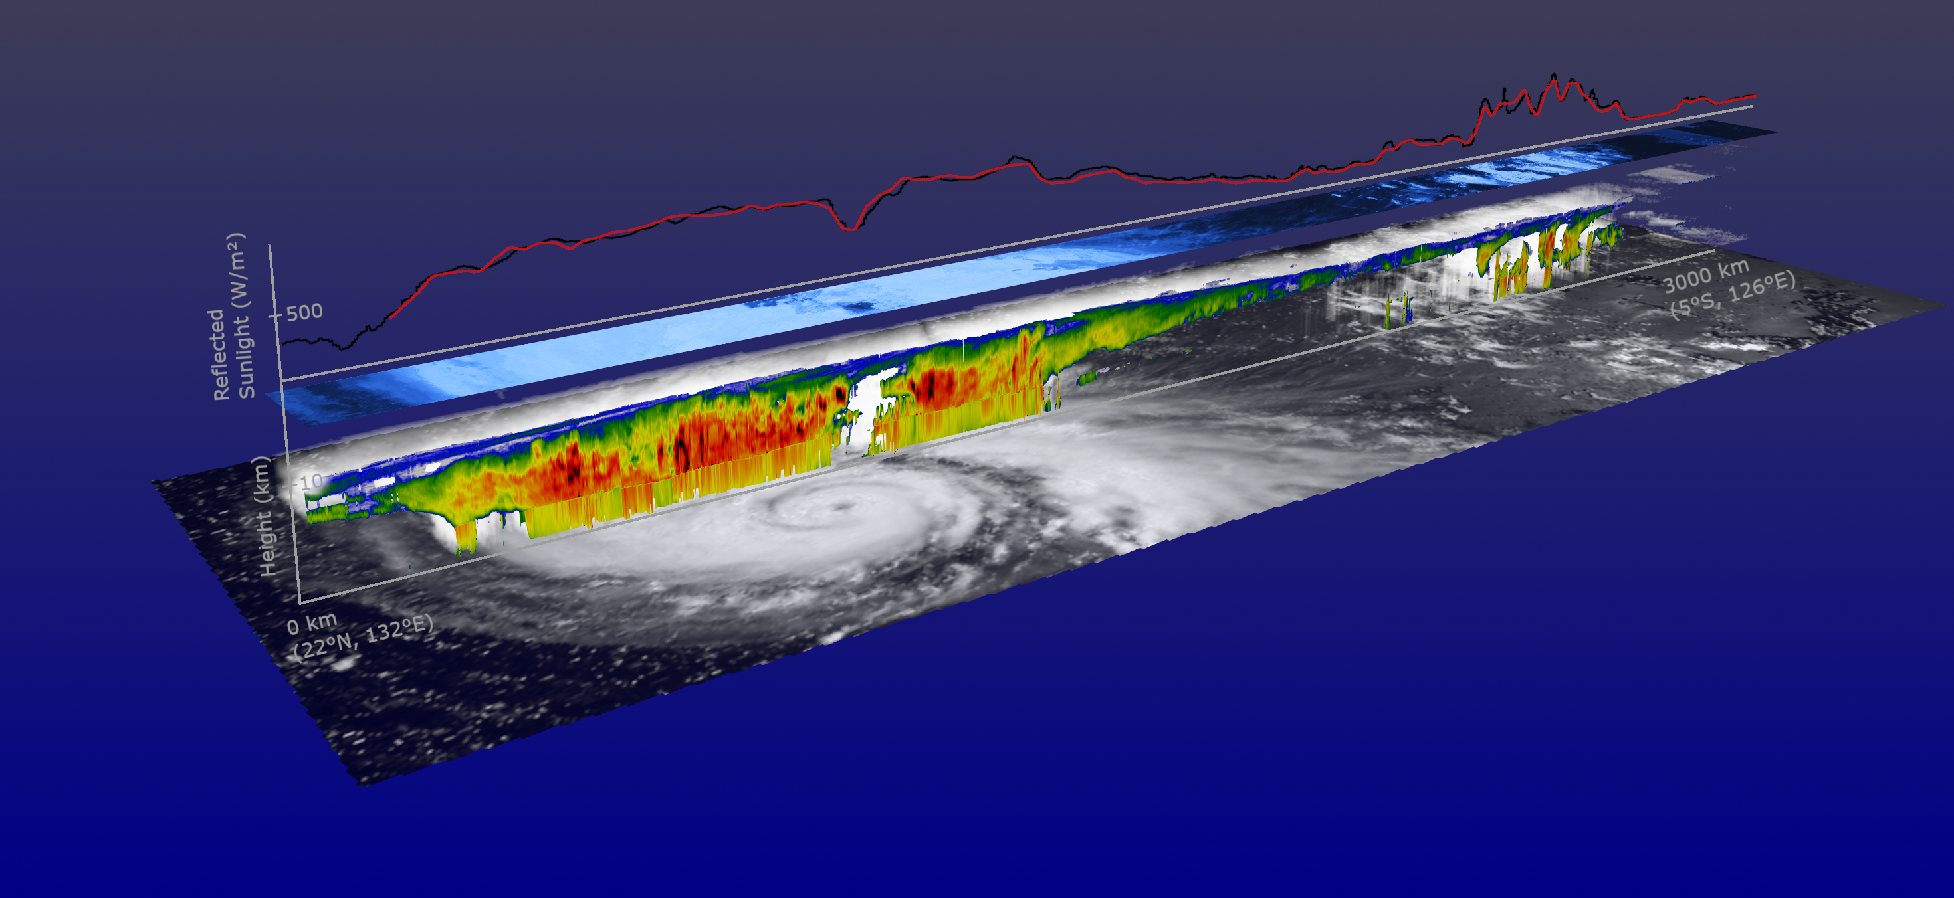
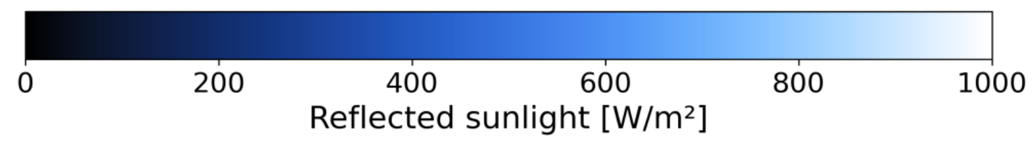
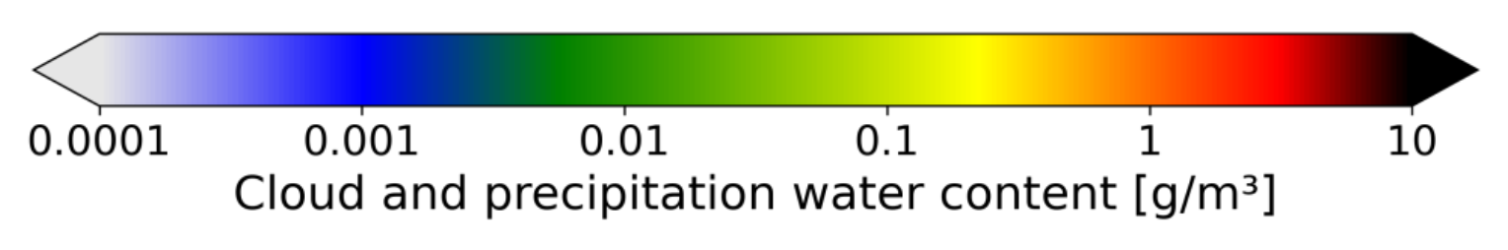
Towards radiative closure
Jonathan Flunger, Alex Hoffmann and the ESA visualization team
3. 1D & 3D radiative transfer (ACM-RT, ACM-RAD)
4. Compare to BBR measurements (BMA-FLX): computed, observed
2. Off-track 3D construction (ACM-3D)
Typhoon Ragasa, 20 Sept 2025
Retrieve cloud properties from synergy of radar, lidar & imager (ACM-CAP, ACM-CLP)

Slide 17
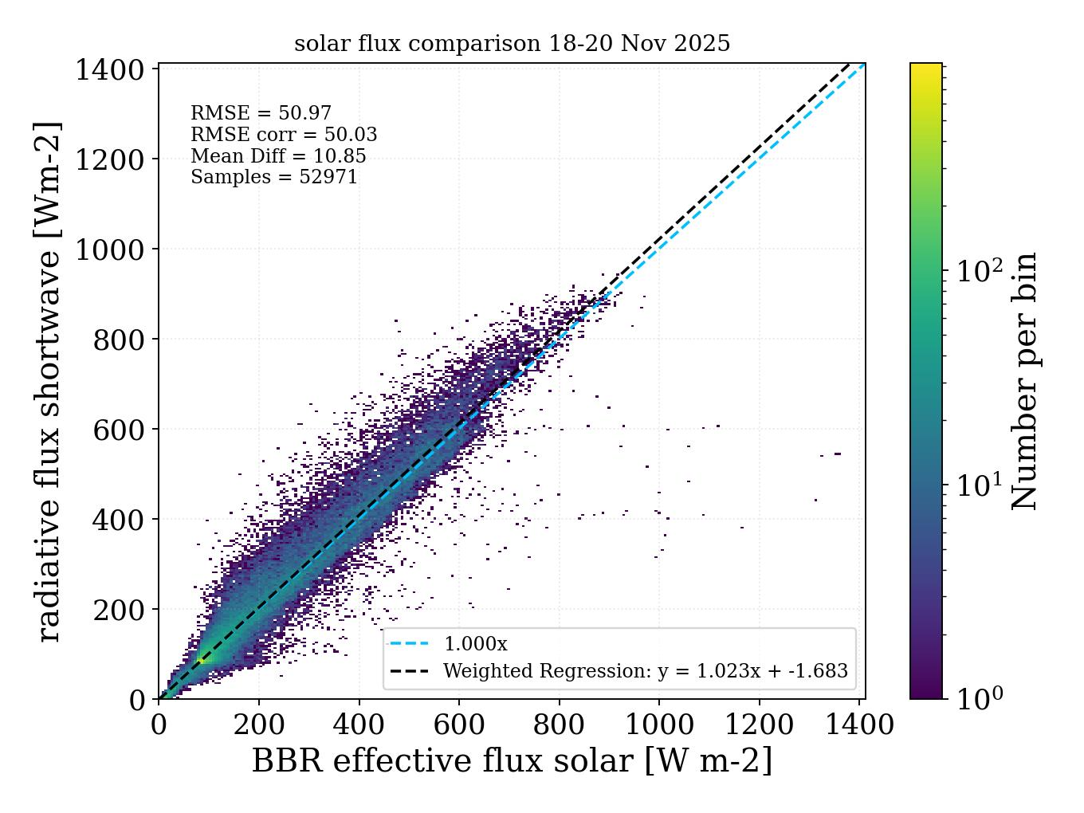
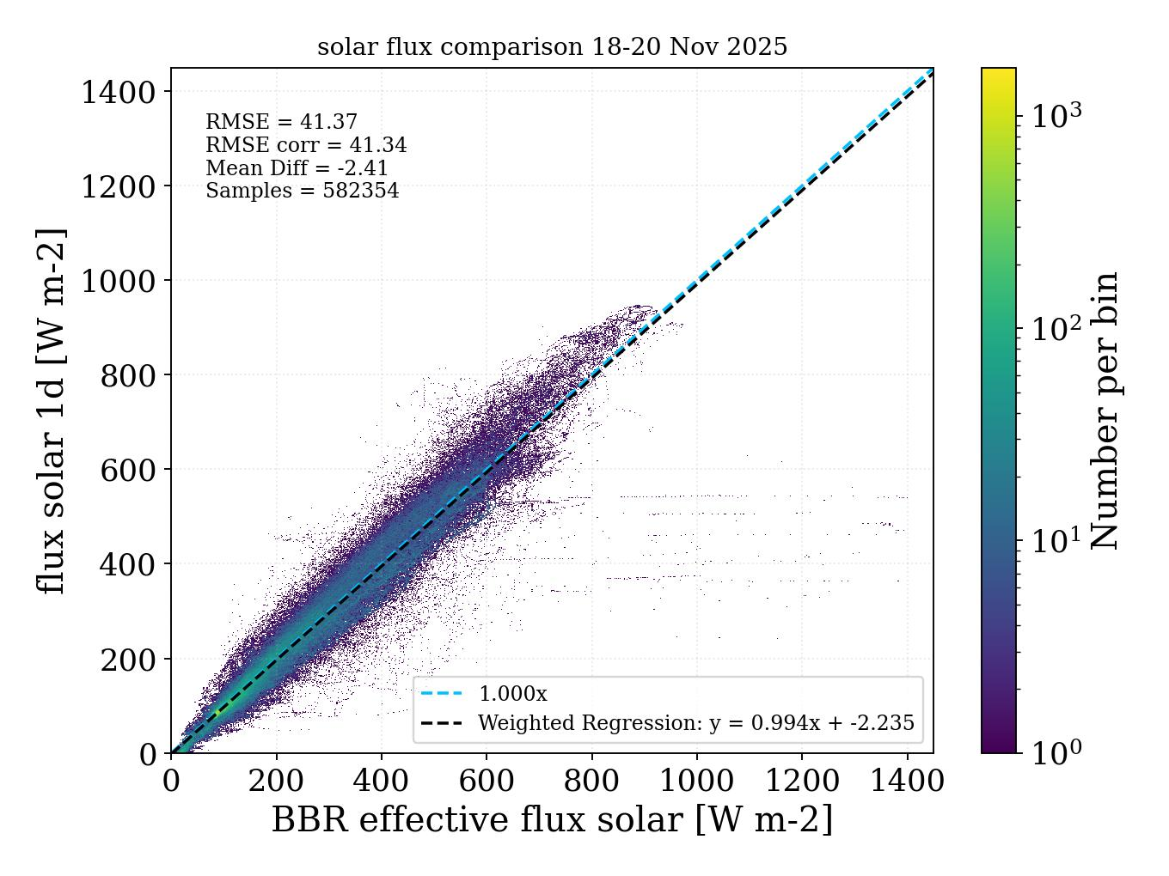
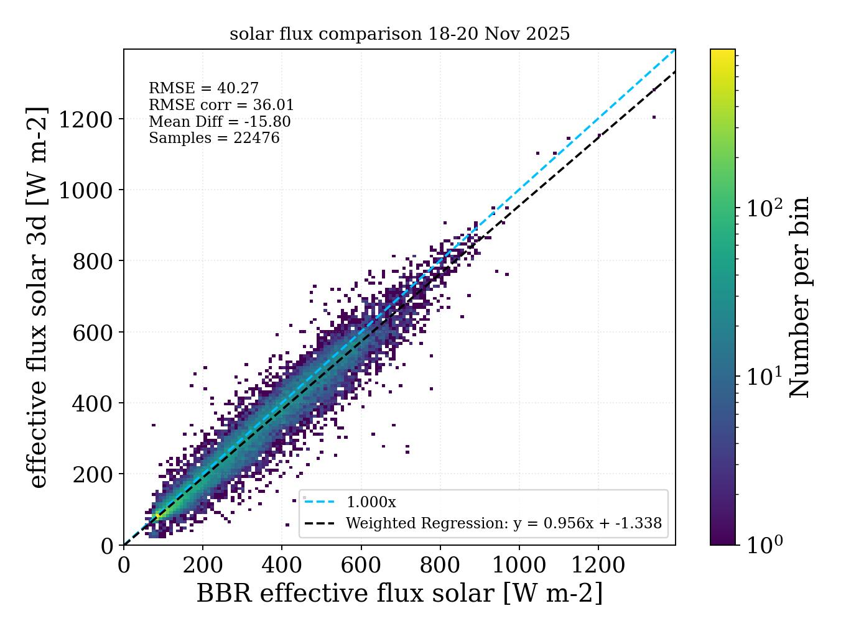
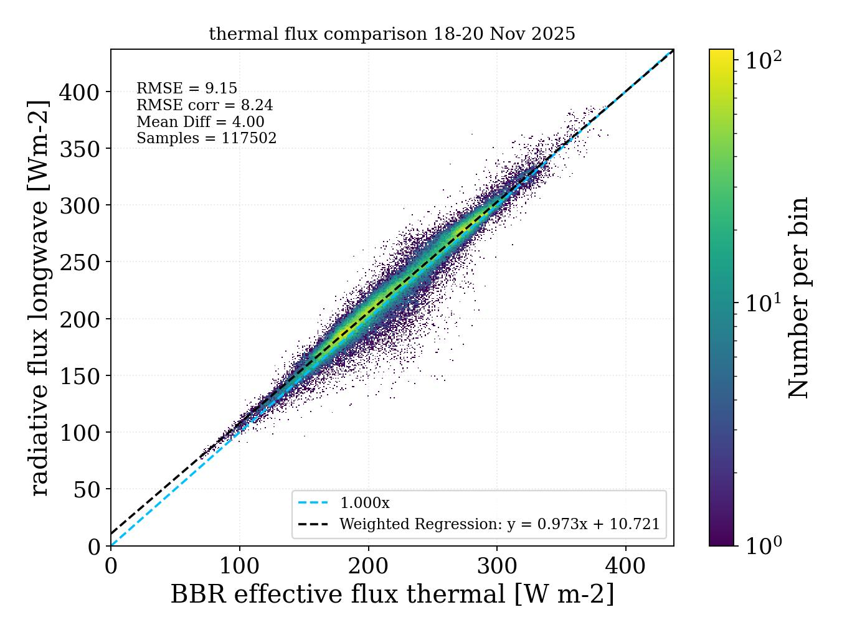
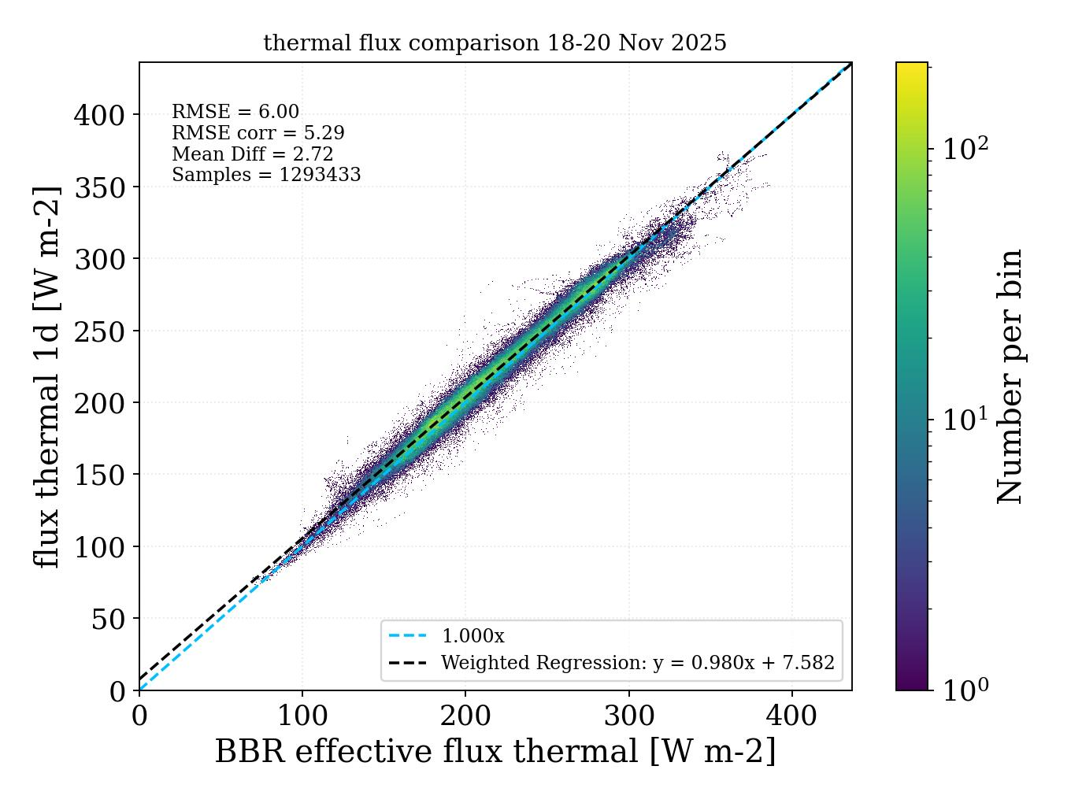
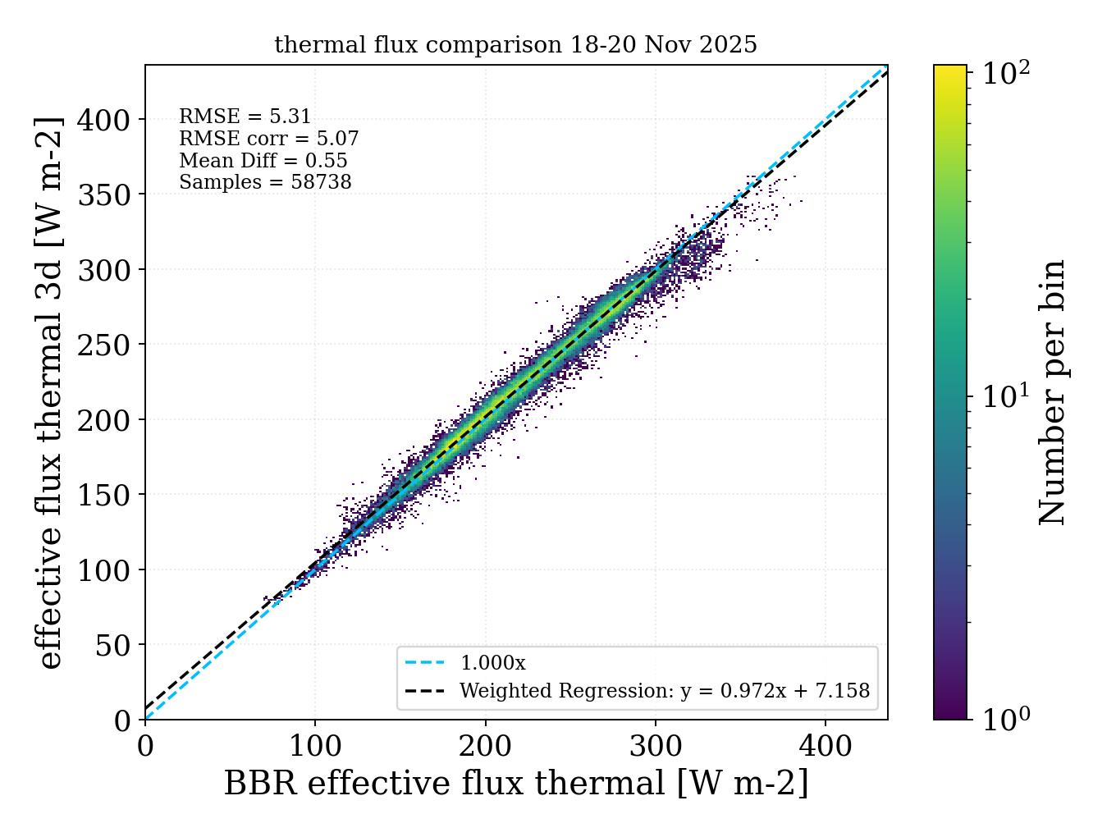
Latest radiative closure results
Jason Cole, Carla Salas, Kentaroh Suzuki, Takashi Nagao, Zhipeng Qu et al.
Japanese 1D comparison (AD) European 1D comparison (BC) European 3D comparison (BC)
Computed flux
RMSE
40 W/m²
Observed flux
Longwave TOA Shortwave TOA
RMSE
5.3 W/m²

Slide 18
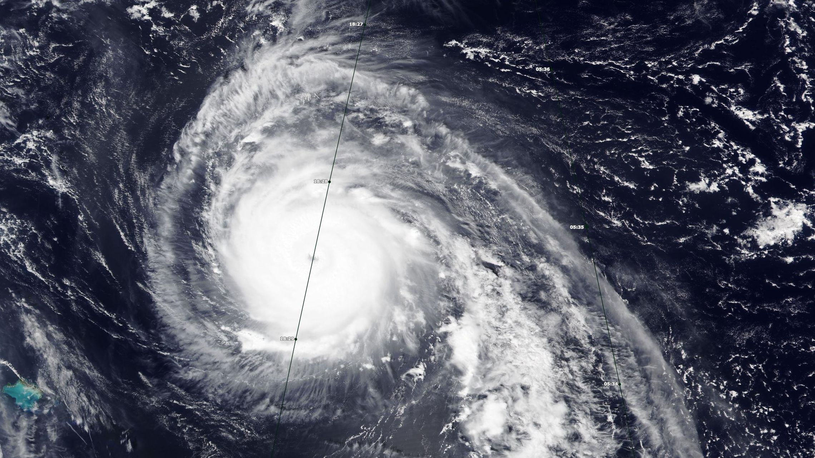
The day EarthCARE hit Hurricane Humberto
28 Sept 2025

Slide 19
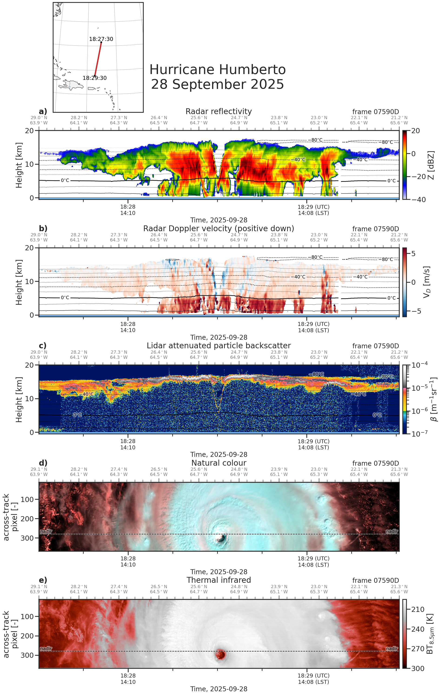
a
V-shaped eyewall
a
Convective rain band
Turbulence
Rising air in eyewall
First cloud band / secondary eyewall
“Natural Colour” scale
RGB = (1.65,0.87,0.67) μm:
Liquid clouds appear red,
Ice clouds appear cyan

Slide 20
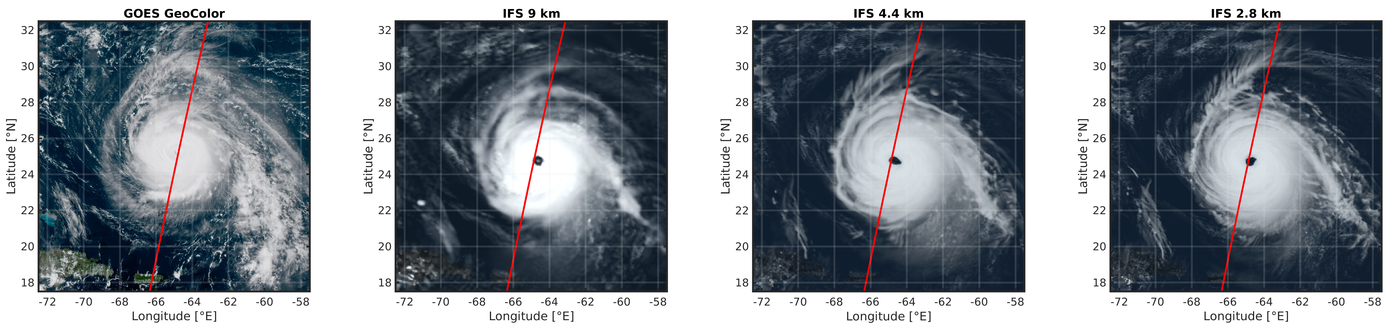
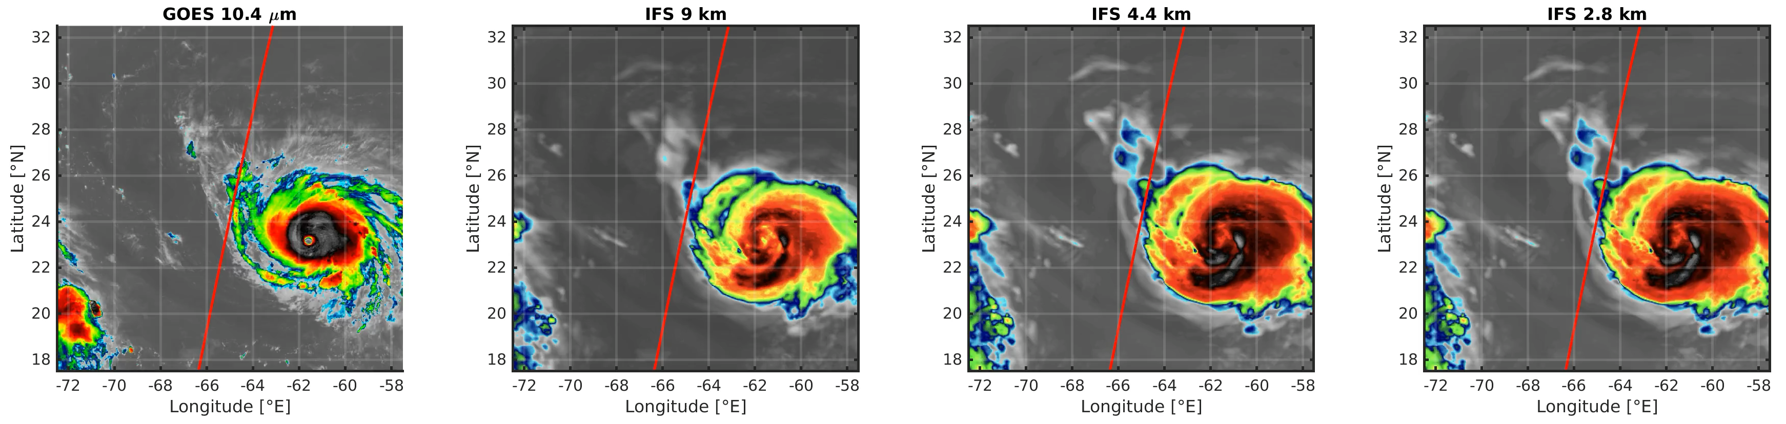
How does IFS perform in 5-day forecasts?
Mark Fielding (ECMWF)
a
Cloud extent and eye too large at all resolutions!

Slide 21
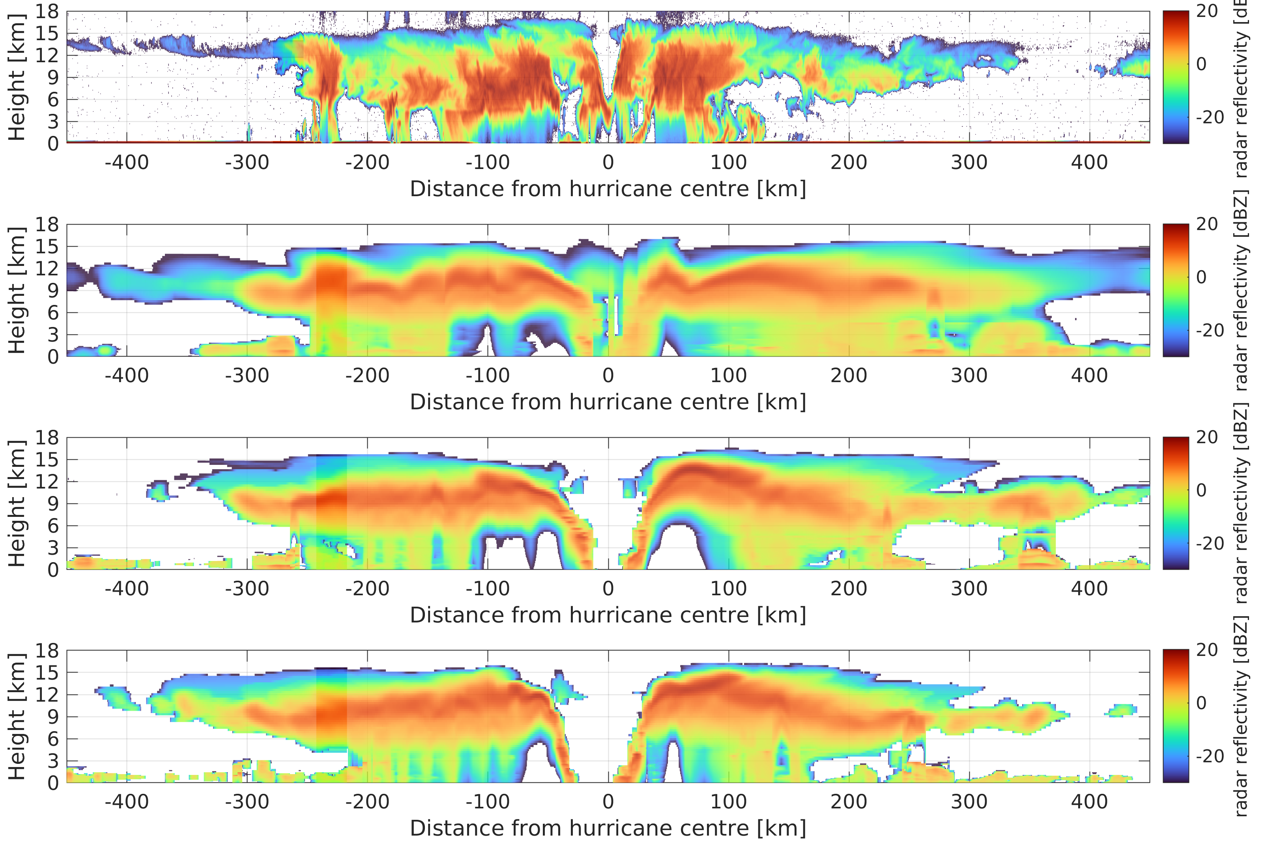
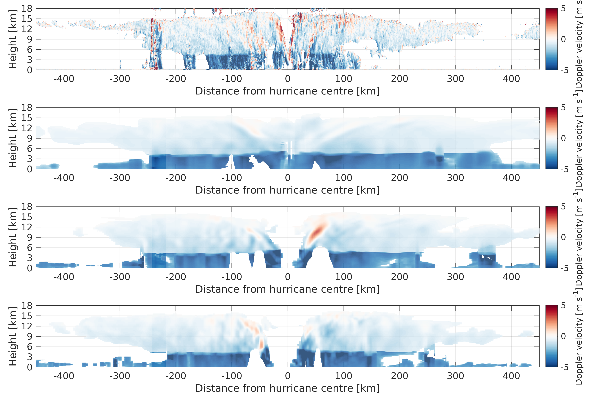
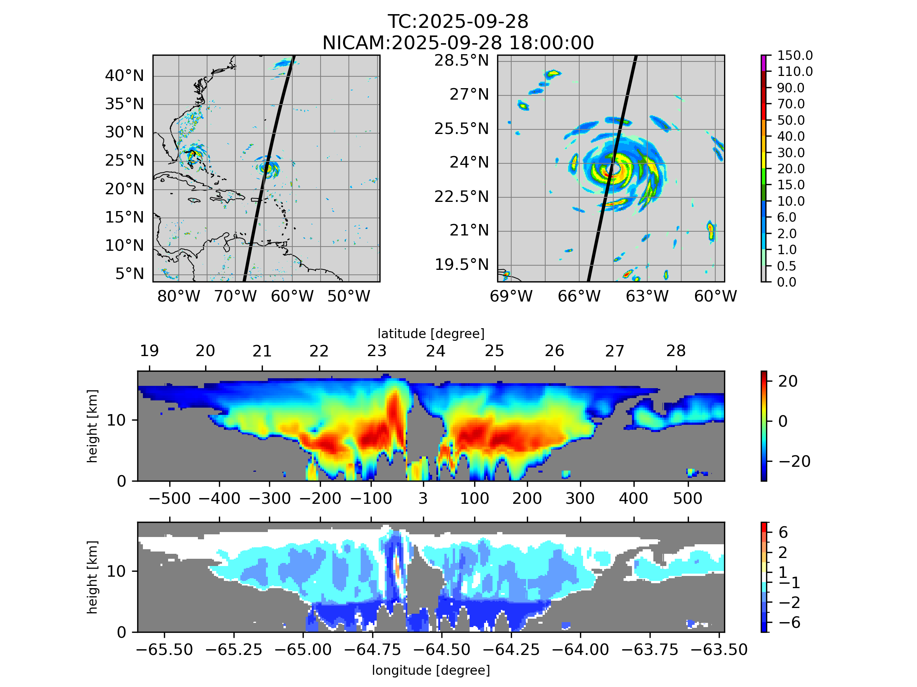
Evaluation of IFS and NICAM using CPR
Mark Fielding
Jin-de Huang, Masaki Satoh
Radar reflectivity (dBZ) Doppler velocity (m/s)
EarthCARE CPR
IFS 9 km
IFS 4.4 km
IFS 2.8 km
NICAM 3.5 km
Significant differences between models and EarthCARE, even with such high resolution
In the ECOMIP project we are exploring how to best use these observations to improve models

Slide 22
Outlook
EarthCARE can address so many aspects of the atmosphere that are poorly understood and represented crudely in both low- & high-resolution models
  Clouds & precipitation: ice effective radius & size distribution, difference between ice and snow, snow evaporation rates, rain/drizzle fallspeeds and drop sizes, process rates in mixed-phase clouds e.g. riming, width and updraft strength of convective cores, marine cloud morphology, blah blah blah
  Aerosols: Global distribution of different aerosol types, single-scattering albedo, scavenging & deposition rates, stratosphere-troposphere exchange, aerosol-cloud interactions in both liquid and ice clouds, radiative impact, blah blah blah
We have an incredible satellite: it’s time to think big: how can EarthCARE contribute to solving the grand challenges of climate science?
  The complete expertise to do this does not lie in this room: seek collaborations!
  EarthCARE alone cannot do this: combine with other satellites, models and datasets!

