Slide 1
Can we achieve multi-spectral consistency in retrievals and simulations of clouds and precipitation?
Robin Hogan, Emma Turner, Shannon Mason, Mark Fielding
Thanks to Shunsuke Aoki for the EarthCARE/GPM coincidence database!
Identifiy EarthCARE/GPM coincidences
Run latest ACM-CAP EarthCARE retrieval assimilating MSI solar/thermal channels
Run Tco1279 IFS with extra diagnostics (12-24 h forecasts)
Use RTTOV to simulate GPM microwave channels (10-183 GHz), MSI thermal and solar channels, BBR fluxes and BBR radiances, from ACM-CAP and IFS
Use ZmVar to simulate EarthCARE reflectivity

Slide 2
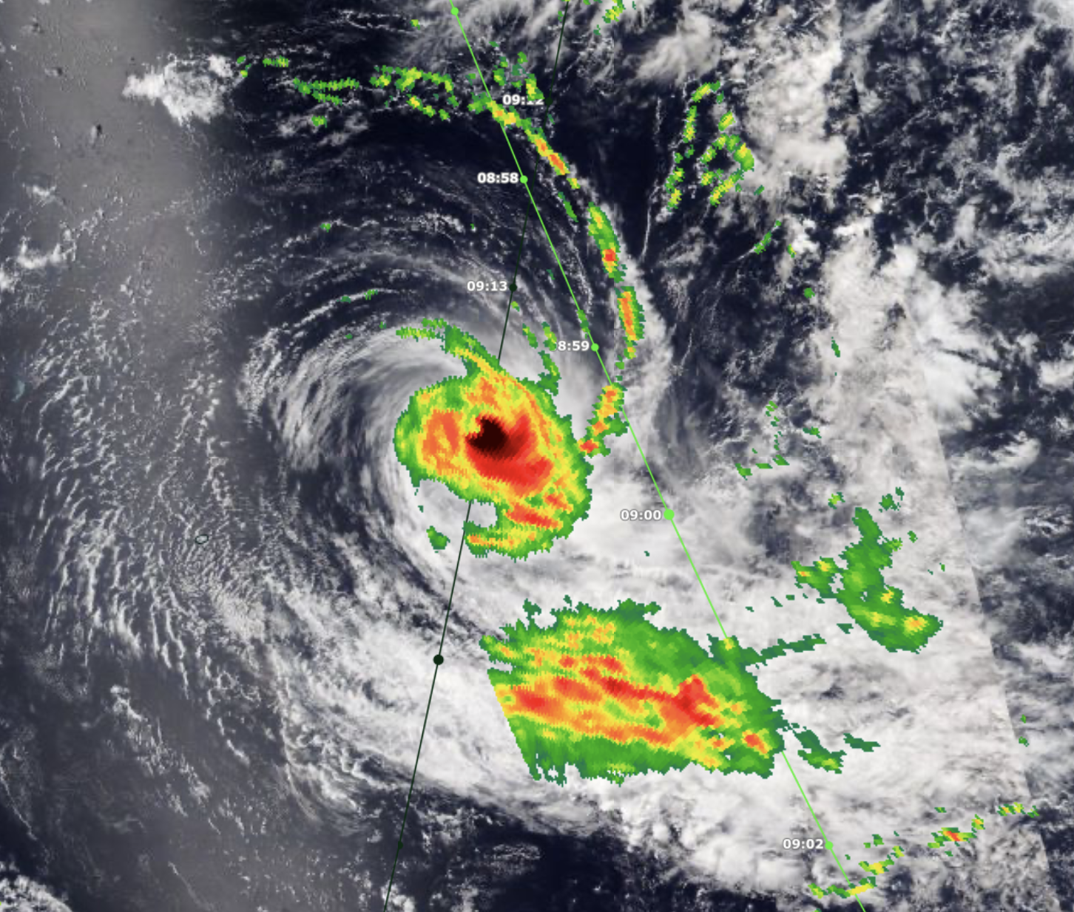
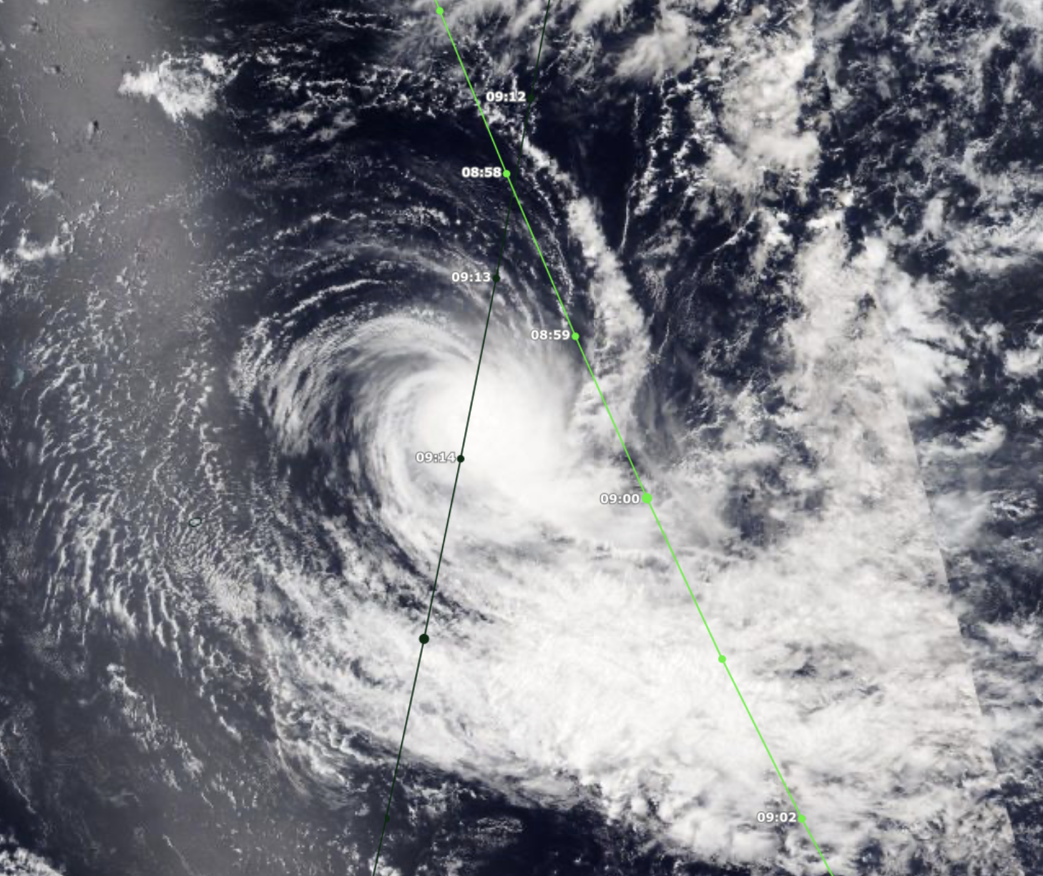

Tropical Cyclone Bheki (Indian Ocean)
18 Nov 2024 (Cat 4)
VIIRS NOAA-21: 09:13
GPM rain rate (used in IMERG): 09:00
EarthCARE overpass: 09:14
GPM
EarthCARE

Slide 3
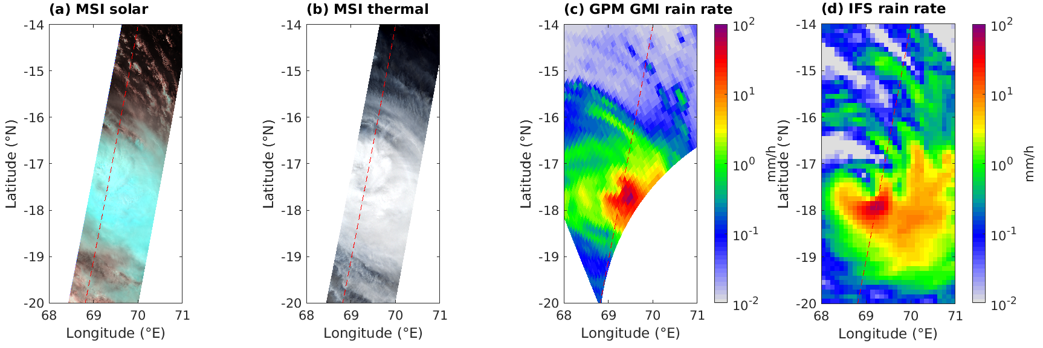
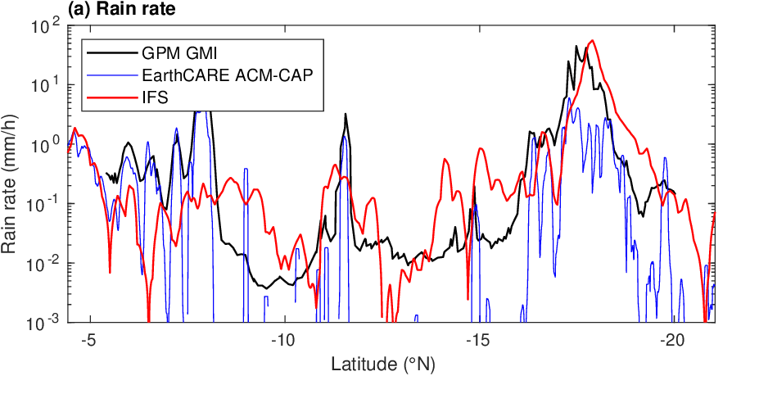
Tropical Cyclone Bheki (Indian Ocean)
18 Nov 2024
IFS rain rate (50 mm/h) is excellent!
ACM-CAP underestimates peak rain rate by a factor of 10

Slide 4
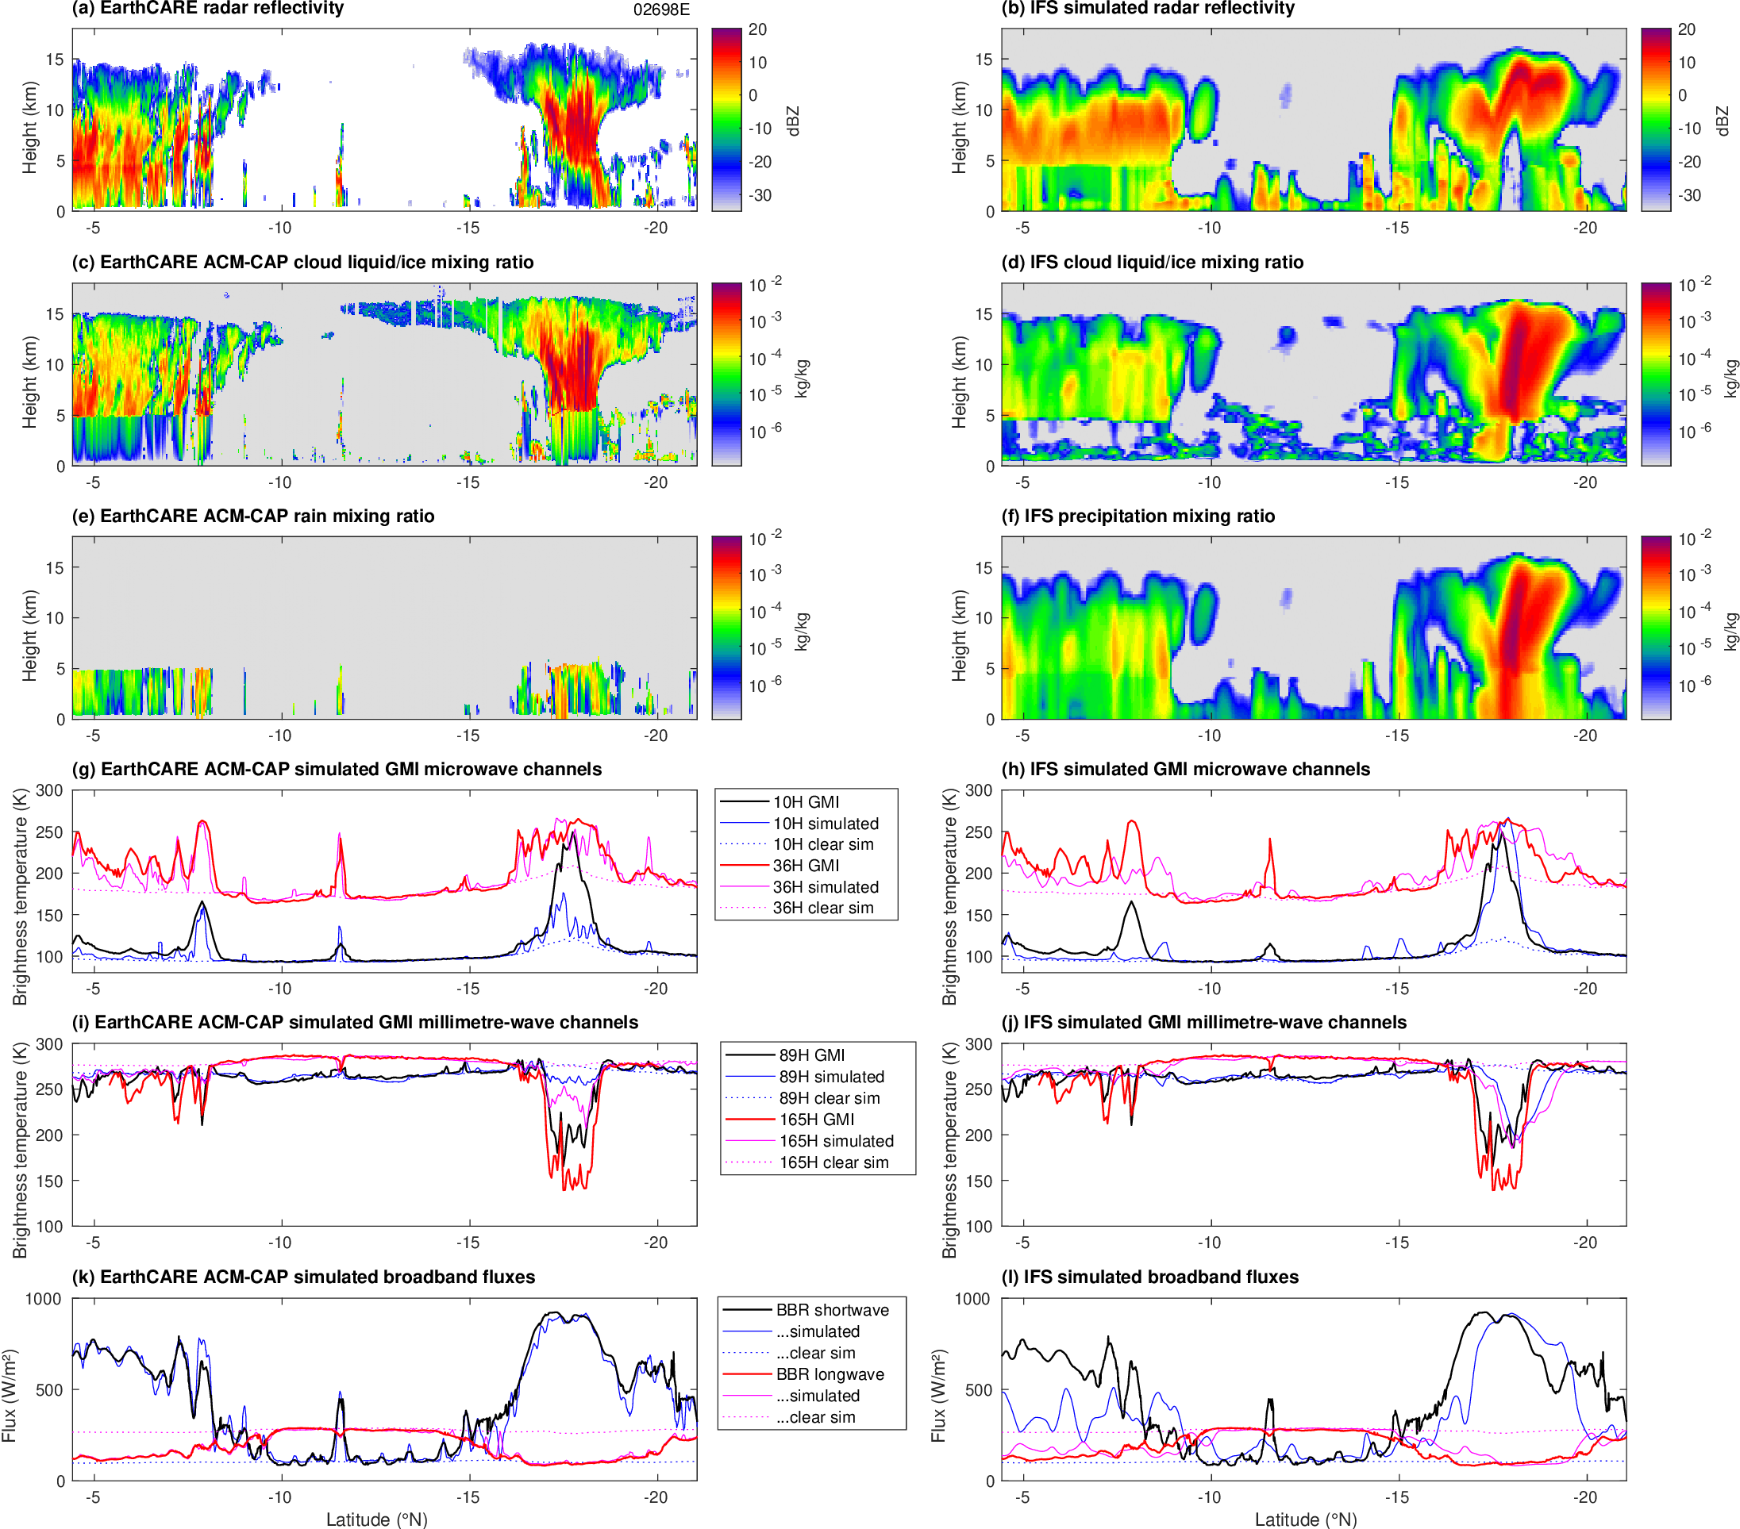
TC Bheki
ZmVar with IFS microphysics predicts strong attenuation but no multiple scattering
ACM-CAP retrieved ice treated as cloud ice in RTTOV
Rain-sensitive 10 GHz BT underestimated
Rain-sensitive 10-GHz BT well captured
Ice-sensitive high frequencies not well captured either
Ice-sensitive high frequencies better than ACM-CAP but not perfect
ACM-CAP simulates broadband fluxes very well

Slide 5
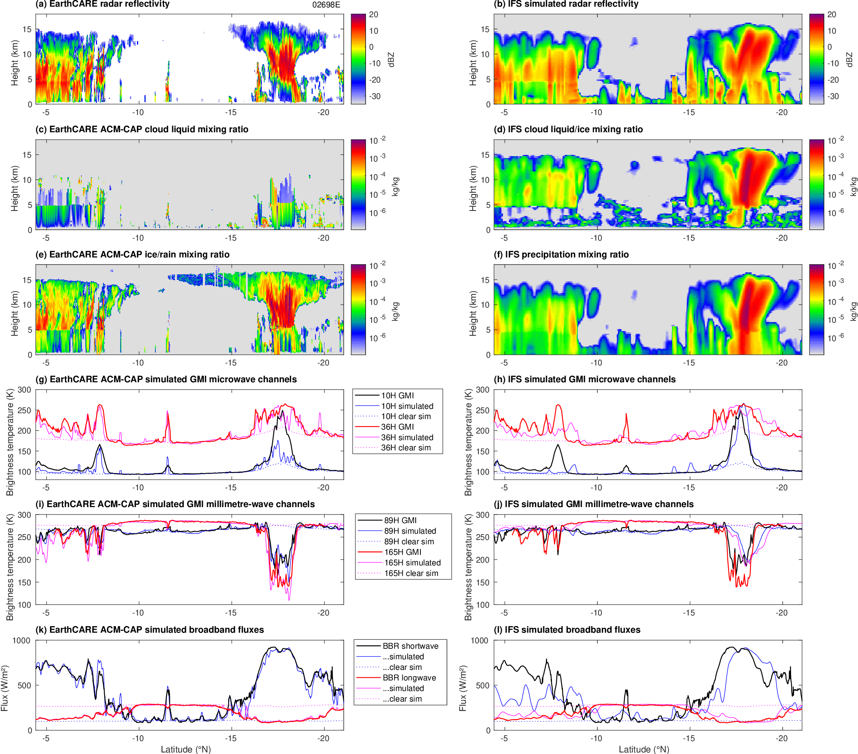
TC Bheki
ZmVar with ACM-CAP microphysics (Field/SSRGA) looks much better!
ACM-CAP retrieved ice treated as snow in RTTOV
Need to run with ACM-CAP’s assumptions!
Rain-sensitive 10 GHz BT underestimated
Rain-sensitive 10-GHz BT well captured
Ice-sensitive high frequencies well captured!
Ice-sensitive high frequencies better than ACM-CAP but not perfect
ACM-CAP simulates broadband fluxes very well

Slide 6
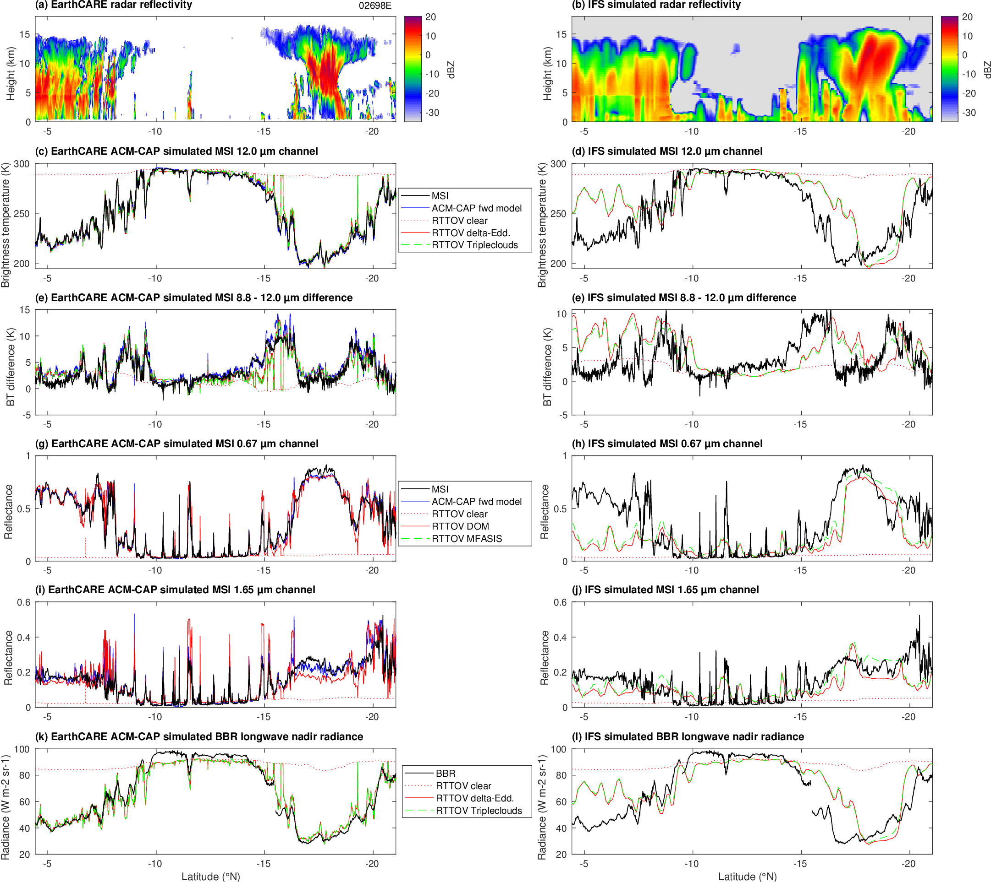
TC Bheki
Baran optics
ACM-CAP forward-models radiances: good agreement
Tripleclouds slightly higher than delta-Eddington: representing heterogeneity
Split-window difference well captured
RTTOV MFASIS higher than DOM with Baran optics
RTTOV DOM with Baran optics not quite right
RTTOV can model broadband radiance but underestimates clear sky

Slide 7

TC Bheki
Baum optics
ACM-CAP forward-models radiances: good agreement
Tripleclouds slightly higher than delta-Eddington: representing heterogeneity
Split-window difference well captured
RTTOV MFASIS closer to DOM with Baum ice optics
RTTOV DOM with “Baum” optics much better (liquid effective radius also used)
RTTOV broadband radiances improved;
still underestimates clear sky

Slide 8
Next steps
This is one case: I’ve run the IFS for 165 more in many different conditions, and Emma has simulated 8 so far
How can we improve ACM-CAP rain retrievals? 94-GHz path-integrated attenuation is well predicted so is there too much liquid cloud in rain assumed?
Use ice particle scattering assumptions in ACM-CAP to do proper high frequency closure in microwave
Resolve differences in solar: DOM vs MFASIS vs FLOTSAM?
Tripleclouds quite close to delta-Eddington in infrared, but how do we adapt to the microwave where sub-grid inhomogeneity of precipitation is important?
How can we improve the assumptions in the IFS for assimilating all wavelengths?
Hoping to get an ESA-ECMWF Fellow to take this work further in 2027 preparation for the FORUM far-infrared Earth Explorer mission

Slide 9
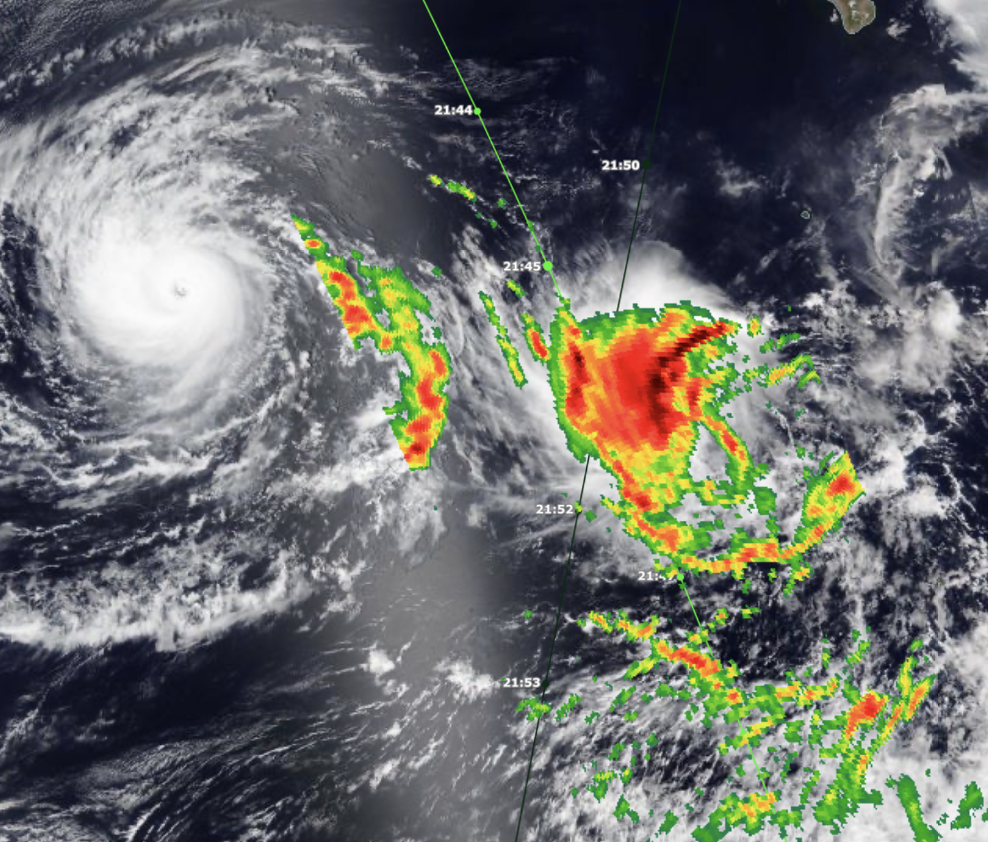
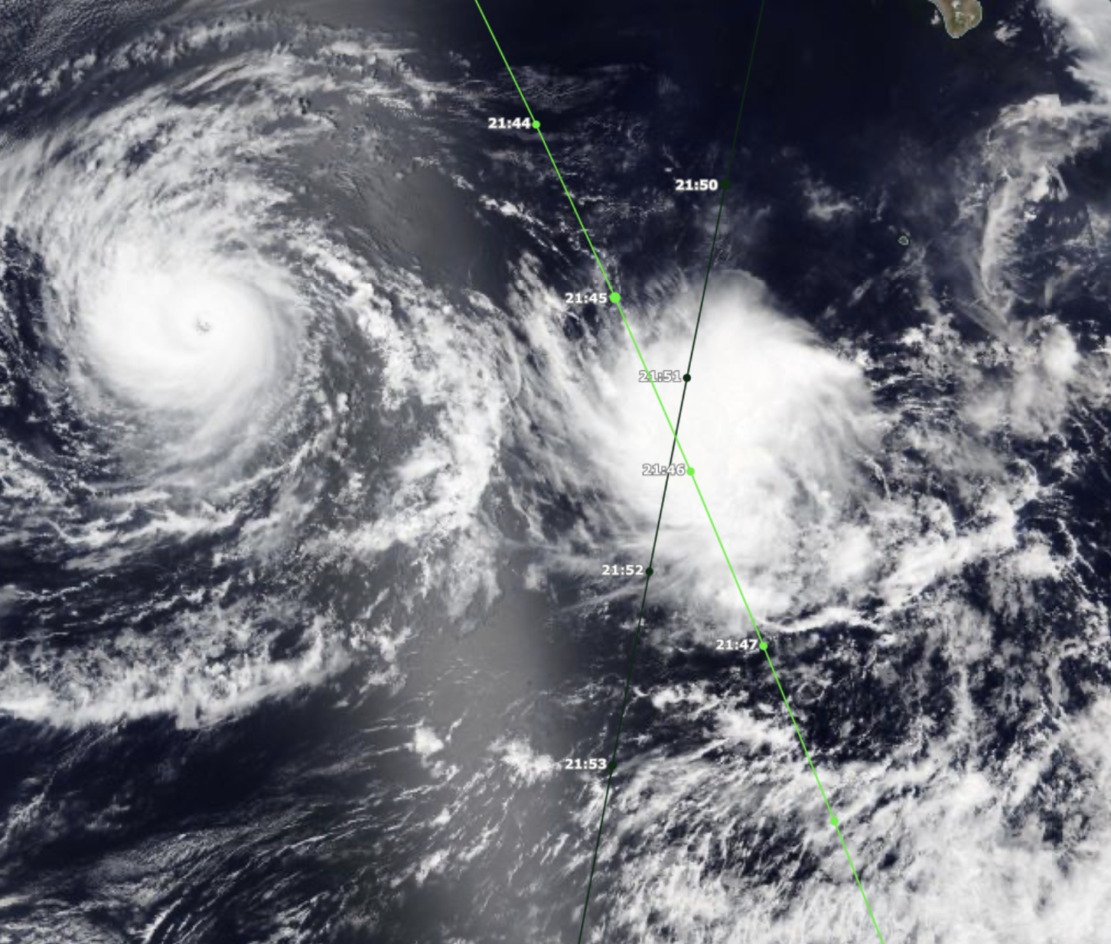
Pre-Tropical Storm Hector (NE Pacific)
22 August 2024
Gilma
VIIRS NOAA-20: 21:10
GPM rain rate: 21:46
EarthCARE overpass: 21:51
Pre-Hector
GPM
EarthCARE

Slide 10
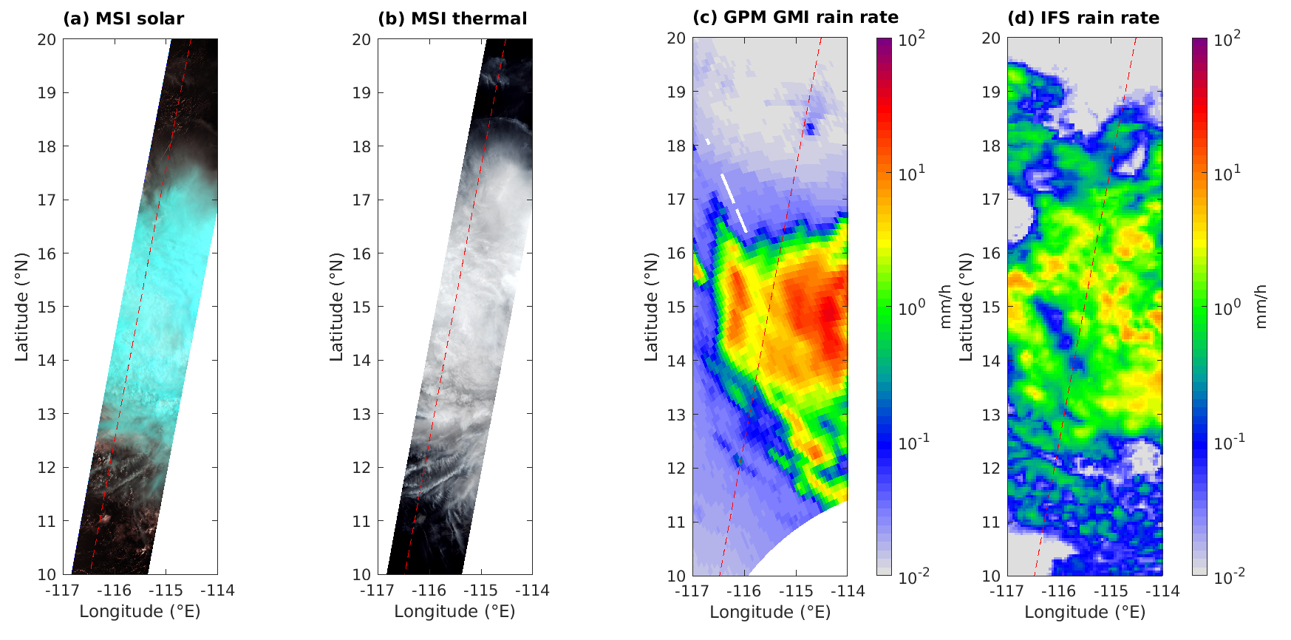
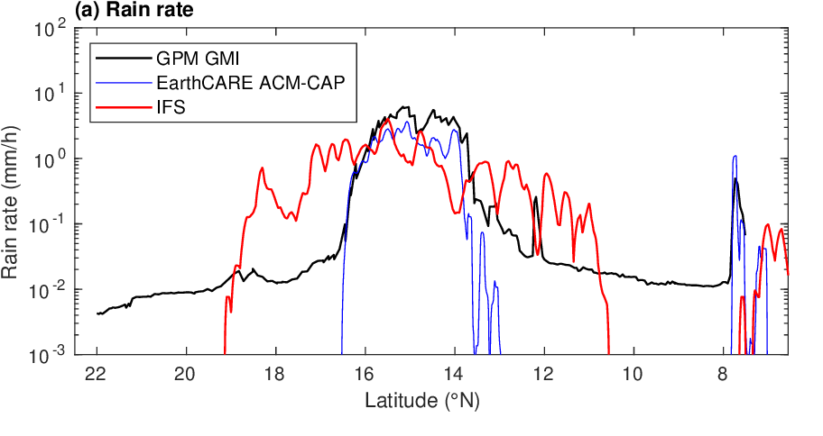
Pre-Hector
GPM retrieves peak rain rate of around 8 mm/h along EarthCARE track
ACM-CAP underestimates rain rate by a factor of 2 rather than 10!
IFS system too wide and weak

Slide 11
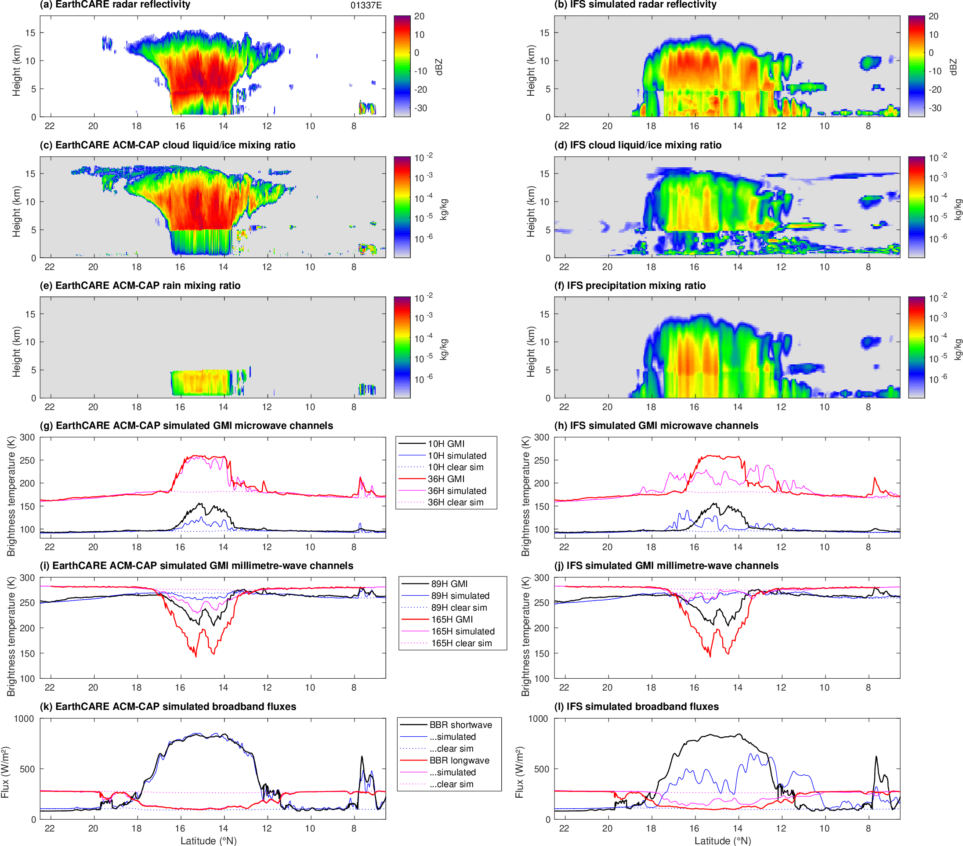
Pre-Hector
Peak reflectivity underestimated, cloud water has higher reflectivity than rain!
ACM-CAP retrieved ice treated as cloud ice in RTTOV
Rain-sensitive 10 GHz BT underestimated
System too broad and weak at all frequencies
Ice-sensitive high frequencies not well captured either
ACM-CAP simulates broadband fluxes very well

Slide 12
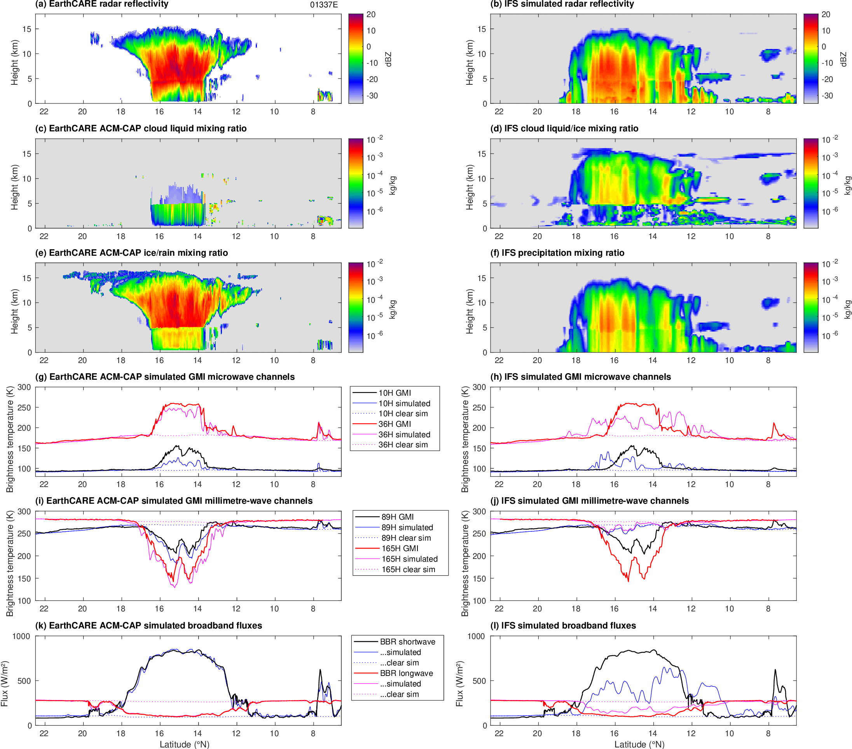
Pre-Hector
ACM-CAP settings look better, but not enough attenuation in rain
ACM-CAP retrieved ice treated as snow in RTTOV
Rain-sensitive 10 GHz BT underestimated
System too broad and weak at all frequencies
Ice-sensitive very well captured!
ACM-CAP simulates broadband fluxes very well

Slide 13
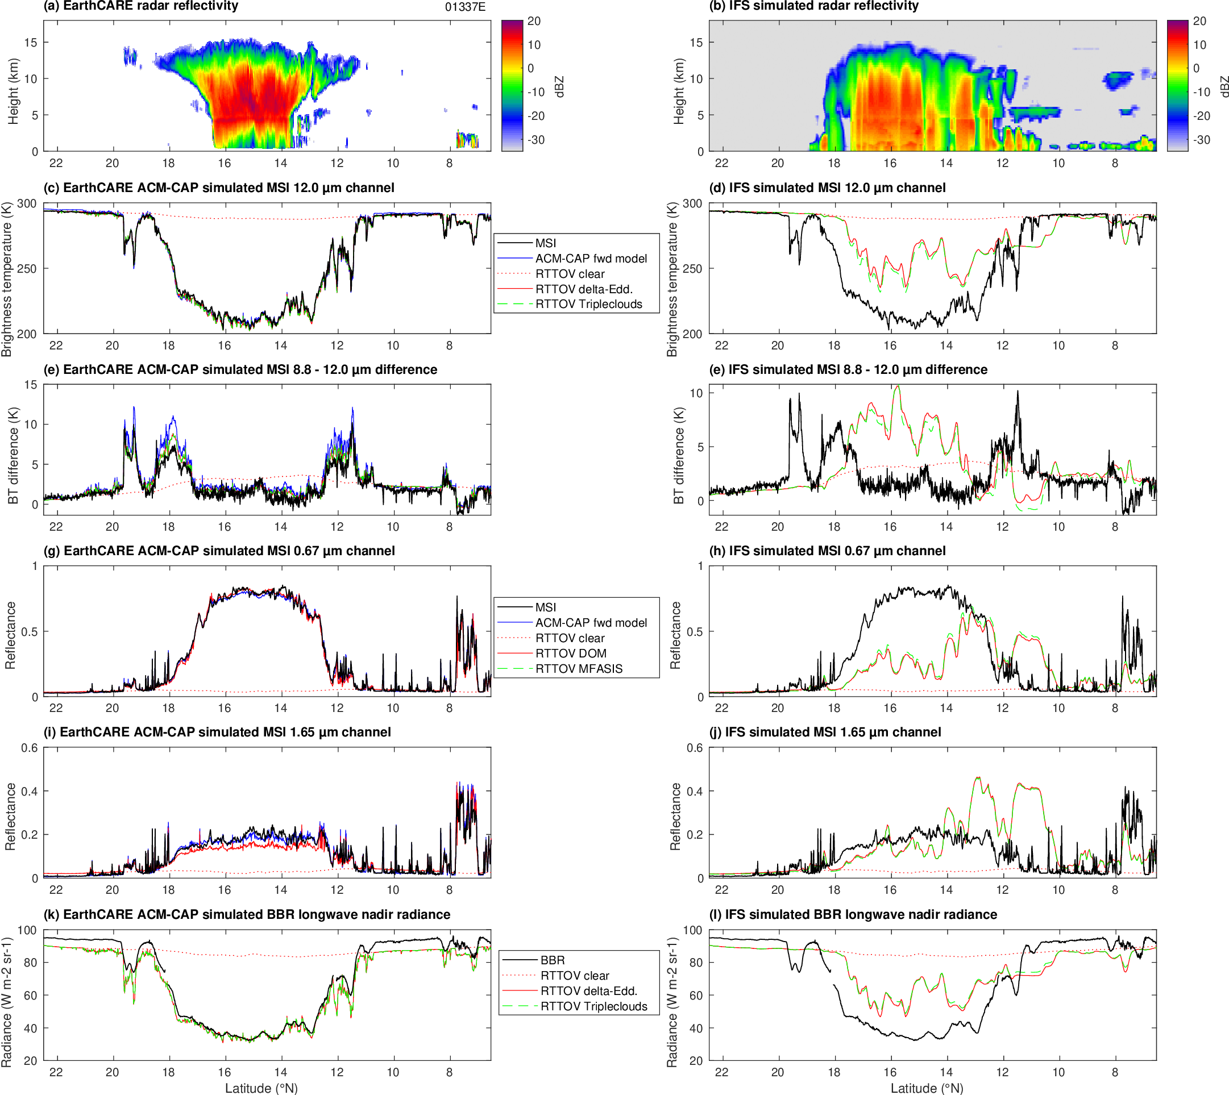
Pre-Hector
ACM-CAP forward model overestimates infrared split-window difference
RTTOV uses Baum ice: excellent agreement

