Slide 1


EarthCARE QWG Meeting no. 3
European Modelling Update: ECMWF, DWD & KNMI
Mark Fielding, Kamil Mroz, Mike Rennie, Axel Seifert, Thirza Feenstra
Robin Hogan
Leipzig, 4.03.2026

Slide 2
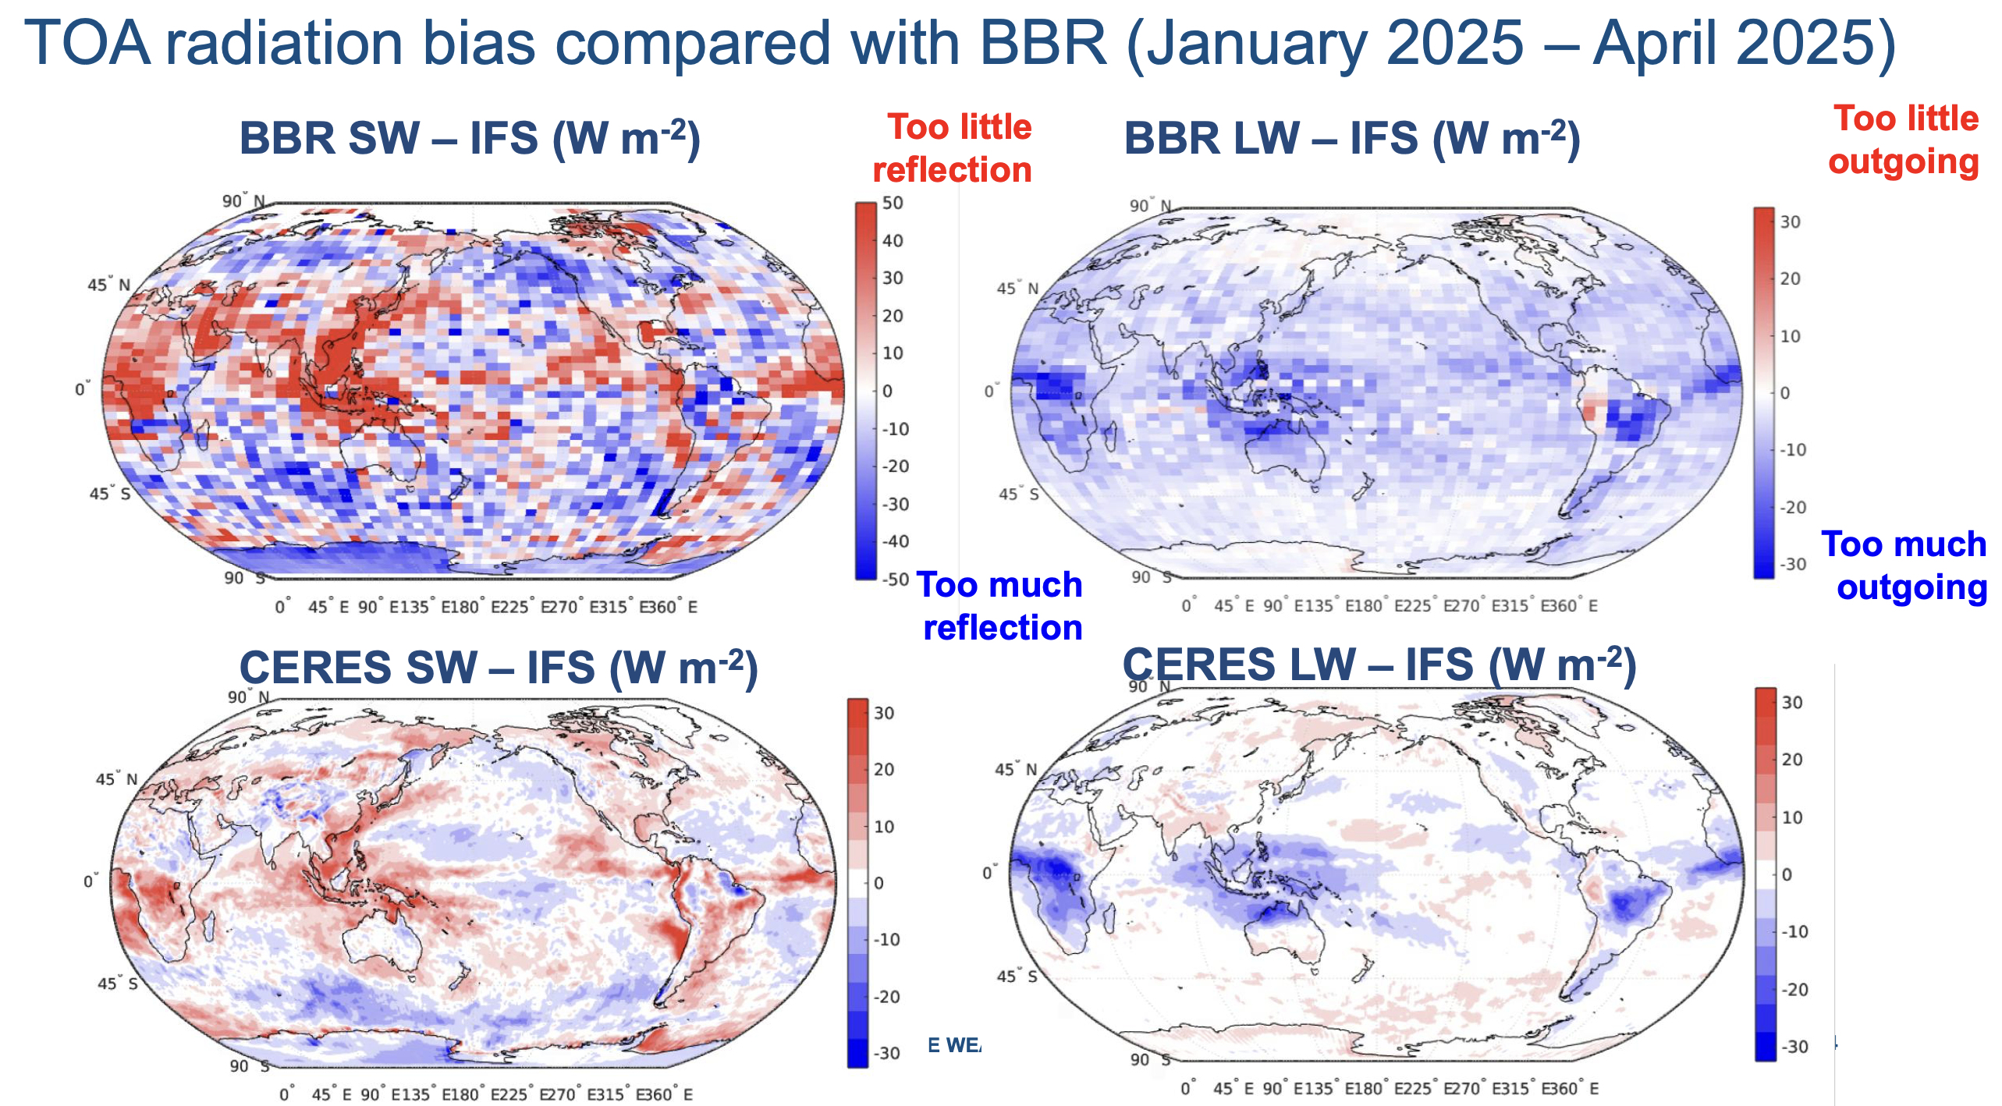
Radiation biases in ECMWF model
Mark Fielding
Bias versus CERES is same as bias versus BBR
Focus on tropical cirrus

Slide 3
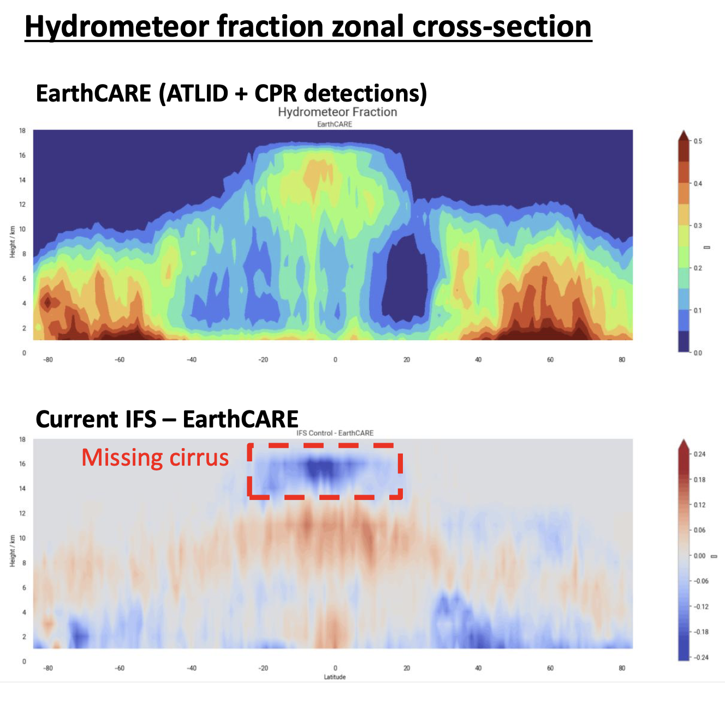
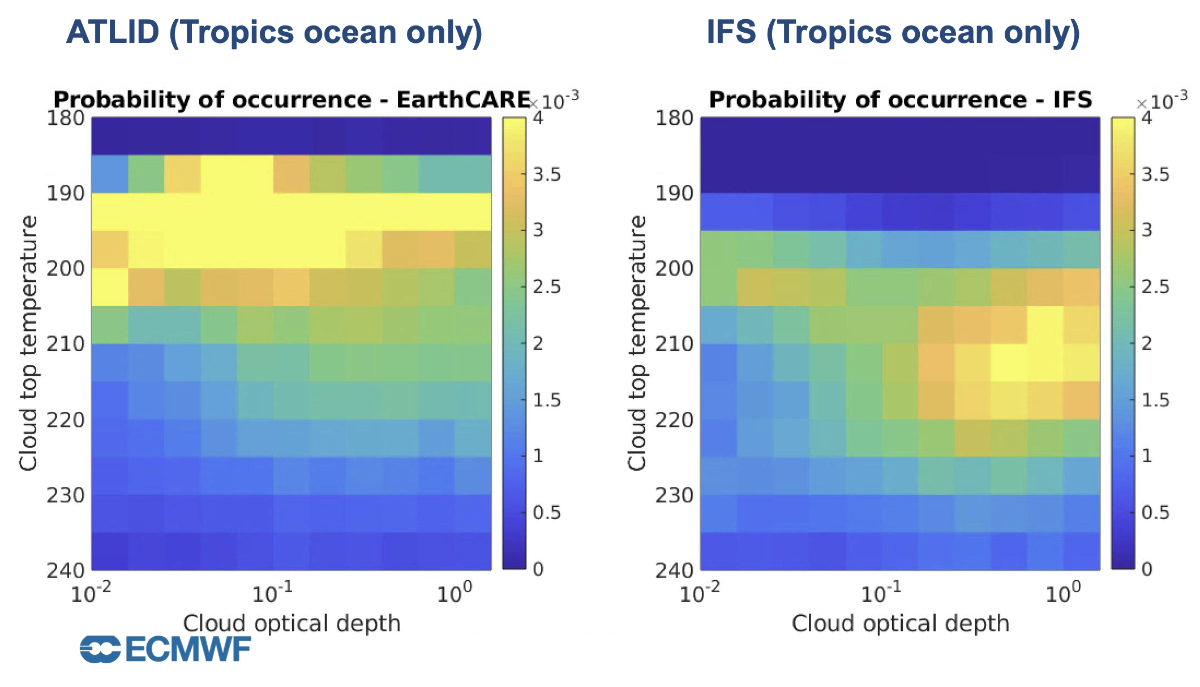
Cirrus bias in ECMWF model
Mark Fielding
ECMWF is missing tropical thin, high (and therefore cold) cirrus detected by EarthCARE, particularly from convective outflows
What is the radiative effect?

Slide 4
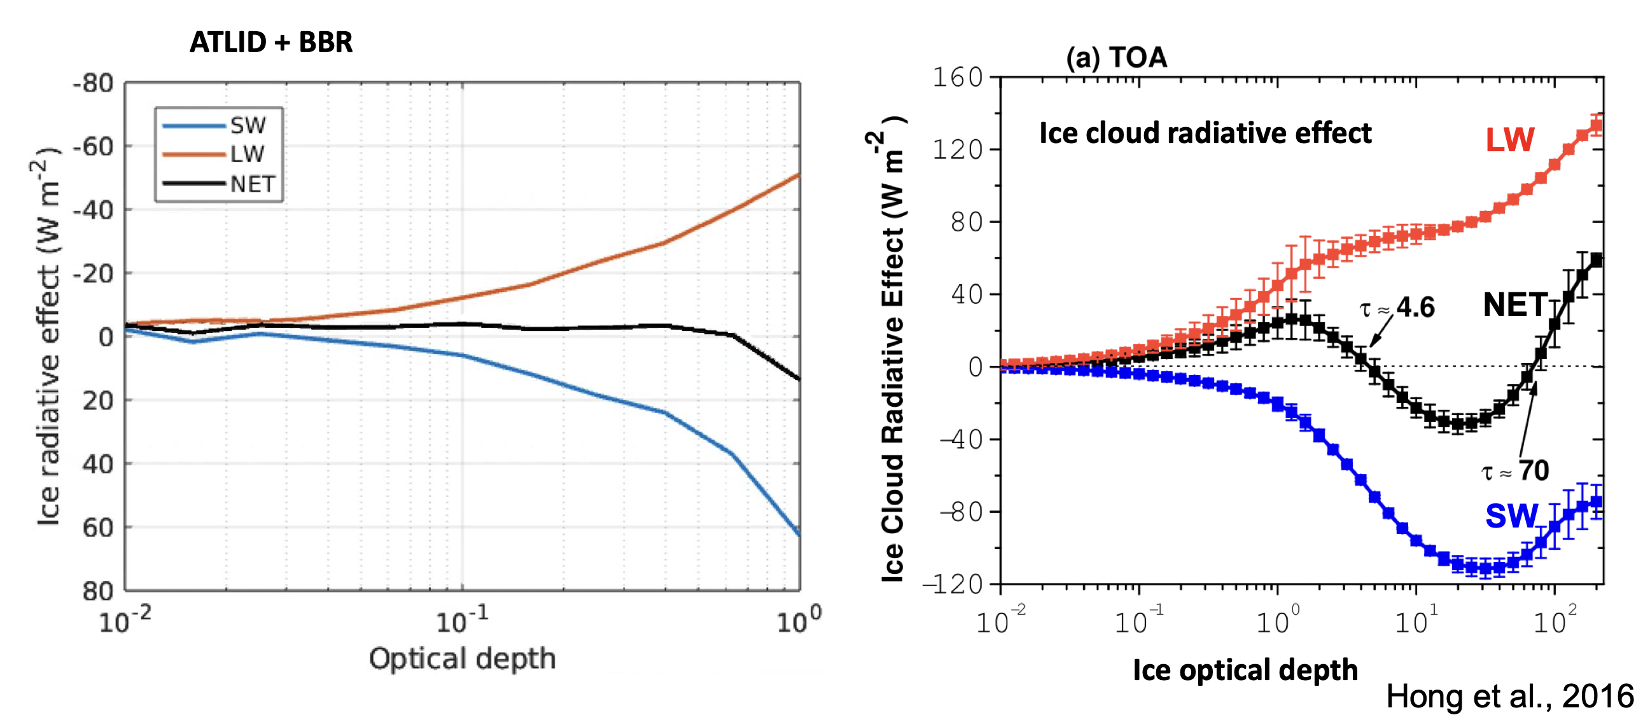
Ice cloud radiative effect (CRE)
Mark Fielding
Hong et al. (2016) reported how the trade-off between longwave warming by thin tropical ice clouds and shortwave cooling was dependent on the optical depth
Can do the same analysis by combining ATLID and BBR, and using the ECMWF’s ecRad radiation scheme to compute the equivalent clear-sky fluxes and thereby get cloud radiative effect
We find virtually the same relationship in the longwave, but a stronger effect in the shortwave due to not sampling the full diurnal cycle

Slide 5
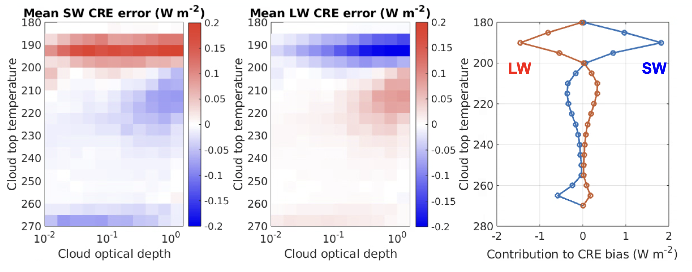
Radiative impact of cirrus bias
Mark Fielding
Diagnose where in optical depth versus cloud top temperature space the bias originates
Missing thin cirrus contributes +4 W/m2 to shortwave CRE and -3 W/m2 to longwave CRE
Need to improve heterogeneous nucleation, fall speeds, convective detrainment, tropopause mixing etc…

Slide 6
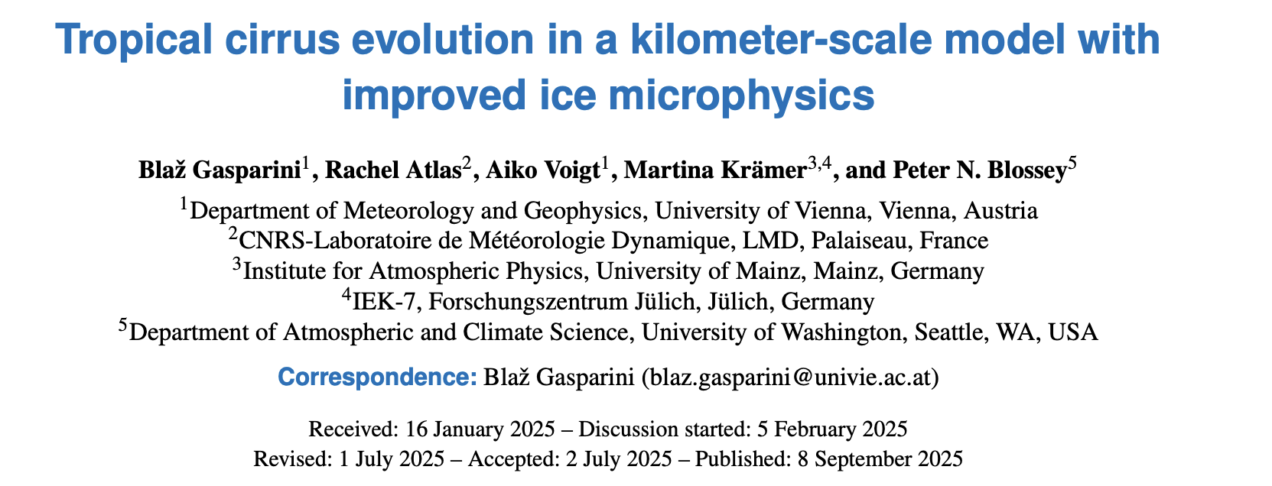
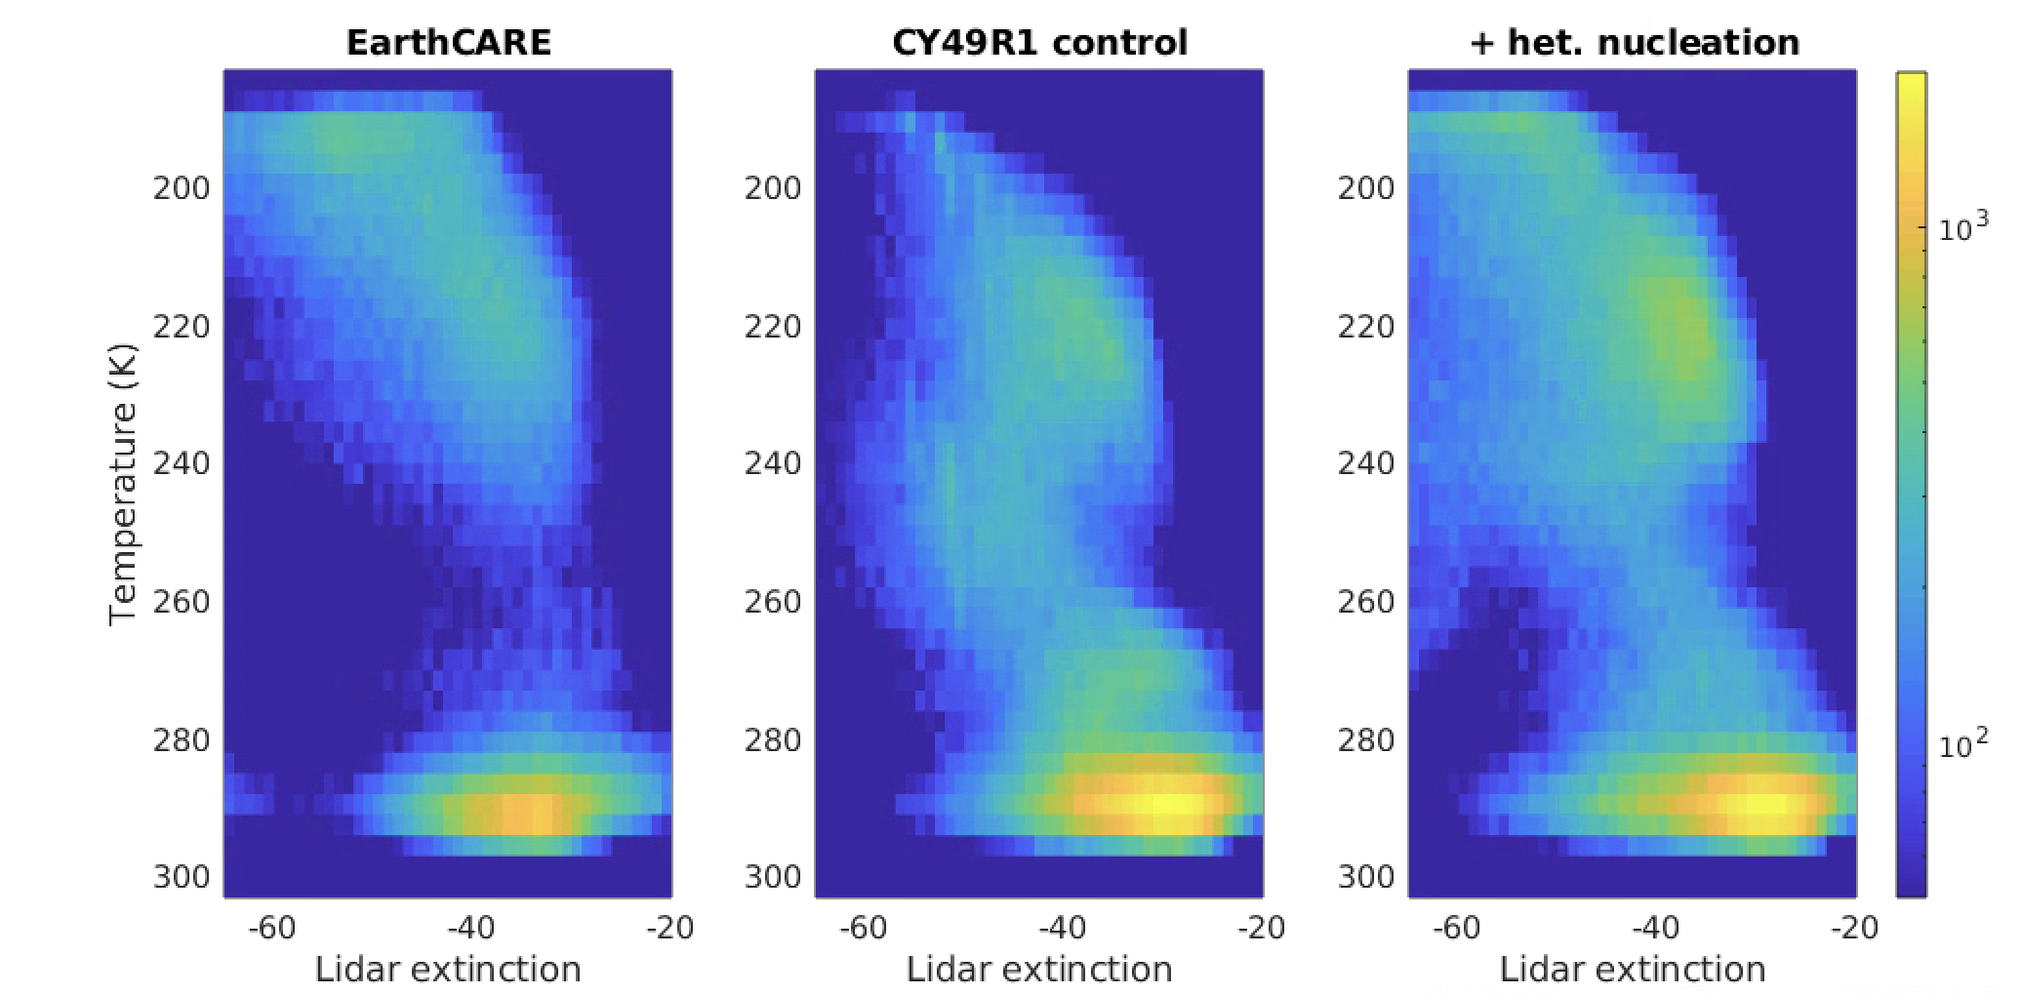
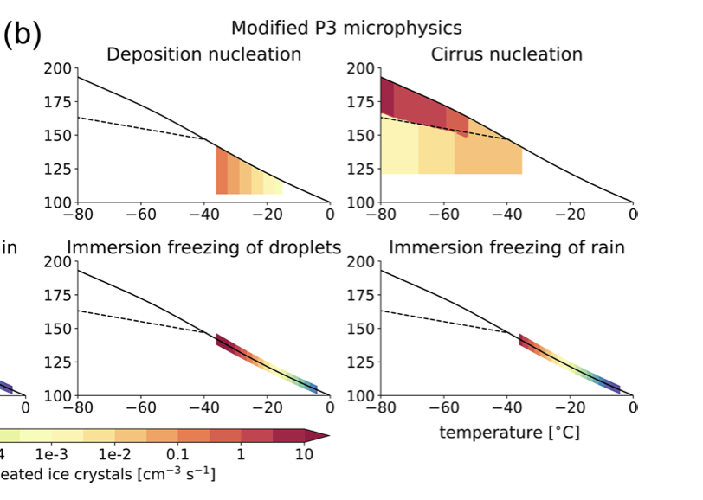
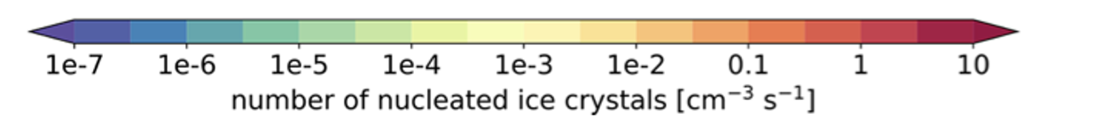
Adding heterogeneous ice nucleation to the IFS
Mark Fielding
Remove ice formation from Tiedtke saturation adjustment- homogeneous ice nucleation only when exceeding Koop limit
Allow ice crystal growth for T<233K, with INP following Gaparini et al., 2025.
Reduce ice effective radius for T <210K

Slide 7
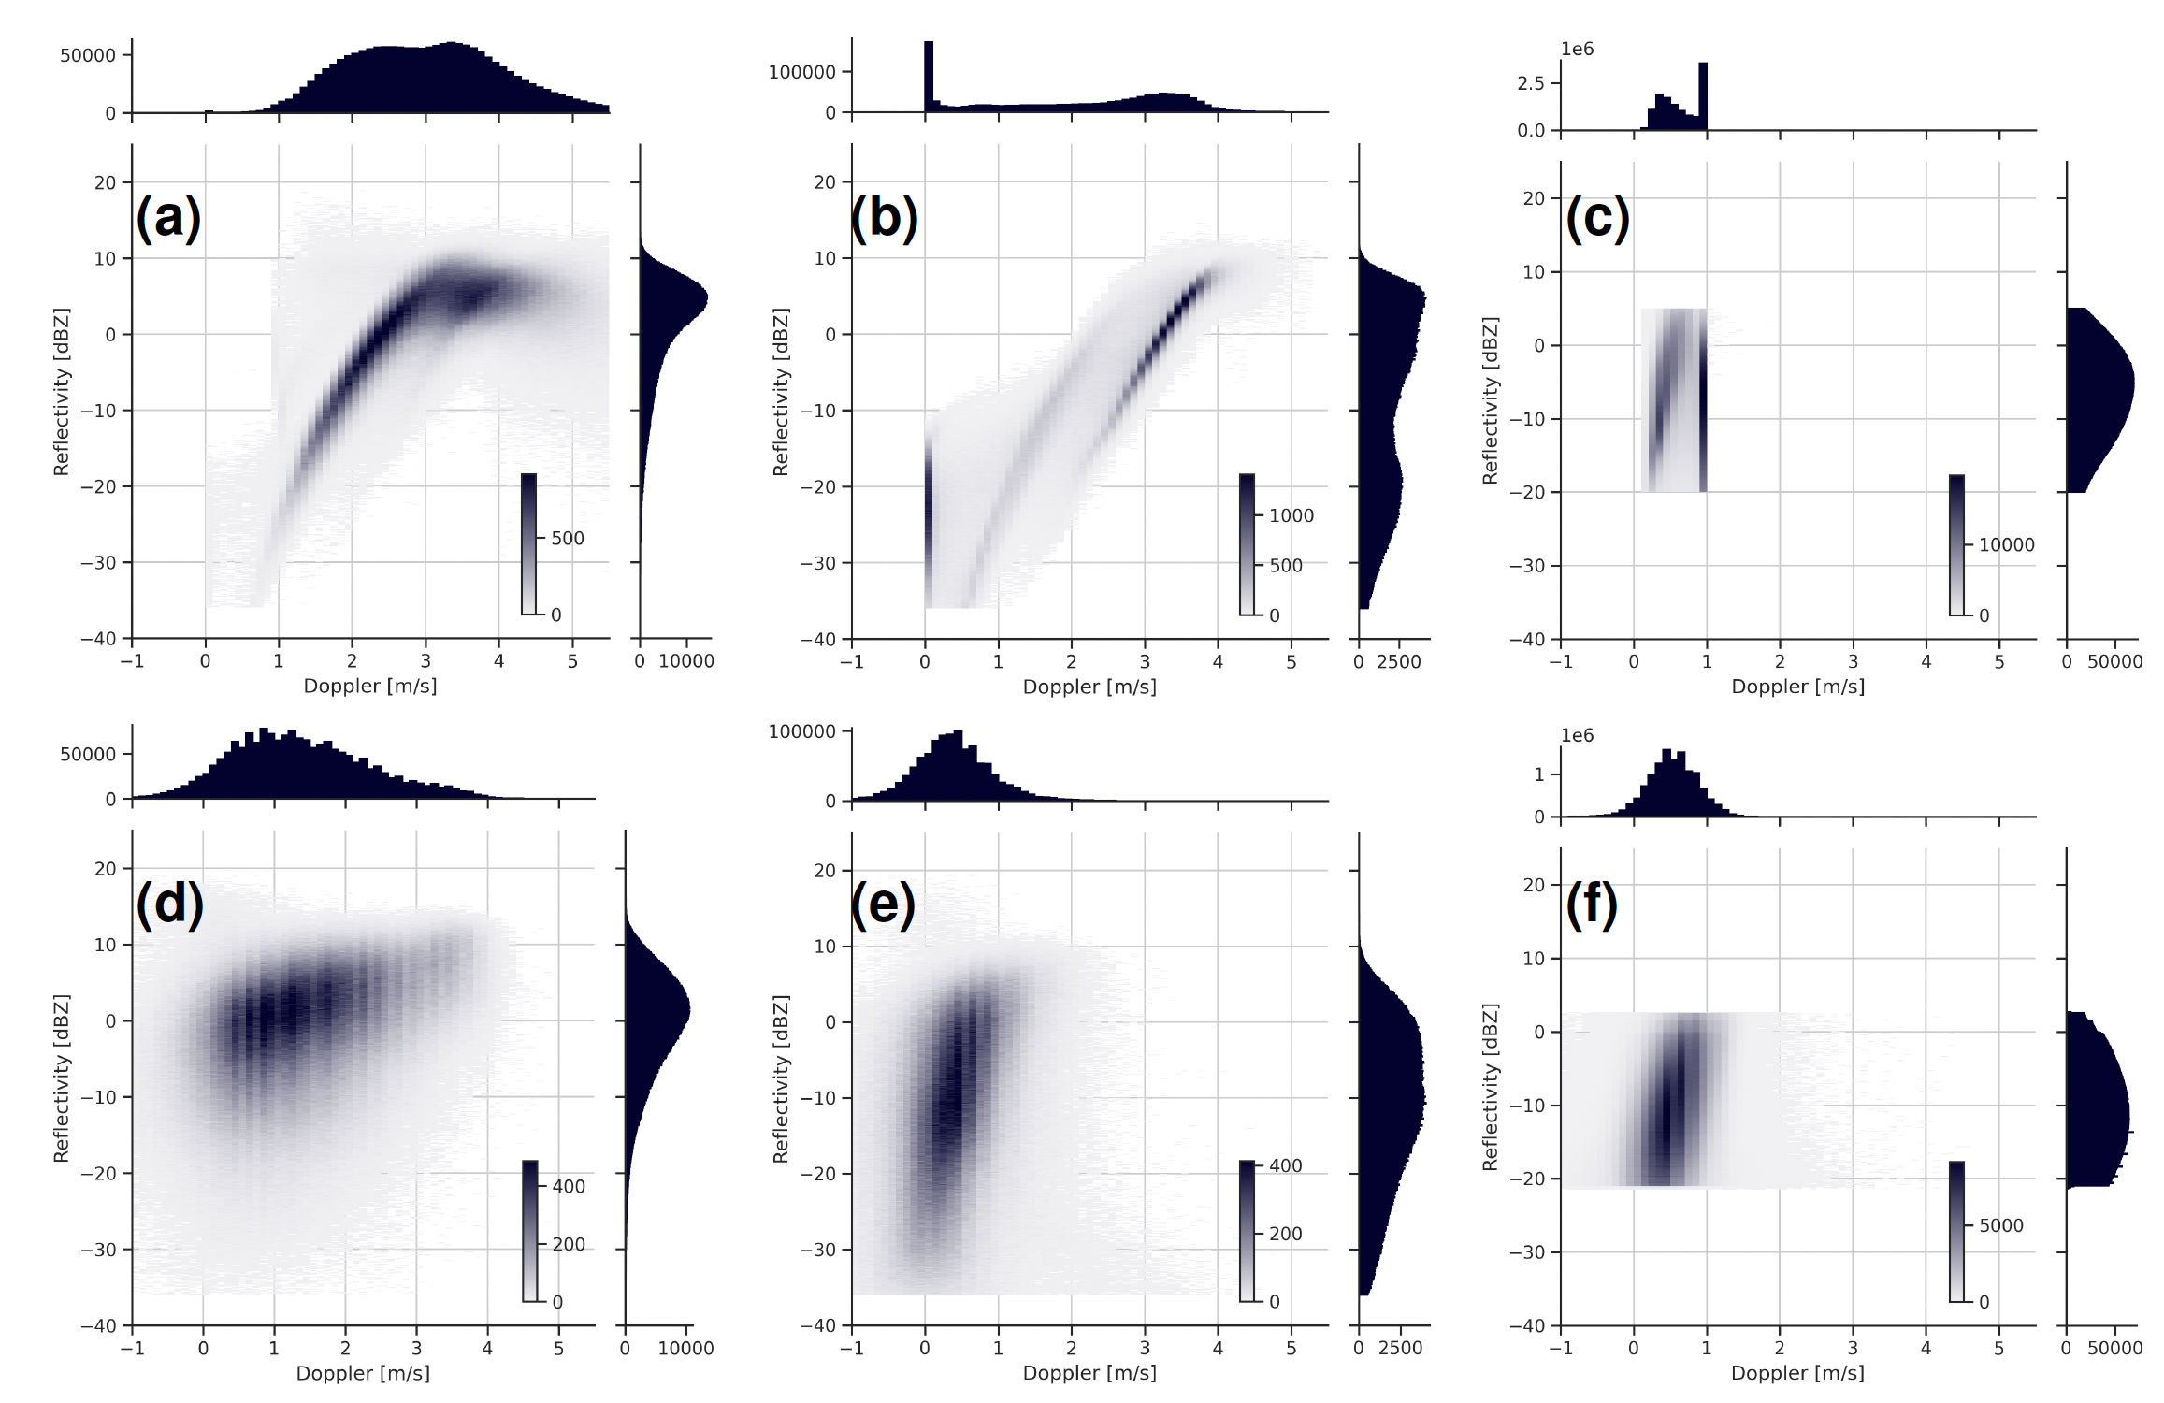
Using EarthCARE to improve the representation of microphysics in the IFS
Kamil Mroz
IFS captures the main reflectivity-Doppler relationships seen by CPR across all regimes
IFS distributions are systematically narrower than observations – instrument noise, 1-moment scheme issue
Fall velocities in warm rain too large – rain droplets too large, overly efficient autoconversion or accretion processes
Fixed snow fall velocity – oversimplified assumption
IFS
CPR
Cold rain
warm rain
Snow/ice

Slide 8
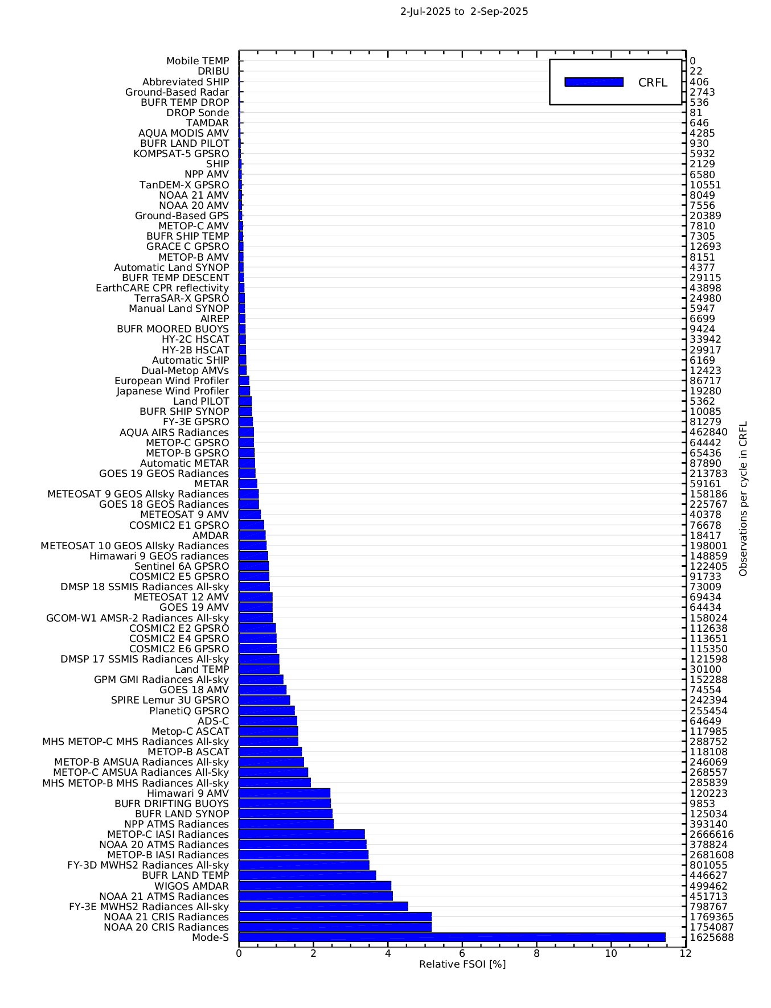
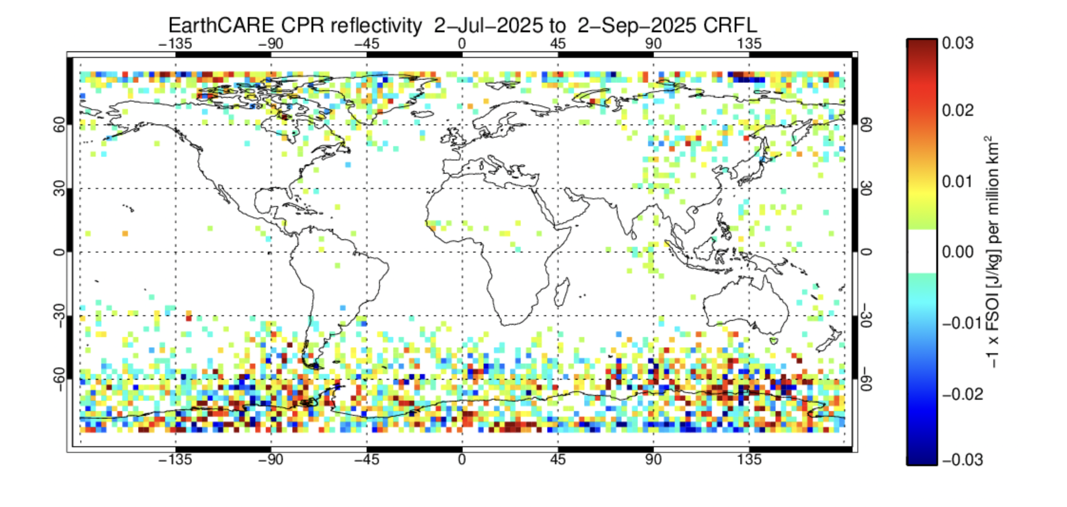
EarthCARE CPR impact relative to other observations
Mike Rennie
Forecast sensitivity to observations impact (FSOI) scores use an adjoint technique to assess the impact of different observation types on forecast error.
Analysis increments from EarthCARE CPR observations contribute 0.15 % to the total reduction in 24 hour forecast error for each 4D-Var cycle.
FSOI scores can be misleading due to correlations between observation types, non-linearities and neglect humidity information (when using dry energy norm).
☺
☹

Slide 9
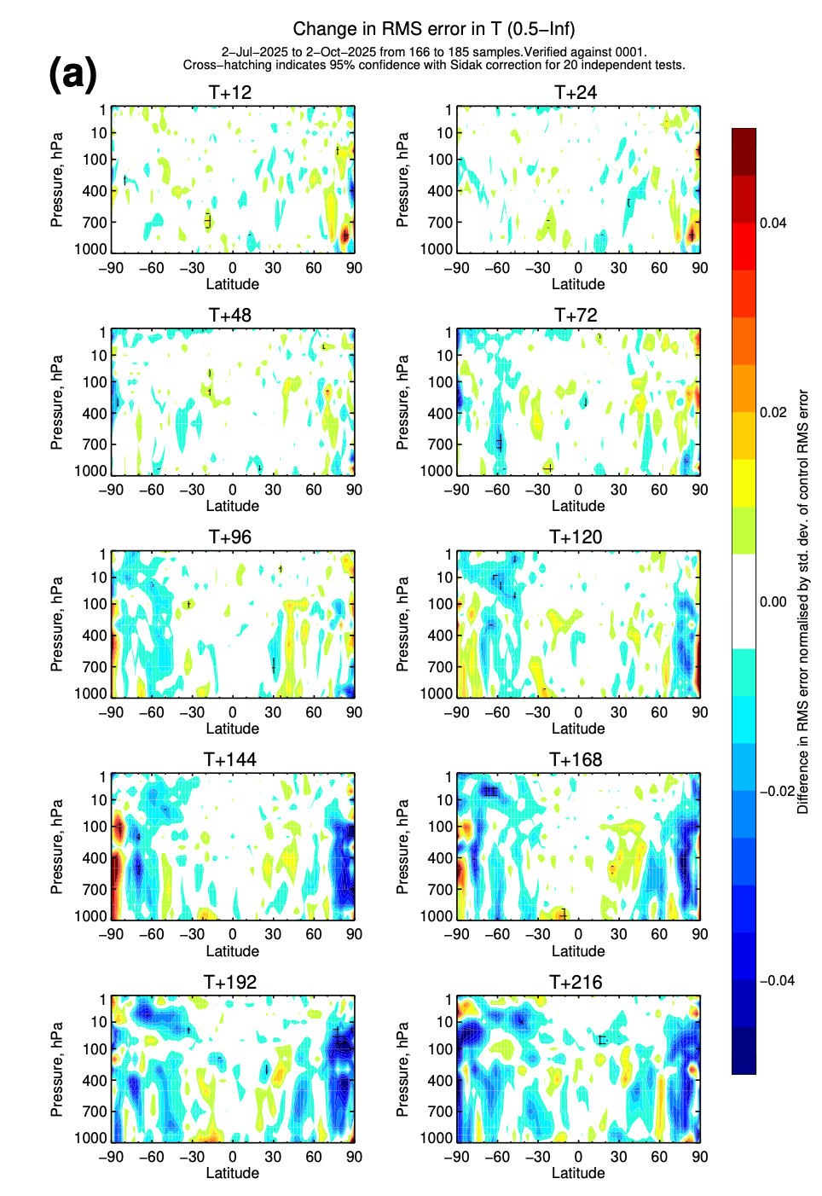
First-ever assimilation of Doppler velocity
Doppler velocity contains similar information content to radar reflectivity, but has two benefits:
  Information on melting layer height
  Unaffected by attenuation
First observation system experiments show promise; some positive medium-range impact on forecast in extra-tropics.
Neutral impact on fits to other assimilated observations.
Mark Fielding and Kamil Mroz

Slide 10
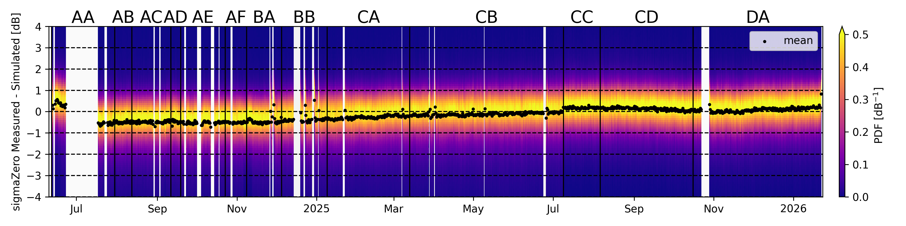
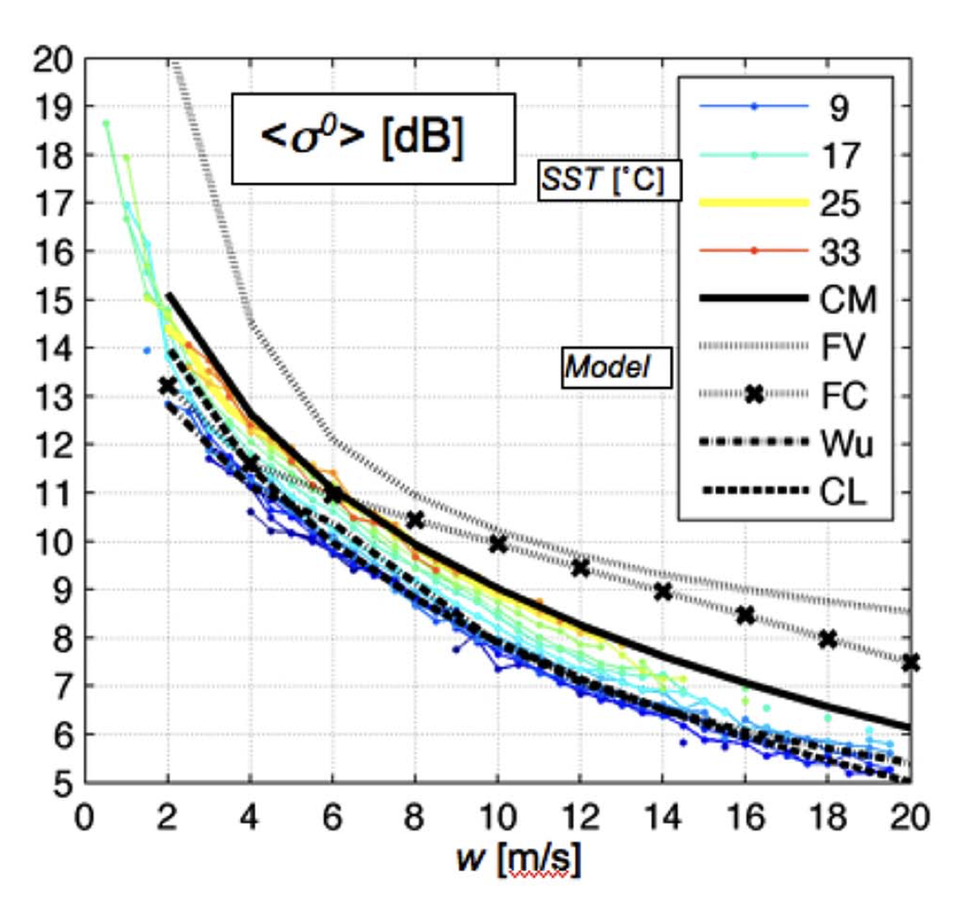
CPR sea surface return – potential for low level wind speed constraint
Baseline DA
Sea surface return (sigmaZero) can be accurately simulated using surface wind speed and surface temperature and water vapour content information
Potential for constraining these variables in the IFS (scatterometer-like data)
Kamil Mroz
Tanelli et al., 2008

Slide 11
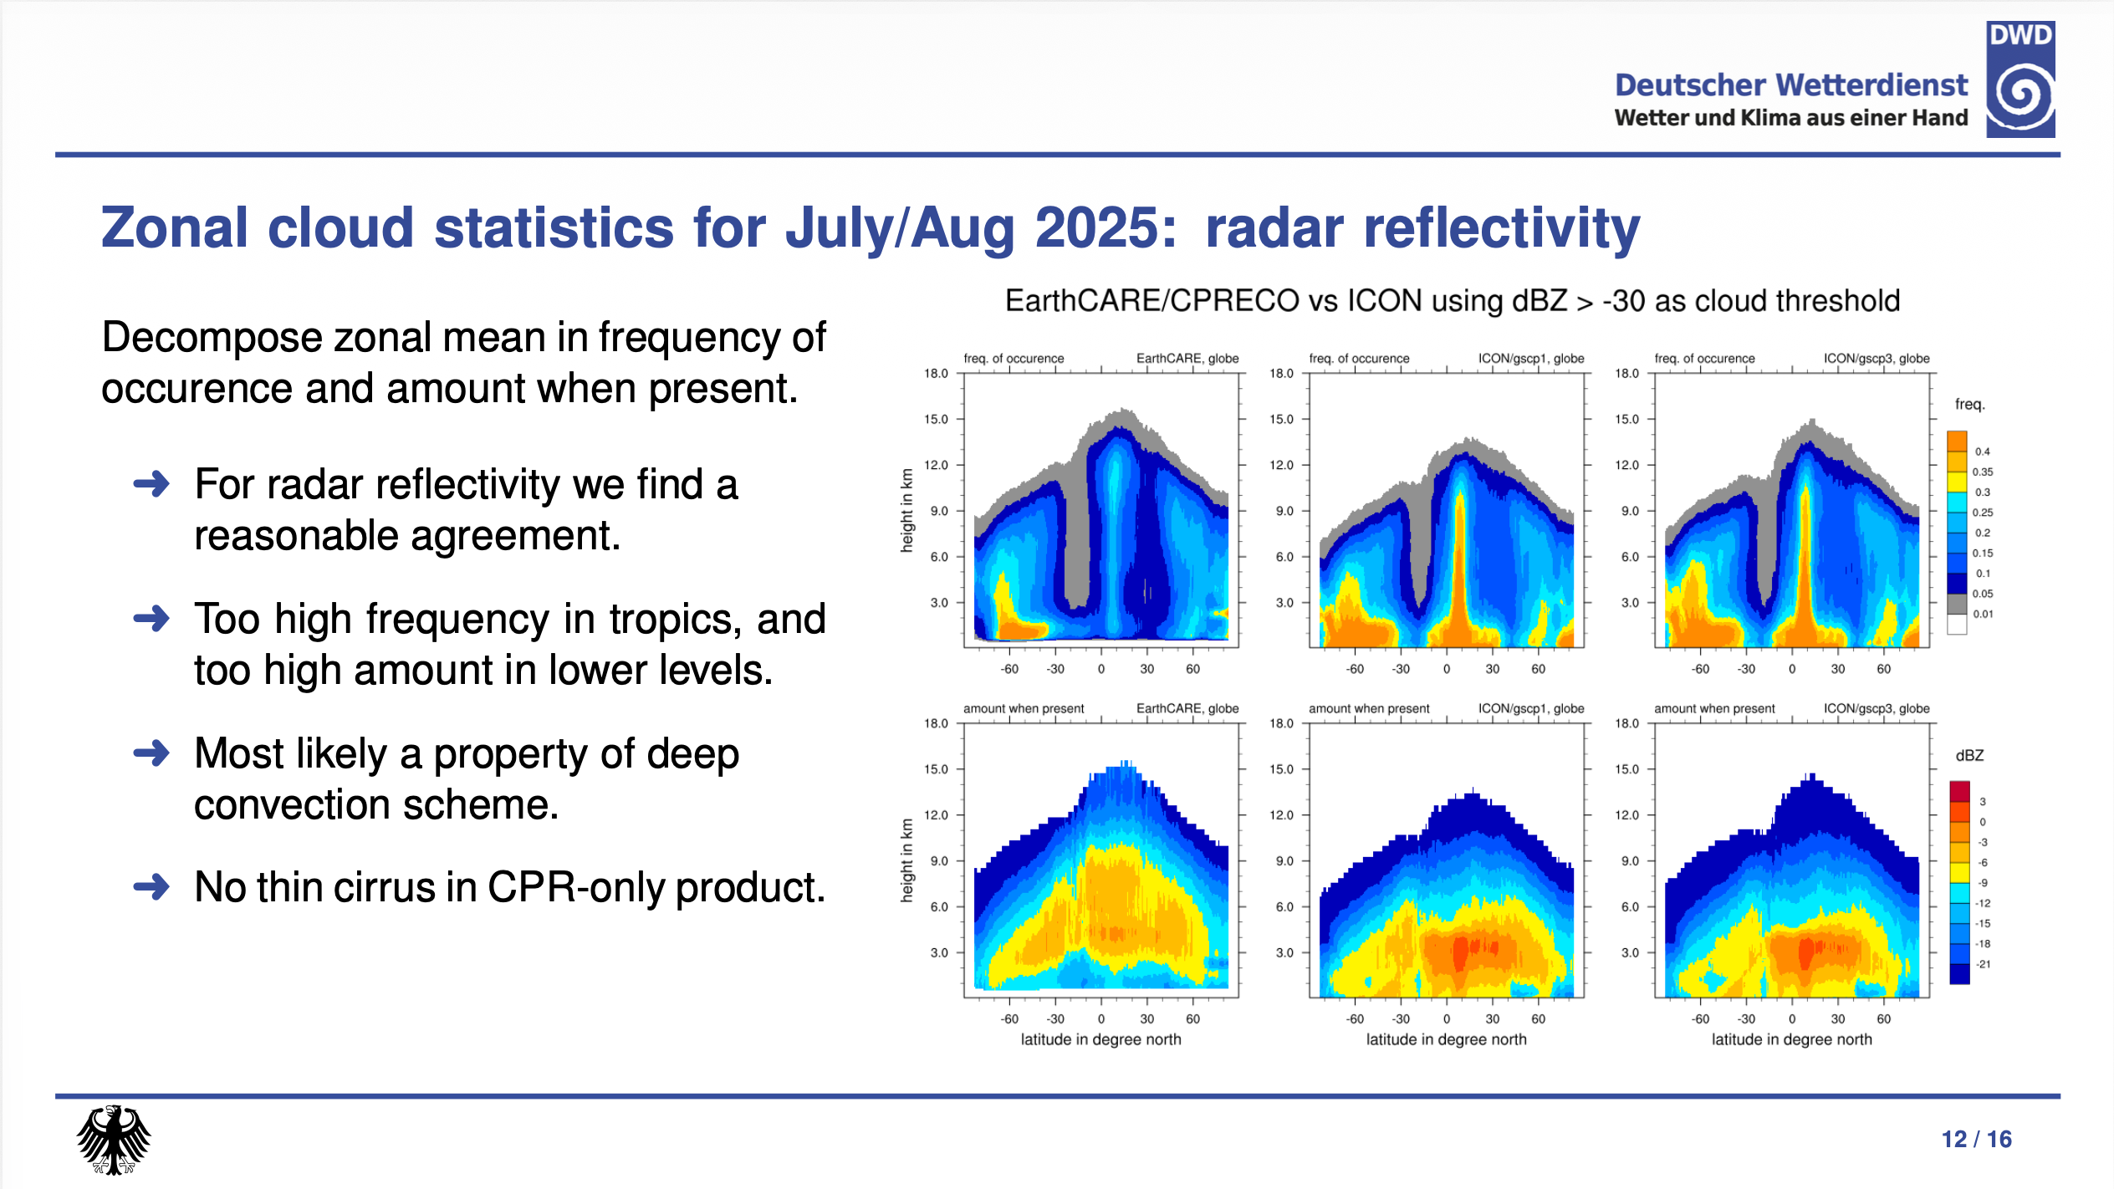
Axel Seifert

Slide 12
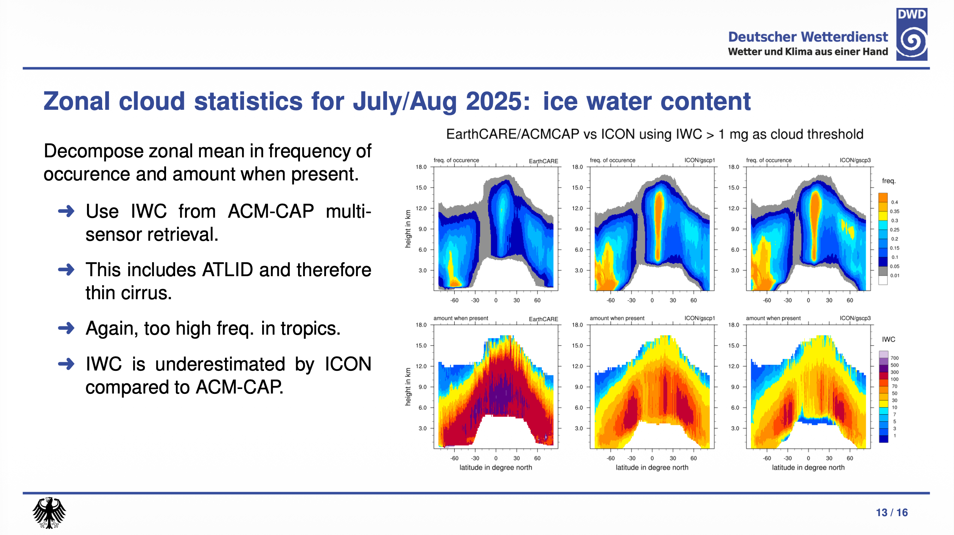
Axel Seifert

Slide 13
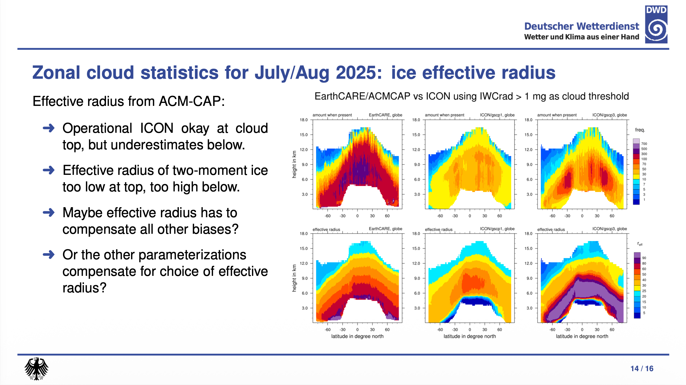
Axel Seifert

Slide 14
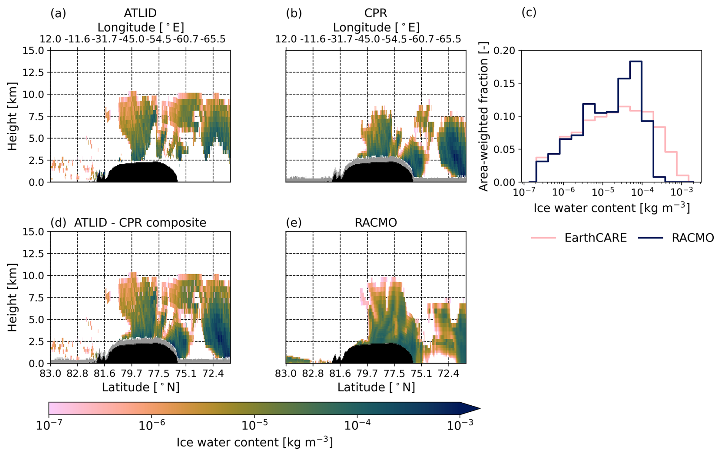
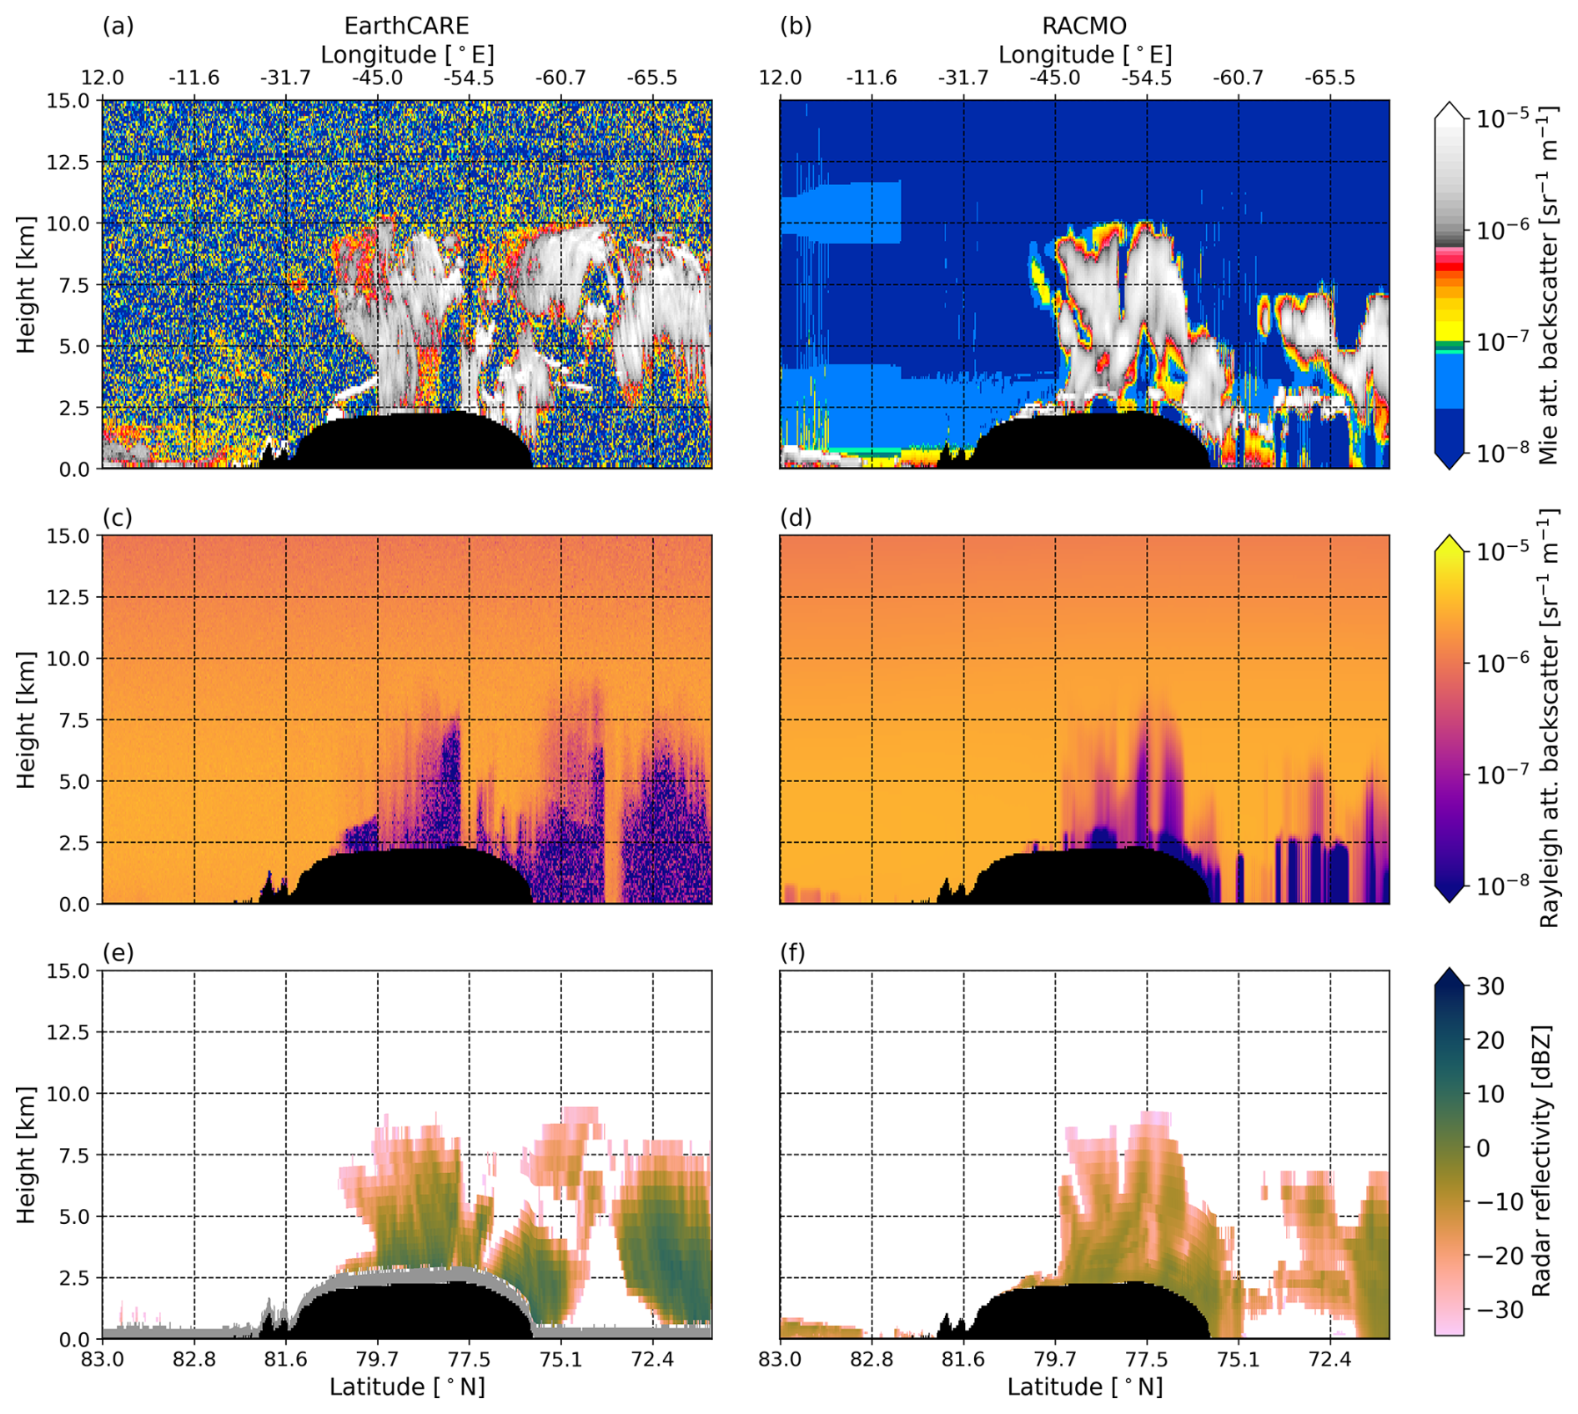
Evaluating RACMO over Greenland
Thirza Feenstra
a

Slide 15

Questions?

