Slide 1


EarthCARE QWG Meeting no. 3
Journal special issues, overview papers
Robin Hogan
Leipzig, 5.03.2026

Slide 2
“Quality Working Group” is a terrible name!
Thanks for your agreement to sign the letter about the FAAM aircraft, this is VERY much appreciated!
The letter has been sent to lots of important people
But “Quality Working Group” sounds very low-level and technical when writing to government ministers!
Can we have an alternative name?
What’s wrong with Science Advisory Group (SAG)?

Slide 3
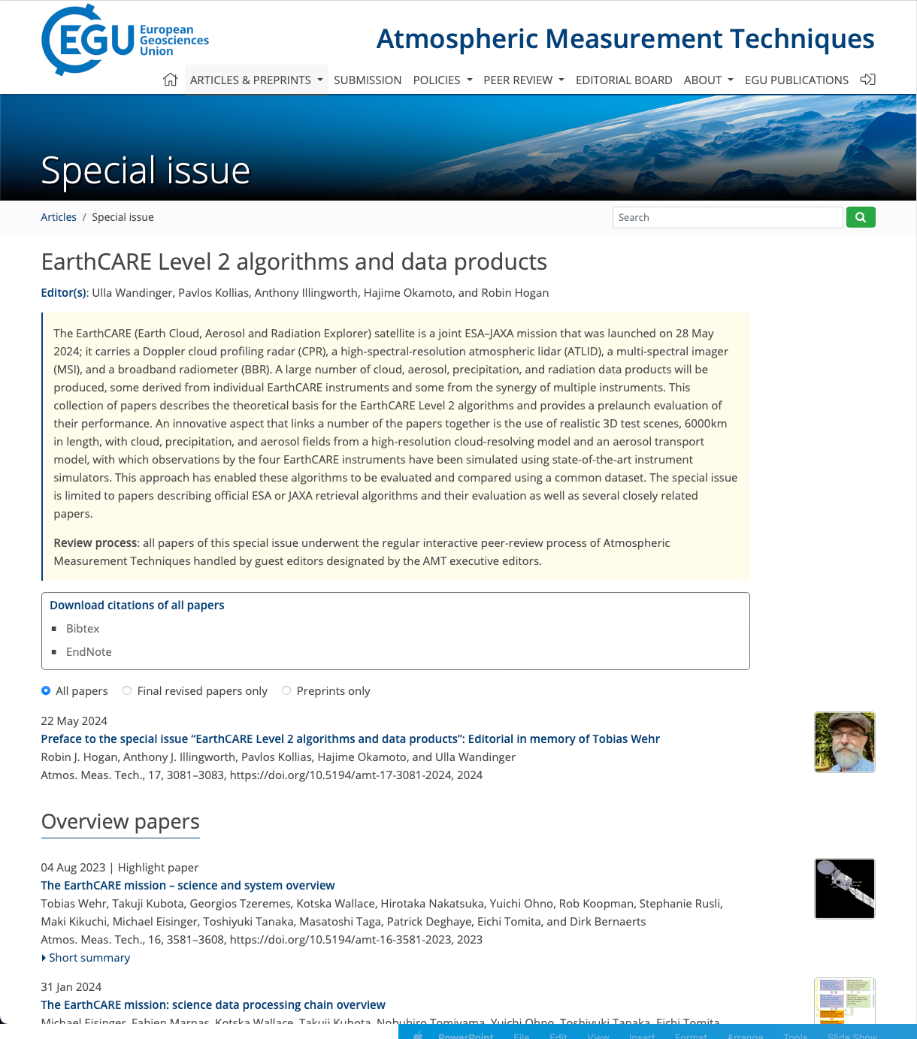
Pre-launch special issue
32 papers now published plus an editorial!
https://amt.copernicus.org/articles/special_issue1156.html

Slide 4
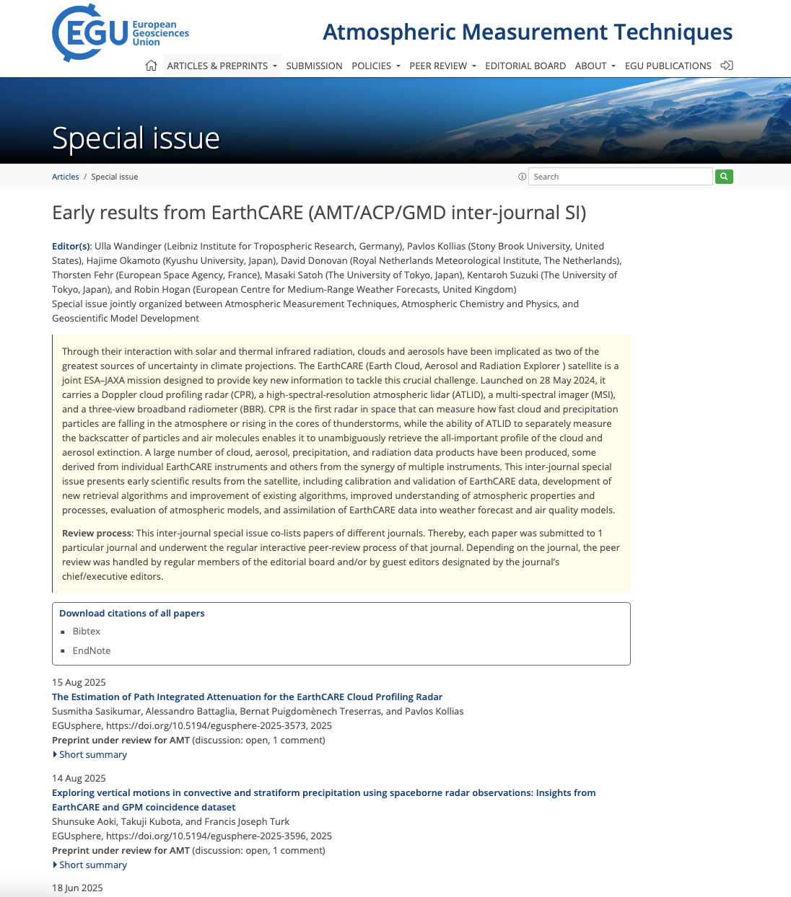
Post-launch special issue
“Early results from EarthCARE”
AMT/ACP/GMD inter-journal special issue
Eight guest editors for AMT (anticipating many submissions)
ACP coordinators: Tim Garrett & Matt Lebsock
GMT coordinator: Robin Hogan
Deadline is 28 February 2027
Eleven manuscripts submitted so far, of which seven have been published
https://amt.copernicus.org/articles/special_issue1357.html
https://acp.copernicus.org/articles/special_issue400_1357.html
https://gmd.copernicus.org/articles/special_issue400_1357.html

Slide 5
Submissions by journal, instrument & status
Almost all manuscripts so far are about the CPR!
Come on ATLID/MSI/BBR people, get writing!!!

Slide 6
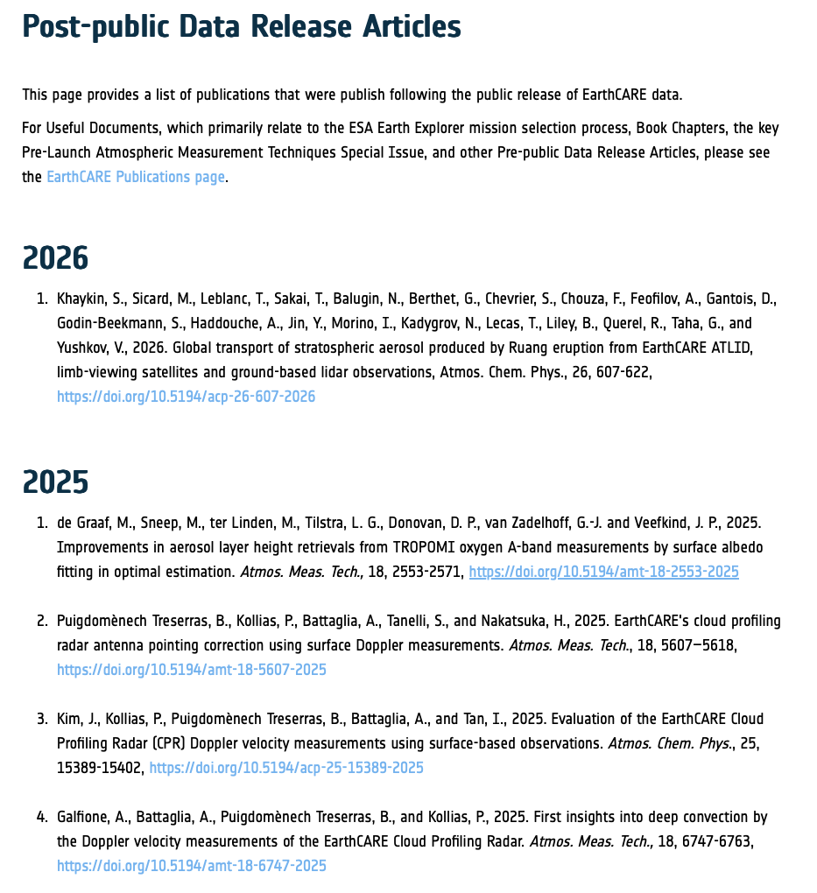
Publications page
https://earth.esa.int/eogateway/missions/earthcare/post-public-data-release-articles
Not only special issue papers
There is also a page on pre-launch EarthCARE papers

Slide 7
Overview papers 2026
Hogan, Okamoto et al.: Mission overview – only 3 pages written so far ☹
  Overview of post-launch mission performance
  Instrument performance: radar/lidar sensitivity/noise vs A-Train, MSI calibration/smile issues, BBR lifetime
  Case study/studies: what does the Doppler/HSRL tell me?
  Radiative closure demonstration: classification -> synergy retrieval -> radiative transfer calcs -> verification against BBR
  Outlook: long mission
Okamoto et al.: Doppler overview

