Slide 1


EarthCARE QWG Meeting no. 3
European Science Update: a selection!
Robin Hogan, Gerd-Jan van Zadelhoff and the European EarthCARE Science Team
Leipzig, 4.03.2026

Slide 2
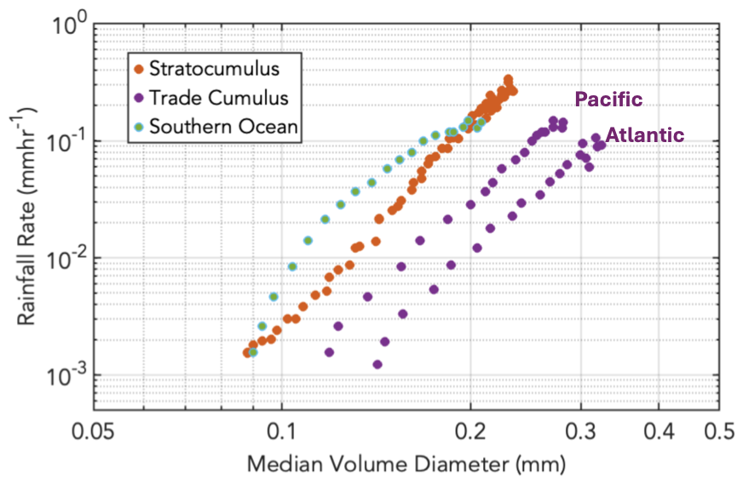
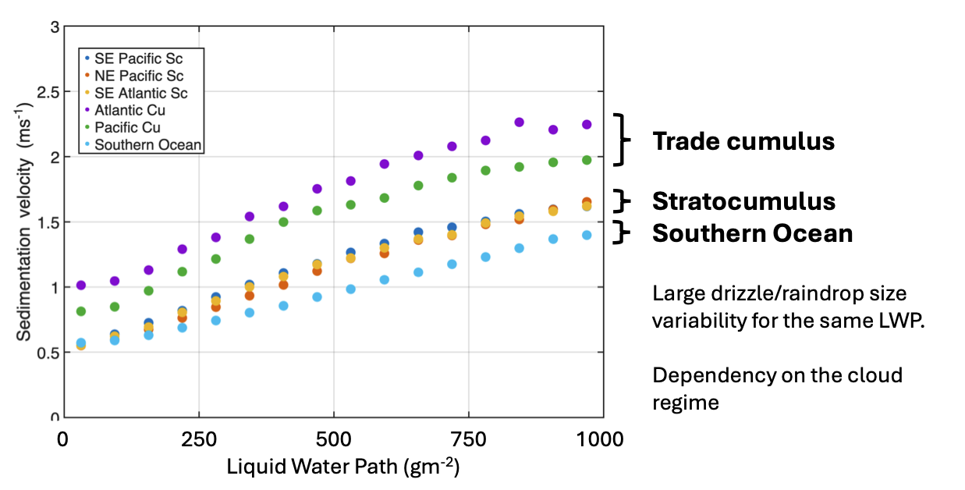
Warm rain characteristics
Pavlos Kollias et al.
Models tend to assume the same size-distribution behaviour for all types of rain, whether “warm rain” formed from collision of cloud droplets, or “cold rain” formed from melting snow aloft
But EarthCARE CPR retrievals show that even considering only warm rain, there is a substantial variation in properties!
Rain from trade Cu significantly different in Pacific and Atlantic! Why, and can we represent this in models??
Rain from trade Cu falls faster than from stratocumulus, so drops must be larger

Slide 3
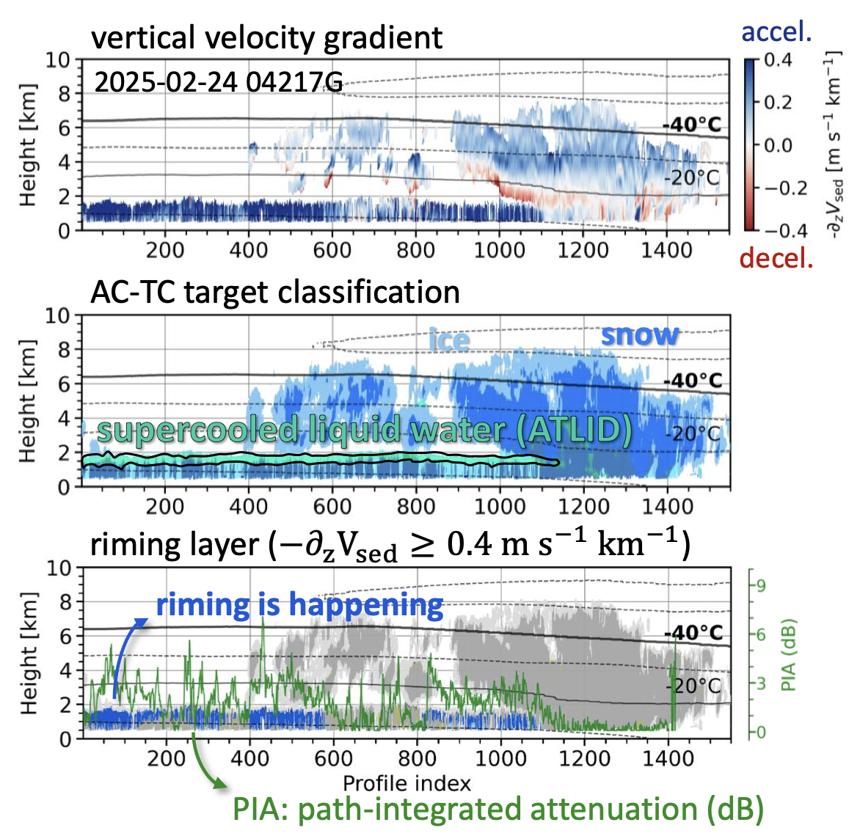
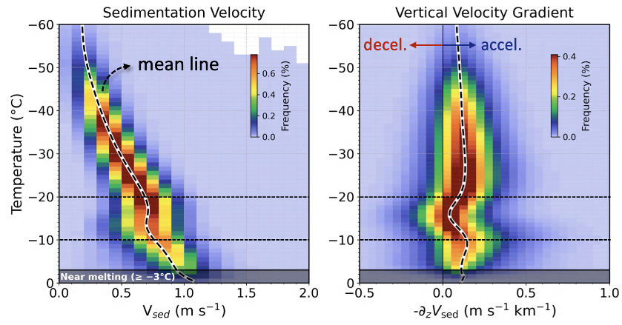
Acceleration/deceleration of ice
Jiseob Kim (McGill) et al.
Use C-CD sedimentation velocity
Rapid acceleration tends to coincide with supercooled water, implying riming is occurring: need in-situ verification
We also commonly see deceleration at around -15 degC, but what is the cause?

Slide 4
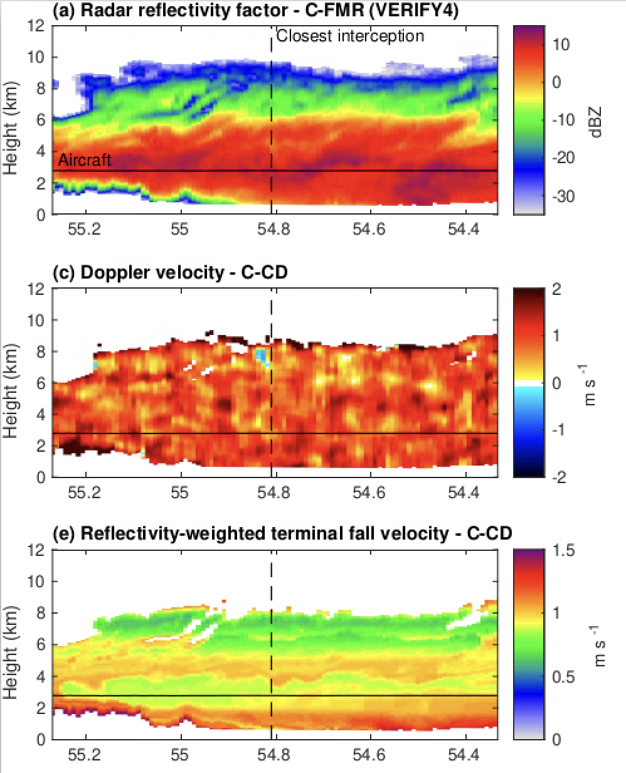
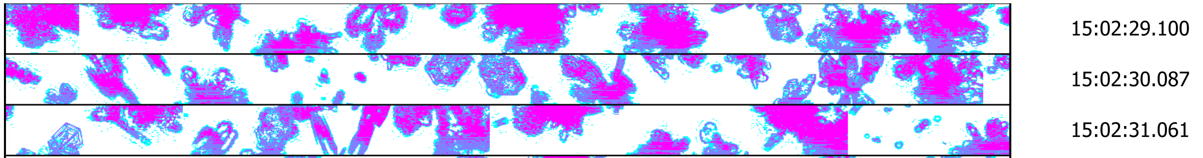
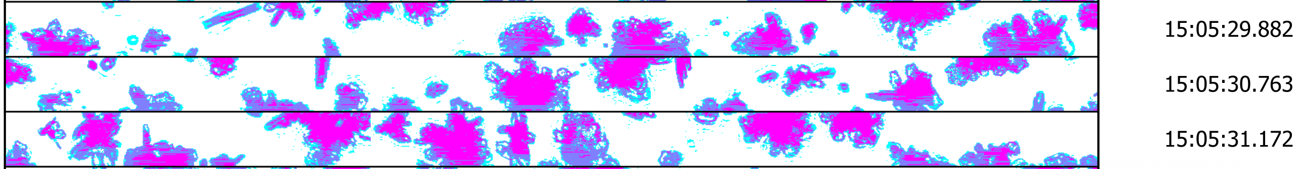
A closer look at ice deceleration
Robin Hogan, Bernat P-T
VERIFY4: in-situ under-flight of EarthCARE on 18 Nov 2024
C-CD finds Doppler velocity is anti-correlated with radar reflectivity, implying: Z goes up while sedimentation velocity goes down!
What kind of ice growth can explain this?
Aircraft sampled aggregates of plates 1 km lower: perhaps rapid growth of horizontally aligned plates increases drag faster than weight?

Slide 5
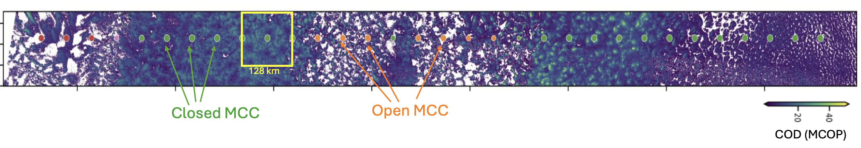
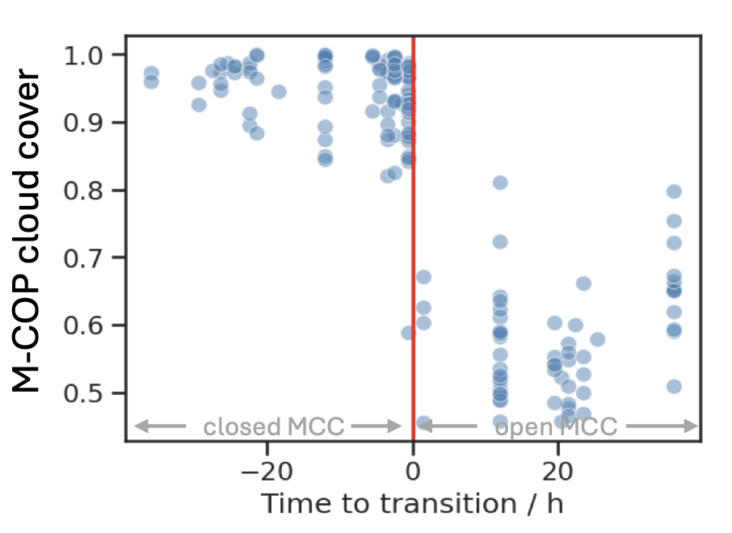
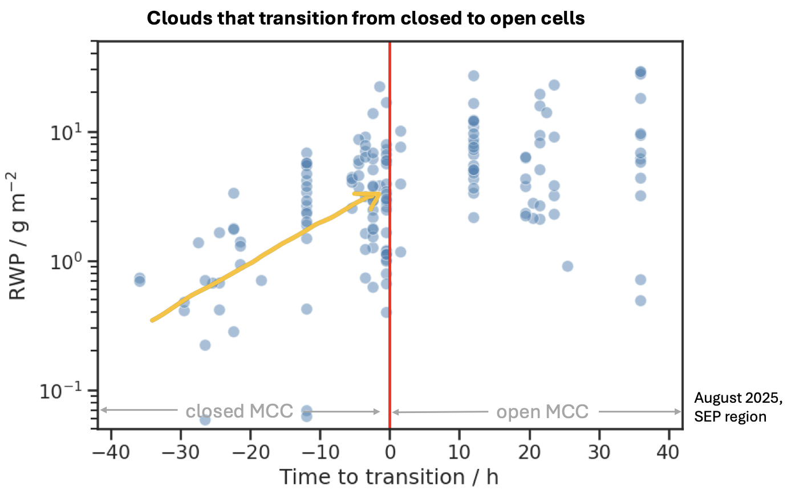
Closed → open cell transition
Johanna Mayer, ESA
Neural network classifies marine clouds seen by MSI into closed and open cells
Use ERA5 trajectories to track the transition from closed to open cells, and examine cloud properties across multiple days with M-COP and ACM-CAP
Very sharp drop in cloud cover at transition
Large increase in rain water path precedes transition!

Slide 6
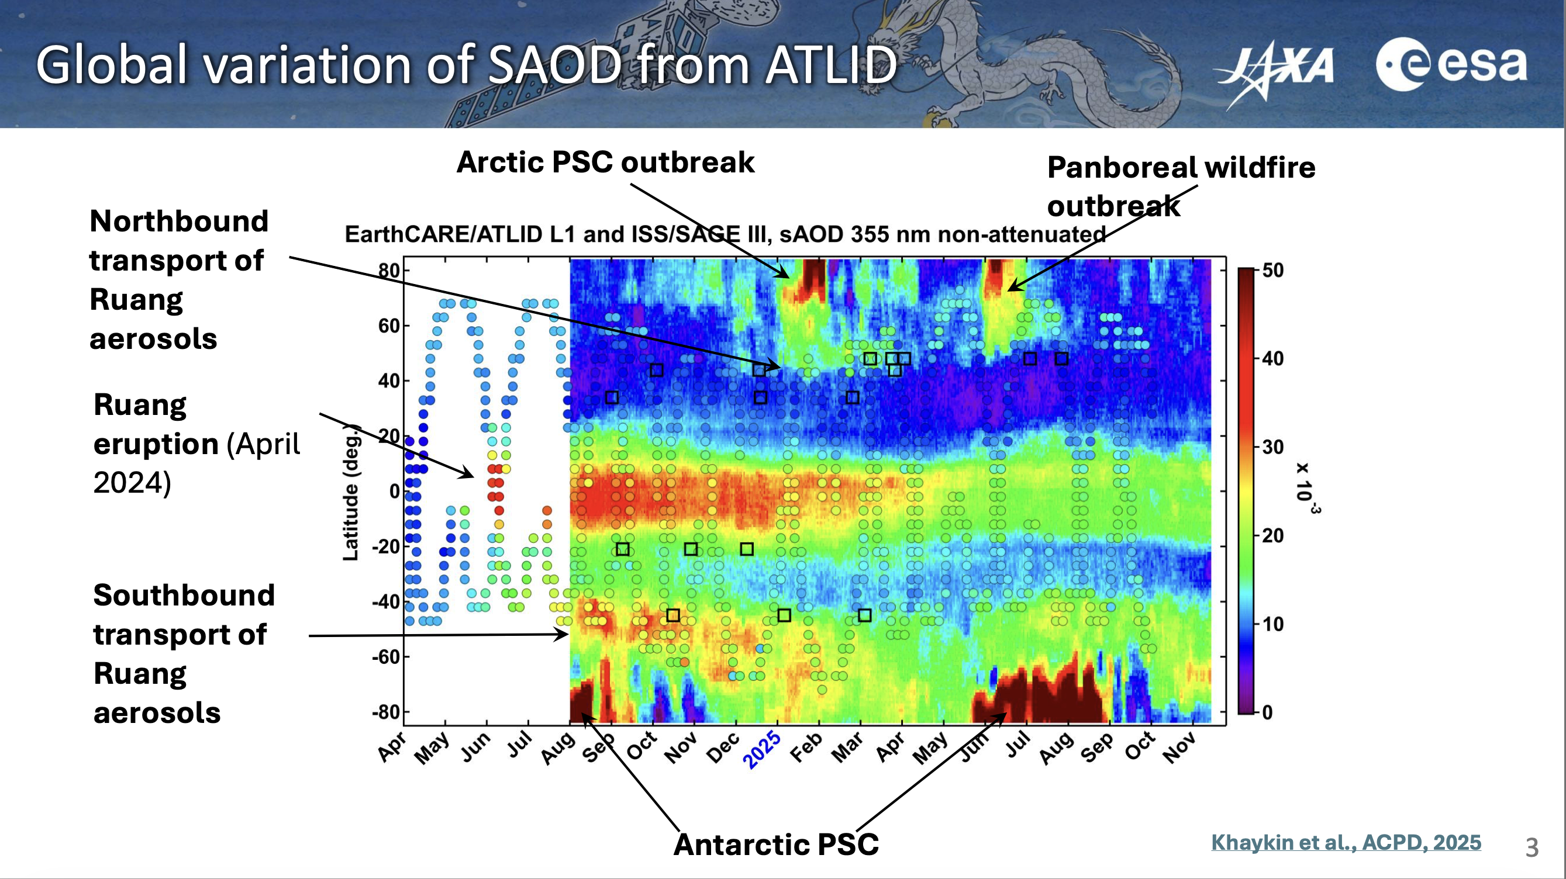

Slide 7
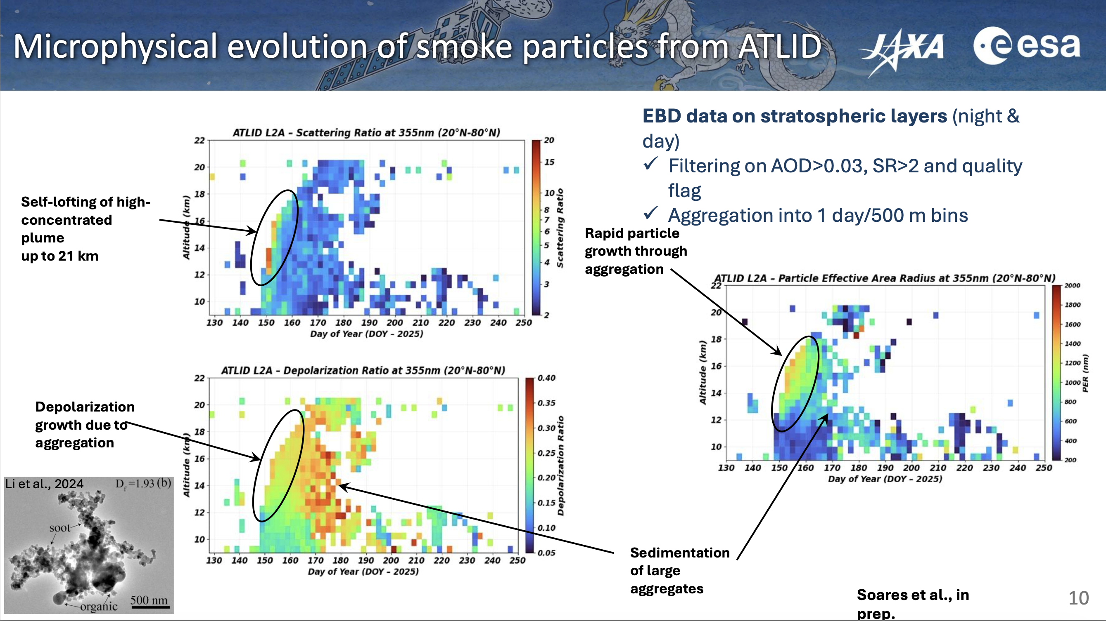

Slide 8
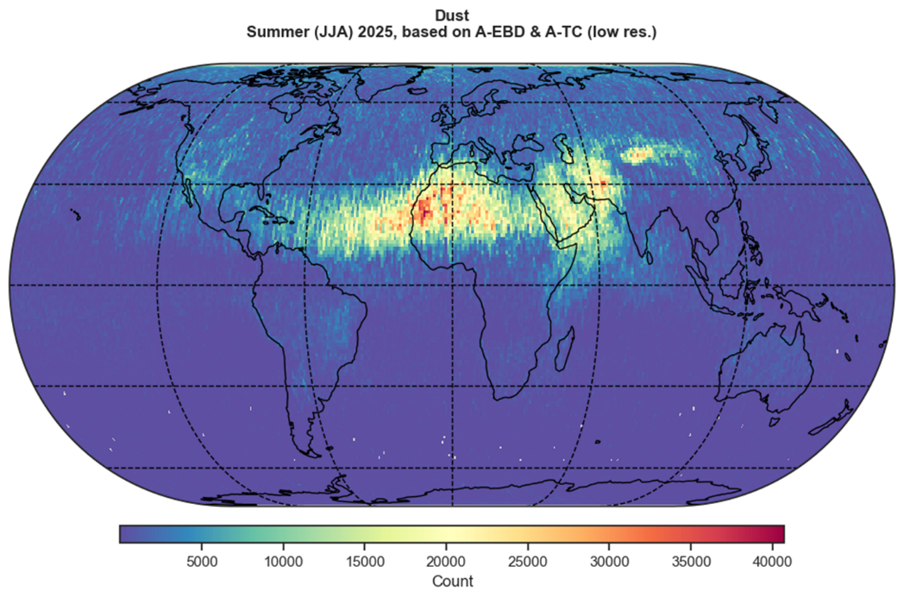
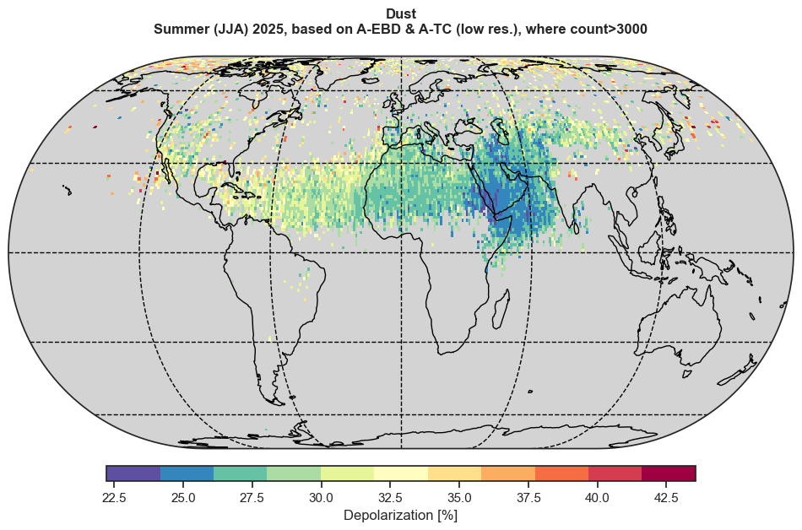
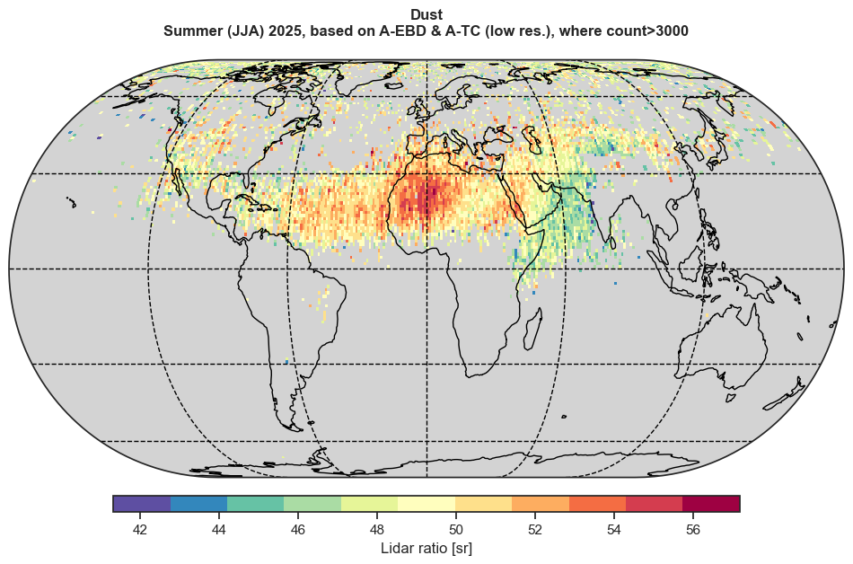
Climatology of dust properties
Ulla Wandinger, Leonard Konig
Dust occurrence
Depolarization
Lidar ratio
Derived from 1.5 years of ATLID data
Reveals systematic differences between sources: higher lidar ratio over Western Sahara, lower depolarization over Arabia
What does this tell us about minerology, size and shape?
Does it have a radiative impact? How can we incorporate it into models?

Slide 9
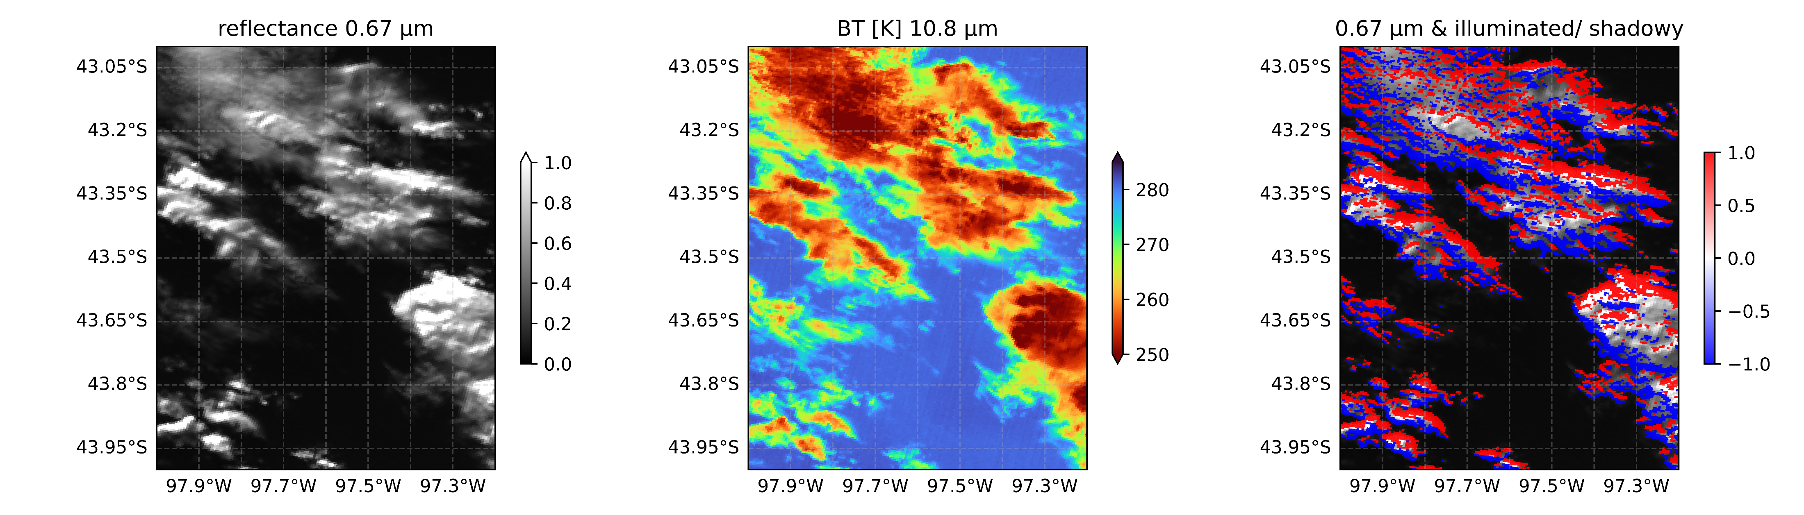
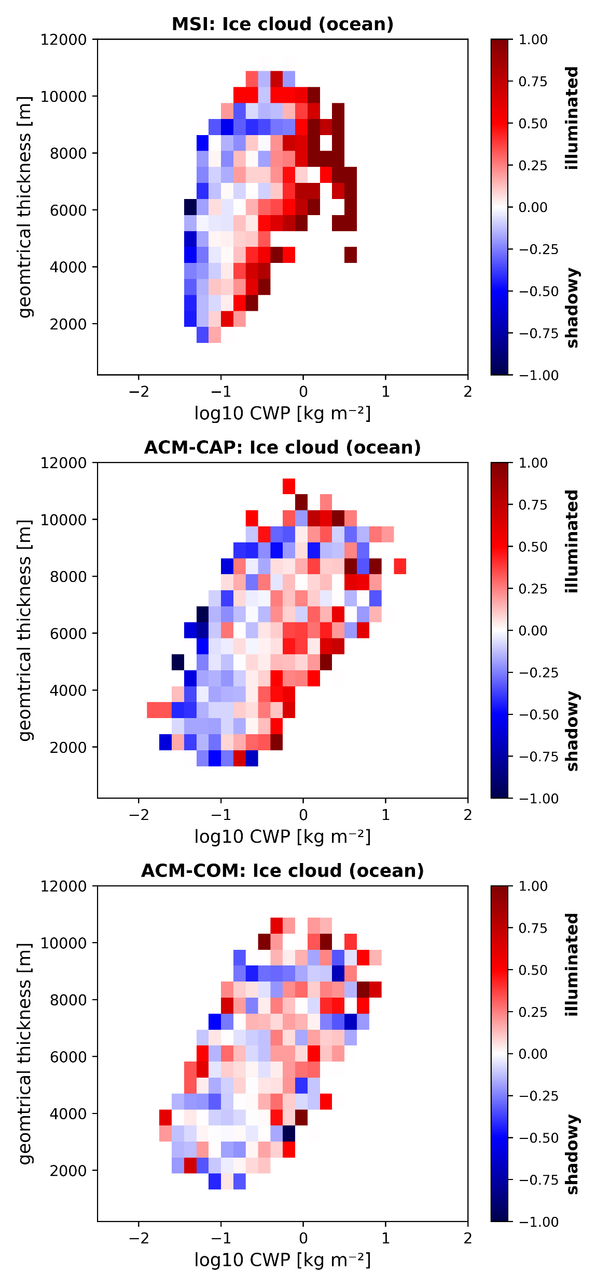
3D effects on MSI retrievals
Gregor Walter, TROPOS
Use the horizontal gradient of the brightness temperature in the direction of the sun to diagnose which parts of a cloud are “illuminated” and which are “shadowed”
MSI retrievals of ice water path are systematically higher in illuminated regions, CPR retrievals are unaffected, and synergistic retrievals are between the two
Question: can a retrieval use the gradient in brightness temperature to correct for this effect and retrieve more reliable cloud properties?

Slide 10
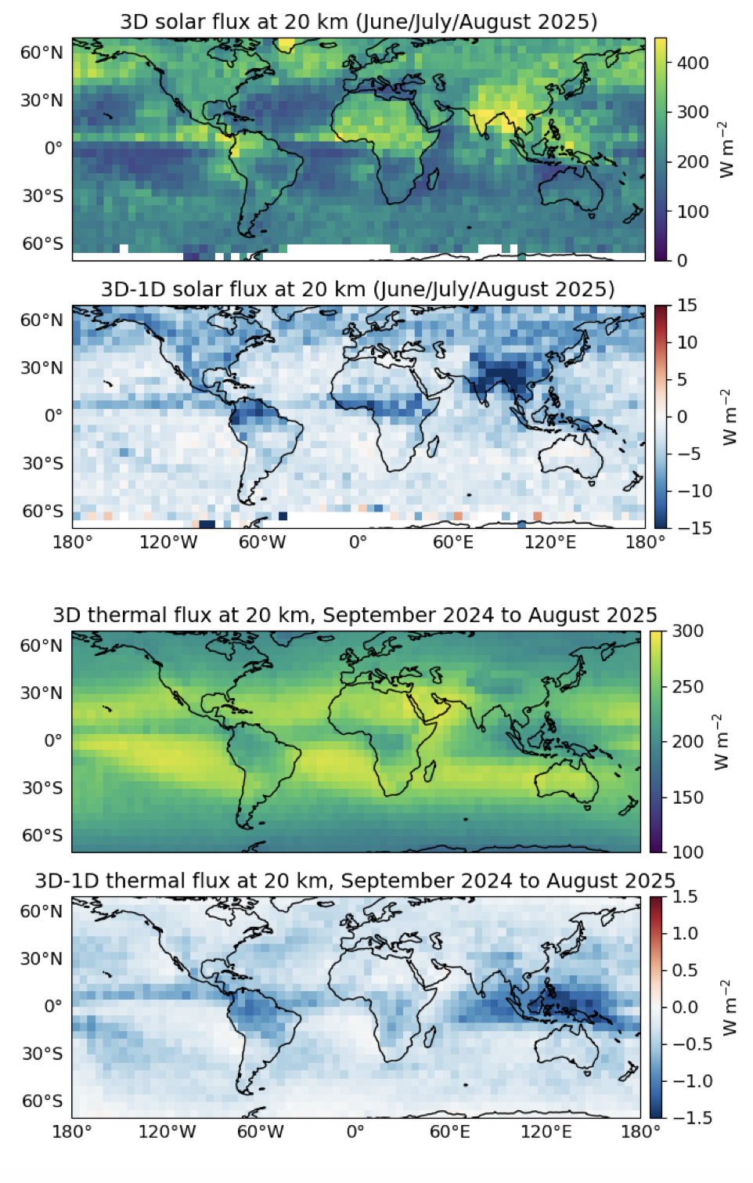
Global 3D radiative effects from ACM-RT
Jason Cole
Shortwave: warming by 5 W/m2 on average, but need to calculate over full diurnal of sun position or will underestimate cloud side illumination effect
Longwave: warming by 0.5 W/m2 on average

Slide 11
EarthCARE science seminar series
To be led by Kamil Mroz, Johanna Mayer, Carla Salas Molar and Sebastian Bley
One hour on Wednesday once per month either at a time to accommodate Japan or east coast of N. America:
  10.00 CET/CEST, 18.00/19.00 JST
  15.00 CET/CEST, 09.00 EST/EDT
Focus on scientific exploitation of EarthCARE data, rather than product development and Cal/Val which are well served by existing meetings
Encourage talks by Early Career Scientists, including PhD students (we have a list!)
Aim for the widest possible audience
Information will be hosted at: https://www.earthcarescience.net/seminars
Supported by a mailing list that could be the same as the current one for newsletters, or something new
Comments welcome!

Slide 12

Questions?

